Slide 1
Peritoneum
DCM ONE
SECOND SEMESTER

Slide 2
Content
Definition of peritoneum
Describe peritoneum and its folds

Slide 3
Definition Peritoneum
Peritoneum is a serous membrane that lines the abdominopelvic cavity and covers the organs found there. The layers are made of simple squamous epithelium and connective tissues
The digestive organs are held in place by peritoneum
Peritoneum is divided into two
Parietal peritoneum
Visceral peritoneum

Slide 4
Peritoneum
Parietal peritoneum lines the wall of abdominopelvic cavity
Visceral peritoneum covers some of the organs and is their serosa
There is a slime space between parietal and visceral peritoneum called peritoneal cavity
Fluid called ASCITES can accumulate in this space in some disease conditions
There are organs located in the posterior abdominal wall and only covered by peritoneum on their anterior surface

Slide 5
Retroperitoneal organs
These organs are not in the peritoneal cavity but located in the posterior aspect of the peritoneal cavity
Examples are;-
Kidneys
Ascending and descending colon of large intestine
Duodenum
Pancreas
Bladder
Rectum

Slide 6
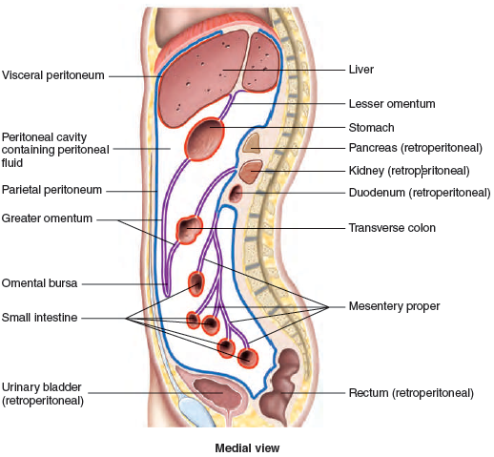
Retroperitoneal organs

Slide 7
Folds found in the peritoneum
There are five peritoneal folds
The peritoneal folds bind organs to one another and to the wall of abdominal cavity
Peritoneal folds contains blood vessels, nerves and lymphatic vessels that supply abdominal organs
Examples are:-
The greater omentum
Falciform ligaments
Lesser omentum
Messenteery
Mesocolon

Slide 8
Folds found in the peritoneum
The greater omentum
Apron-like structure that lies superficial to the small intestine and transverse colon; a site of fat deposition in people who are overweight
The falciform Ligament
Anchors the liver to the anterior abdominal wall and inferior border of the diaphragm. The live is the only digestive organs attached to the anterior abdominal
The lesser omentum
Suspends the stomach from the inferior border of the liver; provides a pathway for structures connecting to the liver

Slide 9
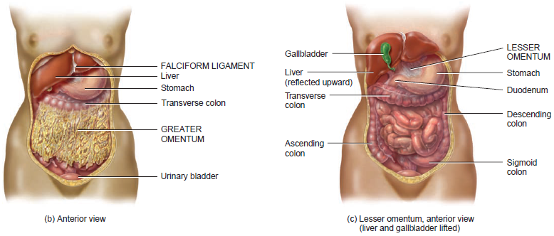

Slide 10
Folds found in the peritoneum
Mesentery
It binds the jejunum and ileum of the small intestine to the posterior abdominal wall except duodenum
Mesocolon
Attaches two portions of the large intestine (the transverse and sigmoid colon) to the posterior abdominal wall
Inflammation of the peritoneum is called peritonitis
Accumulation of fluid in the peritoneal cavity is called ascites

Slide 11
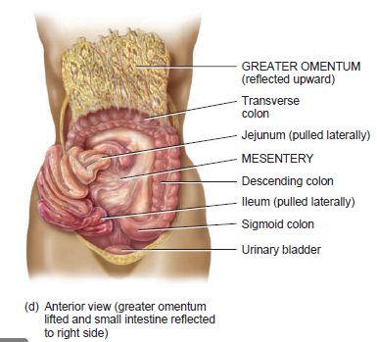

Slide 12
Thank you for your
active participation

