Slide 1
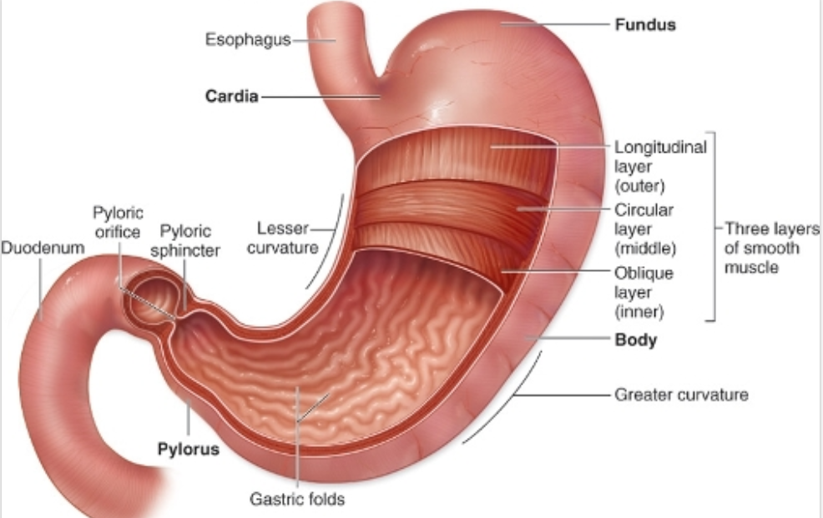
STOMACH

Slide 2
The stomach
The stomach is a J-shaped organ located inferior to the diaphragm
It lies within epigastric, umbilical region and left hypochondriac regions of the abdomen
It connects esophagus to the intestine
When empty capacity of the stomach is 50mls, however, under normal filling with liquids and solid it can expand to 1L to 1.5L. But max capacity is 4L

Slide 3
Parts of the stomach
The stomach has four parts cardia, fundus, body and pylorus
Cardia region
Esophagus opens into the stomach here. It s guarded by cardiac sphincter
Fundus region
Small dome-shaped structure that is elevated above the level of esophageal opening
Body or corpus region
The largest portion of the stomach that extends from below fundus to pyloric region
The angular notch between antrum and body is called incisura angularis

Slide 4
Parts of stomach contin……
Pyloric region
This is the part of the stomach that connects stomach to the duodenum
Pyloric region has two parts
Pyloric Antrum – connects to the body of the stomach
Pyloric canal – connects to the duodenum
When the stomach is empty it forms folds called rugae
Pylorus communicates to the duodenum through pyloric sphincter
Stomach has two curvatures. On the right side is the lesser curvature and left side is the greater curvature

Slide 5
Abnormality of the pyloric sphincture
This common in infants. There are two abnormality
Pylorospasm – smooth muscle fibers of the sphincter fails to relax and food does not move to the intestine, infant’s stomach become full and is relieved by vomiting.
Pyloric stensosis – pyloric sphincter become narrowed and the symptom is projectile vomiting

Slide 6
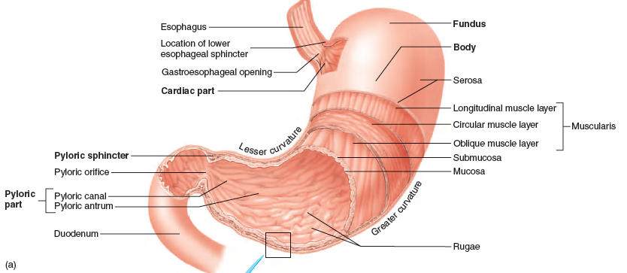
Structure of stomach

Slide 7
Functions of the stomach
The stomach plays a role in mechanical breakdown of the food
It liquefies the food (secrete gastric juice) and start chemical digestion of the food
Forms HCL that activate pepsin and play a role in disease prevention
Produce intrinsic factor that help in absorption of VIT B 12
regulate passage of chyme into the intestine
The stomach serves as a food reservoir
Secrete hormone gastric

Slide 8
Gastric glands
Gastric glands are classified into three
Fundic glands/main gastric or oxyntic glands located on the body of the fundus
Pyloric glands – present in the pyloric part of the stomach and made of enterochromaffin cells, G-cells, mucus cells and enterochromaffin-like cells
Cardiac glands – located in the cardiac region of the stomach and contain EC cells, ECL cells, and chief cells
The stomach lining is covered with simple columnar epithelium
The mucosal surface forms numerous tube-like gastric pits that are the opening of gastric glands

Slide 9
Glands of the fundus and body
These glands are divided into exocrine gland cells and enteroendocrine glands cells
Exocrine glands
Secrete their products directly into the lumen
Parietal cells or oxyntic
Mucous neck cells
Chief cells or pepsinogen cells
Surface mucous cells

Slide 10
Exocrine glands
Parietal cells has the following functions
Production of hydrochloric acid (HCL) that functions as
Activates protein-digesting enzyme, pepsin
Kill bacteria in the stomach
Create acidic medium (pH of about 2) in the stomach
Denature protein
Curding milk
Production of intrinsic factor – that is responsible for absorption of Vit B₁₂ in the terminal ileum

Slide 11
Exocrine glands
Chief cells or pepsinogen cells
Produce a precursor of protein-digesting enzyme pepsinogen
Mucus neck cells
Produce mucus that protect the layer from corrosive action of HCL
The secretions of parietal, mucus neck and chief cells form gastric Juice

Slide 12
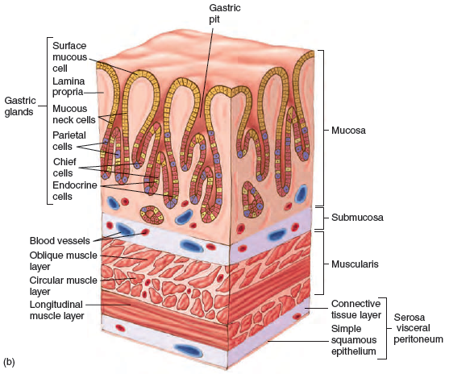
Gastric glands

Slide 13
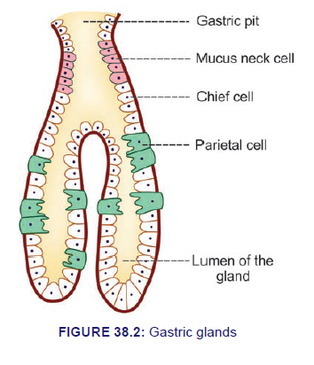
Gastric gland

Slide 14
Enteroendocrine cells
Enteroendocrine cells are hormone-secreting cells found within gastrointestinal mucosae particularly in the stomach and intestine
Enteroenndocrine cells present in gastric glands are
G cells
EC cells
ECL cells

Slide 15
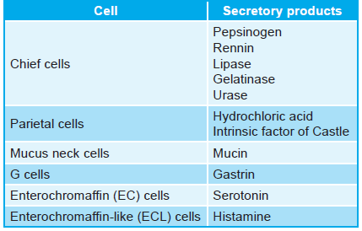
Secretary products of gastric glands

Slide 16
Regulation of stomach secretions
Gastric secretion is controlled by nerves and hormones
Gastric secretion occurs in three phases
Cephalic phase
Gastric phase
Intestinal phase

Slide 17
Cephalic phase
Cephalic phase is a conditioned reflex phase that starts before food enters the stomach
It is triggers by smell, taste, sight or thought of food that stimulate medulla oblongata
Parasympathetic impulse is transmitted from medulla oblongata through the vagus nerve to the enteric nerve systemic that release acetylcholine
Acetylcholine increases secretory activity of parietal and chief cells and also stimulate secretion of gastrin and histamine from endocrine hormone
Gastrin stimulates more secretion of HCL and pepsinogen. Gastrin also stimulate release of histamine that cause parietal cells cell to secrete HCL. Histamine receptors on parietal cells are H₂ receptors
Cephalic phase can be depressed by loss of appetite

Slide 18
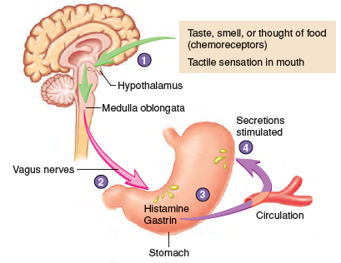
Cephalic phase

Slide 19
Gastric phase
The present of food bolus in the stomach causes distention(swelling, tightness, stretching) which stimulates stretch receptors activating parasympathetic reflex
Action potential generated by stretch receptors are carried by vagus nerves to medulla oblongata
Medulla oblongata sends impulse through vagus nerves to the parietal and chief cells in the stomach stimulating secretions and release of gastrin and histamine
More distention activate local reflexes that increase stomach secretions
Increase of gastrin and histamine in the blood also causes more gastric secretions

Slide 20
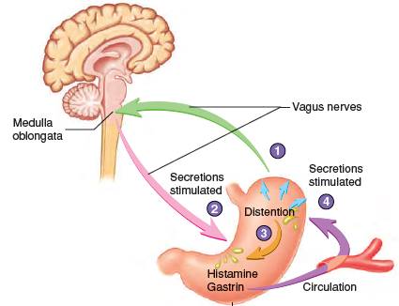
Gastric phase

Slide 21
Intestinal phase
Intestinal phase starts when chyme enters intestine
Chyme with a pH less than 2 or containing lipids inhibits gastric secretions
Presents of H⁺ or lipids in the duodenum send inhibitory impulse to medulla via vagus nerves. This inhibit parasympathetic impulse to stomach decreasing gastric secretions
Local reflexes also activates H⁺ and lipids inhibiting gastric secretions
Present of chyme also stimulate duodenum to secrete two hormone secretin by S-cells and Cholecystokinin by CCK-cells that reduce gastric secretion and motility

Slide 22
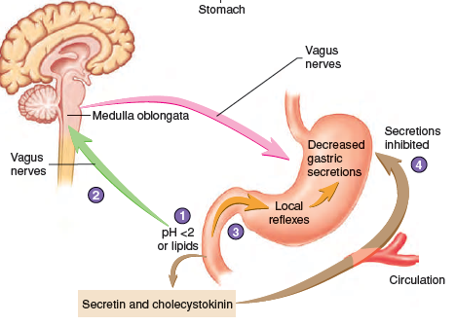
Intestinal phase

Slide 23
Functions of major digestive hormones
Hormone | Source | Functions
Gastrin | Gastrin glands | Increases gastric secretions
Secretin | Duodenum (S-cells) | Decrease gastric secretion Decrease gastric motility Increases pancreatic and bile secretions high in bicarbonates ions
Cholecyctokinin | Duodenum (CCK-cells) | Decreases gastric secretion Strongly reduce gastric motility Increases gall bladder contraction Increases pancreatic enzyme secretions

Slide 24
Mechanical digestion in the stomach
Mechanical digestion in the stomach is by by peristaltic movement called mixing waves that pass over the stomach every 15 to 25 seconds
The waves mix food with gastric gland secretions forming a milky liquid called chyme
The mixing waves forces about 3 mls of food content through the pyloric sphincter into the duodenum a process called gastric emptying

Slide 25
Chemical digestion in the stomach
Enzyme/secretion | Source | Substrate | products
Pepsin secreted in inactive form as pepsinogen | Chief cells | Proteins | Peptides Dipeptides
Gastric lipase | Chief cells | Fatty food (triglycerides) | Fatty acids Monoglycerides
Renin | Chief cells | Proteins | Coagulates protein in milk to slow movement
Hydrochloric Acid (HCL) | Parietal cells | Proteins | Kills microbes in food Denatures proteins Convert pepsinogen to pepsins Inactivate salivary amylase
Intrinsic factor | Parietal cells |  | Absorbs vit B12
Mucus | Mucus neck cells |  | Form protective barrier that prevents digestion of stomach wall

Slide 26
End of lesson
Question pz
Thank you

