Slide 1
Teeth

Slide 2
Teeth
The teeth are accessory organs located within the socket of alveolar processes of the mandible and maxillae
Alveolar processes are covered by gingivae or gum
The tooth has three main external region
The crown – visible above the gum
Root – embedded in the socket
Neck – constricted junction of the crown and root

Slide 3
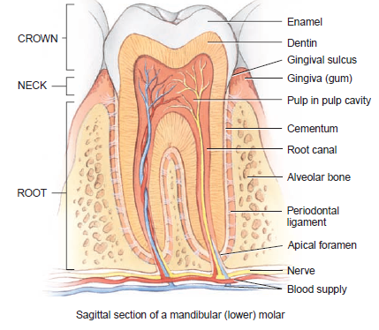
Structure of a tooth

Slide 4
Teeth cont…
Internally
Dentine – forms most part of the tooth, it is a calcifies connective harder bone and has calcium content of 70%
Enamel – thin outer layer of dentine consisting of the hardest substance in the body that protect the teeth against abrasion and acids produced by bacteria. Enamel is hard because it contains high calcium salts of 95% (calcium phosphate and calcium carbonate )

Slide 5
Tooth
Cementum – hard substance that cover the dentin in the root that hanger the tooth in the jaw
Pulp cavity – is the center of the tooth filled with blood vessels, nerves and connective tissues
Root – narrow extension of pulp cavity is called root. Each root has a canal called apical foramen for entry of blood vessel, nerves and lymphatic vessels

Slide 6
Types of teeth
Human have two types of dentition, or set of teeth
Deciduous teeth or primary teeth or milk teeth or baby teeth
This begins to erupt at 6 month until all 20 are present
All deciduous are lost by the age of 6 years and twelve
Permanent teeth or dentition or secondary teeth
Begins to erupt at 6 months until all 32 are present at about 24 years

Slide 7
Types of teeth
The teeth are divided into 4 quadrants
In adult each quadrant has
One central and one lateral incisors
One canine
First and second premolars
First, second and third premolars

Slide 8
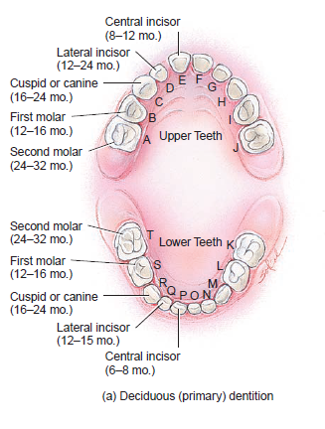
Deciduous (primary) dentition)

Slide 9
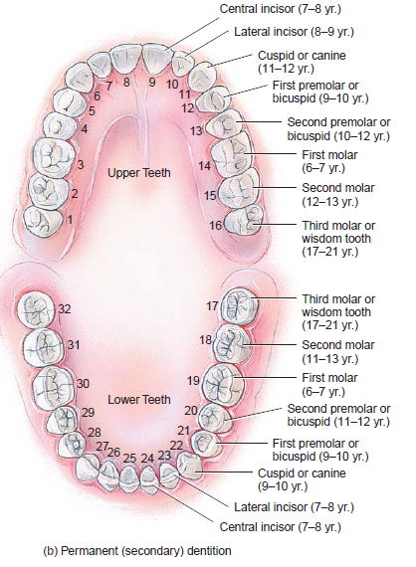
Permanent (secondary) Dentition

Slide 10
Mechanical and chemical digestion in the mouth
Mechanical digestion in the mouth
Done by chewing(mastication) by use of teeth, tongue and mixing with saliva into soft, flexible bolus (lump. Food molecules dissolve in water found in saliva
Chemical digestion in the mouth
Two enzymes are secreted in the mouth
Salivary amylase - secreted by salivary glands break down starch into smaller molecules of disaccharides
Lingual lipase – secreted by lingual glands in the tongue breaks down fat (triglycerides) into fatty acids and diglycerides

Slide 11
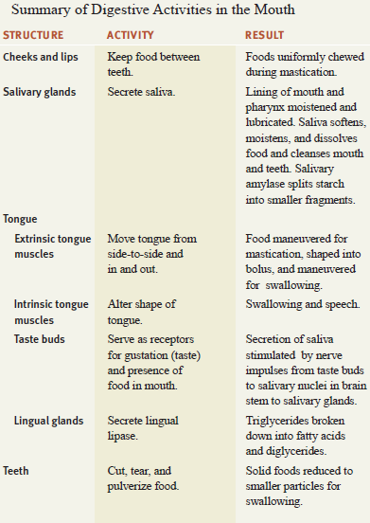

Slide 12
Questions
What structures form the mouth (oral cavity)?
How are the major salivary gland distinguished on the basis of location?
How is the secretion of saliva regulated?
What functions do incisors, cuspids, premolars, and molars perform?
Which permanent teeth do not replace any deciduous teeth?

Slide 13
Esophagus
Is a long muscular tube about 25cm long
It lies posterior to the trachea
Begins at the inferior border of laryngopharynx and passes through mediastinum
it pierces the diaphragm through an opening called esophageal hiatus
Sometimes part of the stomach protrude above the diaphragm through the esophageal hiatus, the condition is called hiatus hernia

Slide 14
Structure of oesophagus
The proximal third is lined by stratified squamous epithelium
Distal third by columnar epithelium
The middle third is line by a mixture of the two
Functions of the mouth, pharynx and oesophagus
Formation of bolus
Swallowing

Slide 15
Deglutition
Deglutition is the process of swallowing food contents from the mouth through the esophagus to the stomach
Deglutition is a complex process aided by the muscles of the tongues, pharynx and esophagus as well as mucus and saliva
There are three stages of deglutition
The voluntary phase
Pharygeal phase
Esophageal phase

Slide 16
Stages of deglutition
Voluntary phase
During this stage food, food is rolled into a bolus during mechanical breakdown in the mouth.
The bolus is pushed by tongue against hard palate, forcing the bolus into oropharynx

Slide 17
2. Pharyngeal phase
Pharyngeal phase starts by stimulation of receptors in the oropharynx by the bolus of food
Impulse generated is sent to the deglutition centre in medulla oblongata and lower pon
Efferent impulse is transmitted from medulla to the uvula and soft palate making both moves upwards and clos off the nasopharynx
The epiglottis constricts and closes off the larynx preventing food entering trachea
At this point deglutition apnea takes place i.e. breath cessation of breathing

Slide 18
3. Esophageal phase
Esophageal phase starts when food enters esophagus and is the initiation of peristalsis
This phase is also controlled by medulla oblongata
Coordinated contraction and relaxation of circular and longitudinal muscles of esophagus squeezes bolus towards stomach
As the bolus approaches the end of the esophagus, the lower esophageal sphincter relaxes releases content into the stomach

Slide 19
