Slide 1
Genome Analysis 2021
Paper II:
Transcriptomic and epigenomic
characterization of the
developing bat wing
Eckalbar et al.
Milena Regina Trabert

Slide 2
Workflow
HTseq
STAR/HiSat2
Counting
Mapping
Trimmomatic
SOAPdenovo
SAMtools
Differential expression analysis
Trim
Assembly
QUAST
Annotation
Rstudio:
edgeR
Quality control
BRAKER
FastQC
EggNOGmapper

Slide 3
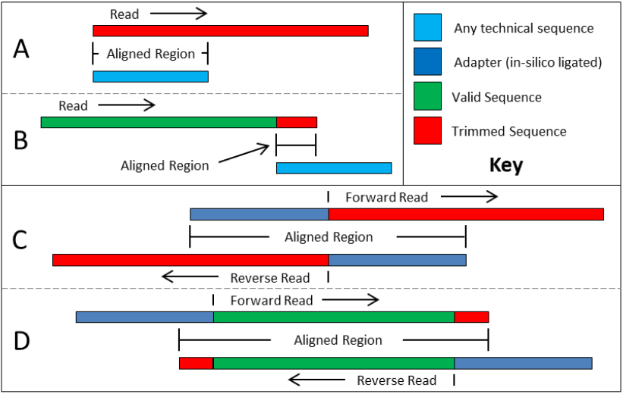
Trimmomatic & FastQC
ILLUMINA alignment parameters
Seed mismatches:………………. 2
palindrome clip threshold:…….. 20
simple clip threshold:……………. 7
minimum adapter length:……….. 2
keep both reads:…………….. true
LEADING & TRAILING:……….. 17
SLIDINGWINDOW: length……… 5 min. avg. quality…………... 20
MINLEN:………………………… 20
Trimmomatic manual:
http://www.usadellab.org/cms/uploads/supplementary/Trimmomatic/TrimmomaticManual_V0.32.pdf

Slide 4
Assembly
SOAPdenovo
SOAPdenovo config file parameters
 | Run 1 | Run 2 | Run 3
reverse_seq | 0 | 1 | 1
asm_flag | 3 | 3 | 1
reverse_seq: complementary reverse paired-end sequences (0=FR, 1=FF)
asm_flag: which parts of the reads are used (1=contig assembly, 3=contig and scaffold assembly)

Slide 5
Assembly
SOAPdenovo & QUAST
SOAPdenovo config file parameters
 | Run 1 | Run 2 | Run 3
reverse_seq | 0 | 1 | 1
asm_flag | 3 | 3 | 1
Total length 141836091
Reference length 3990777
GC (%) 43.24
Reference GC (%) 36.99
reverse_seq: complementary reverse paired-end sequences (0=FR, 1=FF)
asm_flag: which parts of the reads are used (1=contig assembly, 3=contig and scaffold assembly)

Slide 6
Mapping
STAR (+ indexer)
HiSat2 (+ indexer)
Samtools functionality integrated
Unmapped: 69.41%
Samtools used separate (pipe)
Unmapped: 61,88%

Slide 7
Mapping
STAR (+ indexer)
HiSat2 (+ indexer)
Samtools functionality integrated
Unmapped: 69.41%
Samtools used separate (pipe)
Unmapped: 61,88%
Gene content in scaffold 1?

Slide 8
Mapping
STAR (+ indexer)
HiSat2 (+ indexer)
Samtools functionality integrated
Unmapped: 69.41%
Samtools used separate (pipe)
Unmapped: 61,88%
Gene content in scaffold 1?
Scaffold 1
576
Scaffold 2
2210
Scaffold 4
4933

Slide 9
Mapping
STAR (+ indexer)
HiSat2 (+ indexer)
Samtools functionality integrated
Unmapped: 69.41%
Samtools used separate (pipe)
Unmapped: 61,88%
Mapping.bam
Read counting
HTSeq

Slide 10
Structural Annotation
BRAKER
Pipeline
Genome.fasta
mapping_result.bam
Annotation.gff

Slide 11
Functional Annotation
EggNOGmapper
Protein.fasta
Extract protein fasta
from annotation.gff
Functional
Annotation
Cufflinks & Emboss
EggNOGmapper

Slide 12
Differential expression analysis
Rstudio, edgeR
?
Filter out lowly expressed genes
12 Genes
Correct for multiple testing
8 Genes
FilterByExpr
eBayes

Slide 13
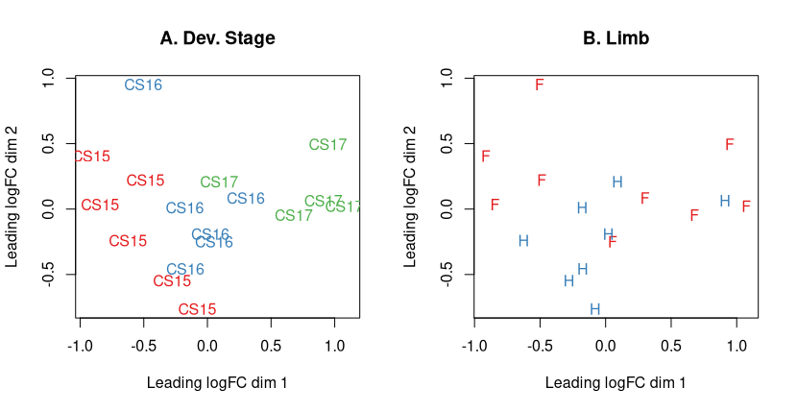
Differential expression analysis
Multidimentional scaling

Slide 14
Differential expression analysis
PCA, clustering, Heatmap
PC1: 89%, PC2: 6%

