Slide 1

DATA ANALYSIS PROJECT
Nang Mo K
Miles M
Shubhangi T

Slide 2
What we'll Cover today
Regional sales in the best performing country
Relationship between annual leave taken and bonus
Relationship between Country and Revenue
Relationship between store trading duration and revenue
Relationship between the size of the stores, number of employees and revenue
Some collective Insights about data

Slide 3
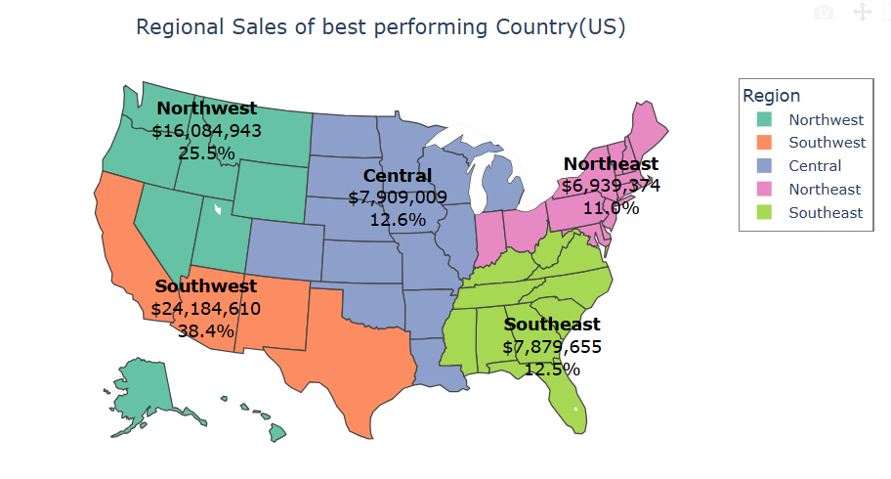
WHAT IS THE REGIONAL SALES IN THE BEST PERFORMING COUNTRY?
Best performing sale is in US country
The Southwest region is the market leader.
The Northwest region holds the position of the second-highest market.

Slide 4
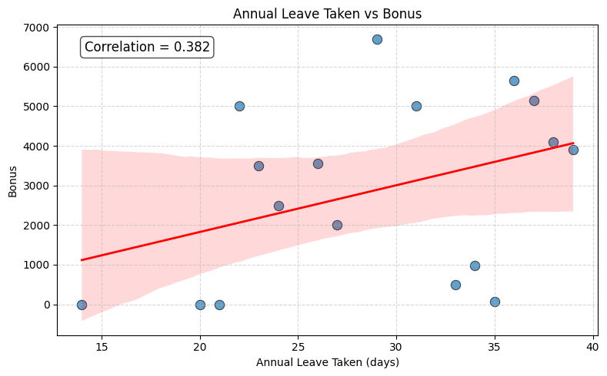
WHAT IS THE RELATIONSHIP BETWEEN ANNUAL LEAVE TAKEN AND BONUS?
Bonuses are only given to sales employees.
The relationship is not strong or consistent.
Leave is not a major factor as it does not significantly impact bonus decisions.

Slide 5
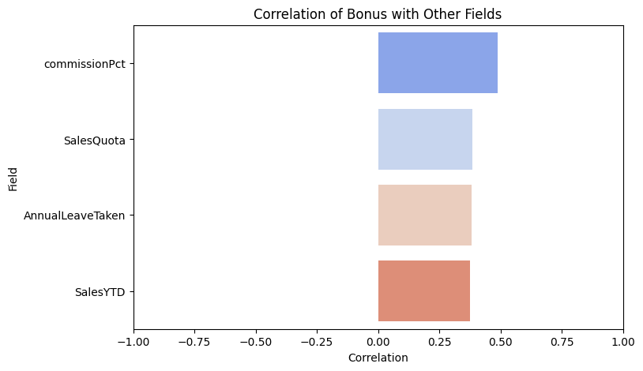
RELATIONSHIP BETWEEN OTHER FIELDS AND BONUS?
Bonuses are mainly influenced by compensation structure (commission and quotas) rather than operational behaviors like leave.

Slide 6
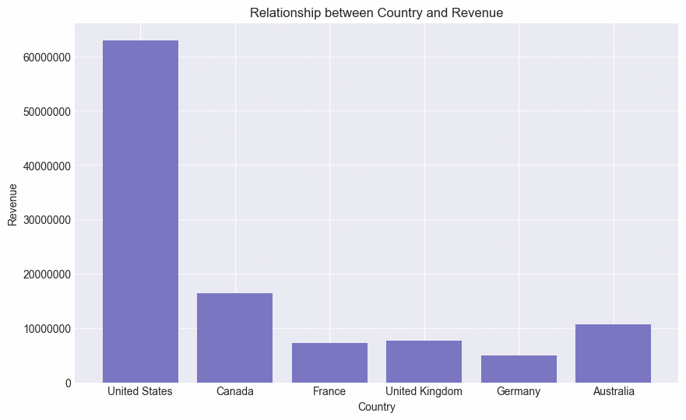
WHAT IS THE RELATIONSHIP BETWEEN COUNTRY AND REVENUE?
United States has the highest revenue.
Followed by Canada and Australia respectively.
European countries are the worst performing.
Notes:
🇩🇪 Germany~84 Million~24%US is ~4x larger🇬🇧 United Kingdom~69 Million~20%US is ~5x larger🇫🇷 France~68 Million~20%US is ~5x larger🇨🇦 Canada~41 Million~12%US is ~8.5x larger🇦🇺 Australia~27 Million~8%US is ~13x larger

Slide 7
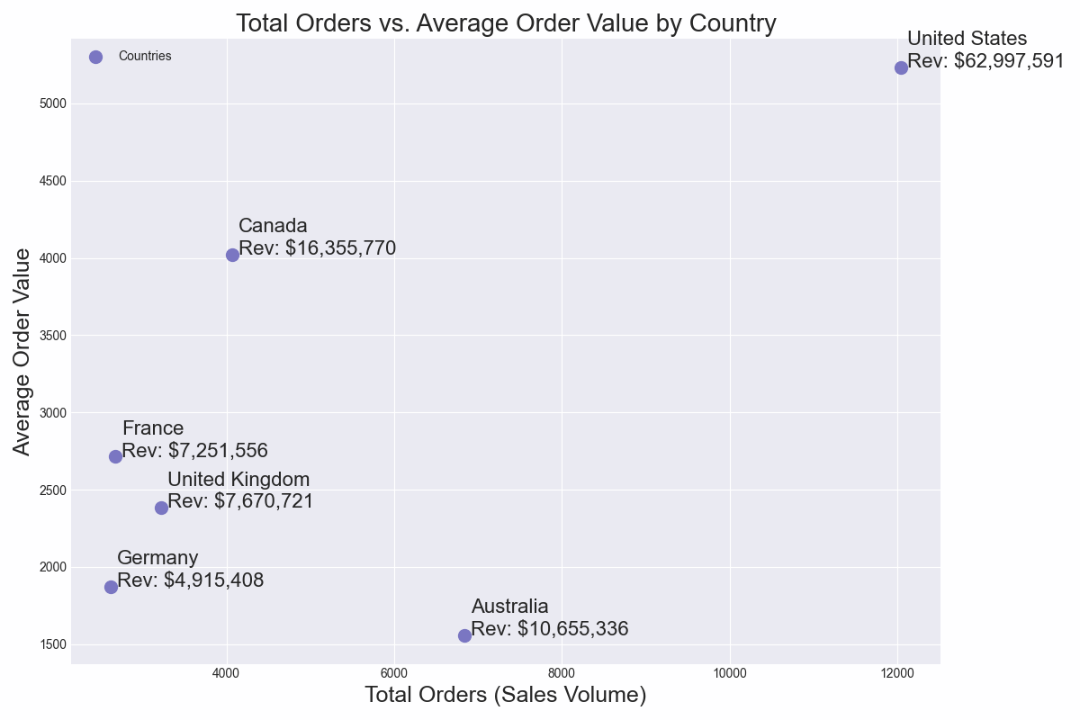
ANALYSIS OF AVERAGE ORDER VALUE AND SALES
Market leader, United States followed by Canada.
Australia is an anomaly.
  High total orders
  Lowest in average order value.
Better calculation can be made with sales per capita.
Notes:
The US generates over $62 million, which is roughly 4x more than the next closest competitor (Canada).
The scatter plot reveals how they get there. Australia has the 2nd highest sales volume (Total Orders), but with the lowest Average Order Value (~$1,500).
This indicate Australians are buying smaller baskets in comparison to other countries.
The entirety of europe is currently the weakest region. It lacks the volume of Australia and the high spending of the North America.

Slide 8
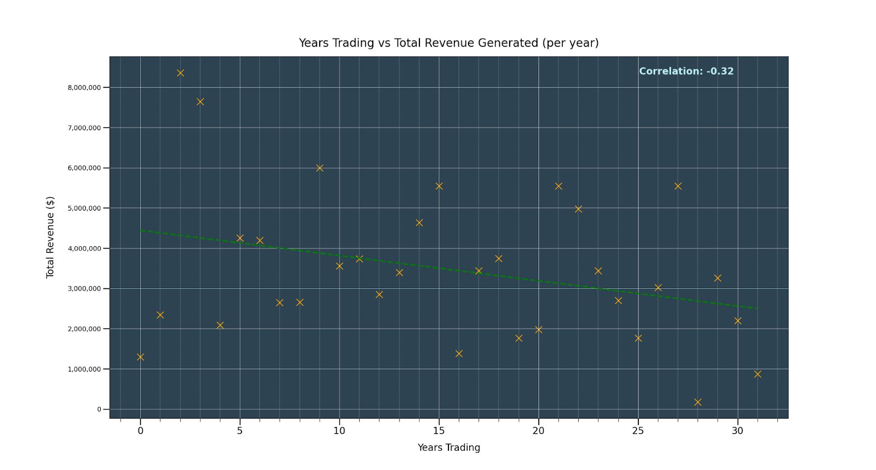
WHAT IS THE RELATIONSHIP BETWEEN STORE TRADING DURATION AND REVENUE?
Notes:
As you can see on this chart, we found that revenue doesn’t change much regardless of years trading, although there is a very slight downward trend. We would ask you not to put much weight behind this trend as the correlation is very weak, but if this may become a factor in the future.
The data we were provided didn’t give a clear picture of yearly revenue by store over time. Instead we had to take total revenue to date and work from that.
Something we would highly recommend is that you log individual store revenue year by year, it could produce a clearer picture of this relationship and give you the opportunity to see store by store breakdowns over time.

Slide 9
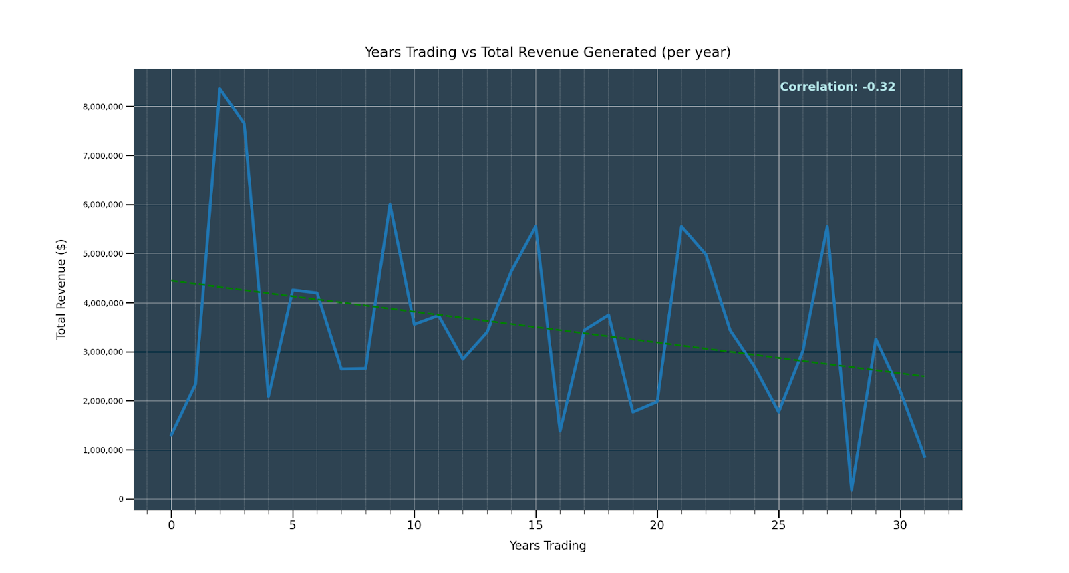
WHAT IS THE RELATIONSHIP BETWEEN STORE TRADING DURATION AND REVENUE?
Year 4 revenue
drop off
Suggest tracking
aggregated sales
data year by year
Notes:
As you can see on this chart, we found that stores generally fall into the same range of revenue regardless of years trading, with a very slight downward trend. We would ask you not to put much weight behind this trend as the correlation is very weak.
The key takeaway from this was that years 1-3 were the most profitable for any store. No store outperformed themselves in any subsequent year after this initial period.
The data we were provided didn’t give a clear picture of yearly revenue by store over time. Instead we had to take total revenue to date and work from that.
Something we would highly recommend is that you log individual store revenue year by year, it could produce a clearer picture of this relationship and give you the opportunity to see store by store breakdowns over time.

Slide 10
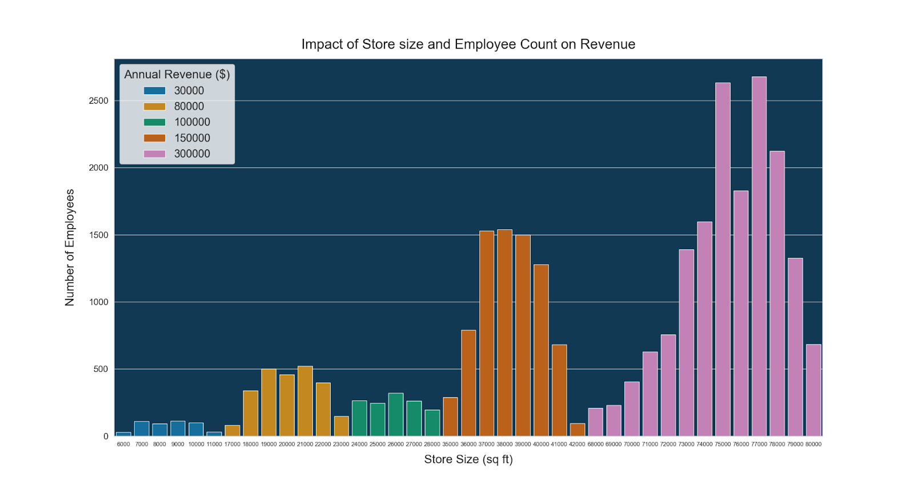
WHAT IS THE RELATIONSHIP BETWEEN THE SIZE OF THE STORES, NUMBER OF EMPLOYEES AND REVENUE?
16482
7700
2926
1289
1289
477
Very Small Small Medium Large Very Large
Notes:
Store sizes fall into 5 categories of revenue, with the largest stores by square footage outperforming all other stores. Although employee count doesn’t factor into revenue as much as store size, profits could be increased by downsizing employee count in these very large stores to be more in line with the beginning and end of their distribution curves.
The top 5 stores by employee count are in the highest revenue category.
As you can see, large stores with a size between 3500 and 42000(orange) sq ft are outperforming the medium sized stores (green) by just 50% revenue per store, even though they have the 2nd highest combined employee count. Considering the number of employees is almost 6 ( 5.97) times more for these large stores, therefore we found that medium stores are much more profitable. We would suggest future stores fall within this range to maximise profits.

Slide 11
In Closing
Next steps?
Sales per capita per year
Explore Australian market
Investigate Year 4 revenue drop off
Q&A

