Slide 1
Management summary
3
Tx total BW stepped up
VS.FEGE.TxTotalBW rose. These are the real bandwidth increases.
5
Throughput rose, Tx BW did not
RxMaxSpeed can rise while Tx total BW stays flat.
# | Site | Finding | Daytime throughput | Tx total BW
1 | GPSRP91 | Solved — Tx BW increased | 16.2 → 19.1 (+2.9) | 250 → 500
2 | NGSDRW3 | Solved — Tx BW increased | 18.2 → 21.1 (+2.9) | 250 → 500
3 | DHRMN65 | Tx BW increased | 31.1 → 30.8 (-0.3) | 250 → 500
4 | DHUTTM5 | Solved | 13.3 → 18.6 (+5.3) | 250 → 250
5 | GPSDR38 | Solved | 16.1 → 20.5 (+4.4) | 250 → 250
6 | NGSNG78 | Solved | 6.7 → 9.2 (+2.5) | 250 → 250
7 | GPSRPM9 | Solved | 25.2 → 27.6 (+2.4) | 250 → 250
8 | DHSHA19 | Solved | 25.2 → 27.5 (+2.3) | 250 → 250
Daytime throughput is the 09:00–22:00 median. Green Tx BW stepped up. Amber Tx BW did not.
1 / 9

Slide 2
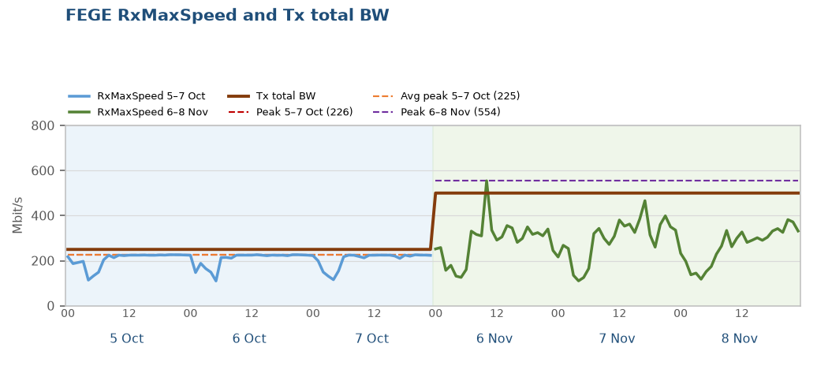

Solved — Tx BW increased: GPSRP91
1 of 2 in this finding
Throughput improved, data volume held
After the Tx BW increase, throughput improved significantly. Data volume was held.
Tx total BW rose from 250 to 500 Mbit/s (+250 Mbit/s, VS.FEGE.TxTotalBW). Busy-hour RxMaxSpeed p90 226 → 381 Mbit/s.
Data BusyHour 1H throughput 12.84 → 15.65 Mbps (+2.81 Mbps, +21.9%). Daytime 09:00–22:00 median 16.2 → 19.1 Mbps.
Data BusyHour 1H data volume 81.4 → 78.5 GB (-2.9 GB, -3.5%).
Choked on 5–7 Oct. Off the choke list on 6–8 Nov.
Pre 5–7 Oct · Post 6–8 Nov · Charts are hourly · Notes use Data BusyHour 1H
2 / 9

Slide 3
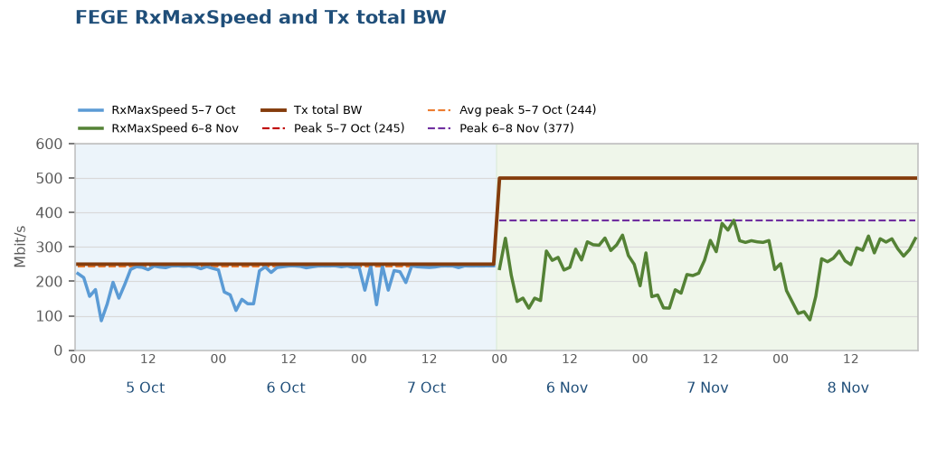

Solved — Tx BW increased: NGSDRW3
2 of 2 in this finding
Small improvement, KPIs did not fall
After the Tx BW increase, throughput is higher and data volume did not fall.
Tx total BW rose from 250 to 500 Mbit/s (+250 Mbit/s, VS.FEGE.TxTotalBW). Busy-hour RxMaxSpeed p90 245 → 329 Mbit/s.
Data BusyHour 1H throughput 15.30 → 16.27 Mbps (+0.97 Mbps, +6.3%). Daytime 09:00–22:00 median 18.2 → 21.1 Mbps.
Data BusyHour 1H data volume 74.4 → 77.8 GB (+3.4 GB, +4.6%).
Choked on 5–7 Oct. Off the choke list on 6–8 Nov.
Pre 5–7 Oct · Post 6–8 Nov · Charts are hourly · Notes use Data BusyHour 1H
3 / 9

Slide 4
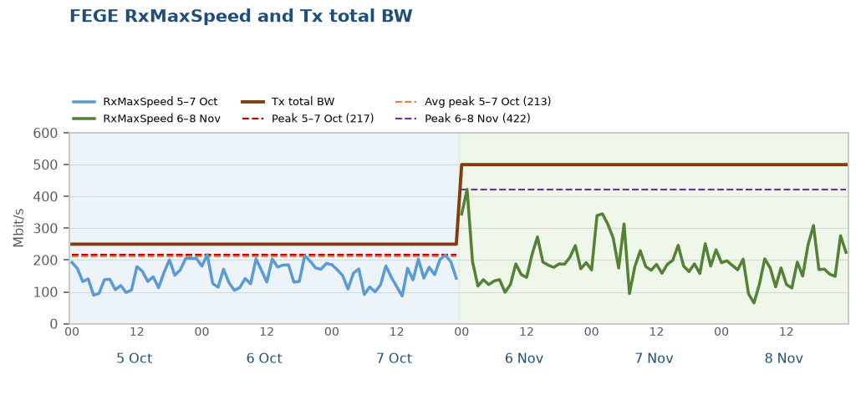
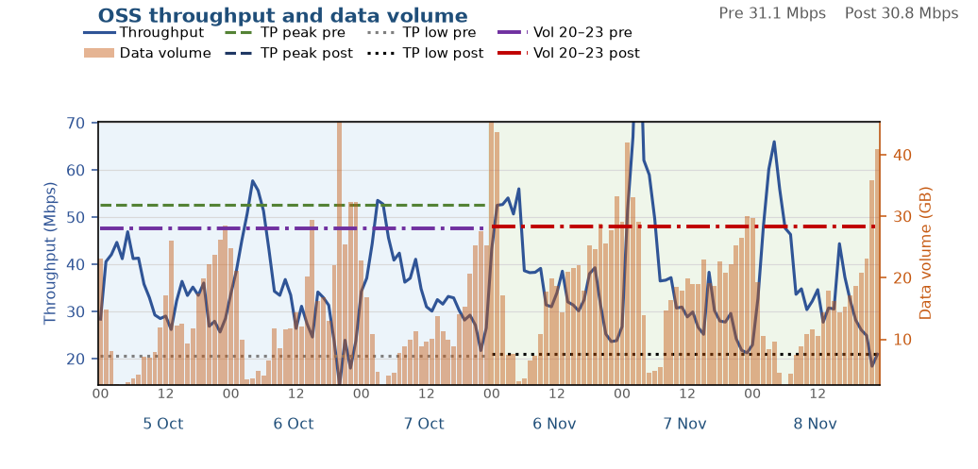
Tx BW increased: DHRMN65
1 of 1 in this finding
Both throughput and data volume improved
After the Tx BW increase, the congested busy hour is faster and data volume increased. Throughput across the rest of the day is about level.
Tx total BW rose from 250 to 500 Mbit/s (+250 Mbit/s, VS.FEGE.TxTotalBW). Busy-hour RxMaxSpeed p90 204 → 248 Mbit/s.
Data BusyHour 1H throughput 18.59 → 34.68 Mbps (+16.10 Mbps, +86.6%). Daytime 09:00–22:00 median 31.1 → 30.8 Mbps.
Data BusyHour 1H data volume 34.2 → 47.8 GB (+13.6 GB, +39.7%).
Not on the choke list in either window.
Pre 5–7 Oct · Post 6–8 Nov · Charts are hourly · Notes use Data BusyHour 1H
4 / 9

Slide 5
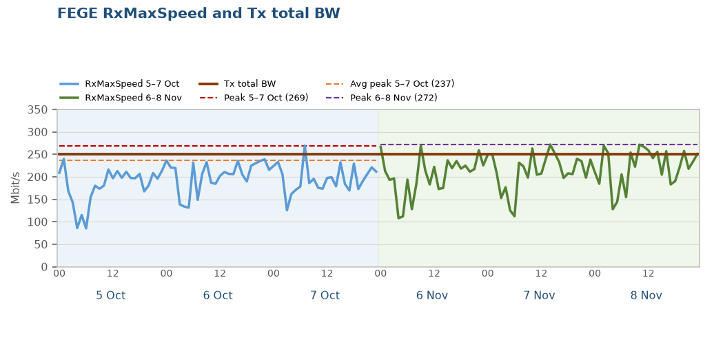
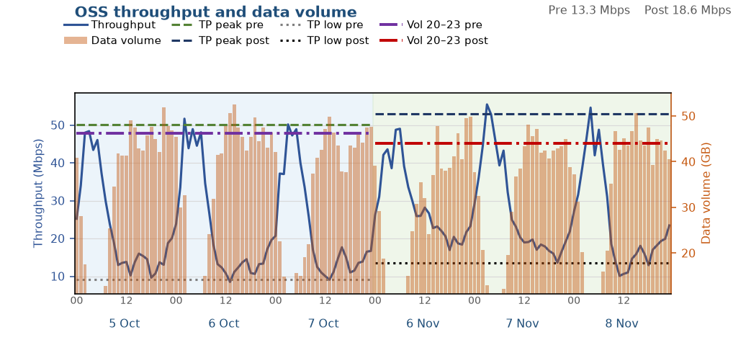
Solved: DHUTTM5
1 of 5 in this finding
Throughput improved, data volume held
Throughput improved significantly and data volume was held. Tx total BW did not increase.
Tx total BW stayed at 250 Mbit/s (VS.FEGE.TxTotalBW). It did not increase. Busy-hour RxMaxSpeed p90 232 → 262 Mbit/s.
Data BusyHour 1H throughput 10.85 → 18.95 Mbps (+8.10 Mbps, +74.6%). Daytime 09:00–22:00 median 13.3 → 18.6 Mbps.
Data BusyHour 1H data volume 51.4 → 49.5 GB (-1.9 GB, -3.6%).
Choked on 5–7 Oct. Off the choke list on 6–8 Nov.
Pre 5–7 Oct · Post 6–8 Nov · Charts are hourly · Notes use Data BusyHour 1H
5 / 9

Slide 6
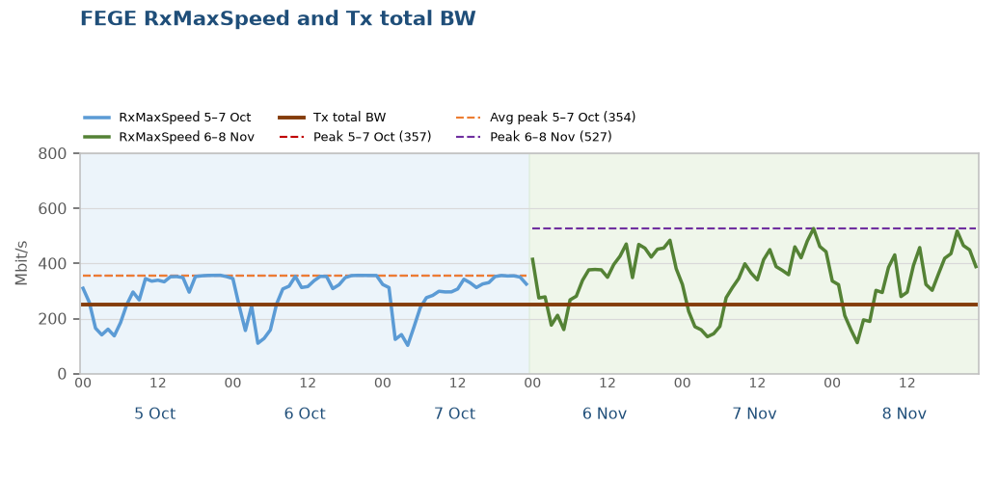

Solved: GPSDR38
2 of 5 in this finding
Throughput improved, data volume held
Throughput improved significantly and data volume was held. Tx total BW did not increase.
Tx total BW stayed at 250 Mbit/s (VS.FEGE.TxTotalBW). It did not increase. Busy-hour RxMaxSpeed p90 356 → 470 Mbit/s.
Data BusyHour 1H throughput 12.34 → 14.03 Mbps (+1.69 Mbps, +13.7%). Daytime 09:00–22:00 median 16.1 → 20.5 Mbps.
Data BusyHour 1H data volume 118.4 → 126.0 GB (+7.7 GB, +6.5%).
Choked on 5–7 Oct. Off the choke list on 6–8 Nov.
Pre 5–7 Oct · Post 6–8 Nov · Charts are hourly · Notes use Data BusyHour 1H
6 / 9

Slide 7
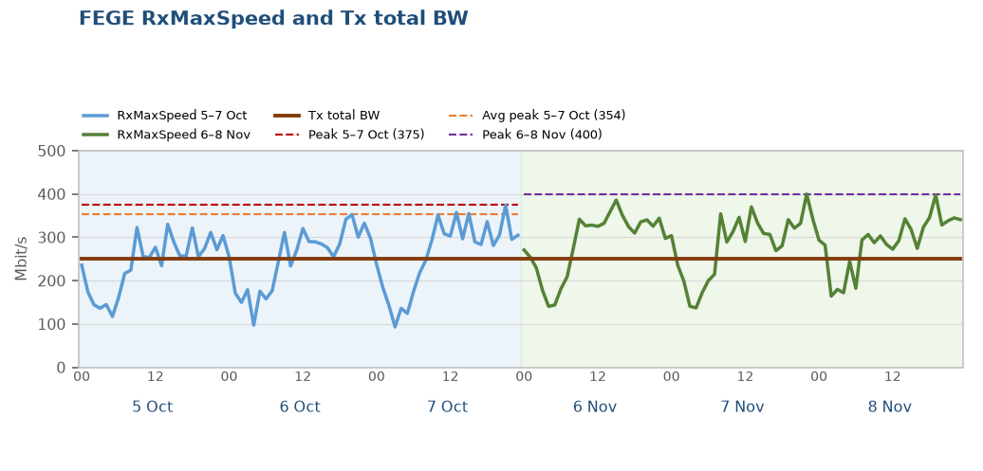
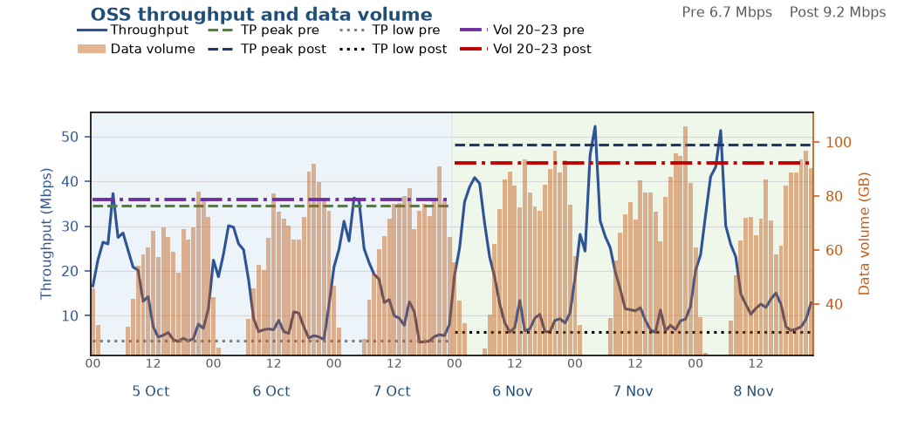
Solved: NGSNG78
3 of 5 in this finding
Both throughput and data volume improved
Throughput and data volume both improved. Tx total BW did not increase.
Tx total BW stayed at 250 Mbit/s (VS.FEGE.TxTotalBW). It did not increase. Busy-hour RxMaxSpeed p90 348 → 357 Mbit/s.
Data BusyHour 1H throughput 6.22 → 9.13 Mbps (+2.91 Mbps, +46.9%). Daytime 09:00–22:00 median 6.7 → 9.2 Mbps.
Data BusyHour 1H data volume 88.1 → 99.8 GB (+11.7 GB, +13.3%).
Choked on 5–7 Oct. Off the choke list on 6–8 Nov.
Pre 5–7 Oct · Post 6–8 Nov · Charts are hourly · Notes use Data BusyHour 1H
7 / 9

Slide 8
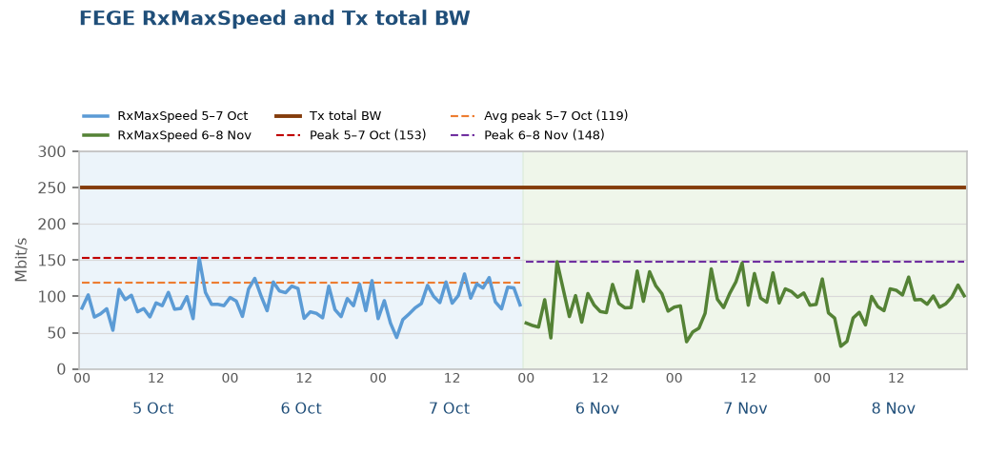
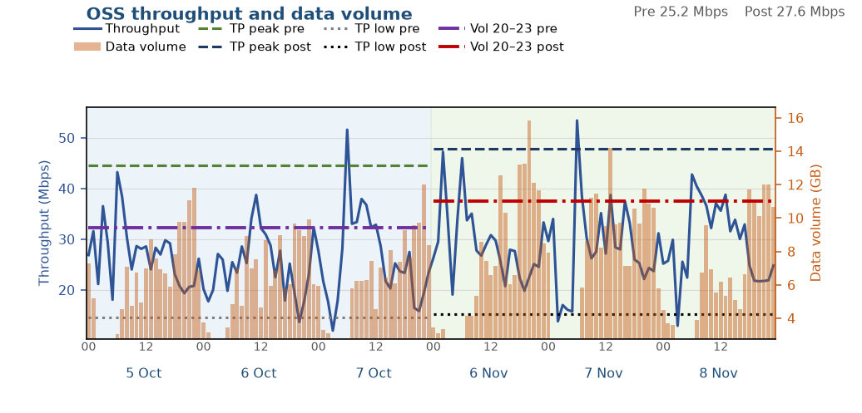
Solved: GPSRPM9
4 of 5 in this finding
Both throughput and data volume improved
Throughput and data volume both improved. Tx total BW did not increase.
Tx total BW stayed at 250 Mbit/s (VS.FEGE.TxTotalBW). It did not increase. Busy-hour RxMaxSpeed p90 117 → 130 Mbit/s.
Data BusyHour 1H throughput 20.82 → 26.42 Mbps (+5.60 Mbps, +26.9%). Daytime 09:00–22:00 median 25.2 → 27.6 Mbps.
Data BusyHour 1H data volume 11.2 → 14.0 GB (+2.8 GB, +24.7%).
Choked on 5–7 Oct. Off the choke list on 6–8 Nov.
Pre 5–7 Oct · Post 6–8 Nov · Charts are hourly · Notes use Data BusyHour 1H
8 / 9

Slide 9
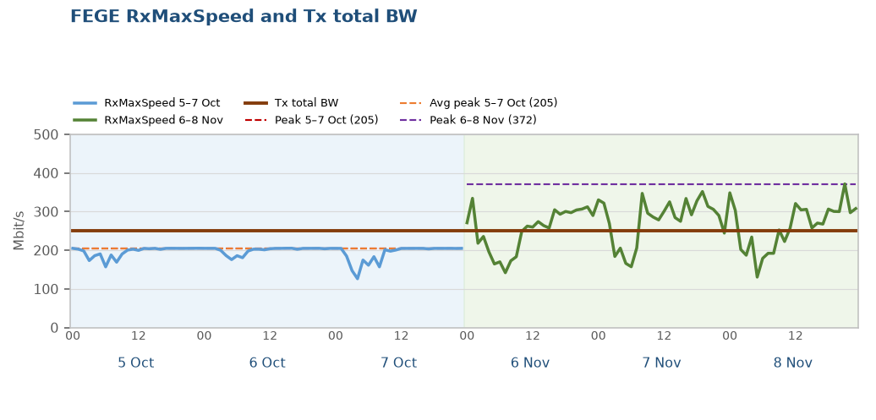
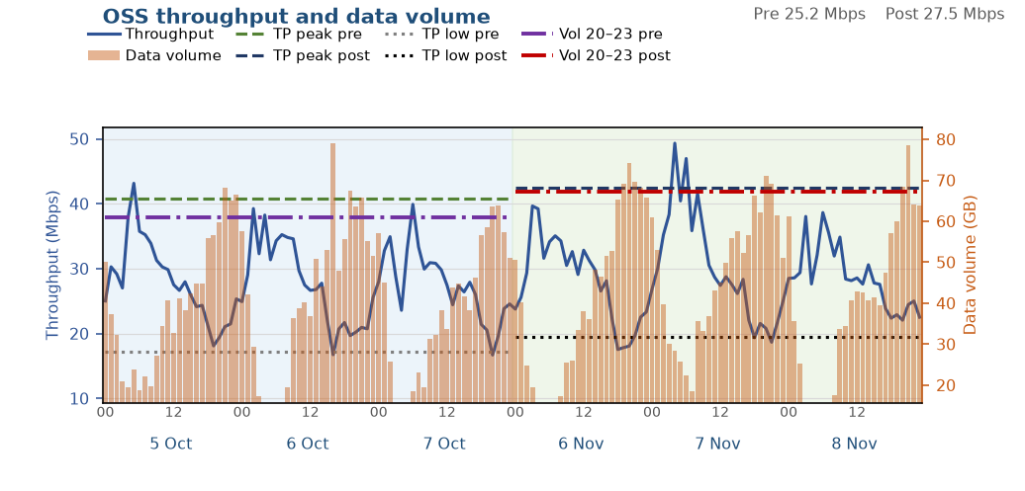
Solved: DHSHA19
5 of 5 in this finding
Small improvement, KPIs did not fall
A small throughput gain, and data volume did not fall. Tx total BW did not increase.
Tx total BW stayed at 250 Mbit/s (VS.FEGE.TxTotalBW). It did not increase. Busy-hour RxMaxSpeed p90 205 → 327 Mbit/s.
Data BusyHour 1H throughput 18.97 → 20.86 Mbps (+1.88 Mbps, +9.9%). Daytime 09:00–22:00 median 25.2 → 27.5 Mbps.
Data BusyHour 1H data volume 70.3 → 74.7 GB (+4.3 GB, +6.1%).
Choked on 5–7 Oct. Off the choke list on 6–8 Nov.
Pre 5–7 Oct · Post 6–8 Nov · Charts are hourly · Notes use Data BusyHour 1H
9 / 9

