Slide 1
Management summary
8 ceiling up · 5 ceiling held
# | Site | Finding | Daytime throughput | Rx ceiling
1 | GPSDR38 | Solved — Tx BW increased | 16.1 → 20.5 (+4.4) | 356 → 470
2 | DHRMN30 | Solved — Tx BW increased | 5.8 → 8.9 (+3.1) | 162 → 240
3 | NGSDRW3 | Solved — Tx BW increased | 18.2 → 21.1 (+2.9) | 245 → 329
4 | DHNMK02 | Solved — Tx BW increased | 33.4 → 35.2 (+1.8) | 200 → 297
5 | DHRMN65 | Solved — Tx BW increased | 31.1 → 30.8 (-0.3) | 204 → 248
6 | DHBDD01 | Choked again | 11.6 → 15.1 (+3.5) | 262 → 318
7 | TNSKP30 | Choked again | 20.6 → 21.4 (+0.8) | 390 → 500
8 | DHSVRI8 | Choked again | 17.7 → 17.8 (+0.0) | 185 → 464
9 | DHUTTM5 | Solved | 13.3 → 18.6 (+5.3) | 232 → 262
10 | DHDHR38 | Solved | 9.0 → 13.3 (+4.2) | 178 → 201
11 | NGSNG78 | Solved | 6.7 → 9.2 (+2.5) | 348 → 357
12 | GPSRPM9 | Solved | 25.2 → 27.6 (+2.4) | 117 → 130
13 | DHMDP02 | Solved | 25.0 → 27.3 (+2.2) | 198 → 229
Rx ceiling is busy-hour RxMaxSpeed p90. Green rose by at least 40 Mbit/s or 12%. Amber did not. A flat trace can still be choked.
1 / 14

Slide 2


Solved — Tx BW increased: GPSDR38
1 of 5 in this finding
Throughput improved, data volume held
After the Tx BW increase, throughput improved significantly. Data volume was held.
Tx ceiling rose from 356 to 470 Mbit/s (+114 Mbit/s, busy-hour RxMaxSpeed p90).
Data BusyHour 1H throughput 12.34 → 14.03 Mbps (+1.69 Mbps, +13.7%). Daytime 09:00–22:00 median 16.1 → 20.5 Mbps.
Data BusyHour 1H data volume 118.4 → 126.0 GB (+7.7 GB, +6.5%).
Choked on 5–7 Oct. Off the choke list on 6–8 Nov.
Pre 5–7 Oct · Post 6–8 Nov · Charts are hourly · Notes use Data BusyHour 1H
2 / 14

Slide 3


Solved — Tx BW increased: DHRMN30
2 of 5 in this finding
Throughput improved, data volume held
After the Tx BW increase, throughput improved significantly. Data volume was held.
Tx ceiling rose from 162 to 240 Mbit/s (+78 Mbit/s, busy-hour RxMaxSpeed p90).
Data BusyHour 1H throughput 3.59 → 4.95 Mbps (+1.36 Mbps, +37.9%). Daytime 09:00–22:00 median 5.8 → 8.9 Mbps.
Data BusyHour 1H data volume 56.0 → 61.5 GB (+5.4 GB, +9.7%).
Choked on 5–7 Oct. Off the choke list on 6–8 Nov.
Pre 5–7 Oct · Post 6–8 Nov · Charts are hourly · Notes use Data BusyHour 1H
3 / 14

Slide 4


Solved — Tx BW increased: NGSDRW3
3 of 5 in this finding
Small improvement, KPIs did not fall
After the Tx BW increase, throughput is higher and data volume did not fall.
Tx ceiling rose from 245 to 329 Mbit/s (+84 Mbit/s, busy-hour RxMaxSpeed p90).
Data BusyHour 1H throughput 15.30 → 16.27 Mbps (+0.97 Mbps, +6.3%). Daytime 09:00–22:00 median 18.2 → 21.1 Mbps.
Data BusyHour 1H data volume 74.4 → 77.8 GB (+3.4 GB, +4.6%).
Choked on 5–7 Oct. Off the choke list on 6–8 Nov.
Pre 5–7 Oct · Post 6–8 Nov · Charts are hourly · Notes use Data BusyHour 1H
4 / 14

Slide 5

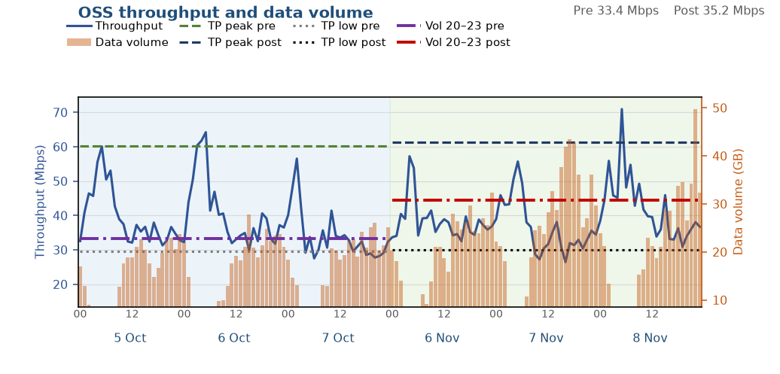
Solved — Tx BW increased: DHNMK02
4 of 5 in this finding
Both throughput and data volume improved
After the Tx BW increase, the congested busy hour is faster and data volume increased. Throughput across the rest of the day is about level.
Tx ceiling rose from 200 to 297 Mbit/s (+97 Mbit/s, busy-hour RxMaxSpeed p90).
Data BusyHour 1H throughput 30.02 → 35.56 Mbps (+5.54 Mbps, +18.5%). Daytime 09:00–22:00 median 33.4 → 35.2 Mbps.
Data BusyHour 1H data volume 26.0 → 41.9 GB (+15.9 GB, +61.3%).
Choked on 5–7 Oct. Off the choke list on 6–8 Nov.
Pre 5–7 Oct · Post 6–8 Nov · Charts are hourly · Notes use Data BusyHour 1H
5 / 14

Slide 6
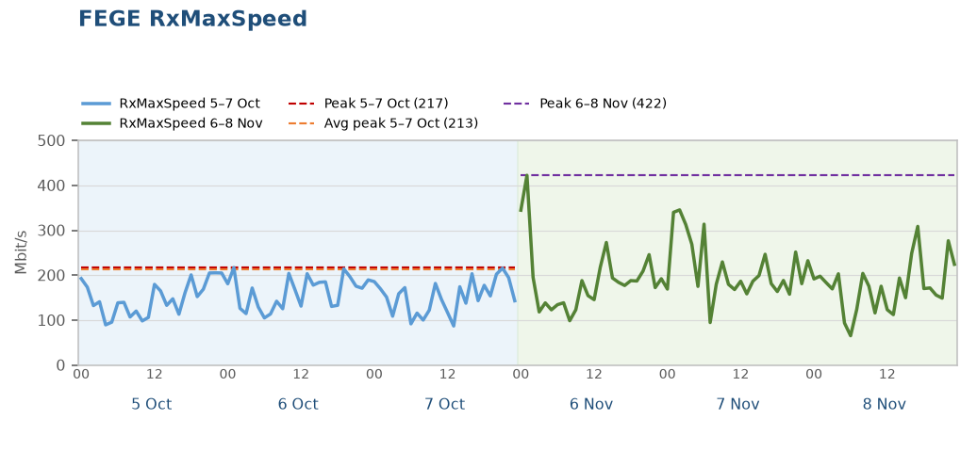
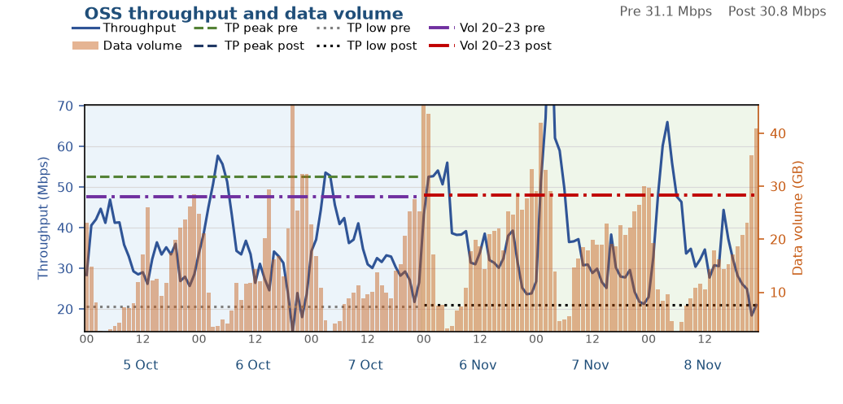
Solved — Tx BW increased: DHRMN65
5 of 5 in this finding
Both throughput and data volume improved
After the Tx BW increase, the congested busy hour is faster and data volume increased. Throughput across the rest of the day is about level.
Tx ceiling rose from 204 to 248 Mbit/s (+44 Mbit/s, busy-hour RxMaxSpeed p90).
Data BusyHour 1H throughput 18.59 → 34.68 Mbps (+16.10 Mbps, +86.6%). Daytime 09:00–22:00 median 31.1 → 30.8 Mbps.
Data BusyHour 1H data volume 34.2 → 47.8 GB (+13.6 GB, +39.7%).
Choked on 5–7 Oct. Off the choke list on 6–8 Nov.
Pre 5–7 Oct · Post 6–8 Nov · Charts are hourly · Notes use Data BusyHour 1H
6 / 14

Slide 7


Choked again: DHBDD01
1 of 3 in this finding
Throughput improved, data volume held
After the Tx BW increase, throughput improved significantly. Data volume was held.
Tx ceiling rose from 262 to 318 Mbit/s (+56 Mbit/s, busy-hour RxMaxSpeed p90).
Data BusyHour 1H throughput 7.19 → 12.78 Mbps (+5.59 Mbps, +77.8%). Daytime 09:00–22:00 median 11.6 → 15.1 Mbps.
Data BusyHour 1H data volume 65.3 → 65.6 GB (+0.3 GB, +0.5%).
Still choked after the window, so the higher throughput is already on the new ceiling.
Pre 5–7 Oct · Post 6–8 Nov · Charts are hourly · Notes use Data BusyHour 1H
7 / 14

Slide 8


Choked again: TNSKP30
2 of 3 in this finding
Throughput improved, data volume held
After the Tx BW increase, the congested busy hour is faster and data volume was held. Throughput across the rest of the day is about level.
Tx ceiling rose from 390 to 500 Mbit/s (+110 Mbit/s, busy-hour RxMaxSpeed p90).
Data BusyHour 1H throughput 16.81 → 20.30 Mbps (+3.49 Mbps, +20.7%). Daytime 09:00–22:00 median 20.6 → 21.4 Mbps.
Data BusyHour 1H data volume 131.8 → 128.9 GB (-2.9 GB, -2.2%).
Still choked after the window, so the higher throughput is already on the new ceiling.
Pre 5–7 Oct · Post 6–8 Nov · Charts are hourly · Notes use Data BusyHour 1H
8 / 14

Slide 9


Choked again: DHSVRI8
3 of 3 in this finding
Both throughput and data volume improved
After the Tx BW increase, the congested busy hour is faster and data volume increased. Throughput across the rest of the day is about level.
Tx ceiling rose from 185 to 464 Mbit/s (+279 Mbit/s, busy-hour RxMaxSpeed p90).
Data BusyHour 1H throughput 9.42 → 11.39 Mbps (+1.97 Mbps, +20.9%). Daytime 09:00–22:00 median 17.7 → 17.8 Mbps.
Data BusyHour 1H data volume 87.6 → 140.3 GB (+52.7 GB, +60.2%).
Still choked after the window, so the higher throughput is already on the new ceiling.
Pre 5–7 Oct · Post 6–8 Nov · Charts are hourly · Notes use Data BusyHour 1H
9 / 14

Slide 10

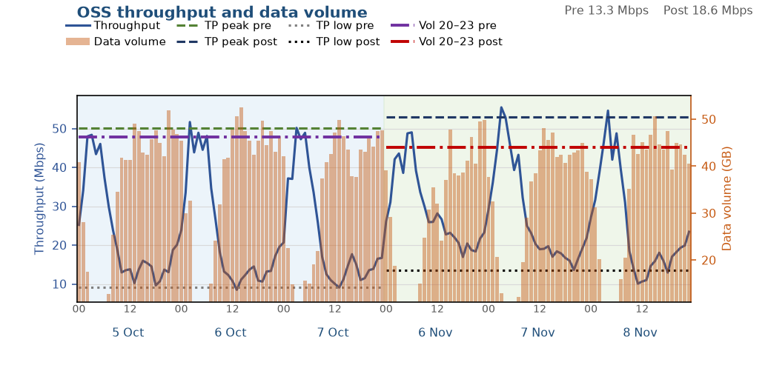
Solved: DHUTTM5
1 of 5 in this finding
Throughput improved, data volume held
Throughput improved significantly and data volume was held. The Tx ceiling did not meet the step-up test.
Busy-hour RxMaxSpeed p90 moved from 232 to 262 Mbit/s. That is below the Tx BW step-up test of 40 Mbit/s or 12%.
Data BusyHour 1H throughput 10.85 → 18.95 Mbps (+8.10 Mbps, +74.6%). Daytime 09:00–22:00 median 13.3 → 18.6 Mbps.
Data BusyHour 1H data volume 51.4 → 49.5 GB (-1.9 GB, -3.6%).
Choked on 5–7 Oct. Off the choke list on 6–8 Nov.
Pre 5–7 Oct · Post 6–8 Nov · Charts are hourly · Notes use Data BusyHour 1H
10 / 14

Slide 11

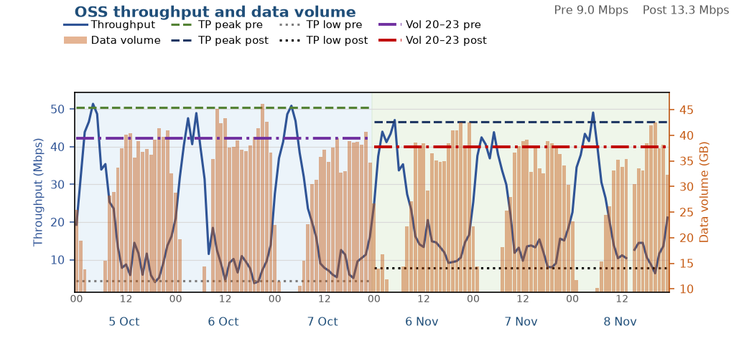
Solved: DHDHR38
2 of 5 in this finding
Throughput improved, data volume held
Throughput improved significantly and data volume was held. The Tx ceiling did not meet the step-up test.
Busy-hour RxMaxSpeed p90 moved from 178 to 201 Mbit/s. That is below the Tx BW step-up test of 40 Mbit/s or 12%.
Data BusyHour 1H throughput 7.18 → 9.22 Mbps (+2.04 Mbps, +28.4%). Daytime 09:00–22:00 median 9.0 → 13.3 Mbps.
Data BusyHour 1H data volume 42.7 → 41.4 GB (-1.3 GB, -3.2%).
Choked on 5–7 Oct. Off the choke list on 6–8 Nov.
Pre 5–7 Oct · Post 6–8 Nov · Charts are hourly · Notes use Data BusyHour 1H
11 / 14

Slide 12

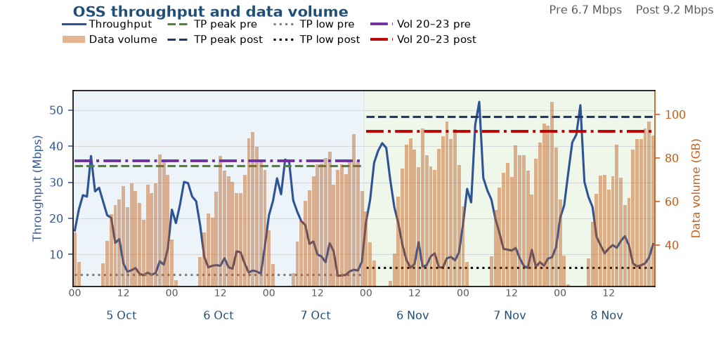
Solved: NGSNG78
3 of 5 in this finding
Both throughput and data volume improved
Throughput and data volume both improved. The Tx ceiling did not meet the step-up test.
Busy-hour RxMaxSpeed p90 moved from 348 to 357 Mbit/s. That is below the Tx BW step-up test of 40 Mbit/s or 12%.
Data BusyHour 1H throughput 6.22 → 9.13 Mbps (+2.91 Mbps, +46.9%). Daytime 09:00–22:00 median 6.7 → 9.2 Mbps.
Data BusyHour 1H data volume 88.1 → 99.8 GB (+11.7 GB, +13.3%).
Choked on 5–7 Oct. Off the choke list on 6–8 Nov.
Pre 5–7 Oct · Post 6–8 Nov · Charts are hourly · Notes use Data BusyHour 1H
12 / 14

Slide 13

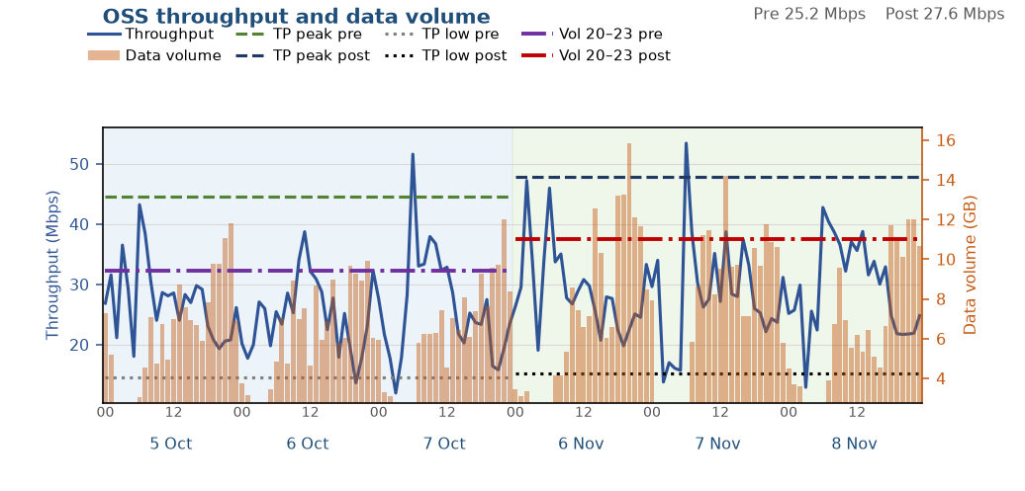
Solved: GPSRPM9
4 of 5 in this finding
Both throughput and data volume improved
Throughput and data volume both improved. The Tx ceiling did not meet the step-up test.
Busy-hour RxMaxSpeed p90 moved from 117 to 130 Mbit/s. That is below the Tx BW step-up test of 40 Mbit/s or 12%.
Data BusyHour 1H throughput 20.82 → 26.42 Mbps (+5.60 Mbps, +26.9%). Daytime 09:00–22:00 median 25.2 → 27.6 Mbps.
Data BusyHour 1H data volume 11.2 → 14.0 GB (+2.8 GB, +24.7%).
Choked on 5–7 Oct. Off the choke list on 6–8 Nov.
Pre 5–7 Oct · Post 6–8 Nov · Charts are hourly · Notes use Data BusyHour 1H
13 / 14

Slide 14

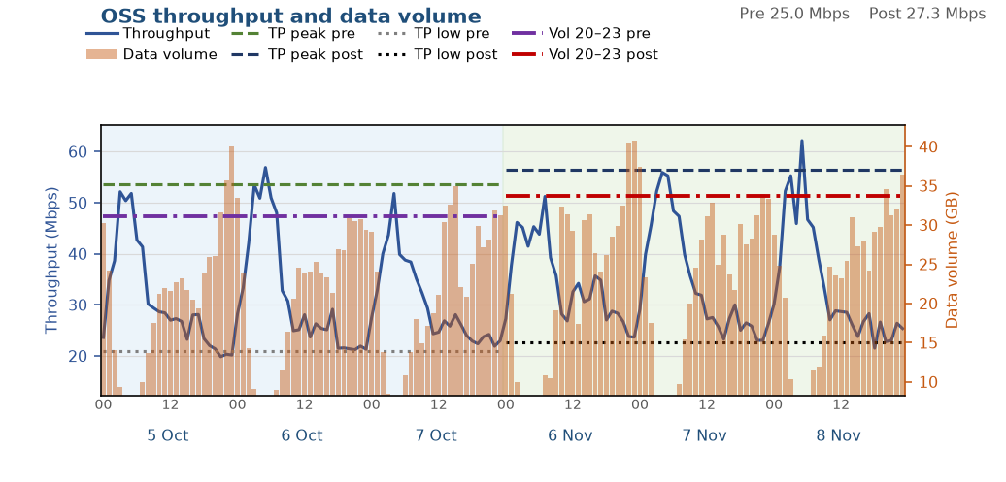
Solved: DHMDP02
5 of 5 in this finding
Small improvement, KPIs did not fall
A small throughput gain, and data volume did not fall. The Tx ceiling did not meet the step-up test.
Busy-hour RxMaxSpeed p90 moved from 198 to 229 Mbit/s. That is below the Tx BW step-up test of 40 Mbit/s or 12%.
Data BusyHour 1H throughput 24.62 → 25.86 Mbps (+1.25 Mbps, +5.1%). Daytime 09:00–22:00 median 25.0 → 27.3 Mbps.
Data BusyHour 1H data volume 36.2 → 38.2 GB (+2.1 GB, +5.7%).
Choked on 5–7 Oct. Off the choke list on 6–8 Nov.
Pre 5–7 Oct · Post 6–8 Nov · Charts are hourly · Notes use Data BusyHour 1H
14 / 14

