Slide 1
Management summary
Combined gain. Throughput -0.5 Mbps over 24h, -0.3 Mbps at 20–22. Data volume +1.3 GB over 24h, +1.2 GB at 20–22.
Choked again
The ceiling rose, and the port is flat again on the new ceiling.
Throughput, 24h avg -0.6 Mbps
Throughput, 20–22 -0.6 Mbps
Data volume, 24h avg +4.5 GB
Data volume, 20–22 +4.8 GB
Solved — Tx BW increased
The ceiling rose and the port is no longer choked.
Throughput, 24h avg -0.2 Mbps
Throughput, 20–22 +0.2 Mbps
Data volume, 24h avg +4.7 GB
Data volume, 20–22 +5.1 GB
Finding | Sites | Throughput improved | Data volume improved
Choked again | 26 | 11 of 26 | 22 of 26
Solved — Tx BW increased | 65 | 40 of 65 | 45 of 65
Solved | 303 | 147 of 303 | 148 of 303
Solved
Choked before, and clear now. The Rx step is under 40 Mbit/s or 12%.
Throughput, 24h avg -0.5 Mbps
Throughput, 20–22 -0.5 Mbps
Data volume, 24h avg +0.8 GB
Data volume, 20–22 +0.5 GB
Median change, 6–8 Nov versus 5–7 Oct. 24h avg uses every hour. 20–22 is the mean of those three hours.
1 / 50

Slide 2
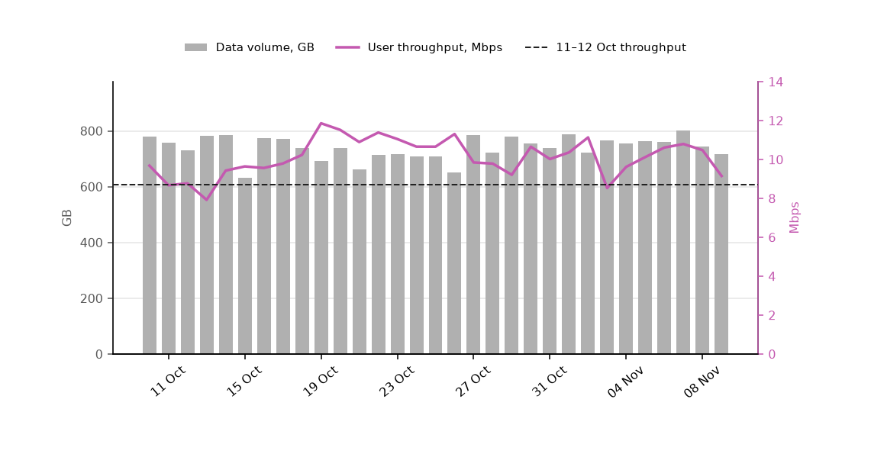
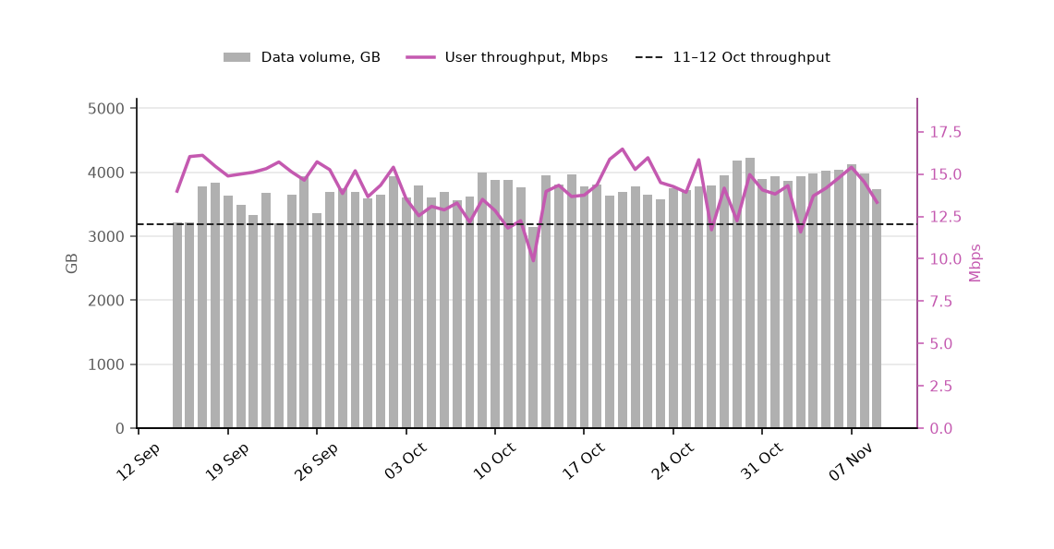
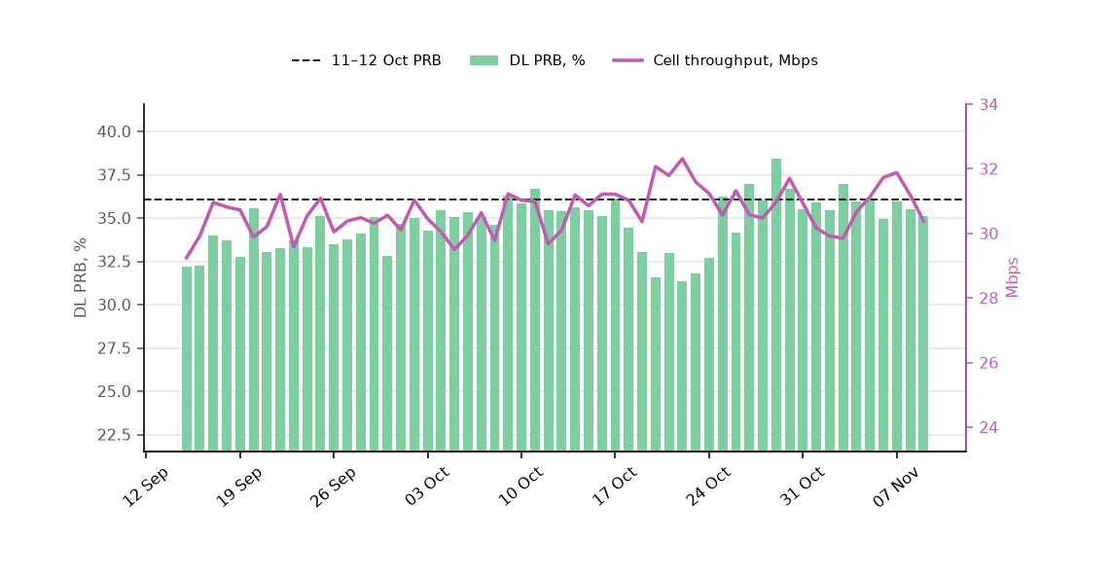
Choked again
BH Chart
Daily Chart
Daily
Choked again: 3 sites from the uploaded trend. Pre is the mean of 11–12 Oct. Post is the mean of 8–9 Nov.
Busy hour (hours 20, 21 and 22): user throughput 8.7 to 9.8 Mbps (+1.1, +12%). Data volume 743 to 731 GB (-12, -2%).
Daily: user throughput 12.0 to 13.9 Mbps (+1.9, +16%). Data volume 3,825 to 3,861 GB (+36, +1%).
Daily cell throughput 30.3 to 30.8 Mbps (+0.5, +1%). DL PRB 36.1% to 35.3% (-0.7 pp).
Dashed line is 11–12 Oct. BH sums hours 20, 21 and 22. Daily runs 15 Sep–9 Nov.
2 / 50

Slide 3
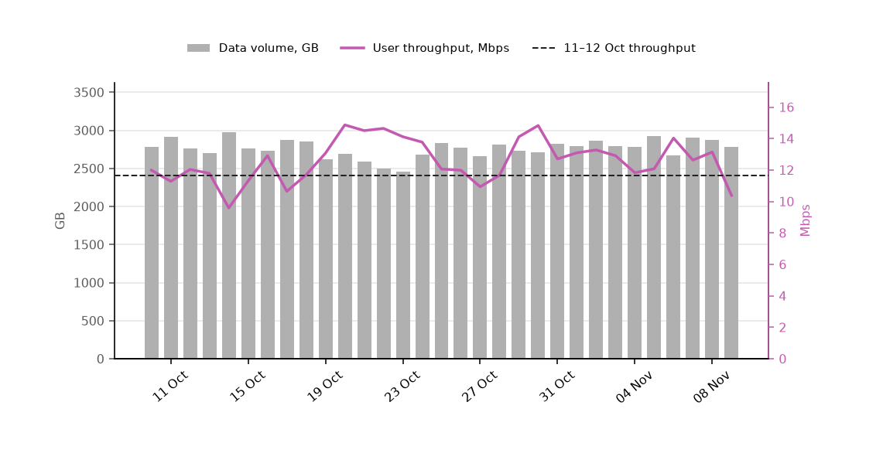
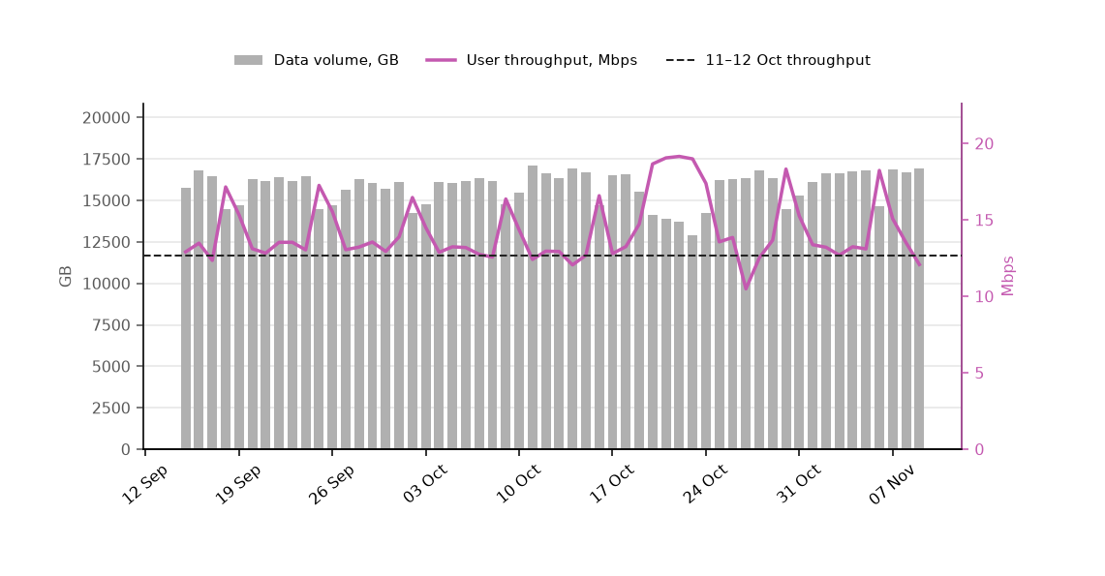
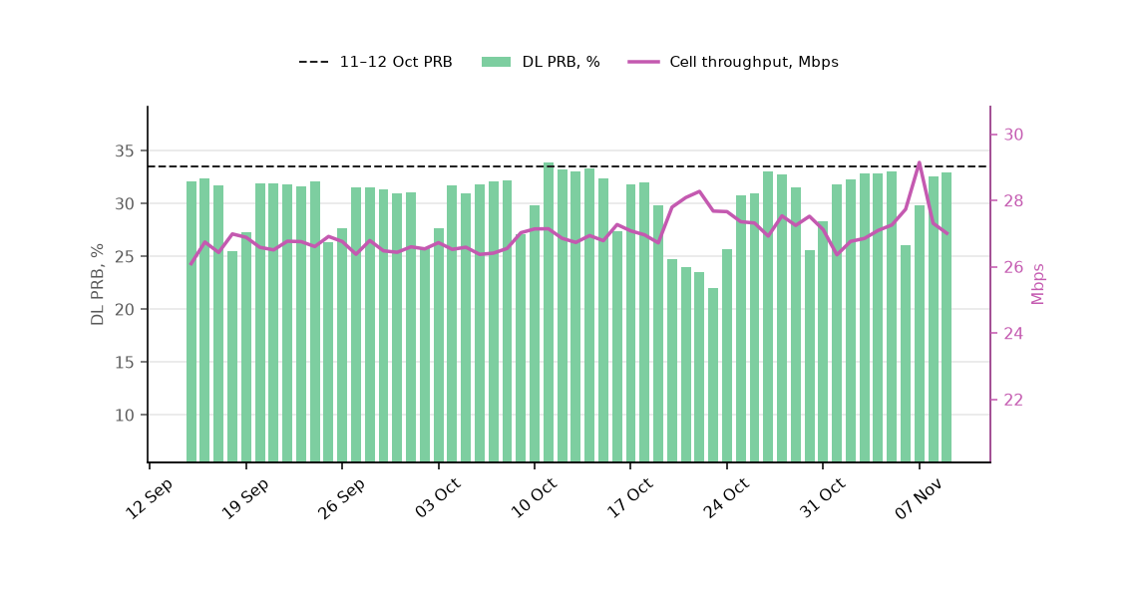
Solved — Tx BW increased
BH Chart
Daily Chart
Daily
Solved — Tx BW increased: 18 sites from the uploaded trend. Pre is the mean of 11–12 Oct. Post is the mean of 8–9 Nov.
Busy hour (hours 20, 21 and 22): user throughput 11.7 to 11.8 Mbps (+0.1, +1%). Data volume 2,840 to 2,827 GB (-13, -0%).
Daily: user throughput 12.7 to 12.8 Mbps (+0.1, +1%). Data volume 16,862 to 16,829 GB (-33, -0%).
Daily cell throughput 27.0 to 27.2 Mbps (+0.2, +1%). DL PRB 33.5% to 32.8% (-0.8 pp).
Dashed line is 11–12 Oct. BH sums hours 20, 21 and 22. Daily runs 15 Sep–9 Nov.
3 / 50

Slide 4
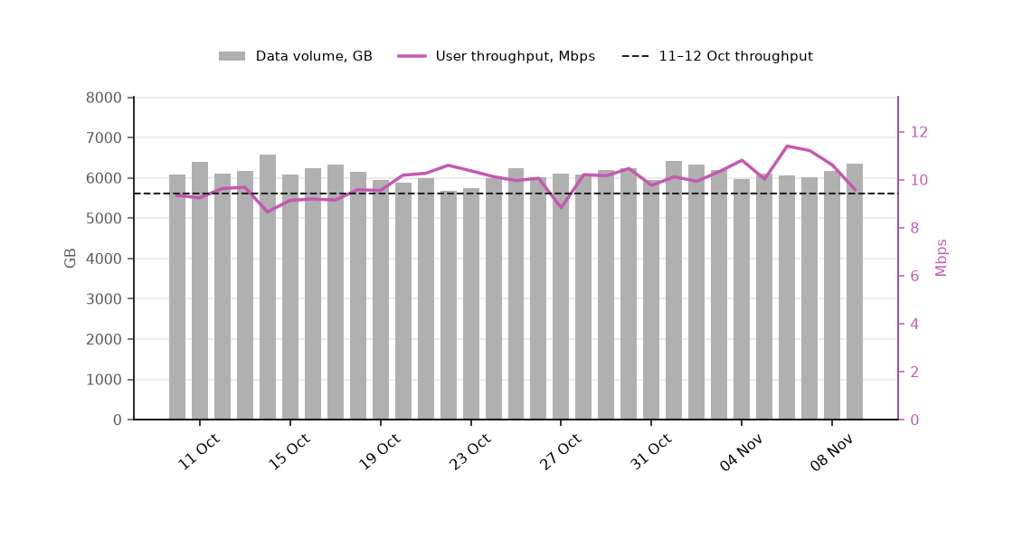
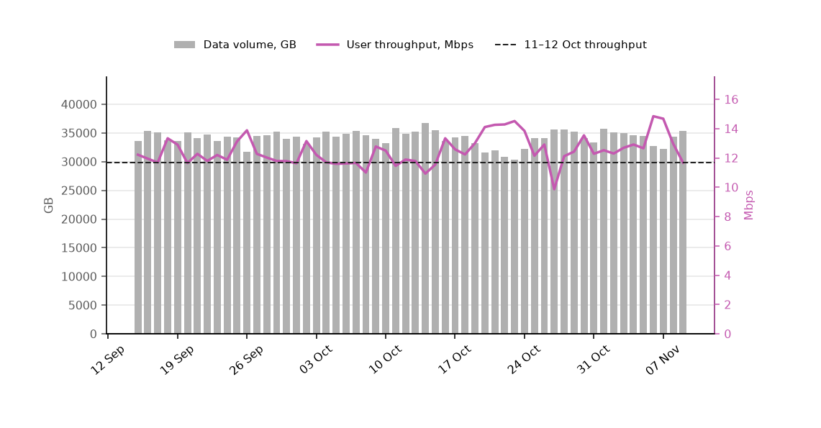
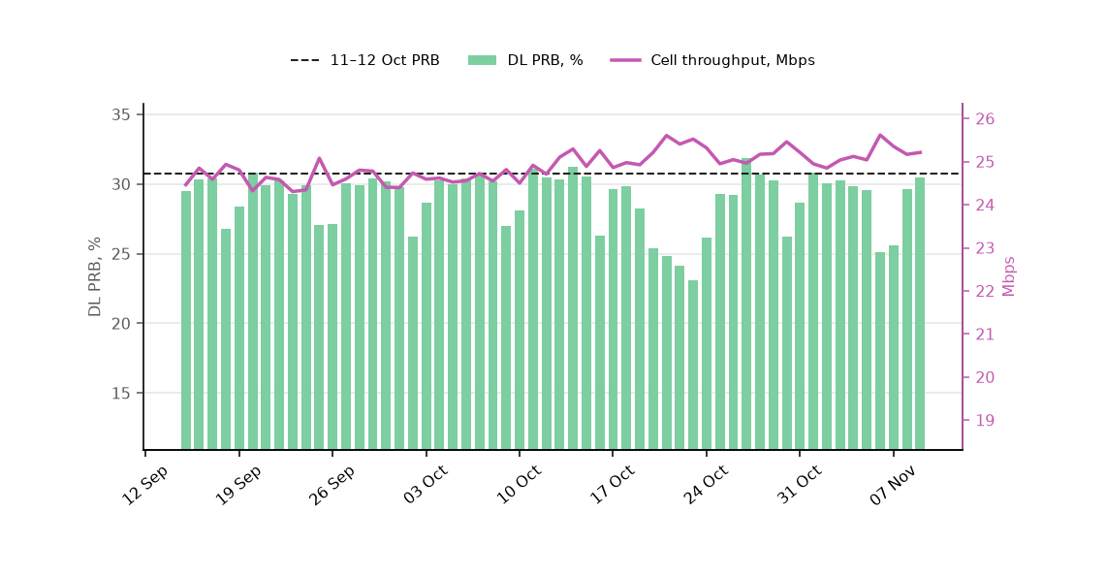
Solved
BH Chart
Daily Chart
Daily
Solved: 50 sites from the uploaded trend. Pre is the mean of 11–12 Oct. Post is the mean of 8–9 Nov.
Busy hour (hours 20, 21 and 22): user throughput 9.4 to 10.1 Mbps (+0.7, +7%). Data volume 6,246 to 6,258 GB (+12, +0%).
Daily: user throughput 11.7 to 12.3 Mbps (+0.6, +6%). Data volume 35,347 to 34,834 GB (-513, -1%).
Daily cell throughput 24.8 to 25.2 Mbps (+0.4, +2%). DL PRB 30.8% to 30.1% (-0.7 pp).
Dashed line is 11–12 Oct. BH sums hours 20, 21 and 22. Daily runs 15 Sep–9 Nov.
4 / 50

Slide 5


Choked again: DHBDD01
1 of 26 in this finding
Throughput improved, data volume held
After the Tx BW increase, throughput improved significantly. Data volume was held.
Tx ceiling rose from 262 to 318 Mbit/s (+56 Mbit/s, busy-hour RxMaxSpeed p90).
Data BusyHour 1H throughput 7.19 → 12.78 Mbps (+5.59 Mbps, +77.8%). Daytime 09:00–22:00 median 11.6 → 15.1 Mbps.
Data BusyHour 1H data volume 65.3 → 65.6 GB (+0.3 GB, +0.5%).
Still choked after the window, so the higher throughput is already on the new ceiling.
Pre 5–7 Oct · Post 6–8 Nov · Charts are hourly · Notes use Data BusyHour 1H
5 / 50

Slide 6


Choked again: DHRMN13
2 of 26 in this finding
Included with every choked-again site
After the Tx BW increase, throughput is higher and data volume did not fall.
Tx ceiling rose from 102 to 183 Mbit/s (+81 Mbit/s, busy-hour RxMaxSpeed p90).
Data BusyHour 1H throughput 23.46 → 23.45 Mbps (-0.01 Mbps, -0.0%). Daytime 09:00–22:00 median 29.4 → 31.2 Mbps.
Data BusyHour 1H data volume 30.5 → 33.7 GB (+3.2 GB, +10.6%).
Still choked after the window, so the higher throughput is already on the new ceiling.
Pre 5–7 Oct · Post 6–8 Nov · Charts are hourly · Notes use Data BusyHour 1H
6 / 50

Slide 7


Choked again: NGRPG51
3 of 26 in this finding
Included with every choked-again site
After the Tx BW increase, throughput is higher and data volume did not fall.
Tx ceiling rose from 440 to 532 Mbit/s (+92 Mbit/s, busy-hour RxMaxSpeed p90).
Data BusyHour 1H throughput 10.25 → 10.14 Mbps (-0.11 Mbps, -1.0%). Daytime 09:00–22:00 median 13.7 → 15.4 Mbps.
Data BusyHour 1H data volume 156.8 → 173.3 GB (+16.5 GB, +10.5%).
Still choked after the window, so the higher throughput is already on the new ceiling.
Pre 5–7 Oct · Post 6–8 Nov · Charts are hourly · Notes use Data BusyHour 1H
7 / 50

Slide 8


Choked again: TNSKP30
4 of 26 in this finding
Throughput improved, data volume held
After the Tx BW increase, the congested busy hour is faster and data volume was held. Throughput across the rest of the day is about level.
Tx ceiling rose from 390 to 500 Mbit/s (+110 Mbit/s, busy-hour RxMaxSpeed p90).
Data BusyHour 1H throughput 16.81 → 20.30 Mbps (+3.49 Mbps, +20.7%). Daytime 09:00–22:00 median 20.6 → 21.4 Mbps.
Data BusyHour 1H data volume 131.8 → 128.9 GB (-2.9 GB, -2.2%).
Still choked after the window, so the higher throughput is already on the new ceiling.
Pre 5–7 Oct · Post 6–8 Nov · Charts are hourly · Notes use Data BusyHour 1H
8 / 50

Slide 9


Choked again: DHSVRI8
5 of 26 in this finding
Both throughput and data volume improved
After the Tx BW increase, the congested busy hour is faster and data volume increased. Throughput across the rest of the day is about level.
Tx ceiling rose from 185 to 464 Mbit/s (+279 Mbit/s, busy-hour RxMaxSpeed p90).
Data BusyHour 1H throughput 9.42 → 11.39 Mbps (+1.97 Mbps, +20.9%). Daytime 09:00–22:00 median 17.7 → 17.8 Mbps.
Data BusyHour 1H data volume 87.6 → 140.3 GB (+52.7 GB, +60.2%).
Still choked after the window, so the higher throughput is already on the new ceiling.
Pre 5–7 Oct · Post 6–8 Nov · Charts are hourly · Notes use Data BusyHour 1H
9 / 50

Slide 10


Choked again: DHBDDA6
6 of 26 in this finding
Included with every choked-again site
After the Tx BW increase, throughput is higher and data volume did not fall.
Tx ceiling rose from 397 to 451 Mbit/s (+54 Mbit/s, busy-hour RxMaxSpeed p90).
Data BusyHour 1H throughput 10.12 → 9.80 Mbps (-0.31 Mbps, -3.1%). Daytime 09:00–22:00 median 21.6 → 21.4 Mbps.
Data BusyHour 1H data volume 136.8 → 145.6 GB (+8.9 GB, +6.5%).
Still choked after the window, so the higher throughput is already on the new ceiling.
Pre 5–7 Oct · Post 6–8 Nov · Charts are hourly · Notes use Data BusyHour 1H
10 / 50

Slide 11


Choked again: SGCHL05
7 of 26 in this finding
Included with every choked-again site
After the Tx BW increase, throughput is higher and data volume did not fall.
Tx ceiling rose from 346 to 397 Mbit/s (+52 Mbit/s, busy-hour RxMaxSpeed p90).
Data BusyHour 1H throughput 4.47 → 4.12 Mbps (-0.35 Mbps, -7.9%). Daytime 09:00–22:00 median 6.4 → 6.2 Mbps.
Data BusyHour 1H data volume 99.0 → 122.5 GB (+23.5 GB, +23.7%).
Still choked after the window, so the higher throughput is already on the new ceiling.
Pre 5–7 Oct · Post 6–8 Nov · Charts are hourly · Notes use Data BusyHour 1H
11 / 50

Slide 12


Choked again: DHTRG68
8 of 26 in this finding
Included with every choked-again site
After the Tx BW increase, throughput is higher and data volume did not fall.
Tx ceiling rose from 360 to 431 Mbit/s (+71 Mbit/s, busy-hour RxMaxSpeed p90).
Data BusyHour 1H throughput 5.91 → 4.20 Mbps (-1.71 Mbps, -29.0%). Daytime 09:00–22:00 median 9.5 → 9.2 Mbps.
Data BusyHour 1H data volume 123.3 → 152.6 GB (+29.3 GB, +23.7%).
Still choked after the window, so the higher throughput is already on the new ceiling.
Pre 5–7 Oct · Post 6–8 Nov · Charts are hourly · Notes use Data BusyHour 1H
12 / 50

Slide 13


Choked again: DHBDD58
9 of 26 in this finding
Included with every choked-again site
After the Tx BW increase, throughput is higher and data volume did not fall.
Tx ceiling rose from 206 to 385 Mbit/s (+178 Mbit/s, busy-hour RxMaxSpeed p90).
Data BusyHour 1H throughput 22.75 → 22.57 Mbps (-0.18 Mbps, -0.8%). Daytime 09:00–22:00 median 25.0 → 24.7 Mbps.
Data BusyHour 1H data volume 73.7 → 82.1 GB (+8.5 GB, +11.5%).
Still choked after the window, so the higher throughput is already on the new ceiling.
Pre 5–7 Oct · Post 6–8 Nov · Charts are hourly · Notes use Data BusyHour 1H
13 / 50

Slide 14


Choked again: DHKDM63
10 of 26 in this finding
Included with every choked-again site
After the Tx BW increase, throughput is higher and data volume did not fall.
Tx ceiling rose from 318 to 378 Mbit/s (+59 Mbit/s, busy-hour RxMaxSpeed p90).
Data BusyHour 1H throughput 17.07 → 17.23 Mbps (+0.16 Mbps, +0.9%). Daytime 09:00–22:00 median 24.2 → 23.8 Mbps.
Data BusyHour 1H data volume 123.8 → 130.1 GB (+6.3 GB, +5.1%).
Still choked after the window, so the higher throughput is already on the new ceiling.
Pre 5–7 Oct · Post 6–8 Nov · Charts are hourly · Notes use Data BusyHour 1H
14 / 50

Slide 15


Choked again: NGSNG30
11 of 26 in this finding
Included with every choked-again site
After the Tx BW increase, throughput is higher and data volume did not fall.
Tx ceiling rose from 398 to 465 Mbit/s (+67 Mbit/s, busy-hour RxMaxSpeed p90).
Data BusyHour 1H throughput 7.71 → 7.31 Mbps (-0.40 Mbps, -5.2%). Daytime 09:00–22:00 median 12.2 → 11.8 Mbps.
Data BusyHour 1H data volume 146.8 → 158.8 GB (+12.0 GB, +8.2%).
Still choked after the window, so the higher throughput is already on the new ceiling.
Pre 5–7 Oct · Post 6–8 Nov · Charts are hourly · Notes use Data BusyHour 1H
15 / 50

Slide 16


Choked again: NGSDRW9
12 of 26 in this finding
Included with every choked-again site
After the Tx BW increase, throughput is higher and data volume did not fall.
Tx ceiling rose from 155 to 225 Mbit/s (+70 Mbit/s, busy-hour RxMaxSpeed p90).
Data BusyHour 1H throughput 7.31 → 7.03 Mbps (-0.29 Mbps, -3.9%). Daytime 09:00–22:00 median 10.7 → 9.7 Mbps.
Data BusyHour 1H data volume 50.4 → 59.9 GB (+9.4 GB, +18.7%).
Still choked after the window, so the higher throughput is already on the new ceiling.
Pre 5–7 Oct · Post 6–8 Nov · Charts are hourly · Notes use Data BusyHour 1H
16 / 50

Slide 17


Choked again: DHNMK09
13 of 26 in this finding
Included with every choked-again site
After the Tx BW increase, throughput is higher and data volume did not fall.
Tx ceiling rose from 455 to 531 Mbit/s (+76 Mbit/s, busy-hour RxMaxSpeed p90).
Data BusyHour 1H throughput 8.28 → 7.67 Mbps (-0.61 Mbps, -7.3%). Daytime 09:00–22:00 median 12.3 → 11.2 Mbps.
Data BusyHour 1H data volume 127.7 → 143.2 GB (+15.5 GB, +12.1%).
Still choked after the window, so the higher throughput is already on the new ceiling.
Pre 5–7 Oct · Post 6–8 Nov · Charts are hourly · Notes use Data BusyHour 1H
17 / 50

Slide 18


Choked again: DHMRP20
14 of 26 in this finding
Included with every choked-again site
After the Tx BW increase, throughput is higher and data volume did not fall.
Tx ceiling rose from 360 to 410 Mbit/s (+50 Mbit/s, busy-hour RxMaxSpeed p90).
Data BusyHour 1H throughput 12.84 → 12.25 Mbps (-0.59 Mbps, -4.6%). Daytime 09:00–22:00 median 18.1 → 17.0 Mbps.
Data BusyHour 1H data volume 109.1 → 113.7 GB (+4.6 GB, +4.2%).
Still choked after the window, so the higher throughput is already on the new ceiling.
Pre 5–7 Oct · Post 6–8 Nov · Charts are hourly · Notes use Data BusyHour 1H
18 / 50

Slide 19


Choked again: DHBDDQ9
15 of 26 in this finding
Throughput improved, data volume held
After the Tx BW increase, the congested busy hour is faster and data volume was held. Throughput across the rest of the day is about level.
Tx ceiling rose from 155 to 225 Mbit/s (+69 Mbit/s, busy-hour RxMaxSpeed p90).
Data BusyHour 1H throughput 8.39 → 10.09 Mbps (+1.69 Mbps, +20.2%). Daytime 09:00–22:00 median 14.9 → 13.7 Mbps.
Data BusyHour 1H data volume 52.2 → 51.9 GB (-0.3 GB, -0.5%).
Still choked after the window, so the higher throughput is already on the new ceiling.
Pre 5–7 Oct · Post 6–8 Nov · Charts are hourly · Notes use Data BusyHour 1H
19 / 50

Slide 20


Choked again: DHKFR90
16 of 26 in this finding
Included with every choked-again site
After the Tx BW increase, throughput is higher and data volume did not fall.
Tx ceiling rose from 268 to 330 Mbit/s (+63 Mbit/s, busy-hour RxMaxSpeed p90).
Data BusyHour 1H throughput 4.94 → 4.24 Mbps (-0.71 Mbps, -14.3%). Daytime 09:00–22:00 median 8.9 → 7.5 Mbps.
Data BusyHour 1H data volume 109.7 → 109.7 GB (-0.0 GB, -0.0%).
Still choked after the window, so the higher throughput is already on the new ceiling.
Pre 5–7 Oct · Post 6–8 Nov · Charts are hourly · Notes use Data BusyHour 1H
20 / 50

Slide 21


Choked again: MGDLP09
17 of 26 in this finding
Included with every choked-again site
After the Tx BW increase, throughput is higher and data volume did not fall.
Tx ceiling rose from 256 to 385 Mbit/s (+129 Mbit/s, busy-hour RxMaxSpeed p90).
Data BusyHour 1H throughput 5.75 → 4.61 Mbps (-1.14 Mbps, -19.8%). Daytime 09:00–22:00 median 8.8 → 7.2 Mbps.
Data BusyHour 1H data volume 103.0 → 105.3 GB (+2.3 GB, +2.2%).
Still choked after the window, so the higher throughput is already on the new ceiling.
Pre 5–7 Oct · Post 6–8 Nov · Charts are hourly · Notes use Data BusyHour 1H
21 / 50

Slide 22


Choked again: DHMRP53
18 of 26 in this finding
Throughput improved, data volume held
After the Tx BW increase, the congested busy hour is faster and data volume was held. Throughput across the rest of the day is about level.
Tx ceiling rose from 163 to 223 Mbit/s (+60 Mbit/s, busy-hour RxMaxSpeed p90).
Data BusyHour 1H throughput 6.96 → 8.57 Mbps (+1.61 Mbps, +23.1%). Daytime 09:00–22:00 median 19.3 → 17.6 Mbps.
Data BusyHour 1H data volume 54.6 → 55.8 GB (+1.2 GB, +2.2%).
Still choked after the window, so the higher throughput is already on the new ceiling.
Pre 5–7 Oct · Post 6–8 Nov · Charts are hourly · Notes use Data BusyHour 1H
22 / 50

Slide 23


Choked again: DHKGNL0
19 of 26 in this finding
Small improvement, KPIs did not fall
After the Tx BW increase, throughput is higher and data volume did not fall.
Tx ceiling rose from 241 to 352 Mbit/s (+111 Mbit/s, busy-hour RxMaxSpeed p90).
Data BusyHour 1H throughput 8.59 → 9.06 Mbps (+0.47 Mbps, +5.5%). Daytime 09:00–22:00 median 16.4 → 14.3 Mbps.
Data BusyHour 1H data volume 94.1 → 94.5 GB (+0.4 GB, +0.4%).
Still choked after the window, so the higher throughput is already on the new ceiling.
Pre 5–7 Oct · Post 6–8 Nov · Charts are hourly · Notes use Data BusyHour 1H
23 / 50

Slide 24


Choked again: DHSVRX3
20 of 26 in this finding
Both throughput and data volume improved
After the Tx BW increase, the congested busy hour is faster and data volume increased. Throughput across the rest of the day is about level.
Tx ceiling rose from 246 to 463 Mbit/s (+218 Mbit/s, busy-hour RxMaxSpeed p90).
Data BusyHour 1H throughput 13.53 → 15.66 Mbps (+2.13 Mbps, +15.8%). Daytime 09:00–22:00 median 23.4 → 20.6 Mbps.
Data BusyHour 1H data volume 108.0 → 131.1 GB (+23.1 GB, +21.4%).
Still choked after the window, so the higher throughput is already on the new ceiling.
Pre 5–7 Oct · Post 6–8 Nov · Charts are hourly · Notes use Data BusyHour 1H
24 / 50

Slide 25


Choked again: DHMJH12
21 of 26 in this finding
Throughput improved, data volume held
After the Tx BW increase, the congested busy hour is faster and data volume was held. Throughput across the rest of the day is about level.
Tx ceiling rose from 145 to 207 Mbit/s (+62 Mbit/s, busy-hour RxMaxSpeed p90).
Data BusyHour 1H throughput 7.65 → 9.75 Mbps (+2.10 Mbps, +27.5%). Daytime 09:00–22:00 median 17.9 → 14.7 Mbps.
Data BusyHour 1H data volume 43.5 → 44.0 GB (+0.6 GB, +1.3%).
Still choked after the window, so the higher throughput is already on the new ceiling.
Pre 5–7 Oct · Post 6–8 Nov · Charts are hourly · Notes use Data BusyHour 1H
25 / 50

Slide 26


Choked again: DHTRG09
22 of 26 in this finding
Included with every choked-again site
After the Tx BW increase, throughput is higher and data volume did not fall.
Tx ceiling rose from 348 to 407 Mbit/s (+60 Mbit/s, busy-hour RxMaxSpeed p90).
Data BusyHour 1H throughput 9.79 → 9.60 Mbps (-0.19 Mbps, -2.0%). Daytime 09:00–22:00 median 21.6 → 17.9 Mbps.
Data BusyHour 1H data volume 133.1 → 148.3 GB (+15.3 GB, +11.5%).
Still choked after the window, so the higher throughput is already on the new ceiling.
Pre 5–7 Oct · Post 6–8 Nov · Charts are hourly · Notes use Data BusyHour 1H
26 / 50

Slide 27


Choked again: DHKGN23
23 of 26 in this finding
Throughput improved, data volume held
After the Tx BW increase, the congested busy hour is faster and data volume was held. Throughput across the rest of the day is about level.
Tx ceiling rose from 240 to 346 Mbit/s (+106 Mbit/s, busy-hour RxMaxSpeed p90).
Data BusyHour 1H throughput 13.76 → 16.48 Mbps (+2.72 Mbps, +19.8%). Daytime 09:00–22:00 median 24.8 → 21.1 Mbps.
Data BusyHour 1H data volume 76.6 → 78.8 GB (+2.2 GB, +2.9%).
Still choked after the window, so the higher throughput is already on the new ceiling.
Pre 5–7 Oct · Post 6–8 Nov · Charts are hourly · Notes use Data BusyHour 1H
27 / 50

Slide 28


Choked again: DHKHL08
24 of 26 in this finding
Included with every choked-again site
After the Tx BW increase, throughput is higher and data volume did not fall.
Tx ceiling rose from 203 to 263 Mbit/s (+59 Mbit/s, busy-hour RxMaxSpeed p90).
Data BusyHour 1H throughput 16.32 → 18.09 Mbps (+1.77 Mbps, +10.9%). Daytime 09:00–22:00 median 34.3 → 30.0 Mbps.
Data BusyHour 1H data volume 47.8 → 38.1 GB (-9.7 GB, -20.4%).
Still choked after the window, so the higher throughput is already on the new ceiling.
Pre 5–7 Oct · Post 6–8 Nov · Charts are hourly · Notes use Data BusyHour 1H
28 / 50

Slide 29


Choked again: NGSDR2D
25 of 26 in this finding
Included with every choked-again site
After the Tx BW increase, throughput is higher and data volume did not fall.
Tx ceiling rose from 198 to 246 Mbit/s (+48 Mbit/s, busy-hour RxMaxSpeed p90).
Data BusyHour 1H throughput 8.22 → 7.19 Mbps (-1.03 Mbps, -12.5%). Daytime 09:00–22:00 median 18.5 → 13.8 Mbps.
Data BusyHour 1H data volume 69.4 → 71.4 GB (+2.0 GB, +2.9%).
Still choked after the window, so the higher throughput is already on the new ceiling.
Pre 5–7 Oct · Post 6–8 Nov · Charts are hourly · Notes use Data BusyHour 1H
29 / 50

Slide 30


Choked again: NGBND84
26 of 26 in this finding
Included with every choked-again site
After the Tx BW increase, throughput is higher and data volume did not fall.
Tx ceiling rose from 324 to 373 Mbit/s (+48 Mbit/s, busy-hour RxMaxSpeed p90).
Data BusyHour 1H throughput 10.23 → 8.00 Mbps (-2.23 Mbps, -21.8%). Daytime 09:00–22:00 median 17.2 → 12.5 Mbps.
Data BusyHour 1H data volume 104.2 → 116.9 GB (+12.7 GB, +12.2%).
Still choked after the window, so the higher throughput is already on the new ceiling.
Pre 5–7 Oct · Post 6–8 Nov · Charts are hourly · Notes use Data BusyHour 1H
30 / 50

Slide 31


Solved — Tx BW increased: DHMJH73
1 of 10 in this finding
Daytime throughput improved
After the Tx BW increase, throughput is higher and data volume did not fall.
Tx ceiling rose from 205 to 281 Mbit/s (+76 Mbit/s, busy-hour RxMaxSpeed p90).
Data BusyHour 1H throughput 7.83 → 7.71 Mbps (-0.12 Mbps, -1.5%). Daytime 09:00–22:00 median 12.7 → 40.2 Mbps.
Data BusyHour 1H data volume 77.0 → 38.7 GB (-38.3 GB, -49.8%).
Choked on 5–7 Oct. Off the choke list on 6–8 Nov.
Pre 5–7 Oct · Post 6–8 Nov · Charts are hourly · Notes use Data BusyHour 1H
31 / 50

Slide 32


Solved — Tx BW increased: DHSBG87
2 of 10 in this finding
Daytime throughput improved
After the Tx BW increase, throughput is higher and data volume did not fall.
Tx ceiling rose from 233 to 275 Mbit/s (+42 Mbit/s, busy-hour RxMaxSpeed p90).
Data BusyHour 1H throughput 7.60 → 7.45 Mbps (-0.15 Mbps, -2.0%). Daytime 09:00–22:00 median 12.9 → 22.4 Mbps.
Data BusyHour 1H data volume 61.7 → 59.0 GB (-2.7 GB, -4.4%).
Choked on 5–7 Oct. Off the choke list on 6–8 Nov.
Pre 5–7 Oct · Post 6–8 Nov · Charts are hourly · Notes use Data BusyHour 1H
32 / 50

Slide 33


Solved — Tx BW increased: DHKTL20
3 of 10 in this finding
Daytime throughput improved
After the Tx BW increase, throughput is higher and data volume did not fall.
Tx ceiling rose from 99 to 175 Mbit/s (+76 Mbit/s, busy-hour RxMaxSpeed p90).
Data BusyHour 1H throughput 8.75 → 9.14 Mbps (+0.39 Mbps, +4.4%). Daytime 09:00–22:00 median 17.5 → 22.0 Mbps.
Data BusyHour 1H data volume 28.9 → 22.4 GB (-6.4 GB, -22.2%).
Choked on 5–7 Oct. Off the choke list on 6–8 Nov.
Pre 5–7 Oct · Post 6–8 Nov · Charts are hourly · Notes use Data BusyHour 1H
33 / 50

Slide 34


Solved — Tx BW increased: GPSDR38
4 of 10 in this finding
Throughput improved, data volume held
After the Tx BW increase, throughput improved significantly. Data volume was held.
Tx ceiling rose from 356 to 470 Mbit/s (+114 Mbit/s, busy-hour RxMaxSpeed p90).
Data BusyHour 1H throughput 12.34 → 14.03 Mbps (+1.69 Mbps, +13.7%). Daytime 09:00–22:00 median 16.1 → 20.5 Mbps.
Data BusyHour 1H data volume 118.4 → 126.0 GB (+7.7 GB, +6.5%).
Choked on 5–7 Oct. Off the choke list on 6–8 Nov.
Pre 5–7 Oct · Post 6–8 Nov · Charts are hourly · Notes use Data BusyHour 1H
34 / 50

Slide 35


Solved — Tx BW increased: MGSDR34
5 of 10 in this finding
Daytime throughput improved
After the Tx BW increase, throughput is higher and data volume did not fall.
Tx ceiling rose from 207 to 249 Mbit/s (+42 Mbit/s, busy-hour RxMaxSpeed p90).
Data BusyHour 1H throughput 8.07 → 20.52 Mbps (+12.45 Mbps, +154.4%). Daytime 09:00–22:00 median 14.6 → 18.2 Mbps.
Data BusyHour 1H data volume 71.3 → 65.4 GB (-5.9 GB, -8.2%).
Choked on 5–7 Oct. Off the choke list on 6–8 Nov.
Pre 5–7 Oct · Post 6–8 Nov · Charts are hourly · Notes use Data BusyHour 1H
35 / 50

Slide 36


Solved — Tx BW increased: DHRMN30
6 of 10 in this finding
Throughput improved, data volume held
After the Tx BW increase, throughput improved significantly. Data volume was held.
Tx ceiling rose from 162 to 240 Mbit/s (+78 Mbit/s, busy-hour RxMaxSpeed p90).
Data BusyHour 1H throughput 3.59 → 4.95 Mbps (+1.36 Mbps, +37.9%). Daytime 09:00–22:00 median 5.8 → 8.9 Mbps.
Data BusyHour 1H data volume 56.0 → 61.5 GB (+5.4 GB, +9.7%).
Choked on 5–7 Oct. Off the choke list on 6–8 Nov.
Pre 5–7 Oct · Post 6–8 Nov · Charts are hourly · Notes use Data BusyHour 1H
36 / 50

Slide 37


Solved — Tx BW increased: GPSDRJ9
7 of 10 in this finding
Throughput improved, data volume held
After the Tx BW increase, throughput improved significantly. Data volume was held.
Tx ceiling rose from 496 to 564 Mbit/s (+67 Mbit/s, busy-hour RxMaxSpeed p90).
Data BusyHour 1H throughput 10.31 → 12.15 Mbps (+1.84 Mbps, +17.9%). Daytime 09:00–22:00 median 17.9 → 20.8 Mbps.
Data BusyHour 1H data volume 94.5 → 92.0 GB (-2.5 GB, -2.7%).
Choked on 5–7 Oct. Off the choke list on 6–8 Nov.
Pre 5–7 Oct · Post 6–8 Nov · Charts are hourly · Notes use Data BusyHour 1H
37 / 50

Slide 38


Solved — Tx BW increased: DHCNT55
8 of 10 in this finding
Daytime throughput improved
After the Tx BW increase, throughput is higher and data volume did not fall.
Tx ceiling rose from 152 to 203 Mbit/s (+51 Mbit/s, busy-hour RxMaxSpeed p90).
Data BusyHour 1H throughput 12.90 → 14.81 Mbps (+1.91 Mbps, +14.8%). Daytime 09:00–22:00 median 15.4 → 18.3 Mbps.
Data BusyHour 1H data volume 28.5 → 22.1 GB (-6.4 GB, -22.6%).
Choked on 5–7 Oct. Off the choke list on 6–8 Nov.
Pre 5–7 Oct · Post 6–8 Nov · Charts are hourly · Notes use Data BusyHour 1H
38 / 50

Slide 39


Solved — Tx BW increased: GPSRP91
9 of 10 in this finding
Throughput improved, data volume held
After the Tx BW increase, throughput improved significantly. Data volume was held.
Tx ceiling rose from 226 to 381 Mbit/s (+155 Mbit/s, busy-hour RxMaxSpeed p90).
Data BusyHour 1H throughput 12.84 → 15.65 Mbps (+2.81 Mbps, +21.9%). Daytime 09:00–22:00 median 16.2 → 19.1 Mbps.
Data BusyHour 1H data volume 81.4 → 78.5 GB (-2.9 GB, -3.5%).
Choked on 5–7 Oct. Off the choke list on 6–8 Nov.
Pre 5–7 Oct · Post 6–8 Nov · Charts are hourly · Notes use Data BusyHour 1H
39 / 50

Slide 40


Solved — Tx BW increased: NGSDRW3
10 of 10 in this finding
Small improvement, KPIs did not fall
After the Tx BW increase, throughput is higher and data volume did not fall.
Tx ceiling rose from 245 to 329 Mbit/s (+84 Mbit/s, busy-hour RxMaxSpeed p90).
Data BusyHour 1H throughput 15.30 → 16.27 Mbps (+0.97 Mbps, +6.3%). Daytime 09:00–22:00 median 18.2 → 21.1 Mbps.
Data BusyHour 1H data volume 74.4 → 77.8 GB (+3.4 GB, +4.6%).
Choked on 5–7 Oct. Off the choke list on 6–8 Nov.
Pre 5–7 Oct · Post 6–8 Nov · Charts are hourly · Notes use Data BusyHour 1H
40 / 50

Slide 41


Solved: DHSVR3W
1 of 10 in this finding
Daytime throughput improved
Daytime throughput improved. The Tx ceiling did not meet the step-up test.
Busy-hour RxMaxSpeed p90 moved from 207 to 232 Mbit/s. That is below the Tx BW step-up test of 40 Mbit/s or 12%.
Data BusyHour 1H throughput 4.32 → 8.98 Mbps (+4.65 Mbps, +107.6%). Daytime 09:00–22:00 median 13.8 → 36.7 Mbps.
Data BusyHour 1H data volume 59.2 → 23.1 GB (-36.0 GB, -60.9%).
Choked on 5–7 Oct. Off the choke list on 6–8 Nov.
Pre 5–7 Oct · Post 6–8 Nov · Charts are hourly · Notes use Data BusyHour 1H
41 / 50

Slide 42


Solved: DHMJH25
2 of 10 in this finding
Daytime throughput improved
Daytime throughput improved. The Tx ceiling did not meet the step-up test.
Busy-hour RxMaxSpeed p90 moved from 104 to 104 Mbit/s. That is below the Tx BW step-up test of 40 Mbit/s or 12%.
Data BusyHour 1H throughput 14.17 → 18.35 Mbps (+4.19 Mbps, +29.5%). Daytime 09:00–22:00 median 19.9 → 40.8 Mbps.
Data BusyHour 1H data volume 13.4 → 8.2 GB (-5.2 GB, -38.7%).
Choked on 5–7 Oct. Off the choke list on 6–8 Nov.
Pre 5–7 Oct · Post 6–8 Nov · Charts are hourly · Notes use Data BusyHour 1H
42 / 50

Slide 43


Solved: DHMJHD1
3 of 10 in this finding
Daytime throughput improved
Daytime throughput improved. The Tx ceiling did not meet the step-up test.
Busy-hour RxMaxSpeed p90 moved from 94 to 95 Mbit/s. That is below the Tx BW step-up test of 40 Mbit/s or 12%.
Data BusyHour 1H throughput 24.01 → 24.44 Mbps (+0.43 Mbps, +1.8%). Daytime 09:00–22:00 median 28.4 → 44.5 Mbps.
Data BusyHour 1H data volume 19.8 → 11.4 GB (-8.4 GB, -42.6%).
Choked on 5–7 Oct. Off the choke list on 6–8 Nov.
Pre 5–7 Oct · Post 6–8 Nov · Charts are hourly · Notes use Data BusyHour 1H
43 / 50

Slide 44


Solved: DHMJH23
4 of 10 in this finding
Daytime throughput improved
Daytime throughput improved. The Tx ceiling did not meet the step-up test.
Busy-hour RxMaxSpeed p90 moved from 118 to 117 Mbit/s. That is below the Tx BW step-up test of 40 Mbit/s or 12%.
Data BusyHour 1H throughput 17.47 → 20.49 Mbps (+3.03 Mbps, +17.3%). Daytime 09:00–22:00 median 21.9 → 37.6 Mbps.
Data BusyHour 1H data volume 15.7 → 6.7 GB (-9.0 GB, -57.4%).
Choked on 5–7 Oct. Off the choke list on 6–8 Nov.
Pre 5–7 Oct · Post 6–8 Nov · Charts are hourly · Notes use Data BusyHour 1H
44 / 50

Slide 45


Solved: DHCKB76
5 of 10 in this finding
Daytime throughput improved
Daytime throughput improved. The Tx ceiling did not meet the step-up test.
Busy-hour RxMaxSpeed p90 moved from 71 to 108 Mbit/s. That is below the Tx BW step-up test of 40 Mbit/s or 12%.
Data BusyHour 1H throughput 16.73 → 42.24 Mbps (+25.52 Mbps, +152.6%). Daytime 09:00–22:00 median 22.9 → 37.7 Mbps.
Data BusyHour 1H data volume 10.5 → 3.6 GB (-7.0 GB, -66.1%).
Choked on 5–7 Oct. Off the choke list on 6–8 Nov.
Pre 5–7 Oct · Post 6–8 Nov · Charts are hourly · Notes use Data BusyHour 1H
45 / 50

Slide 46


Solved: DHPTN51
6 of 10 in this finding
Daytime throughput improved
Daytime throughput improved. The Tx ceiling did not meet the step-up test.
Busy-hour RxMaxSpeed p90 moved from 97 to 85 Mbit/s. That is below the Tx BW step-up test of 40 Mbit/s or 12%.
Data BusyHour 1H throughput 33.17 → 32.21 Mbps (-0.97 Mbps, -2.9%). Daytime 09:00–22:00 median 38.1 → 51.0 Mbps.
Data BusyHour 1H data volume 6.1 → 3.8 GB (-2.3 GB, -37.7%).
Choked on 5–7 Oct. Off the choke list on 6–8 Nov.
Pre 5–7 Oct · Post 6–8 Nov · Charts are hourly · Notes use Data BusyHour 1H
46 / 50

Slide 47


Solved: DHBNS69
7 of 10 in this finding
Both throughput and data volume improved
Throughput and data volume both improved. The Tx ceiling did not meet the step-up test.
Busy-hour RxMaxSpeed p90 moved from 153 to 170 Mbit/s. That is below the Tx BW step-up test of 40 Mbit/s or 12%.
Data BusyHour 1H throughput 10.72 → 14.74 Mbps (+4.02 Mbps, +37.5%). Daytime 09:00–22:00 median 6.9 → 17.7 Mbps.
Data BusyHour 1H data volume 32.0 → 36.0 GB (+4.0 GB, +12.5%).
Choked on 5–7 Oct. Off the choke list on 6–8 Nov.
Pre 5–7 Oct · Post 6–8 Nov · Charts are hourly · Notes use Data BusyHour 1H
47 / 50

Slide 48


Solved: DHMJH63
8 of 10 in this finding
Daytime throughput improved
Daytime throughput improved. The Tx ceiling did not meet the step-up test.
Busy-hour RxMaxSpeed p90 moved from 77 to 78 Mbit/s. That is below the Tx BW step-up test of 40 Mbit/s or 12%.
Data BusyHour 1H throughput 12.56 → 16.61 Mbps (+4.04 Mbps, +32.2%). Daytime 09:00–22:00 median 16.5 → 27.2 Mbps.
Data BusyHour 1H data volume 7.3 → 5.9 GB (-1.5 GB, -20.2%).
Choked on 5–7 Oct. Off the choke list on 6–8 Nov.
Pre 5–7 Oct · Post 6–8 Nov · Charts are hourly · Notes use Data BusyHour 1H
48 / 50

Slide 49


Solved: DHGUL87
9 of 10 in this finding
Daytime throughput improved
Daytime throughput improved. The Tx ceiling did not meet the step-up test.
Busy-hour RxMaxSpeed p90 moved from 128 to 133 Mbit/s. That is below the Tx BW step-up test of 40 Mbit/s or 12%.
Data BusyHour 1H throughput 37.00 → 40.28 Mbps (+3.28 Mbps, +8.9%). Daytime 09:00–22:00 median 38.7 → 46.6 Mbps.
Data BusyHour 1H data volume 14.9 → 13.0 GB (-2.0 GB, -13.1%).
Choked on 5–7 Oct. Off the choke list on 6–8 Nov.
Pre 5–7 Oct · Post 6–8 Nov · Charts are hourly · Notes use Data BusyHour 1H
49 / 50

Slide 50


Solved: DHUTT55
10 of 10 in this finding
Daytime throughput improved
Daytime throughput improved. The Tx ceiling did not meet the step-up test.
Busy-hour RxMaxSpeed p90 moved from 221 to 242 Mbit/s. That is below the Tx BW step-up test of 40 Mbit/s or 12%.
Data BusyHour 1H throughput 21.82 → 30.49 Mbps (+8.67 Mbps, +39.8%). Daytime 09:00–22:00 median 25.1 → 32.8 Mbps.
Data BusyHour 1H data volume 28.1 → 19.2 GB (-8.9 GB, -31.6%).
Choked on 5–7 Oct. Off the choke list on 6–8 Nov.
Pre 5–7 Oct · Post 6–8 Nov · Charts are hourly · Notes use Data BusyHour 1H
50 / 50

