Slide 1
Management summary
Pre 5–7 Oct versus post 6–8 Nov. Where the Tx ceiling stepped up, throughput is higher. Data volume rising or holding is an acceptable result. Each following page is one site.
Solved — Tx BW increased · 4 sites
Choked on 5–7 Oct, the Tx ceiling stepped up, and the port is off the choke list on 6–8 Nov. Both rose at DHNMK02 (+18% throughput, +61% volume). Throughput rose and volume held at GPSDR38 and DHRMN30. NGSDRW3 is a smaller gain (+6% throughput) and volume did not fall.
Tx BW increased · 5 sites
The Tx ceiling stepped up. The port was not choked in either window. Both rose at TNMDP56 (+28% throughput, +19% volume) and DHDHN69 (+16% throughput, +12% volume). Throughput rose and volume held at DHMRP03 and DHSBG58. DHGULO6 is a smaller gain (+6% throughput) and volume did not fall.
Choked again · 3 sites
The Tx ceiling stepped up and the port is still choked, so the gain is already on the new ceiling. Both rose at DHSVRI8 (+21% throughput, +60% volume). Throughput rose and volume held at DHBDD01 and TNSKP30.
Tx BW increased — choked on latest · 3 sites
The Tx ceiling stepped up and the port is newly choked on 6–8 Nov. Both rose at TNMZP92 (+194% throughput, +278% volume) and NGRPGF4 (+19% throughput, +34% volume). Throughput rose and volume held at MNTGB03.
Solved · 5 sites
Off the choke list without a ceiling step-up, so this gain is not from a Tx BW increase. Both rose at NGSNG78 (+47% throughput, +13% volume) and GPSRPM9 (+27% throughput, +25% volume). Throughput rose and volume held at DHUTTM5 and DHDHR38. DHMDP02 is a smaller gain (+5% throughput) and volume did not fall.
Data BusyHour 1H · Throughput up at least 1 Mbps and 10% is a significant gain
1 / 21

Slide 2

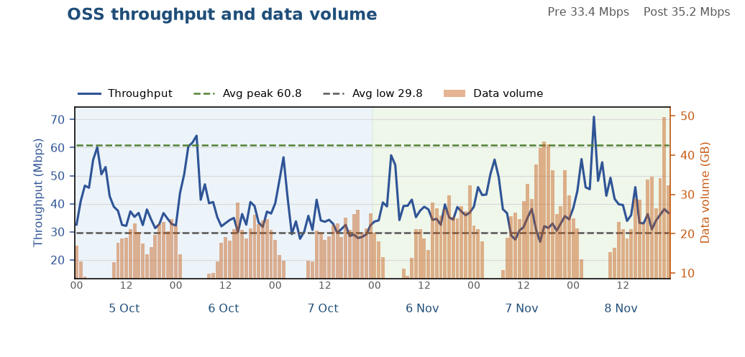
Solved — Tx BW increased: DHNMK02
1 of 4 in this finding
Both throughput and data volume improved
After the Tx BW increase, the congested busy hour is faster and data volume increased. Throughput across the rest of the day is about level.
Tx ceiling rose from 200 to 297 Mbit/s (+97 Mbit/s, busy-hour RxMaxSpeed p90).
Data BusyHour 1H throughput 30.02 → 35.56 Mbps (+5.54 Mbps, +18.5%). Daytime 09:00–22:00 median 33.4 → 35.2 Mbps.
Data BusyHour 1H data volume 26.0 → 41.9 GB (+15.9 GB, +61.3%).
Choked on 5–7 Oct. Off the choke list on 6–8 Nov.
Pre 5–7 Oct · Post 6–8 Nov · Charts are hourly · Notes use Data BusyHour 1H
2 / 21

Slide 3

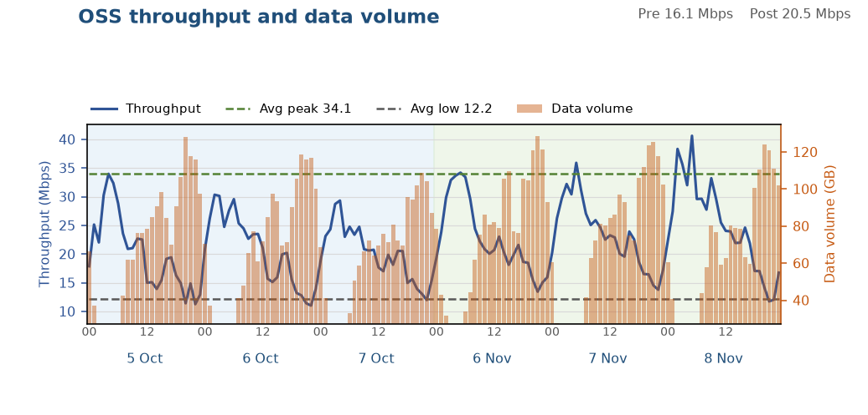
Solved — Tx BW increased: GPSDR38
2 of 4 in this finding
Throughput improved, data volume held
After the Tx BW increase, throughput improved significantly. Data volume was held.
Tx ceiling rose from 356 to 470 Mbit/s (+114 Mbit/s, busy-hour RxMaxSpeed p90).
Data BusyHour 1H throughput 12.34 → 14.03 Mbps (+1.69 Mbps, +13.7%). Daytime 09:00–22:00 median 16.1 → 20.5 Mbps.
Data BusyHour 1H data volume 118.4 → 126.0 GB (+7.7 GB, +6.5%).
Choked on 5–7 Oct. Off the choke list on 6–8 Nov.
Pre 5–7 Oct · Post 6–8 Nov · Charts are hourly · Notes use Data BusyHour 1H
3 / 21

Slide 4

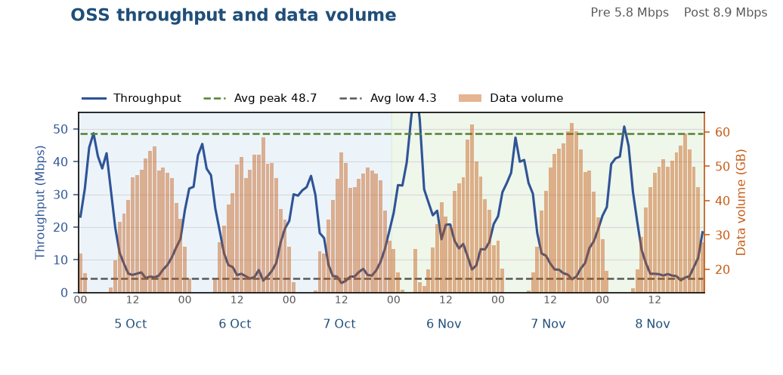
Solved — Tx BW increased: DHRMN30
3 of 4 in this finding
Throughput improved, data volume held
After the Tx BW increase, throughput improved significantly. Data volume was held.
Tx ceiling rose from 162 to 240 Mbit/s (+78 Mbit/s, busy-hour RxMaxSpeed p90).
Data BusyHour 1H throughput 3.59 → 4.95 Mbps (+1.36 Mbps, +37.9%). Daytime 09:00–22:00 median 5.8 → 8.9 Mbps.
Data BusyHour 1H data volume 56.0 → 61.5 GB (+5.4 GB, +9.7%).
Choked on 5–7 Oct. Off the choke list on 6–8 Nov.
Pre 5–7 Oct · Post 6–8 Nov · Charts are hourly · Notes use Data BusyHour 1H
4 / 21

Slide 5

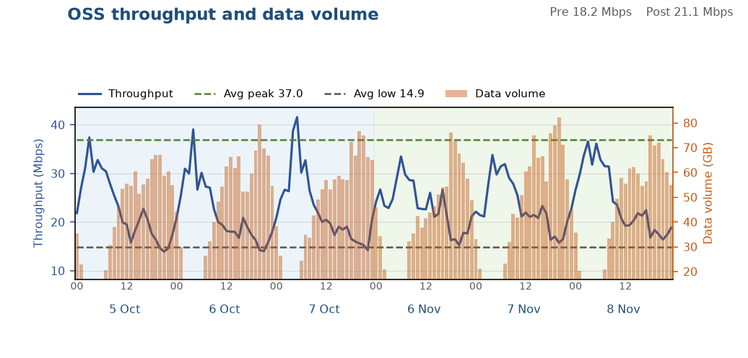
Solved — Tx BW increased: NGSDRW3
4 of 4 in this finding
Small improvement, KPIs did not fall
After the Tx BW increase, throughput is higher and data volume did not fall.
Tx ceiling rose from 245 to 329 Mbit/s (+84 Mbit/s, busy-hour RxMaxSpeed p90).
Data BusyHour 1H throughput 15.30 → 16.27 Mbps (+0.97 Mbps, +6.3%). Daytime 09:00–22:00 median 18.2 → 21.1 Mbps.
Data BusyHour 1H data volume 74.4 → 77.8 GB (+3.4 GB, +4.6%).
Choked on 5–7 Oct. Off the choke list on 6–8 Nov.
Pre 5–7 Oct · Post 6–8 Nov · Charts are hourly · Notes use Data BusyHour 1H
5 / 21

Slide 6

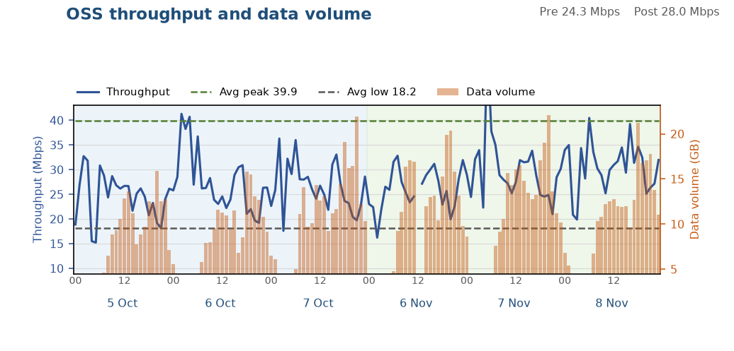
Tx BW increased: TNMDP56
1 of 5 in this finding
Both throughput and data volume improved
After the Tx BW increase, throughput improved significantly and data volume increased with it.
Tx ceiling rose from 157 to 198 Mbit/s (+42 Mbit/s, busy-hour RxMaxSpeed p90).
Data BusyHour 1H throughput 19.95 → 25.48 Mbps (+5.53 Mbps, +27.7%). Daytime 09:00–22:00 median 24.3 → 28.0 Mbps.
Data BusyHour 1H data volume 17.9 → 21.2 GB (+3.3 GB, +18.6%).
Not on the choke list in either window.
Pre 5–7 Oct · Post 6–8 Nov · Charts are hourly · Notes use Data BusyHour 1H
6 / 21

Slide 7

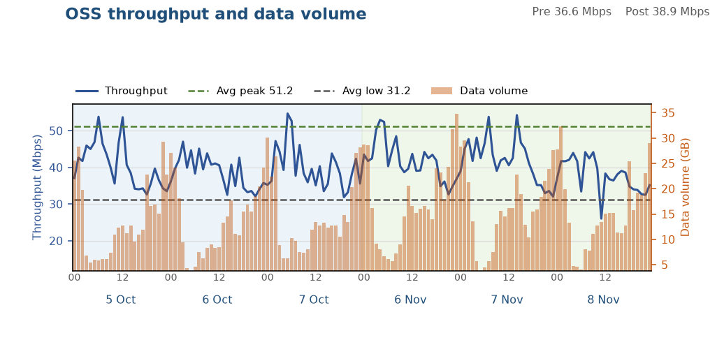
Tx BW increased: DHDHN69
2 of 5 in this finding
Both throughput and data volume improved
After the Tx BW increase, the congested busy hour is faster and data volume increased. Throughput across the rest of the day is about level.
Tx ceiling rose from 405 to 507 Mbit/s (+102 Mbit/s, busy-hour RxMaxSpeed p90).
Data BusyHour 1H throughput 35.25 → 40.79 Mbps (+5.54 Mbps, +15.7%). Daytime 09:00–22:00 median 36.6 → 38.9 Mbps.
Data BusyHour 1H data volume 28.8 → 32.3 GB (+3.4 GB, +11.9%).
Not on the choke list in either window.
Pre 5–7 Oct · Post 6–8 Nov · Charts are hourly · Notes use Data BusyHour 1H
7 / 21

Slide 8

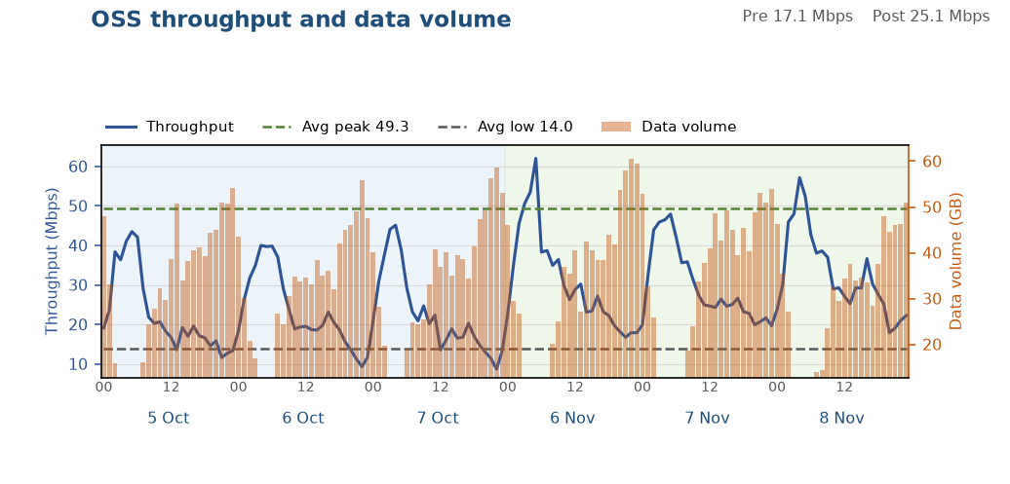
Tx BW increased: DHMRP03
3 of 5 in this finding
Throughput improved, data volume held
After the Tx BW increase, throughput improved significantly. Data volume was held.
Tx ceiling rose from 233 to 292 Mbit/s (+59 Mbit/s, busy-hour RxMaxSpeed p90).
Data BusyHour 1H throughput 10.07 → 19.69 Mbps (+9.62 Mbps, +95.5%). Daytime 09:00–22:00 median 17.1 → 25.1 Mbps.
Data BusyHour 1H data volume 56.2 → 55.1 GB (-1.1 GB, -2.0%).
Not on the choke list in either window.
Pre 5–7 Oct · Post 6–8 Nov · Charts are hourly · Notes use Data BusyHour 1H
8 / 21

Slide 9

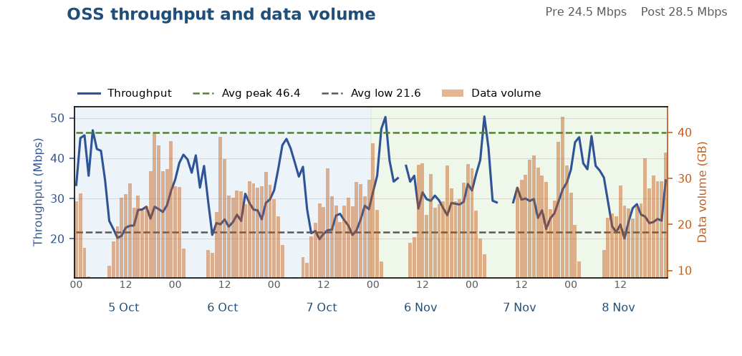
Tx BW increased: DHSBG58
4 of 5 in this finding
Throughput improved, data volume held
After the Tx BW increase, throughput improved significantly. Data volume was held.
Tx ceiling rose from 507 to 572 Mbit/s (+64 Mbit/s, busy-hour RxMaxSpeed p90).
Data BusyHour 1H throughput 24.34 → 32.69 Mbps (+8.34 Mbps, +34.3%). Daytime 09:00–22:00 median 24.5 → 28.5 Mbps.
Data BusyHour 1H data volume 37.1 → 38.8 GB (+1.8 GB, +4.8%).
Not on the choke list in either window.
Pre 5–7 Oct · Post 6–8 Nov · Charts are hourly · Notes use Data BusyHour 1H
9 / 21

Slide 10

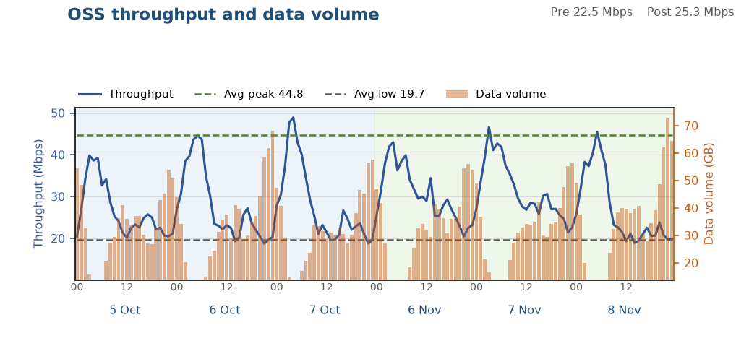
Tx BW increased: DHGULO6
5 of 5 in this finding
Small improvement, KPIs did not fall
After the Tx BW increase, throughput is higher and data volume did not fall.
Tx ceiling rose from 446 to 501 Mbit/s (+54 Mbit/s, busy-hour RxMaxSpeed p90).
Data BusyHour 1H throughput 20.16 → 21.34 Mbps (+1.18 Mbps, +5.8%). Daytime 09:00–22:00 median 22.5 → 25.3 Mbps.
Data BusyHour 1H data volume 60.0 → 61.8 GB (+1.7 GB, +2.9%).
Not on the choke list in either window.
Pre 5–7 Oct · Post 6–8 Nov · Charts are hourly · Notes use Data BusyHour 1H
10 / 21

Slide 11

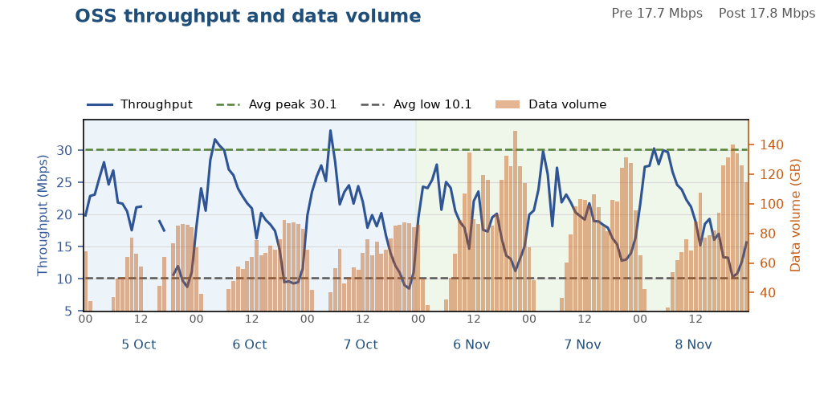
Choked again: DHSVRI8
1 of 3 in this finding
Both throughput and data volume improved
After the Tx BW increase, the congested busy hour is faster and data volume increased. Throughput across the rest of the day is about level.
Tx ceiling rose from 185 to 464 Mbit/s (+279 Mbit/s, busy-hour RxMaxSpeed p90).
Data BusyHour 1H throughput 9.42 → 11.39 Mbps (+1.97 Mbps, +20.9%). Daytime 09:00–22:00 median 17.7 → 17.8 Mbps.
Data BusyHour 1H data volume 87.6 → 140.3 GB (+52.7 GB, +60.2%).
Still choked after the window, so the higher throughput is already on the new ceiling.
Pre 5–7 Oct · Post 6–8 Nov · Charts are hourly · Notes use Data BusyHour 1H
11 / 21

Slide 12

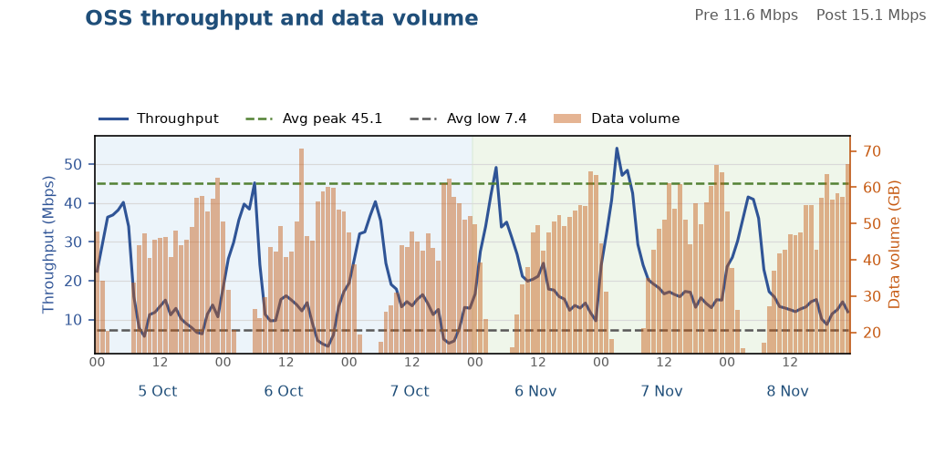
Choked again: DHBDD01
2 of 3 in this finding
Throughput improved, data volume held
After the Tx BW increase, throughput improved significantly. Data volume was held.
Tx ceiling rose from 262 to 318 Mbit/s (+56 Mbit/s, busy-hour RxMaxSpeed p90).
Data BusyHour 1H throughput 7.19 → 12.78 Mbps (+5.59 Mbps, +77.8%). Daytime 09:00–22:00 median 11.6 → 15.1 Mbps.
Data BusyHour 1H data volume 65.3 → 65.6 GB (+0.3 GB, +0.5%).
Still choked after the window, so the higher throughput is already on the new ceiling.
Pre 5–7 Oct · Post 6–8 Nov · Charts are hourly · Notes use Data BusyHour 1H
12 / 21

Slide 13

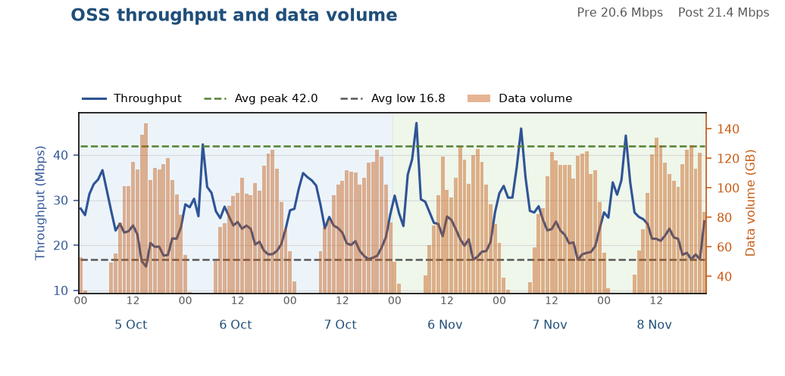
Choked again: TNSKP30
3 of 3 in this finding
Throughput improved, data volume held
After the Tx BW increase, the congested busy hour is faster and data volume was held. Throughput across the rest of the day is about level.
Tx ceiling rose from 390 to 500 Mbit/s (+110 Mbit/s, busy-hour RxMaxSpeed p90).
Data BusyHour 1H throughput 16.81 → 20.30 Mbps (+3.49 Mbps, +20.7%). Daytime 09:00–22:00 median 20.6 → 21.4 Mbps.
Data BusyHour 1H data volume 131.8 → 128.9 GB (-2.9 GB, -2.2%).
Still choked after the window, so the higher throughput is already on the new ceiling.
Pre 5–7 Oct · Post 6–8 Nov · Charts are hourly · Notes use Data BusyHour 1H
13 / 21

Slide 14

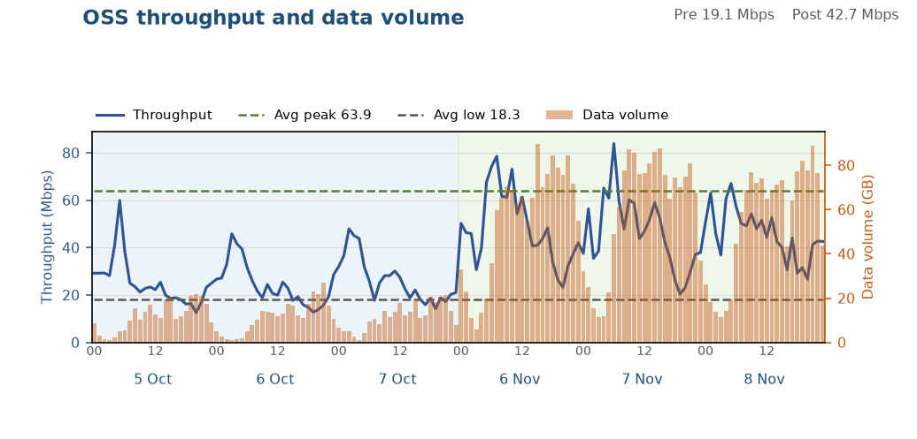
Tx BW increased — choked on latest: TNMZP92
1 of 3 in this finding
Both throughput and data volume improved
After the Tx BW increase, throughput improved significantly and data volume increased with it.
Tx ceiling rose from 194 to 272 Mbit/s (+78 Mbit/s, busy-hour RxMaxSpeed p90).
Data BusyHour 1H throughput 15.03 → 44.21 Mbps (+29.18 Mbps, +194.1%). Daytime 09:00–22:00 median 19.1 → 42.7 Mbps.
Data BusyHour 1H data volume 23.5 → 88.7 GB (+65.2 GB, +277.8%).
Not choked on 5–7 Oct. Choked on 6–8 Nov.
Pre 5–7 Oct · Post 6–8 Nov · Charts are hourly · Notes use Data BusyHour 1H
14 / 21

Slide 15

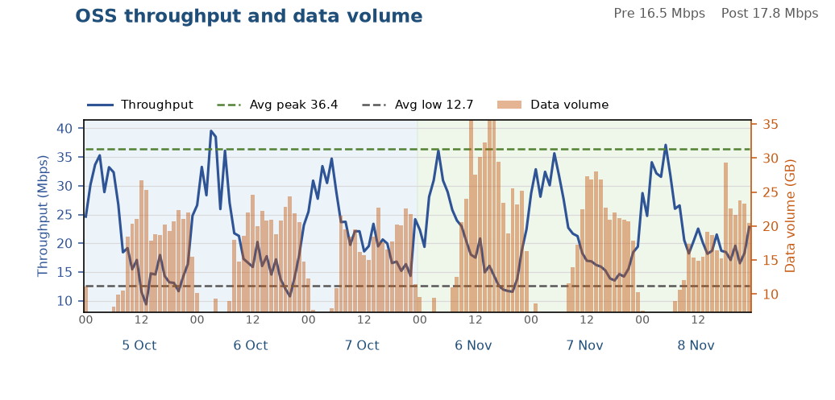
Tx BW increased — choked on latest: NGRPGF4
2 of 3 in this finding
Both throughput and data volume improved
After the Tx BW increase, the congested busy hour is faster and data volume increased. Throughput across the rest of the day is about level.
Tx ceiling rose from 173 to 215 Mbit/s (+42 Mbit/s, busy-hour RxMaxSpeed p90).
Data BusyHour 1H throughput 14.79 → 17.59 Mbps (+2.80 Mbps, +18.9%). Daytime 09:00–22:00 median 16.5 → 17.8 Mbps.
Data BusyHour 1H data volume 24.7 → 33.0 GB (+8.3 GB, +33.8%).
Not choked on 5–7 Oct. Choked on 6–8 Nov.
Pre 5–7 Oct · Post 6–8 Nov · Charts are hourly · Notes use Data BusyHour 1H
15 / 21

Slide 16

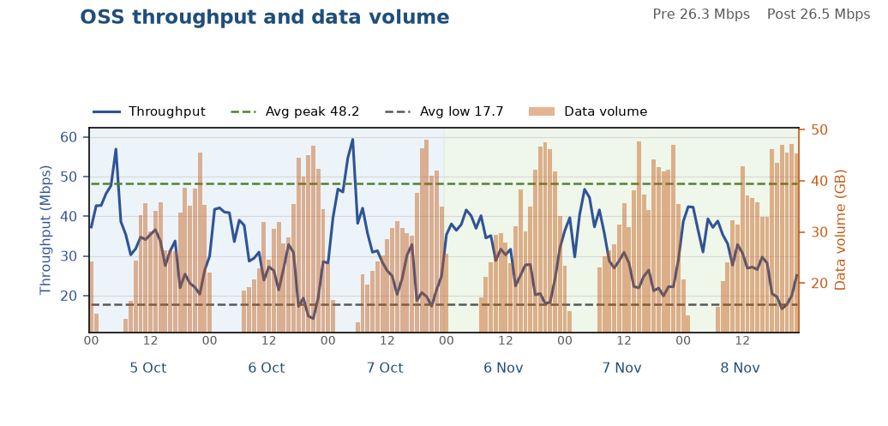
Tx BW increased — choked on latest: MNTGB03
3 of 3 in this finding
Throughput improved, data volume held
After the Tx BW increase, the congested busy hour is faster and data volume was held. Throughput across the rest of the day is about level.
Tx ceiling rose from 257 to 312 Mbit/s (+55 Mbit/s, busy-hour RxMaxSpeed p90).
Data BusyHour 1H throughput 17.60 → 19.89 Mbps (+2.29 Mbps, +13.0%). Daytime 09:00–22:00 median 26.3 → 26.5 Mbps.
Data BusyHour 1H data volume 46.8 → 47.4 GB (+0.6 GB, +1.3%).
Not choked on 5–7 Oct. Choked on 6–8 Nov.
Pre 5–7 Oct · Post 6–8 Nov · Charts are hourly · Notes use Data BusyHour 1H
16 / 21

Slide 17

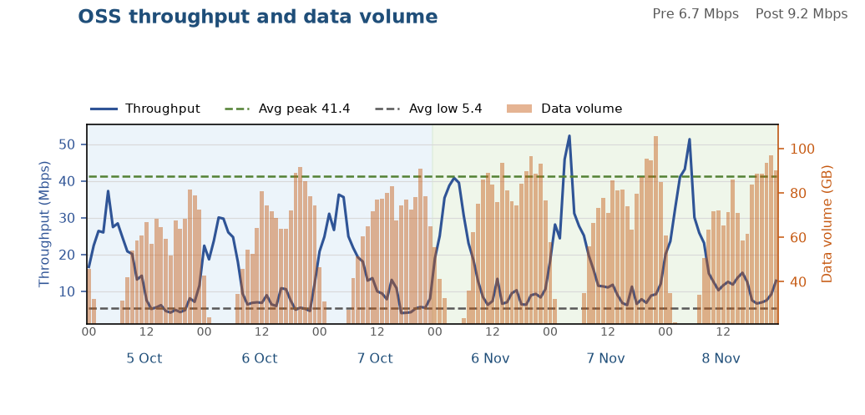
Solved: NGSNG78
1 of 5 in this finding
Both throughput and data volume improved
Throughput and data volume both improved. The Tx ceiling did not meet the step-up test.
Busy-hour RxMaxSpeed p90 moved from 348 to 357 Mbit/s. That is below the Tx BW step-up test of 40 Mbit/s or 12%.
Data BusyHour 1H throughput 6.22 → 9.13 Mbps (+2.91 Mbps, +46.9%). Daytime 09:00–22:00 median 6.7 → 9.2 Mbps.
Data BusyHour 1H data volume 88.1 → 99.8 GB (+11.7 GB, +13.3%).
Choked on 5–7 Oct. Off the choke list on 6–8 Nov.
Pre 5–7 Oct · Post 6–8 Nov · Charts are hourly · Notes use Data BusyHour 1H
17 / 21

Slide 18

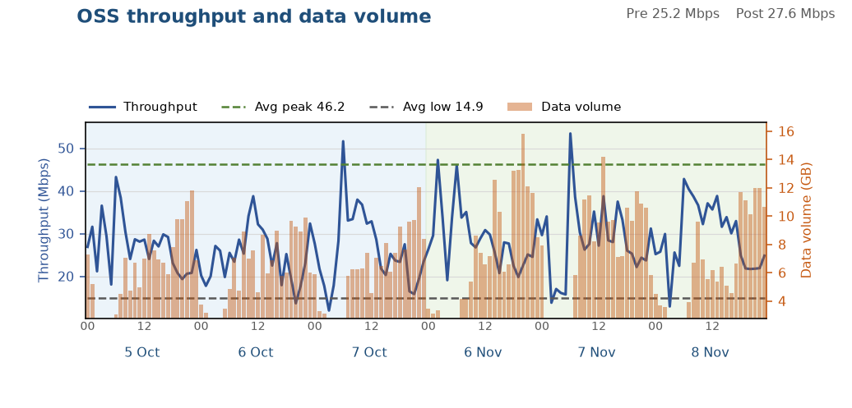
Solved: GPSRPM9
2 of 5 in this finding
Both throughput and data volume improved
Throughput and data volume both improved. The Tx ceiling did not meet the step-up test.
Busy-hour RxMaxSpeed p90 moved from 117 to 130 Mbit/s. That is below the Tx BW step-up test of 40 Mbit/s or 12%.
Data BusyHour 1H throughput 20.82 → 26.42 Mbps (+5.60 Mbps, +26.9%). Daytime 09:00–22:00 median 25.2 → 27.6 Mbps.
Data BusyHour 1H data volume 11.2 → 14.0 GB (+2.8 GB, +24.7%).
Choked on 5–7 Oct. Off the choke list on 6–8 Nov.
Pre 5–7 Oct · Post 6–8 Nov · Charts are hourly · Notes use Data BusyHour 1H
18 / 21

Slide 19

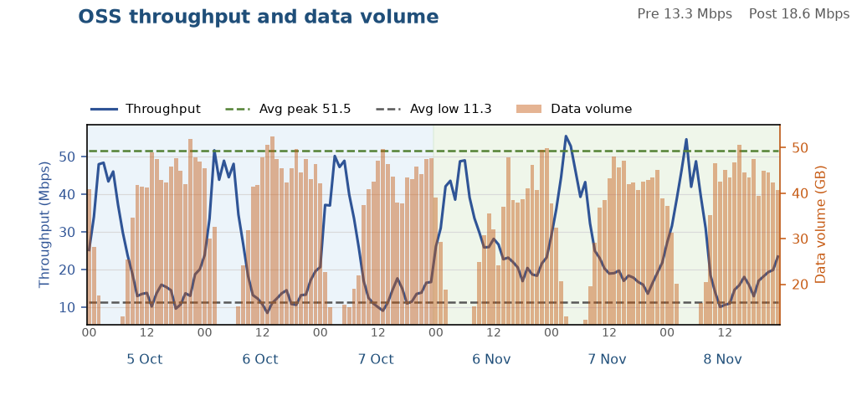
Solved: DHUTTM5
3 of 5 in this finding
Throughput improved, data volume held
Throughput improved significantly and data volume was held. The Tx ceiling did not meet the step-up test.
Busy-hour RxMaxSpeed p90 moved from 232 to 262 Mbit/s. That is below the Tx BW step-up test of 40 Mbit/s or 12%.
Data BusyHour 1H throughput 10.85 → 18.95 Mbps (+8.10 Mbps, +74.6%). Daytime 09:00–22:00 median 13.3 → 18.6 Mbps.
Data BusyHour 1H data volume 51.4 → 49.5 GB (-1.9 GB, -3.6%).
Choked on 5–7 Oct. Off the choke list on 6–8 Nov.
Pre 5–7 Oct · Post 6–8 Nov · Charts are hourly · Notes use Data BusyHour 1H
19 / 21

Slide 20

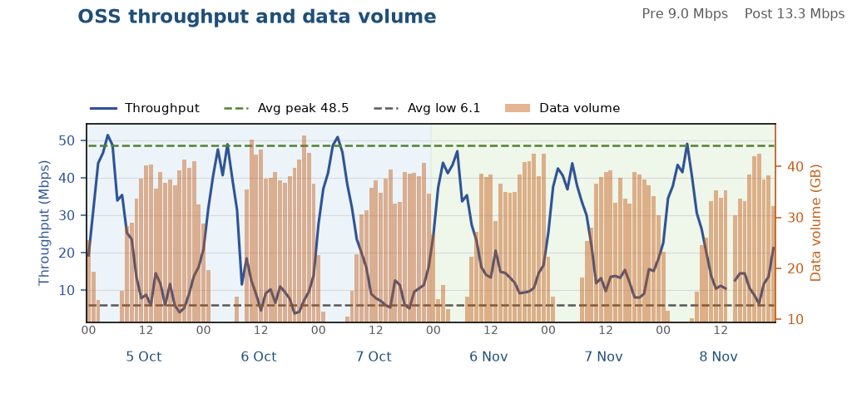
Solved: DHDHR38
4 of 5 in this finding
Throughput improved, data volume held
Throughput improved significantly and data volume was held. The Tx ceiling did not meet the step-up test.
Busy-hour RxMaxSpeed p90 moved from 178 to 201 Mbit/s. That is below the Tx BW step-up test of 40 Mbit/s or 12%.
Data BusyHour 1H throughput 7.18 → 9.22 Mbps (+2.04 Mbps, +28.4%). Daytime 09:00–22:00 median 9.0 → 13.3 Mbps.
Data BusyHour 1H data volume 42.7 → 41.4 GB (-1.3 GB, -3.2%).
Choked on 5–7 Oct. Off the choke list on 6–8 Nov.
Pre 5–7 Oct · Post 6–8 Nov · Charts are hourly · Notes use Data BusyHour 1H
20 / 21

Slide 21

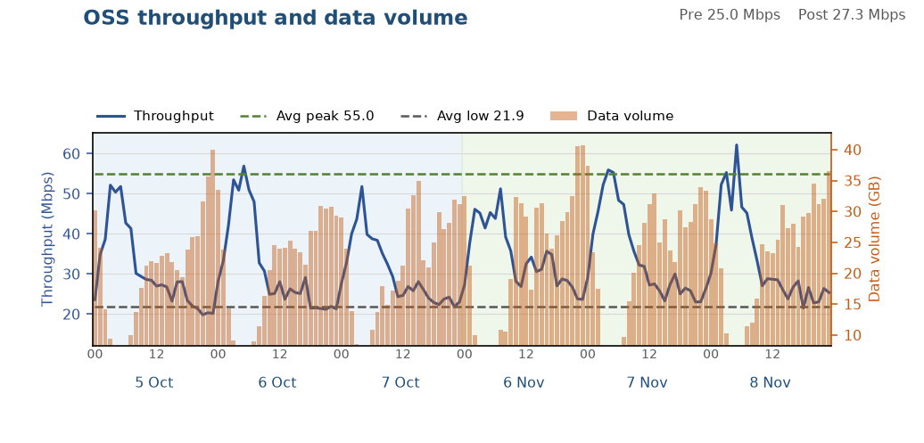
Solved: DHMDP02
5 of 5 in this finding
Small improvement, KPIs did not fall
A small throughput gain, and data volume did not fall. The Tx ceiling did not meet the step-up test.
Busy-hour RxMaxSpeed p90 moved from 198 to 229 Mbit/s. That is below the Tx BW step-up test of 40 Mbit/s or 12%.
Data BusyHour 1H throughput 24.62 → 25.86 Mbps (+1.25 Mbps, +5.1%). Daytime 09:00–22:00 median 25.0 → 27.3 Mbps.
Data BusyHour 1H data volume 36.2 → 38.2 GB (+2.1 GB, +5.7%).
Choked on 5–7 Oct. Off the choke list on 6–8 Nov.
Pre 5–7 Oct · Post 6–8 Nov · Charts are hourly · Notes use Data BusyHour 1H
21 / 21

