Slide 1
Management summary
Pre 5–7 Oct versus post 6–8 Nov. Tx BW increased means Tx total BW stepped up. Sites run from the largest daytime throughput step.
# | Finding | Sites — largest daytime gain first
1 | Solved — Tx BW increased Tx total BW stepped up. Off the choke list. 2 sites | GPSRP91 16.2 → 19.1 Mbps (+2.9) Tx BW 250→500 NGSDRW3 18.2 → 21.1 Mbps (+2.9) Tx BW 250→500
2 | Tx BW increased Tx total BW stepped up. Not choked in either window. 1 site | DHRMN65 31.1 → 30.8 Mbps (-0.3) Tx BW 250→500
3 | Solved Off the choke list. Tx total BW did not increase. 5 sites | DHUTTM5 13.3 → 18.6 Mbps (+5.3) Tx BW 250→250 GPSDR38 16.1 → 20.5 Mbps (+4.4) Tx BW 250→250 NGSNG78 6.7 → 9.2 Mbps (+2.5) Tx BW 250→250 GPSRPM9 25.2 → 27.6 Mbps (+2.4) Tx BW 250→250 DHSHA19 25.2 → 27.5 Mbps (+2.3) Tx BW 250→250
Daytime throughput is the 09:00–22:00 median. Tx BW increased is a step in VS.FEGE.TxTotalBW, not in RxMaxSpeed.
1 / 9

Slide 2
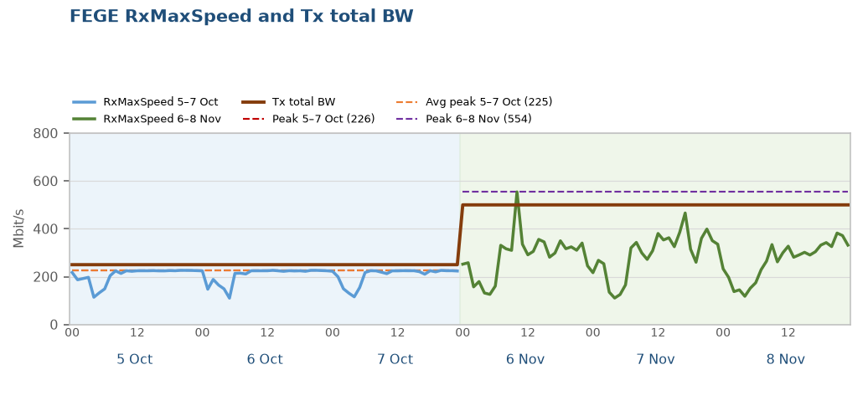
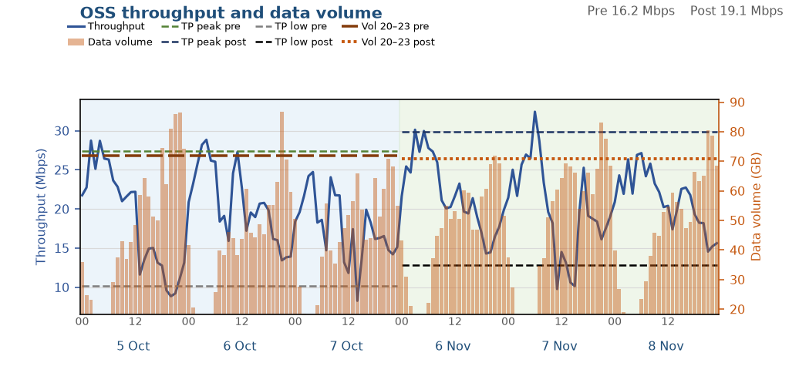
Solved — Tx BW increased: GPSRP91
1 of 2 in this finding
Throughput improved, data volume held
After the Tx BW increase, throughput improved significantly. Data volume was held.
Tx total BW rose from 250 to 500 Mbit/s (+250 Mbit/s, VS.FEGE.TxTotalBW). Busy-hour RxMaxSpeed p90 226 → 381 Mbit/s.
Data BusyHour 1H throughput 12.84 → 15.65 Mbps (+2.81 Mbps, +21.9%). Daytime 09:00–22:00 median 16.2 → 19.1 Mbps.
Data BusyHour 1H data volume 81.4 → 78.5 GB (-2.9 GB, -3.5%).
Choked on 5–7 Oct. Off the choke list on 6–8 Nov.
Pre 5–7 Oct · Post 6–8 Nov · Charts are hourly · Notes use Data BusyHour 1H
2 / 9

Slide 3
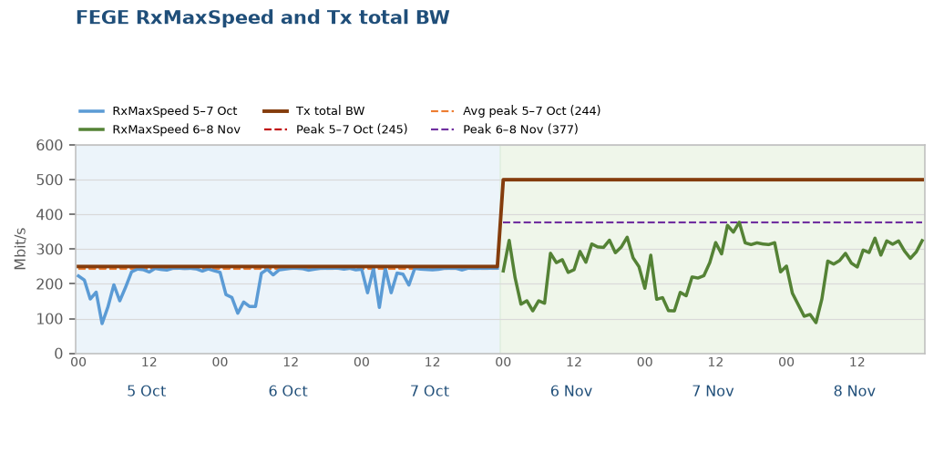
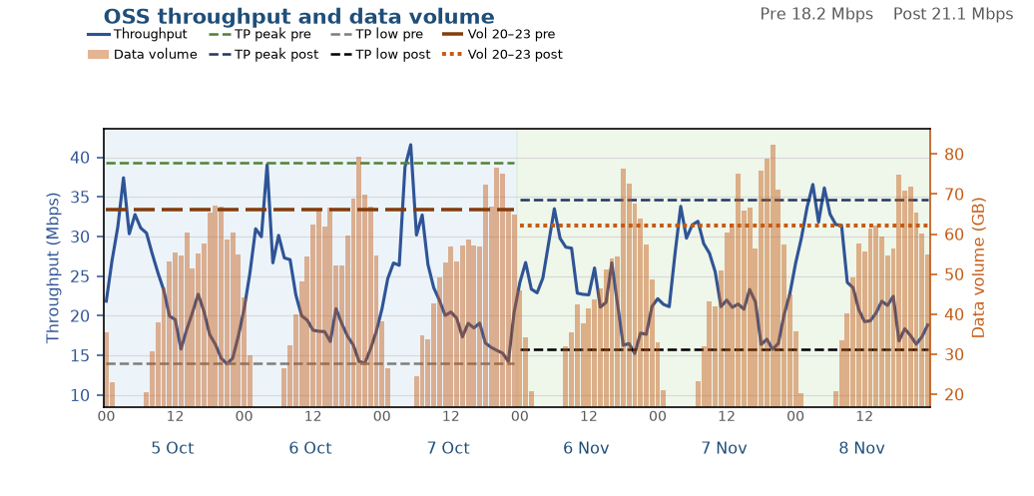
Solved — Tx BW increased: NGSDRW3
2 of 2 in this finding
Small improvement, KPIs did not fall
After the Tx BW increase, throughput is higher and data volume did not fall.
Tx total BW rose from 250 to 500 Mbit/s (+250 Mbit/s, VS.FEGE.TxTotalBW). Busy-hour RxMaxSpeed p90 245 → 329 Mbit/s.
Data BusyHour 1H throughput 15.30 → 16.27 Mbps (+0.97 Mbps, +6.3%). Daytime 09:00–22:00 median 18.2 → 21.1 Mbps.
Data BusyHour 1H data volume 74.4 → 77.8 GB (+3.4 GB, +4.6%).
Choked on 5–7 Oct. Off the choke list on 6–8 Nov.
Pre 5–7 Oct · Post 6–8 Nov · Charts are hourly · Notes use Data BusyHour 1H
3 / 9

Slide 4
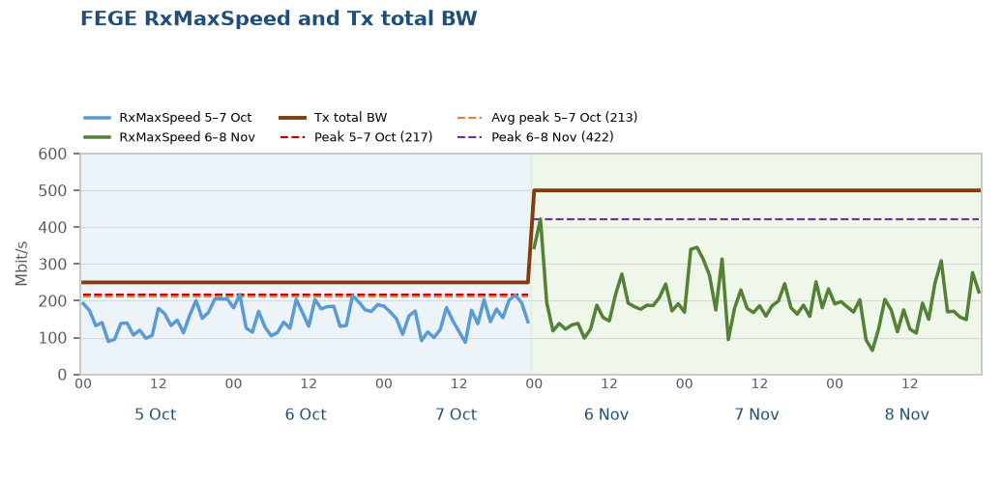
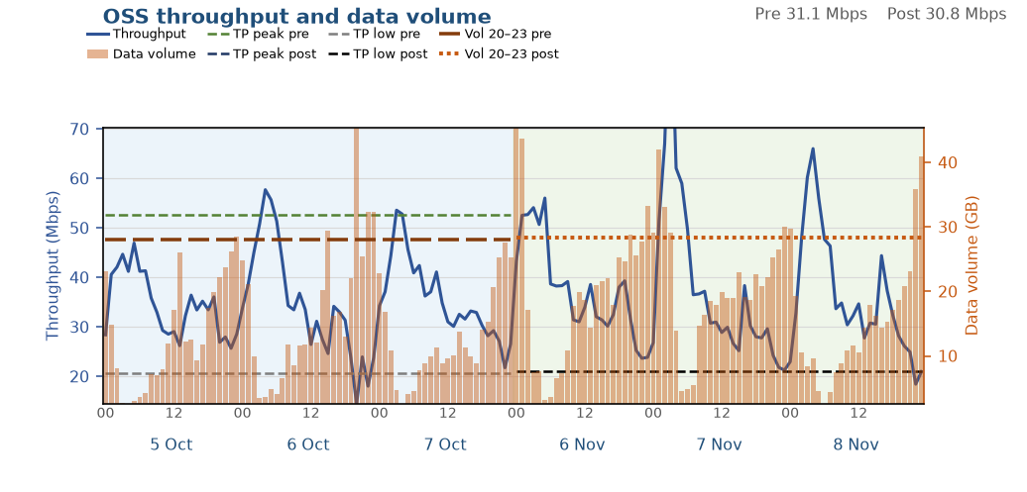
Tx BW increased: DHRMN65
1 of 1 in this finding
Both throughput and data volume improved
After the Tx BW increase, the congested busy hour is faster and data volume increased. Throughput across the rest of the day is about level.
Tx total BW rose from 250 to 500 Mbit/s (+250 Mbit/s, VS.FEGE.TxTotalBW). Busy-hour RxMaxSpeed p90 204 → 248 Mbit/s.
Data BusyHour 1H throughput 18.59 → 34.68 Mbps (+16.10 Mbps, +86.6%). Daytime 09:00–22:00 median 31.1 → 30.8 Mbps.
Data BusyHour 1H data volume 34.2 → 47.8 GB (+13.6 GB, +39.7%).
Not on the choke list in either window.
Pre 5–7 Oct · Post 6–8 Nov · Charts are hourly · Notes use Data BusyHour 1H
4 / 9

Slide 5
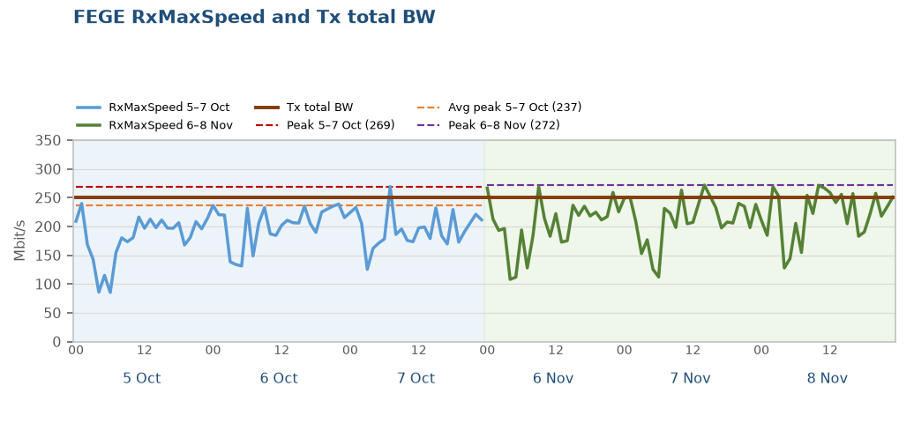
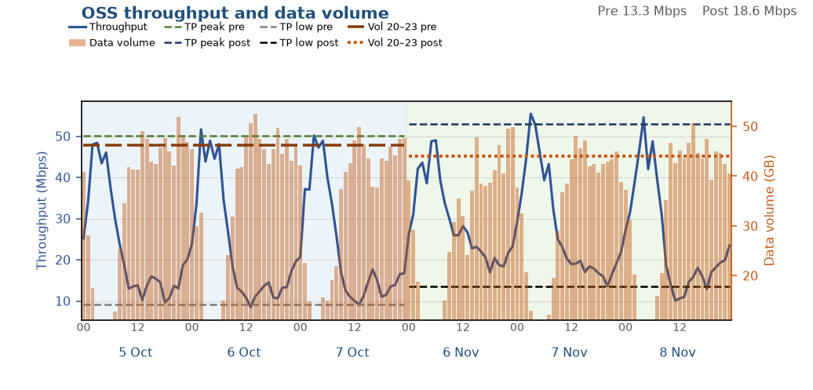
Solved: DHUTTM5
1 of 5 in this finding
Throughput improved, data volume held
Throughput improved significantly and data volume was held. Tx total BW did not increase.
Tx total BW stayed at 250 Mbit/s (VS.FEGE.TxTotalBW). It did not increase. Busy-hour RxMaxSpeed p90 232 → 262 Mbit/s.
Data BusyHour 1H throughput 10.85 → 18.95 Mbps (+8.10 Mbps, +74.6%). Daytime 09:00–22:00 median 13.3 → 18.6 Mbps.
Data BusyHour 1H data volume 51.4 → 49.5 GB (-1.9 GB, -3.6%).
Choked on 5–7 Oct. Off the choke list on 6–8 Nov.
Pre 5–7 Oct · Post 6–8 Nov · Charts are hourly · Notes use Data BusyHour 1H
5 / 9

Slide 6
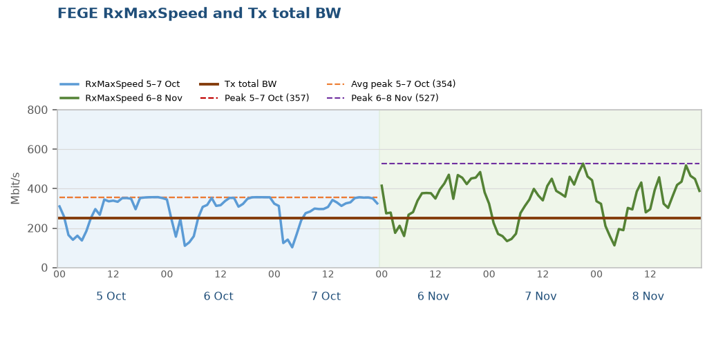
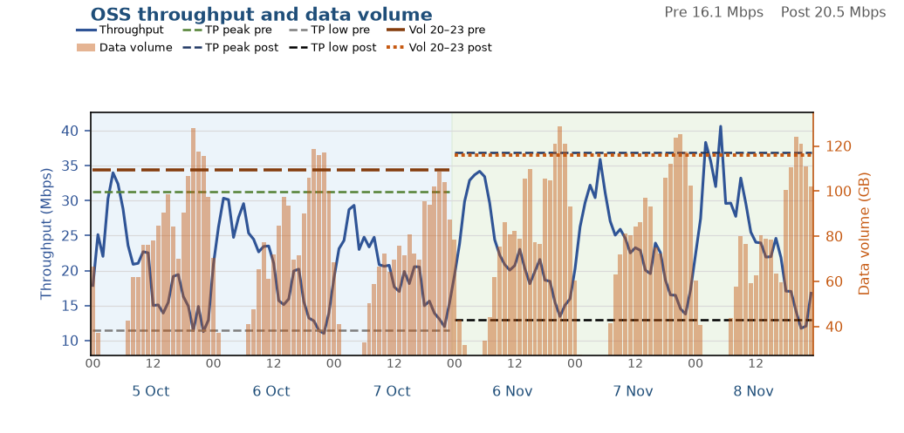
Solved: GPSDR38
2 of 5 in this finding
Throughput improved, data volume held
Throughput improved significantly and data volume was held. Tx total BW did not increase.
Tx total BW stayed at 250 Mbit/s (VS.FEGE.TxTotalBW). It did not increase. Busy-hour RxMaxSpeed p90 356 → 470 Mbit/s.
Data BusyHour 1H throughput 12.34 → 14.03 Mbps (+1.69 Mbps, +13.7%). Daytime 09:00–22:00 median 16.1 → 20.5 Mbps.
Data BusyHour 1H data volume 118.4 → 126.0 GB (+7.7 GB, +6.5%).
Choked on 5–7 Oct. Off the choke list on 6–8 Nov.
Pre 5–7 Oct · Post 6–8 Nov · Charts are hourly · Notes use Data BusyHour 1H
6 / 9

Slide 7
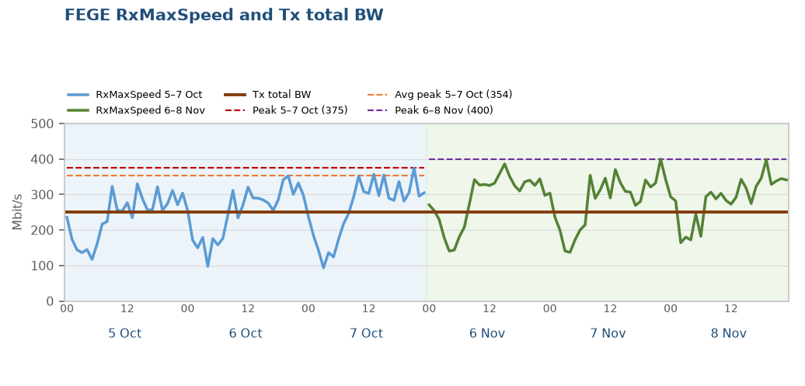
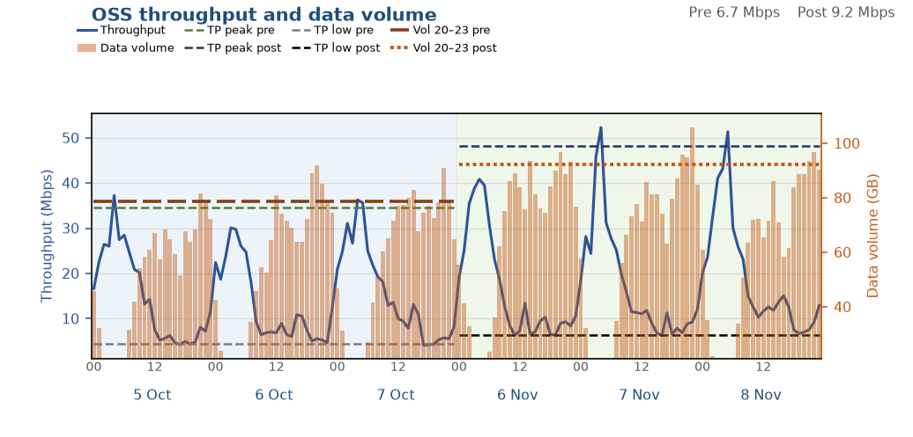
Solved: NGSNG78
3 of 5 in this finding
Both throughput and data volume improved
Throughput and data volume both improved. Tx total BW did not increase.
Tx total BW stayed at 250 Mbit/s (VS.FEGE.TxTotalBW). It did not increase. Busy-hour RxMaxSpeed p90 348 → 357 Mbit/s.
Data BusyHour 1H throughput 6.22 → 9.13 Mbps (+2.91 Mbps, +46.9%). Daytime 09:00–22:00 median 6.7 → 9.2 Mbps.
Data BusyHour 1H data volume 88.1 → 99.8 GB (+11.7 GB, +13.3%).
Choked on 5–7 Oct. Off the choke list on 6–8 Nov.
Pre 5–7 Oct · Post 6–8 Nov · Charts are hourly · Notes use Data BusyHour 1H
7 / 9

Slide 8
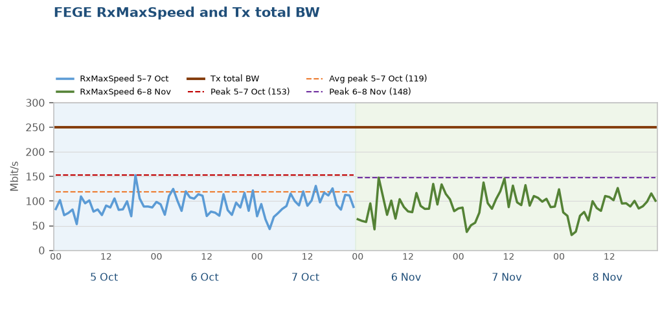
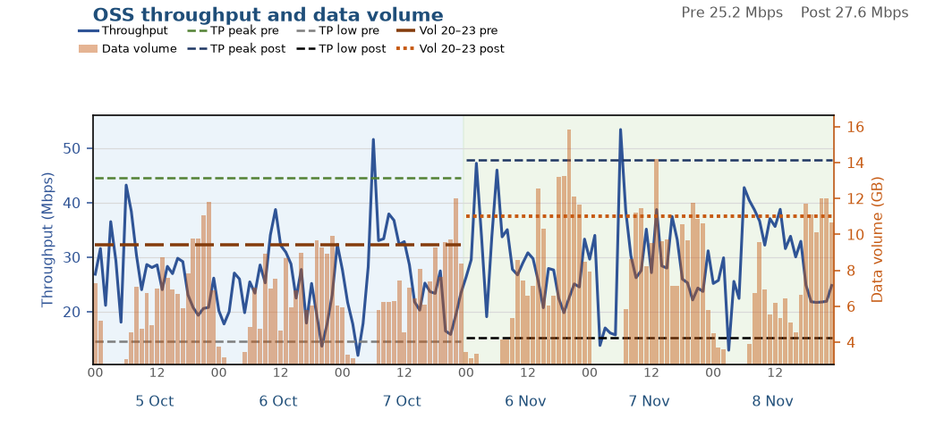
Solved: GPSRPM9
4 of 5 in this finding
Both throughput and data volume improved
Throughput and data volume both improved. Tx total BW did not increase.
Tx total BW stayed at 250 Mbit/s (VS.FEGE.TxTotalBW). It did not increase. Busy-hour RxMaxSpeed p90 117 → 130 Mbit/s.
Data BusyHour 1H throughput 20.82 → 26.42 Mbps (+5.60 Mbps, +26.9%). Daytime 09:00–22:00 median 25.2 → 27.6 Mbps.
Data BusyHour 1H data volume 11.2 → 14.0 GB (+2.8 GB, +24.7%).
Choked on 5–7 Oct. Off the choke list on 6–8 Nov.
Pre 5–7 Oct · Post 6–8 Nov · Charts are hourly · Notes use Data BusyHour 1H
8 / 9

Slide 9
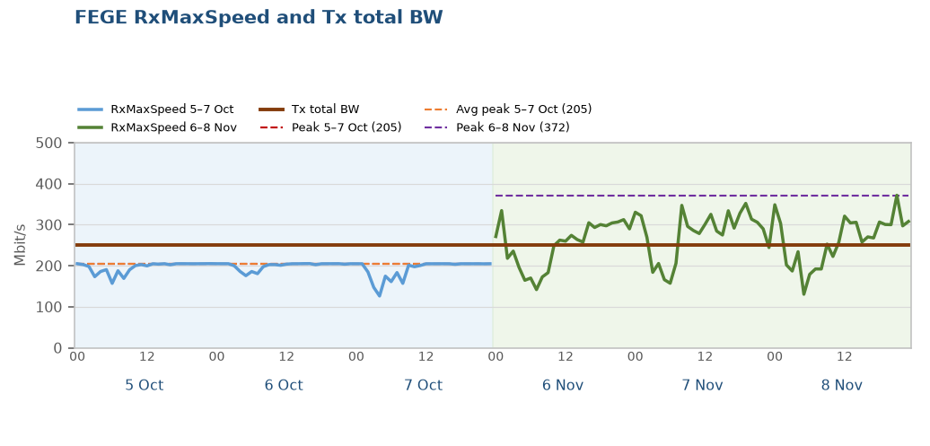
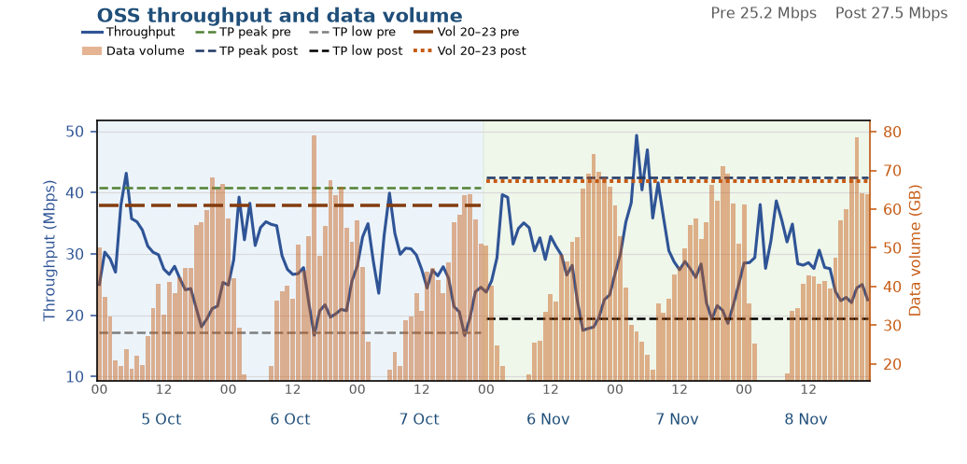
Solved: DHSHA19
5 of 5 in this finding
Small improvement, KPIs did not fall
A small throughput gain, and data volume did not fall. Tx total BW did not increase.
Tx total BW stayed at 250 Mbit/s (VS.FEGE.TxTotalBW). It did not increase. Busy-hour RxMaxSpeed p90 205 → 327 Mbit/s.
Data BusyHour 1H throughput 18.97 → 20.86 Mbps (+1.88 Mbps, +9.9%). Daytime 09:00–22:00 median 25.2 → 27.5 Mbps.
Data BusyHour 1H data volume 70.3 → 74.7 GB (+4.3 GB, +6.1%).
Choked on 5–7 Oct. Off the choke list on 6–8 Nov.
Pre 5–7 Oct · Post 6–8 Nov · Charts are hourly · Notes use Data BusyHour 1H
9 / 9

