Slide 1
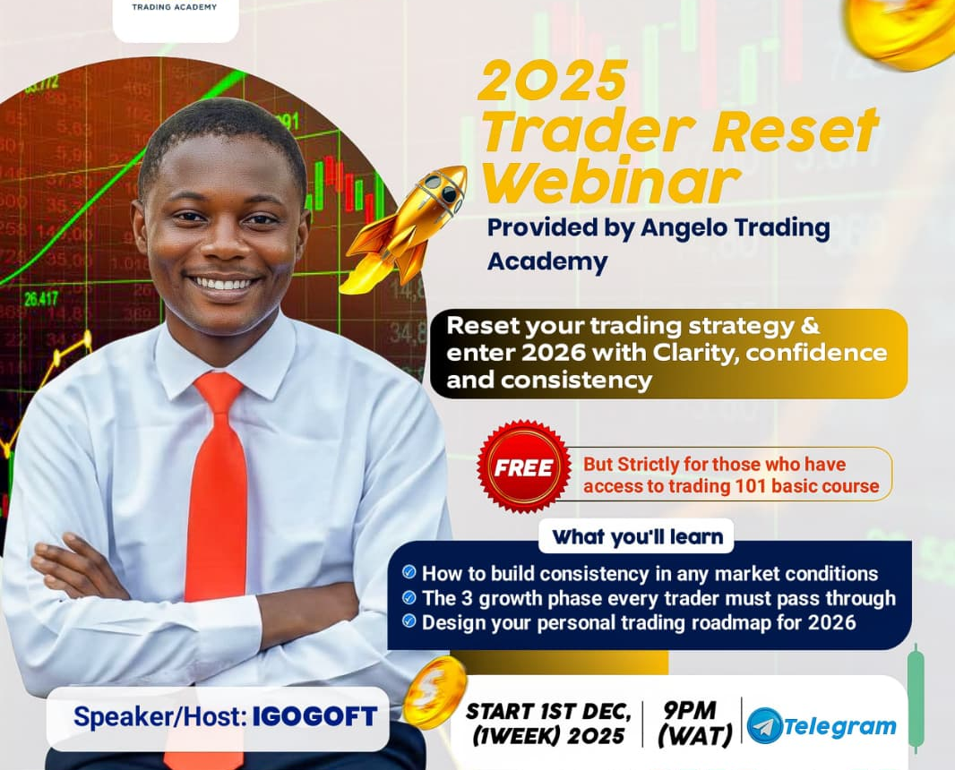
2026
TRADER RESET
RESET YOUR TRADING STRATEGY AND ENTER 2026 WITH CLARITY, CONFIDENCE AND CONSISTENCY
POWERED BY ANGELO TRADING ACADEMY
Notes:
NOTE:
To change the image on this slide, select the picture and delete it. Then click the Pictures icon in the placeholder to insert your own image.

Slide 2
Welcome to Angelo Trading Academy
A learning space for beginners & experienced traders
Our mission: Build confident, independent traders
Today’s session = clarity + structure + growth

Slide 3

Meet Your Instructor
Founder, Angelo Trading Academy
I am a forex and crypto market analyst with 4+ years of trading experience, specializing in price action, market psychology, and building consistent routines.
I began trading with no background or support, and through years of learning, testing, and refining my system, I developed a clear step-by-step approach that helps traders grow without confusion.
My Mission:
Create a beginner-friendly learning environment
Teach practical, real-life trading systems
Help traders build discipline, structure, and consistency
Today, I mentor traders at all levels, helping them understand the market, build confidence, and grow at their own pace.

Slide 4
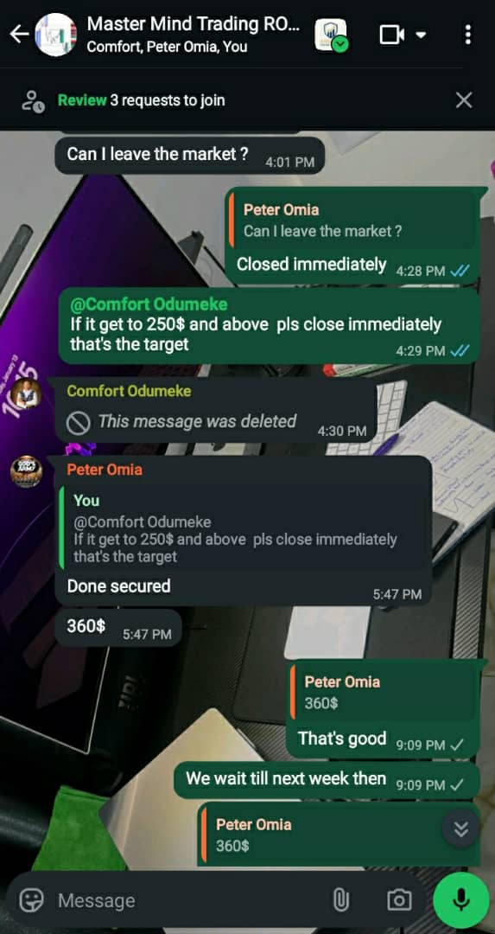
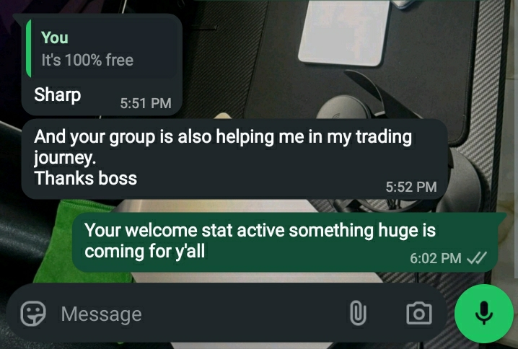
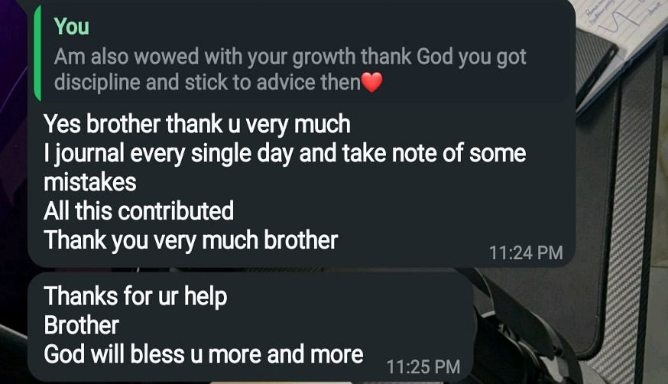
Real ATA Student Transformations
Improved trade journaling
Better discipline → fewer emotional trades
Clearer chart markups
Stronger consistency routines

Slide 5
What You Will Learn Today
Building consistency in any market condition
The 3 trader growth phases
Your personal trading roadmap for 2026

Slide 6
How to build consistency in any market
FOREX,CRYPTO,STOCK.ETC.

Slide 7
What Is Trading Consistency?
The Truth About Consistency
Not winning every trade
Predictable process → predictable results
Consistency = repeatable system + discipline

Slide 8
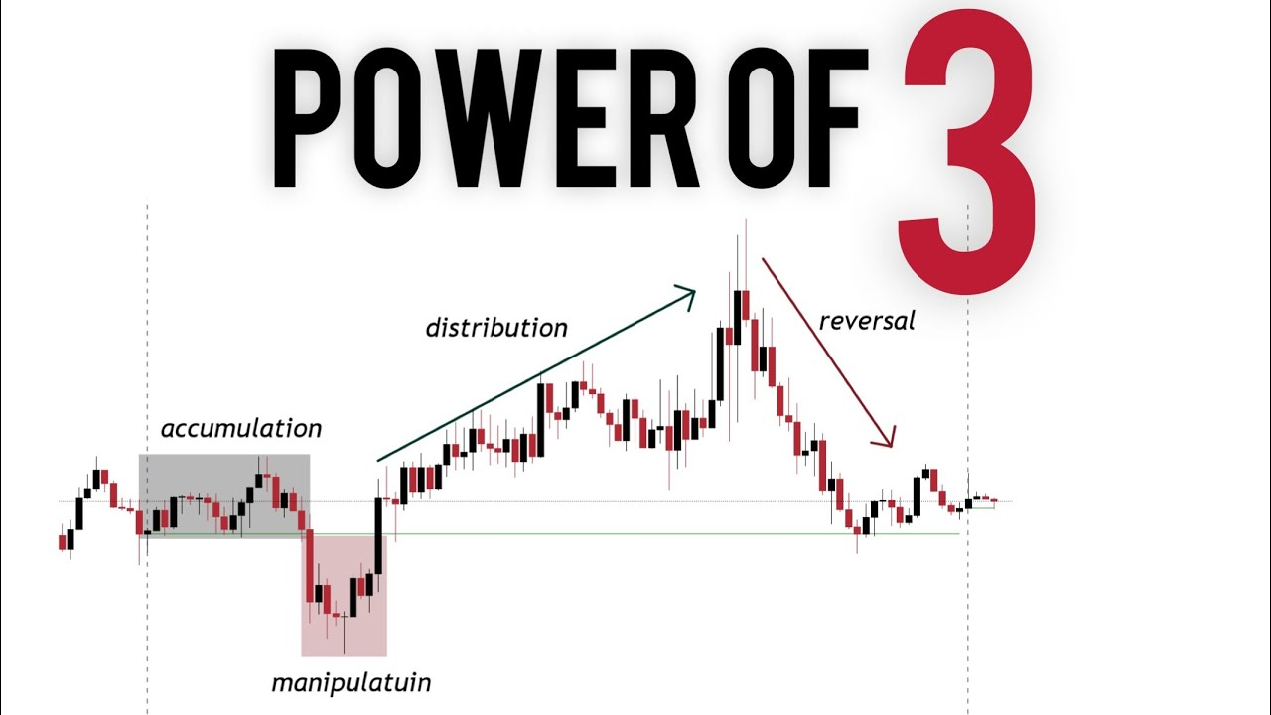
Market Conditions Every Trader Faces
3 Key Market Conditions
Trending market → clear direction
Ranging market → sideways movement
Manipulative/choppy → liquidity hunts

Slide 9
Why Traders Lose Consistency
The 4 Enemies of Consistency
Overtrading (impulse entries)
Small account pressure
No fixed setup
Emotional decision-making

Slide 10
ATA Consistency Blueprint
The 4-Part Consistency Framework
One Market (Crypto,Forex,indices.etc)
One clear trade setup
Time and routine
Risk discipline
Journal → Review → Improve

Slide 11
Understanding one market
Master ONE Market First
Choose the market
Understand how it works
Trade it only = Build experience & competence

Slide 12
Setup Familiarity
Master ONE Setup First
Know your setup’s structure
Know when it forms
Know when it fails
Avoid mixing strategies

Slide 13
Time & Routine
Trading Routine = Trading Confidence
Identify your best trading hour(s)
Reduce screen time
Weekly planning → daily checklist

Slide 14
Risk Rules
Risk Before Reward
Max 1–2% per trade
Daily/Weekly loss limit
“No signal = no trade” rule
Avoid revenge trading

Slide 15
Journal & Review
Your Journal = Your Teacher
What setup did you take?
Why did you enter?
What went right/wrong?
Review weekly → fix weaknesses

Slide 16
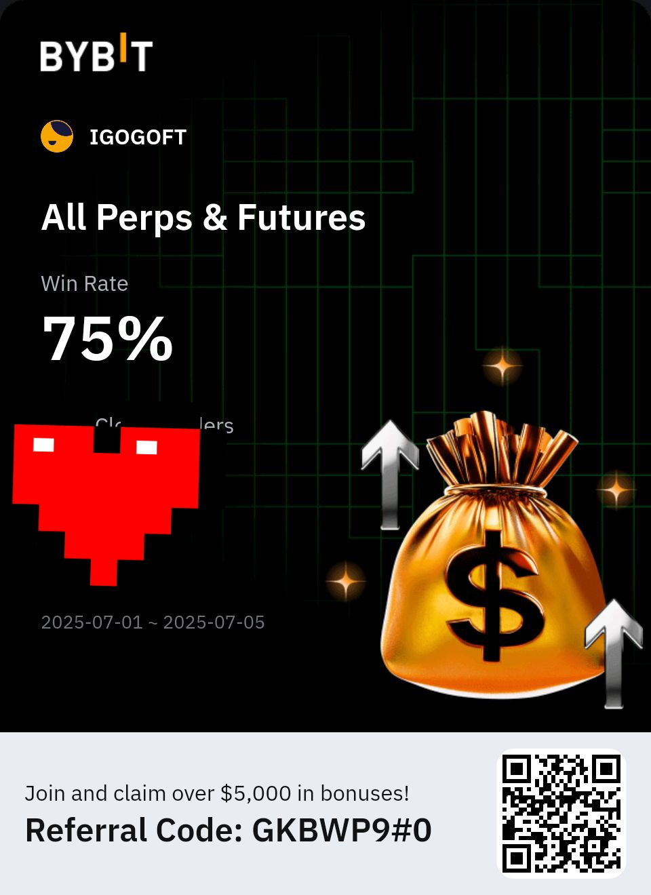
Consistency Proof
What Consistency Looks Like
Cleaner charts
Fewer trades,
Better entries
Stronger discipline
Result of staying consistent

Slide 17
Summary
Consistency Key Takeaways
Simplicity wins
Trade high probability setup
Stick to a schedule
Track everything
Plan your Trade your Plan

Slide 18

FOLLOW THE PLAN

Slide 19
THE GROWTH PHASES
The 3 Trader Growth Phases

Slide 20

The 3 Trader Growth Phases
Every Trader Grows Through 3 Stages
Foundation
Development
Execution/Mastery

Slide 21
Phase 1: Foundation
Phase 1: The Beginner Stage
Get a mentor
Learn basics + market structure(understand the market you want to trade)
Understand one strategy
Common struggles: confusion, impatience

Slide 22
Growing in Phase 1
How to Grow in Phase 1
Stick to ONE system
Start backtesting
Limit strategy hopping
Focus on discipline

Slide 23
Phase 2: Development
Phase 2: The Skill-Building Stage
You know a strategy
Your emotions start affecting results
Most traders quit here

Slide 24
Growing in Phase 2
How to Grow in Phase 2
Build a weekly routine
Deep journaling
Track setups
Emotional awareness training

Slide 25
Phase 3: Mastery
Phase 3: Execution & Confidence
More patience
Fewer but higher-quality setups
More predictable results

Slide 26
Growing in Phase 3
How to Grow in Phase 3
Scaling responsibly
System refinement
Deep backtesting
Peer review / community

Slide 27
Why Traders Get Stuck
Why Most Traders Don’t Grow Beyond Phase 1 & 2
No structure
No accountability
Emotional trading
Information overload
Approach and perspective towards Trading

Slide 28
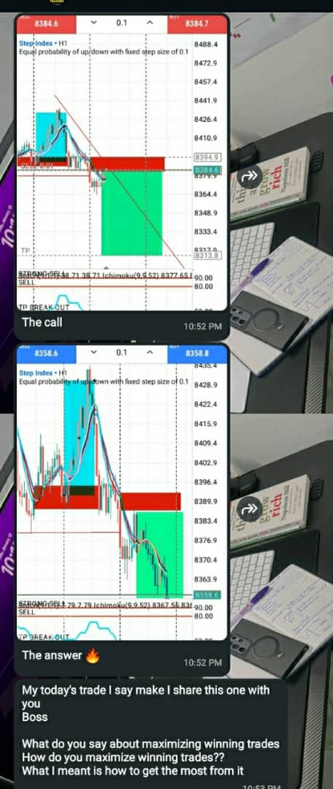
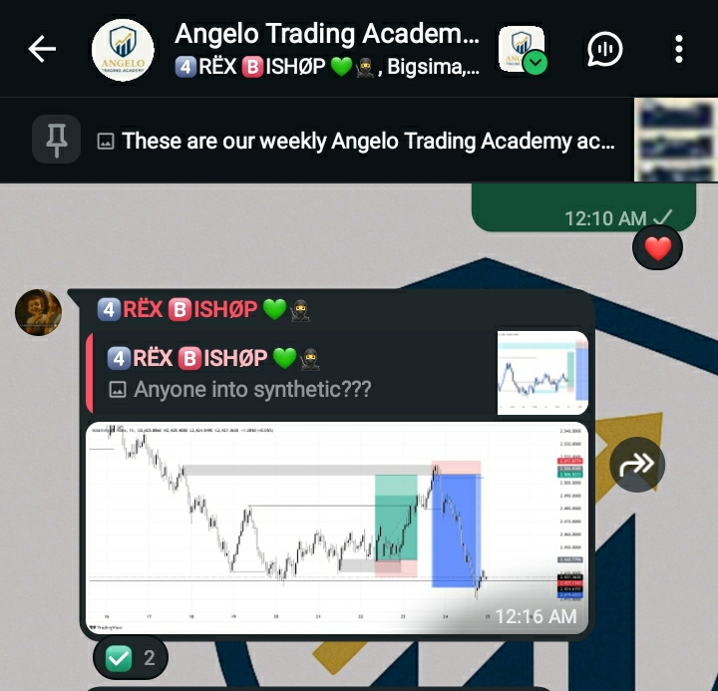
ATA Growth Proof
Real Examples from ATA Students
Before/after charts
Weekly plans
Journals
Testimonials
Before/after charts

Slide 29
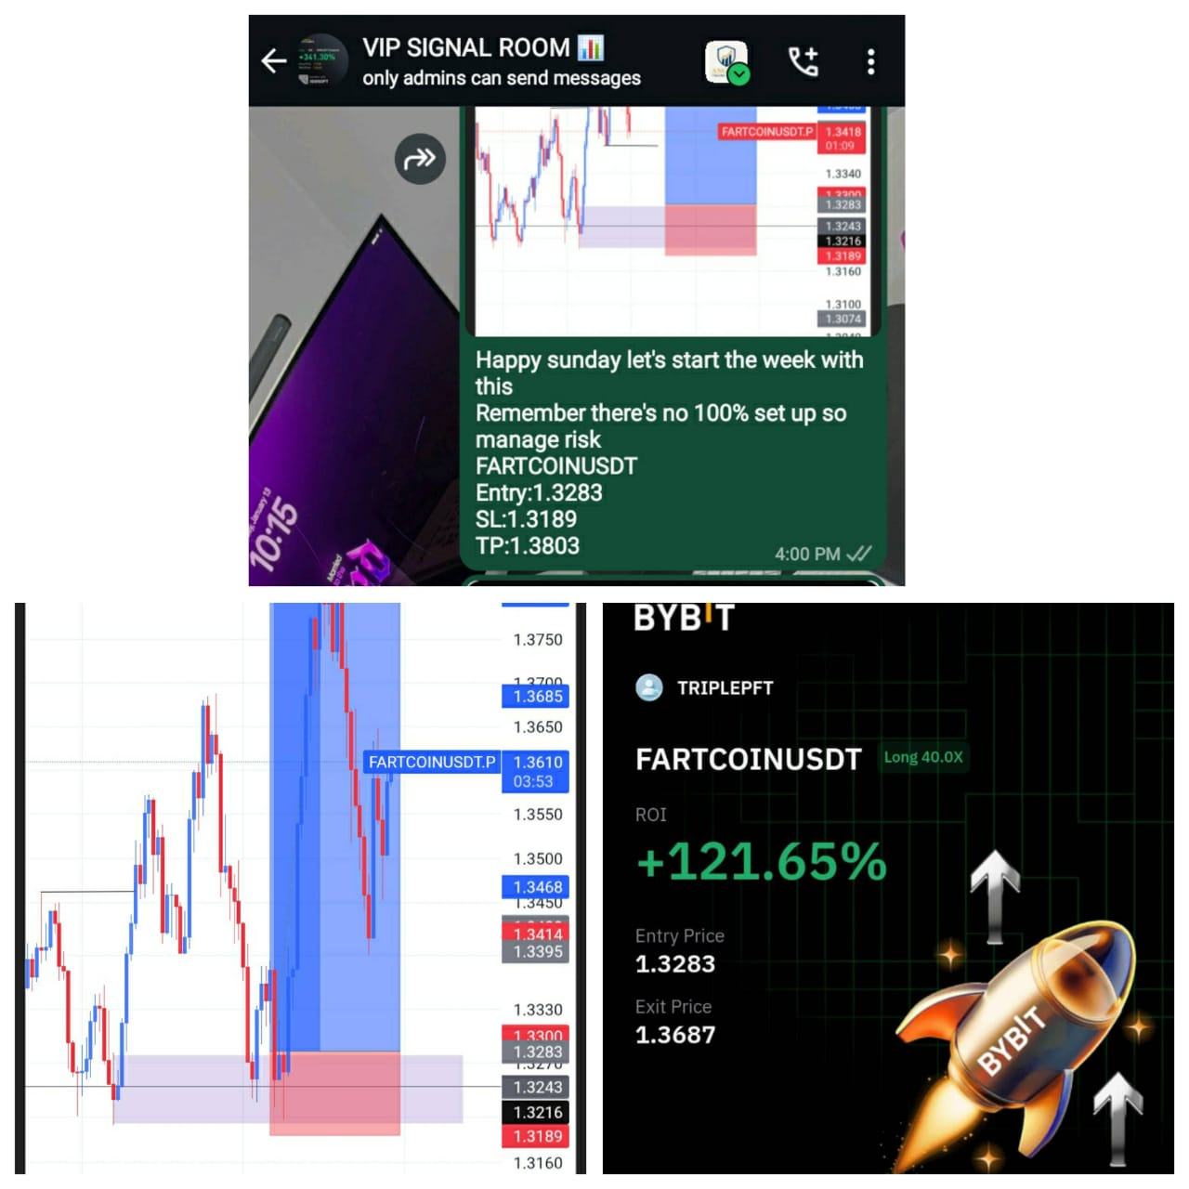
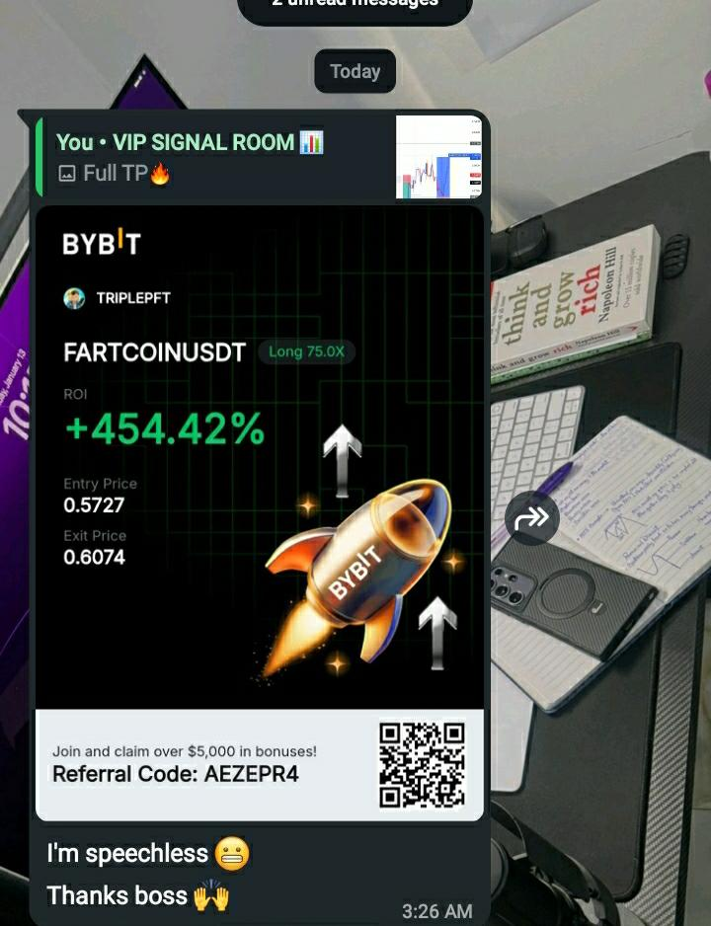
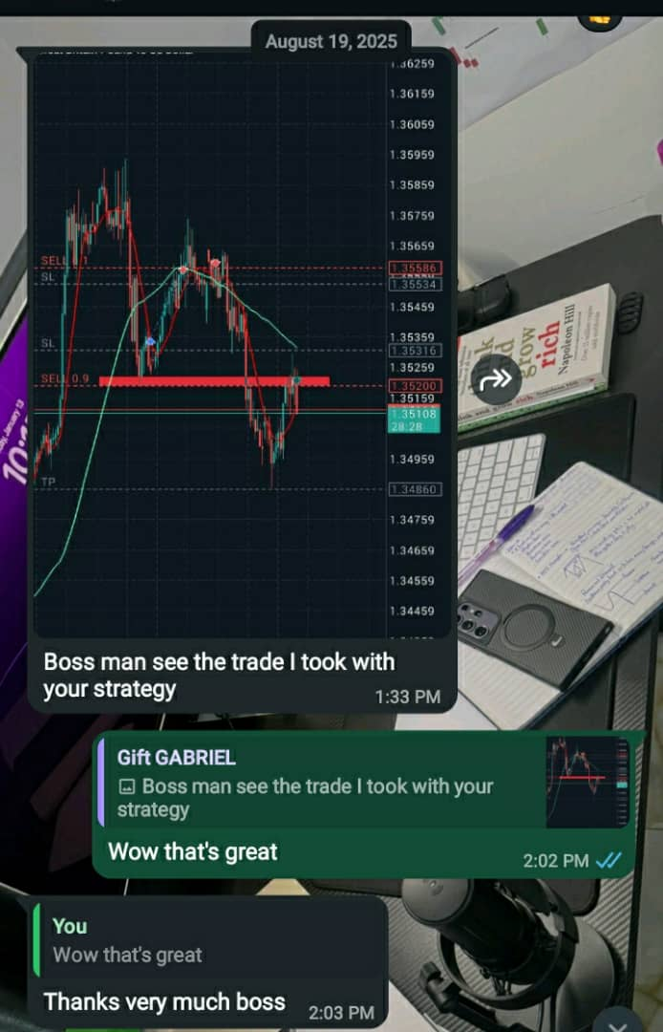
Testimonies
VIP signal Room Result
VIP signal Room Result
Trading course Result

Slide 30
What Phase Are You In?
Identify Your Current Phase
Phase 1?
Phase 2?
Phase 3?

Slide 31
Section Summary
Growth Phases — Summary
Phase 1 → Learn
Phase 2 → Build
Phase 3 → Master

Slide 32
ROADMAP 2026
2026 = Your Structured Growth Year

Slide 33
Step 1: Designing Your Roadmap
2026 = Your Structured Growth Year
You cannot grow randomly
You need a plan
Let’s build your roadmap together

Slide 34
Step 2: Identify Your Phase
Choose Your Starting Point
Phase 1 → Learning
Phase 2 → Consistency building
Phase 3 → Scaling

Slide 35
Step 3: Create Your Vision
Your 2026 Skill Vision
Define your:
Preferred market (FX, crypto, indices)
Core strategy
Trading time
Level of discipline

Slide 36
Step 3: Quarterly Growth Plan
Your 2026 Quarterly Breakdown
Q1: Learn + Backtest
Q2: Structure + Routine
Q3: Live account consistency
Q4: Refinement + Scaling

Slide 37
Your Trading Routine
Daily & Weekly Routine Template
Daily
Markup charts
Journal
Take only valid setups
Weekly:
Backtest
Review past trades
Update plan

Slide 38
Risk & Psychology Goals
Master Your Mind = Master Your Trades
Max risk per trade
Daily reset routine
Emotional discipline checklist

Slide 39
Tools You Need for 2026
Your Trading Toolkit
Strategy checklist
Trading journal
Backtesting sheet
ATA community

Slide 40
Tools You Need for 2026
Your Trading Toolkit for Beginners
To grow as a trader, you don’t need 10 strategies — you need the right tools.
Here’s the exact toolkit every beginner should start with:
Charting Terminal — TradingView
  Your main workspace for analysis, charting, and tracking market structure.
Broker / Exchange
  Where your trades are executed.
  Use a reliable, regulated platform only.
Trading Journal
  The most important tool for growth.
  Track your trades, emotions, mistakes, and improvements.
ATA Community
  A support system where you can learn, ask questions, stay accountable, and grow with other traders.

Slide 41
ATA Ecosystem Overview
How ATA Helps You Grow
Courses: Beginner → Advanced
Mentorship
Journals, templates, checklists
Community feedback

Slide 42
Why ATA Works
4 Reasons ATA Helps You Grow Faster
Clear structure
Accountability
Routine building
Community support

Slide 43
Want Personal Help With Your Roadmap?
Join ATA Mentorship Program
Full roadmap support
Weekly reviews
Accountability

Slide 44
Follow Us
Stay Connected with ATA
Telegram
https://t.me/TraderReset2025
Facebook
https://www.facebook.com/share/1KnjGo2naY/
Whatsapp
https://chat.whatsapp.com/K5beqvgp3OE6mzY9WXaCNK?mode=wwt
Daily lessons, charts & trading resources

Slide 45

Any Questions? Let’s Talk.

Slide 46

Thank You
Thank You for Joining the Webinar

