Slide 1
Edge Detection
EN605.617.FA – Introduction to GPU Programming
Miles Gapcynski
12/10/2018

Slide 2
Project Overview
Wanted to explore Image Processing
Deep and interesting field
Images can be broken down into blocks of data
Chose Edge Detection to focus scope of project
Edge Detection is a deep topic as well
Needed specific algorithm
Chose convolution of image data with image kernels
What can I measure and analyze?
Compare CPU and GPU runtimes
Analyze image data produced by different image kernels
Notes:
Two motivations for choosing Image Processing
Fascinated by image manipulation and signal processing techniques
Algorithms can be written in SIMD fashion
Edge Detection can be used in object and pattern recognition applications, as well as photo editing software
Didn’t want to explore machine learning (another deep topic)
Image kernel also known as convolution matrix, mask, or filter
Edge Detection produces images with highlighted edges
Can compare how long it takes to produce the imagery
Can analyze different kernel outputs to determine how they might be used in different scenarios

Slide 3
Implementation - Convolution and Kernels
Convolution is a common approach for filtering image data
Multiply pixel and neighbors with image kernel
Perform summation of multiplication results
Perform these steps on every pixel
Kernels represent weights that filter image data
Gradient operators (kernels) exist that specialize in finding edges
Two different matrices for finding horizontal or vertical edge
Calculate magnitude of convolution results for edge intensity
Notes:
Multiply pixel and neighbors with corresponding positions in kernel
Kernel applied to each pixel in an iterative fashion
Slides over each row and column one by one
Must deal with neighbors outside of edge boundaries
Ignore outermost rows/columns
Perform techniques such as zero padding, replicating, or wrapping

Slide 4
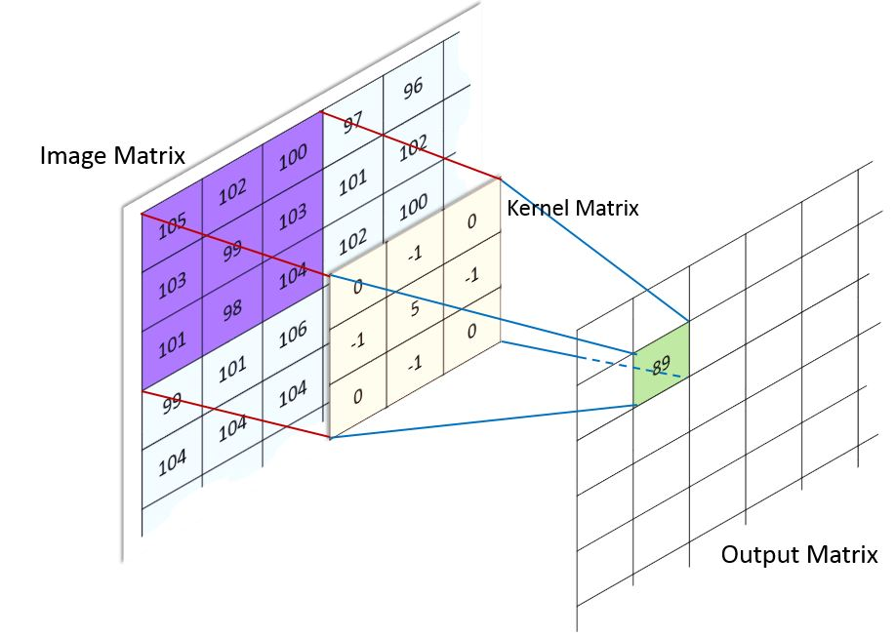
Implementation - Convolution and Kernels (cont.)
Figure 1 – Convolution (Kazemi, Figure 3)

Slide 5
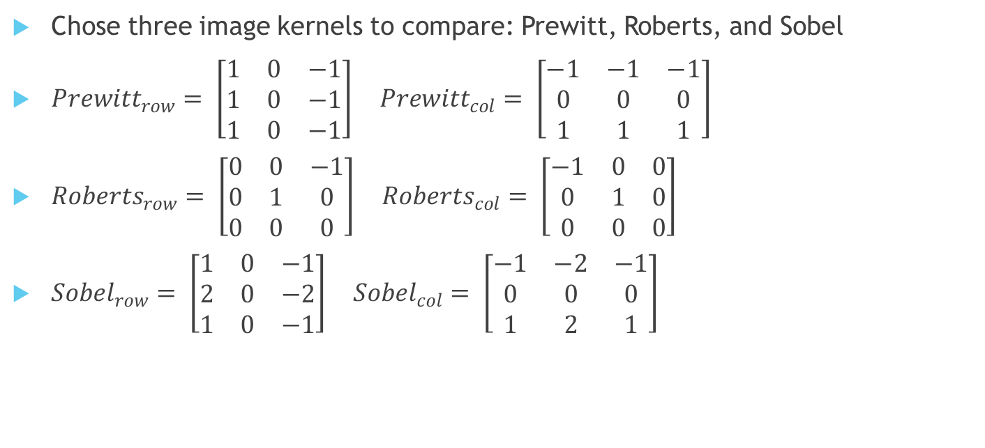
Implementation - Convolution and Kernels (cont.)
Chose three image kernels to compare: Prewitt, Roberts, and Sobel
${Prewitt}_{row}= \left[\begin{matrix}1 & 0 & −1 \\ 1 & 0 & −1 \\ 1 & 0 & −1\end{matrix}\right] {Prewitt}_{col}= \left[\begin{matrix}−1 & −1 & −1 \\ 0 & 0 & 0 \\ 1 & 1 & 1\end{matrix}\right]$
${Roberts}_{row}= \left[\begin{matrix}0 & 0 & −1 \\ 0 & 1 & 0 \\ 0 & 0 & 0\end{matrix}\right] {Roberts}_{col}= \left[\begin{matrix}−1 & 0 & 0 \\ 0 & 1 & 0 \\ 0 & 0 & 0\end{matrix}\right]$
${Sobel}_{row}= \left[\begin{matrix}1 & 0 & −1 \\ 2 & 0 & −2 \\ 1 & 0 & −1\end{matrix}\right] {Sobel}_{col}= \left[\begin{matrix}−1 & −2 & −1 \\ 0 & 0 & 0 \\ 1 & 2 & 1\end{matrix}\right]$
Notes:
Prewitt operator “is more sensitive to vertical and horizontal edges than diagonal edges” (Crane, 86)
Roberts operator “has a smaller effective area than other masks, making it more susceptible to noise. The other masks are better able to average out fluctuations” (Crane, 86)
Sobel operator “is more sensitive to diagonal edges than vertical and horizontal edges” (Crane, 86)

Slide 6
Implementation - General Approach
Structure of file formats varies
1 to N channels of values per pixel represented by different bit depths
Channel values can be interleaved or sequential
Decided to use FreeImage library
Open-source library specializing in read/writing image files
Wrote utility methods to interface with library
Focused on how to convolve grayscale vs color images
Iterate over grayscale data and convolve with image kernels
Converted color images to grayscale
Notes:
Utility methods focused on reading/writing image files, and mapping image data into channel-separated RGB values
All red channel values, then all green, then all blue
I found this easier to index into array for each pixel and neighbors
Converted color image data to grayscale
Didn’t need to retain the color information (edges still present in grayscale)
Average the RGB channel values to convert to grayscale

Slide 7
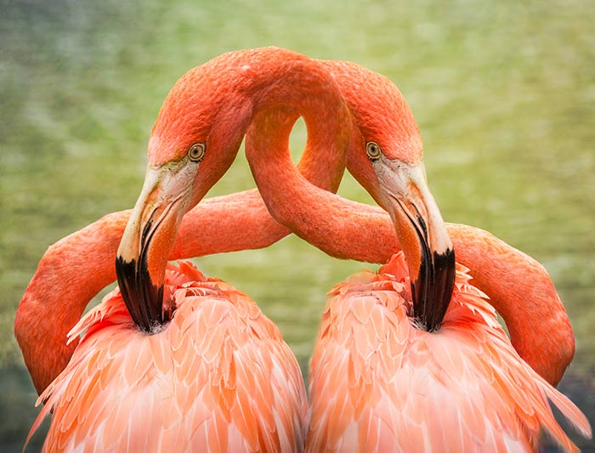
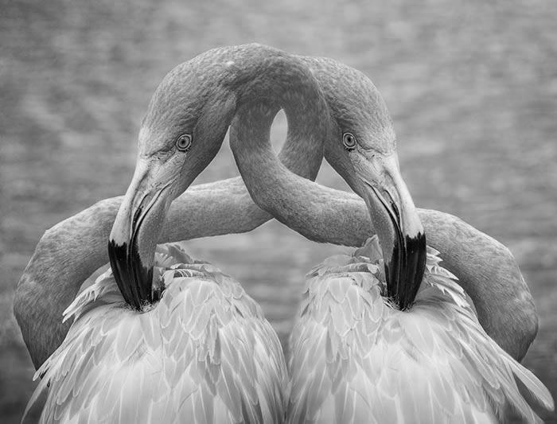
Implementation - General Approach (cont.)
Figure 2 – Test Image and Grayscale

Slide 8
Implementation - CPU Approach
Nested for loop iterates over rows and columns of image data
Skipped outermost rows/columns to avoid boundary issues
Apply gradient operator to each pixel and surround neighbors
Calculate magnitude of row and column convolution results
Repeat for all three gradient operators

Slide 9
Implementation - GPU Approach
Copy image and filter data to GPU
Decompose image data into grid of blocks
Created 2D grid made up of 16x16 blocks
Execute kernel
Utilized same filter method as CPU
Created global and shared memory kernels for additional comparison
Copy image data back to host
Repeat for all three gradient operators, and global/shared memory kernels

Slide 10
Implementation - HSV
Found other color models during research
Color models provide different view of image data
Chose to implement Hue, Saturation, and Value (HSV) color model
Hue indicates how similar a color is to red, green, or blue
Saturation refers to intensity/purity of a color
Value represents the maximum value of the RGB components
Could now compare three image kernels across multiple color models

Slide 11
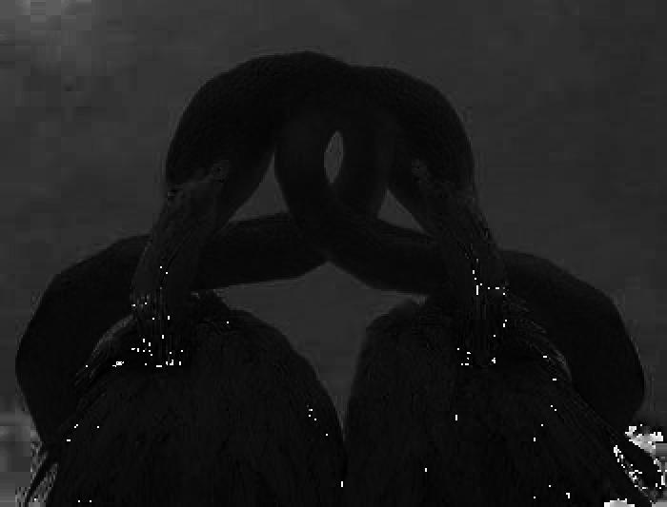
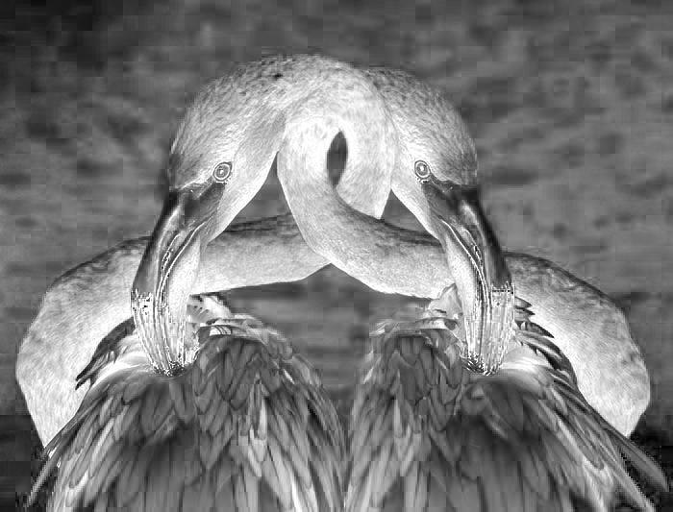
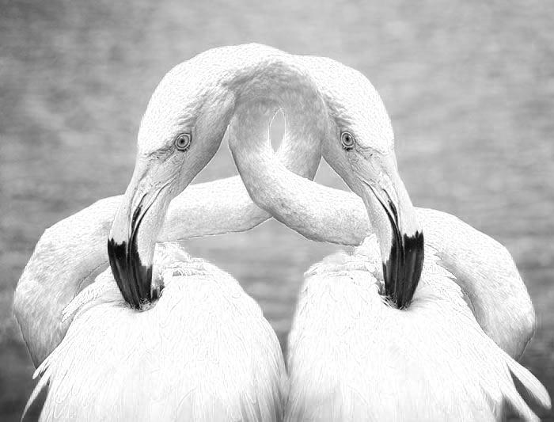
Implementation - HSV (cont.)
Figure 3 – Test Image (TL), Hue (TR), Saturation (BL), and Value (BR)

Slide 12
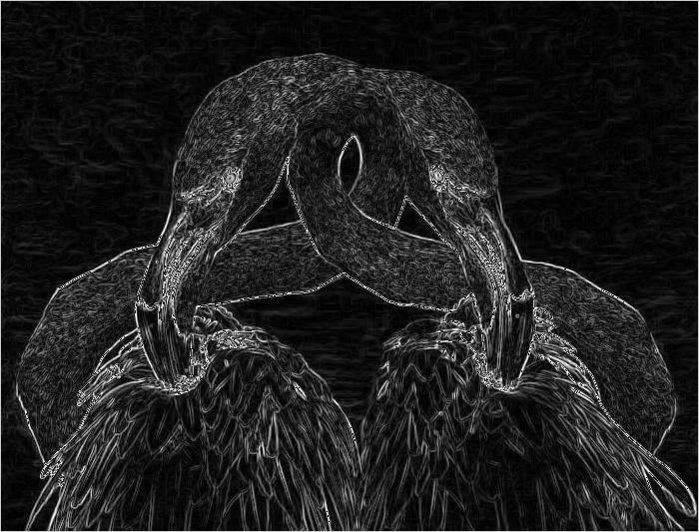
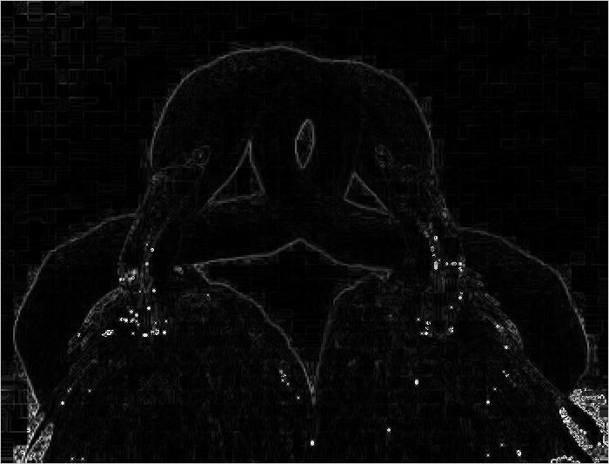
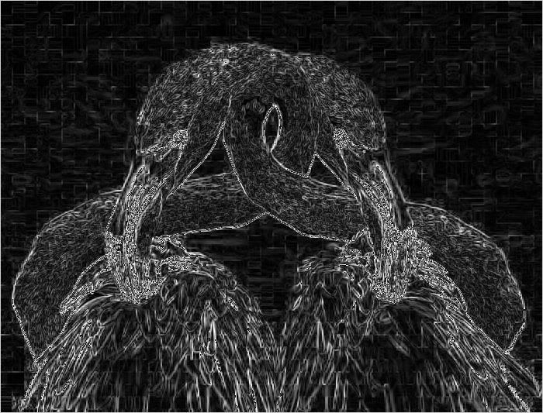
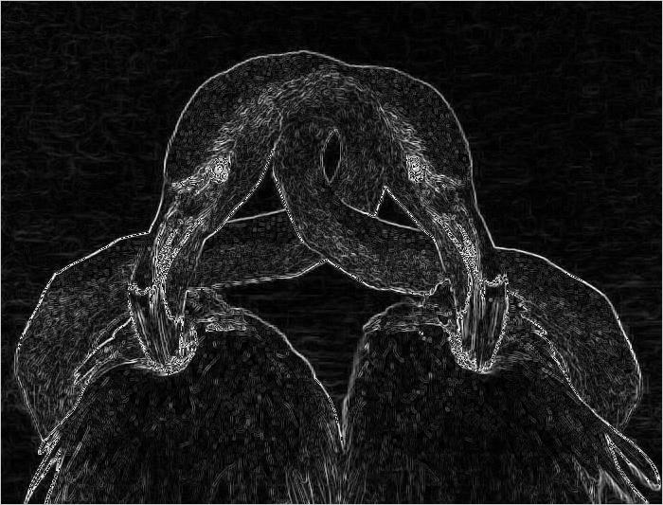
Analysis - Grayscale vs HSV (Prewitt)
Grayscale and Value output highlight less distinct edges
Ex. Feathers
Hue output seems to focus on just the birds
Could be useful for object recognition algorithms
Saturation output has concentrated intensity around the eyes and beaks
Could be useful for facial recognition algorithms
Figure 4 – Grayscale (TL), Hue (TR), Saturation (BL), and Value (BR)
Notes:
“More sensitive to vertical and horizontal edges than diagonal edges” (Crane, 86)

Slide 13
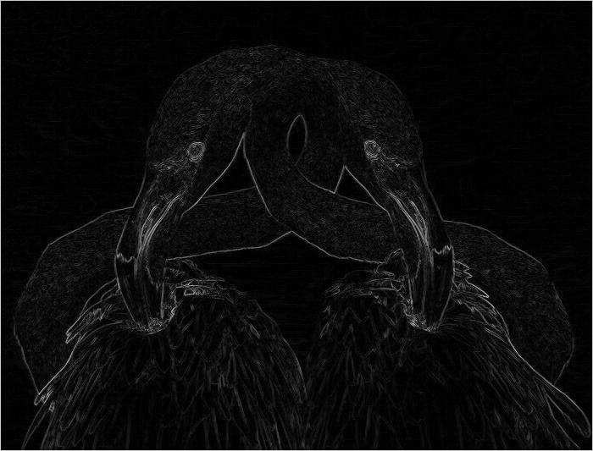
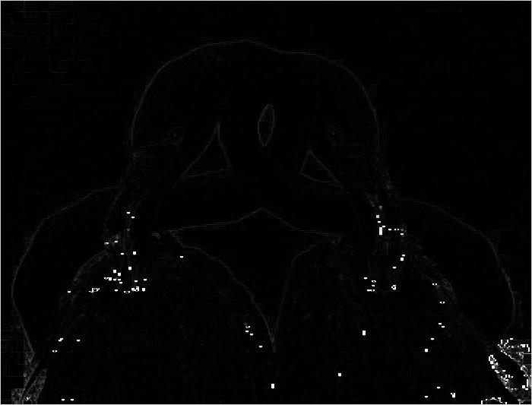
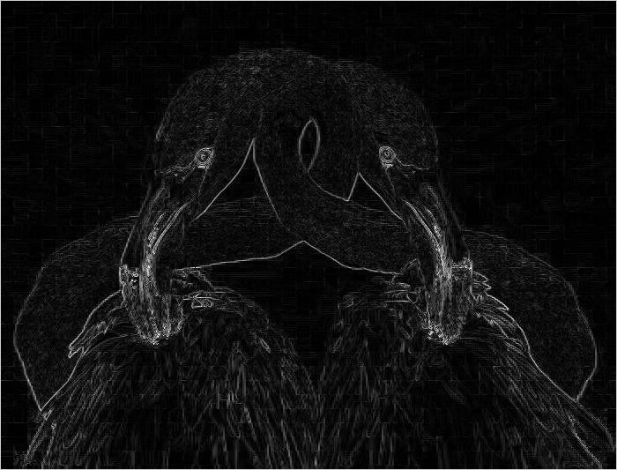
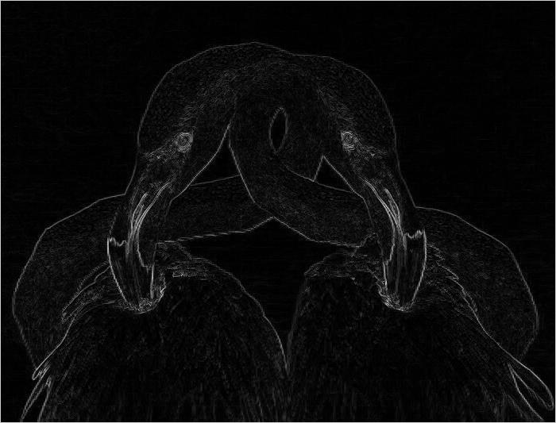
Analysis - Grayscale vs HSV (Roberts)
Grayscale and HSV comparisons match those made in the Prewitt section
Comparison to Prewitt output
Seems to do a better job at highlighting just the birds in the image
Appears to be less noisy
Figure 5 – Grayscale (TL), Hue (TR), Saturation (BL), and Value (BR)
Notes:
“More sensitive to vertical and horizontal edges than diagonal edges” (Crane, 86)

Slide 14
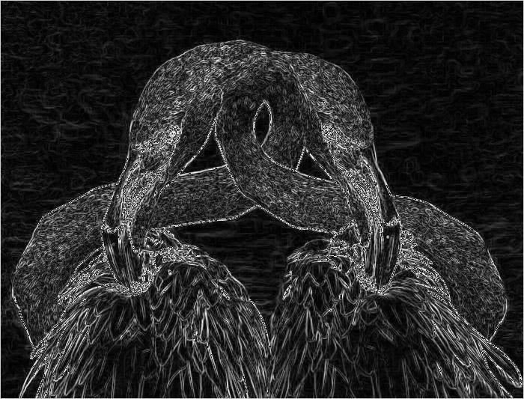
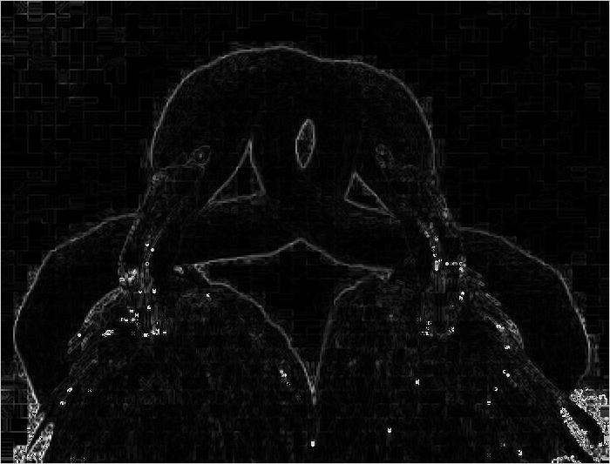
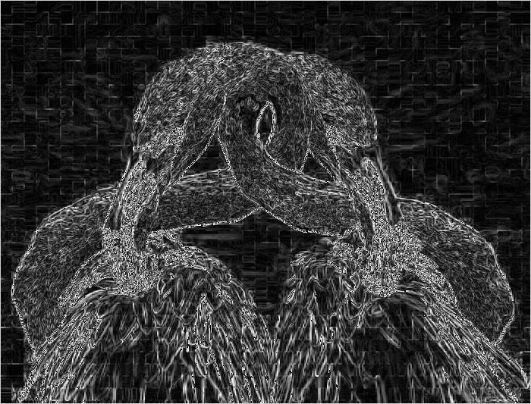
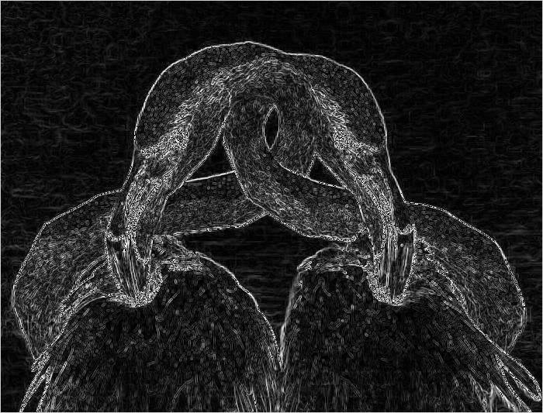
Analysis - Grayscale vs HSV (Sobel)
Grayscale and HSV comparisons match those made in the Prewitt section
Comparison to Prewitt and Roberts output
Output quite similar to Prewitt output
A bit noisier than other two gradient operators
Seems to do a better job at finding the diagonal edges in the image
Figure 6 – Grayscale (TL), Hue (TR), Saturation (BL), and Value (BR)
Notes:
“More sensitive to vertical and horizontal edges than diagonal edges” (Crane, 86)

Slide 15
Analysis - Timing Results
Image | Image Dimensions (total pixels) | CPU Execution Times (ms) | GPU Execution Times (ms)
 |  |  | Global Memory | Shared Memory
mountains.jpg | 500 x 348 (174,000) | 10.6232 | 0.5930 | 0.6353
lena.png | 512 x 512 (262,144) | 16.0494 | 0.7689 | 0.9739
birds.jpg | 700 x 533 (373,100) | 24.1710 | 1.1357 | 1.1654
church.jpg | 1024 x 768 (786,432) | 48.7879 | 1.9197 | 2.2372
pisa.jpg | 1600 x 900 (1,440,000) | 88.7504 | 3.5310 | 3.7038
valley.jpg | 2560 x 1440 (3,686,400) | 228.5247 | 7.8206 | 8.3551
town.jpg | 3840 x 2160 (8,294,400) | 516.8103 | 17.3303 | 18.7000
Figure 7 – Timing Results

Slide 16
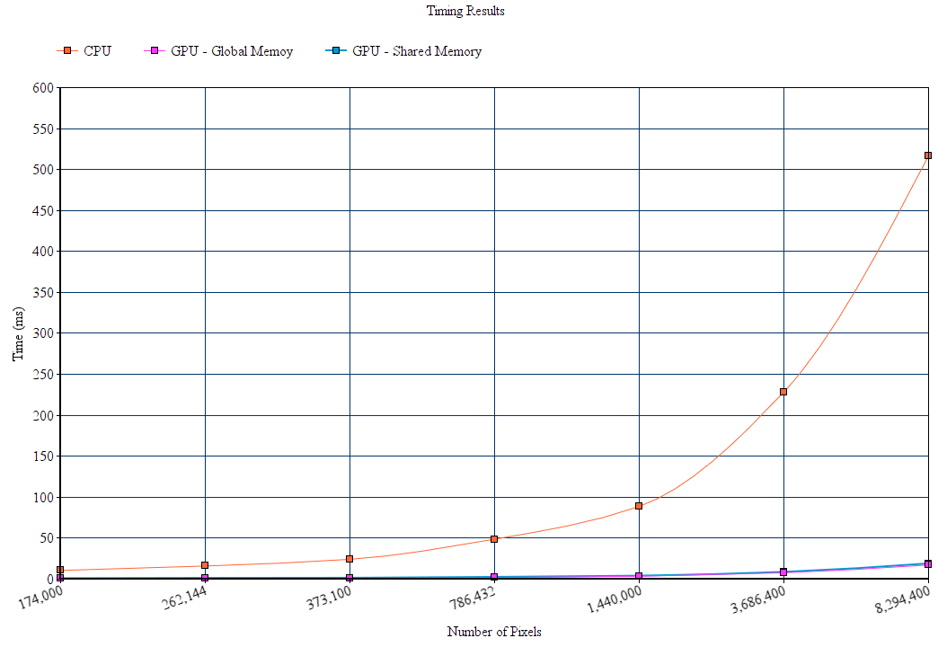
Analysis - Timing Results (cont.)
Figure 8 – Timing Results

Slide 17
Conclusion
GPU considerably better than CPU processing image data in SIMD fashion
Discrepancy grows substantially as image data size increases
CPU would have better results with multithreading support
Global memory kernel outperformed shared memory kernel
Surprising, though difference is quite small
Pros and cons of each gradient operator made evident by RGB/grayscale and HSV color model output
Possible project extensions and improvements
Implement additional edge detection algorithms, gradient operators, and color models
Utilize pixel thresholds to reduce noise in output
Analyze filtered image data further using object/pattern recognition algorithms
Utilize texture memory, NPP library, and/or different block sizes for potential GPU improvements

Slide 18
Works Cited
Crane, Randy. A Simplified Approach to Image Processing: Classical and Modern Techniques in C. Prentice Hall PTR, 1997.
Kazemi, Hadi. “Image Filtering.” Machine Learning Guru, 6 Feb. 2017, 15:52:07, machinelearninguru.com/computer_vision/basics/convolution/image_convolution_1.html.

