Slide 1
Edge Detection on the CPU and GPU
EN605.617.FA – Introduction to GPU Programming
Miles Gapcynski
12/10/2018

Slide 2
Agenda
Project Overview
Implementation
Convolution and Kernels
General Approach
CPU and GPU Approach
HSV
Analysis
Grayscale vs HSV
Timing Results
Conclusion

Slide 3
Project Overview
Wanted to explore Image Processing
Deep and interesting field
Images can be broken down into blocks of data
Chose Edge Detection to focus scope of project
Edge Detection produces image data that highlights edges in a picture
Useful for computer vision, object recognition, and photo editing software
Utilized convolution algorithm to filter image data in search of edges
What can I measure and analyze?
Compare CPU and GPU runtimes
Analyze image data produced by different filters (kernels)

Slide 4
Implementation - Convolution and Kernels
Convolution is a common approach for filtering image data
Multiply pixel and neighbors with kernel values
Perform summation of multiplication results
Perform multiplication and summation for every pixel
Kernels represent weights that filter image data
Also known as convolution matrices, masks, or filters

Slide 5
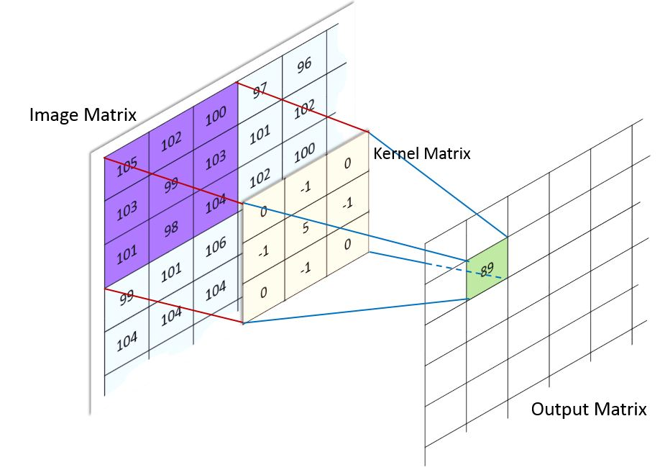
Implementation - Convolution and Kernels (cont.)
Figure 1 – Convolution (Kazemi, Figure 3)

Slide 6
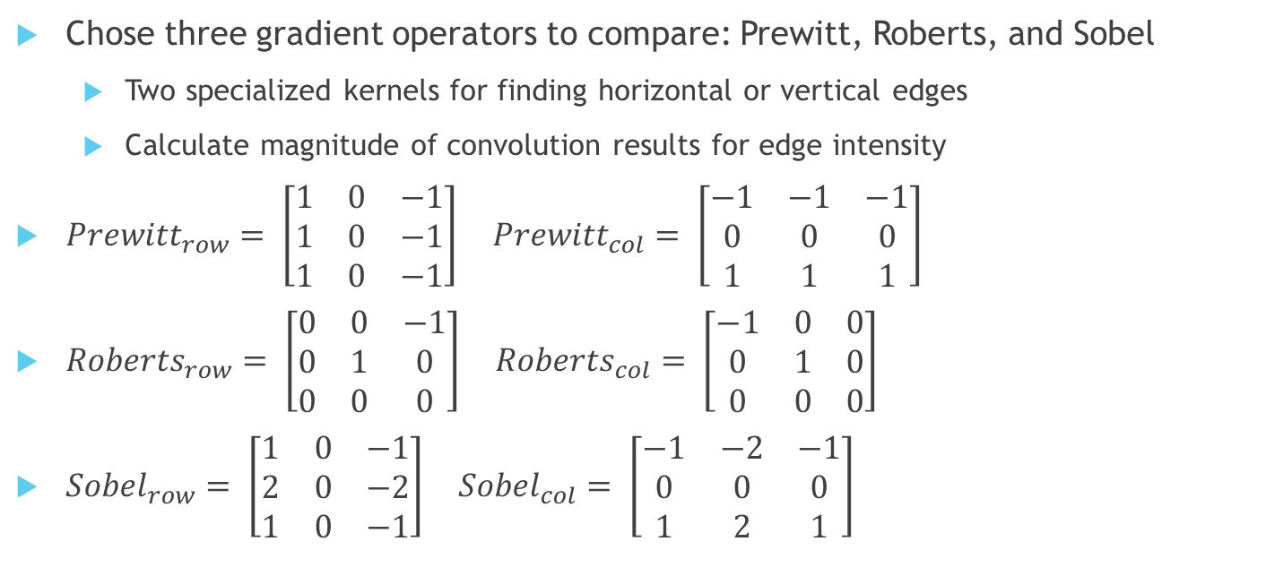
Implementation - Convolution and Kernels (cont.)
Chose three gradient operators to compare: Prewitt, Roberts, and Sobel
Two specialized kernels for finding horizontal or vertical edges
Calculate magnitude of convolution results for edge intensity
${Prewitt}_{row}= \left[\begin{matrix}1 & 0 & −1 \\ 1 & 0 & −1 \\ 1 & 0 & −1\end{matrix}\right] {Prewitt}_{col}= \left[\begin{matrix}−1 & −1 & −1 \\ 0 & 0 & 0 \\ 1 & 1 & 1\end{matrix}\right]$
${Roberts}_{row}= \left[\begin{matrix}0 & 0 & −1 \\ 0 & 1 & 0 \\ 0 & 0 & 0\end{matrix}\right] {Roberts}_{col}= \left[\begin{matrix}−1 & 0 & 0 \\ 0 & 1 & 0 \\ 0 & 0 & 0\end{matrix}\right]$
${Sobel}_{row}= \left[\begin{matrix}1 & 0 & −1 \\ 2 & 0 & −2 \\ 1 & 0 & −1\end{matrix}\right] {Sobel}_{col}= \left[\begin{matrix}−1 & −2 & −1 \\ 0 & 0 & 0 \\ 1 & 2 & 1\end{matrix}\right]$

Slide 7
Implementation - General Approach
Structure of file formats varies
Different file header structures
1 to N channels of values per pixel represented by different bit depths
Decided to use FreeImage library
Open-source library specializing in read/writing image files
Wrote utility methods to interface with library
Focused on how to convolve grayscale vs color images
Iterate over grayscale data and convolve with image kernels
Converted color images to grayscale

Slide 8
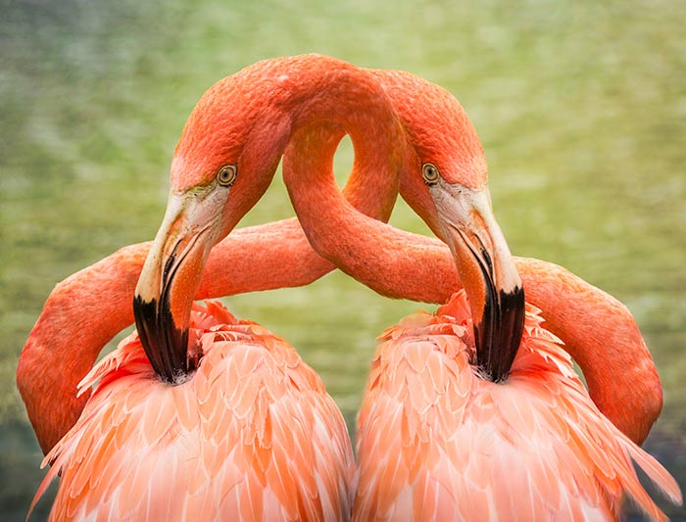
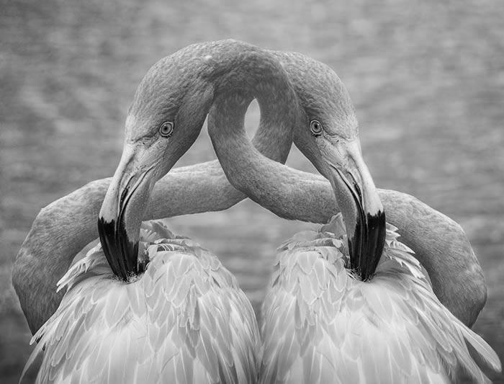
Implementation - General Approach (cont.)
Figure 2 – Test Image and Grayscale

Slide 9
Implementation - CPU Approach
Nested for loop iterates over rows and columns of image data
Skipped outermost rows/columns to avoid boundary issues
Apply gradient operator to each pixel and it’s neighbors
Calculate magnitude of row and column convolution results
Repeat for all three gradient operators

Slide 10
Implementation - GPU Approach
Copy image and gradient operators to GPU
Decompose image data into grid of blocks
Created 2D grid made up of 16x16 blocks
Execute kernel
Utilized same convolution method as CPU
Created global and shared memory kernels for additional comparison
Copy image data back to host
Repeat for all three gradient operators, and global/shared memory kernels

Slide 11
Implementation - HSV
Found other color models during research
Color data represented in ways besides RGB model
Chose to implement Hue, Saturation, and Value (HSV) color model
Hue indicates how similar a color is to red, green, or blue
Saturation refers to intensity/purity of a color
Value represents the maximum value of the RGB components
Could now compare three image kernels across multiple color models

Slide 12
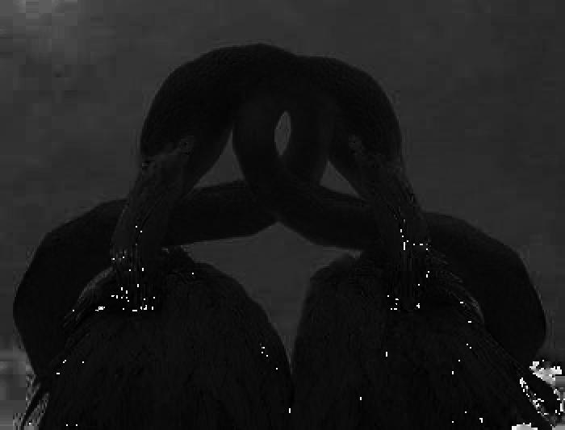
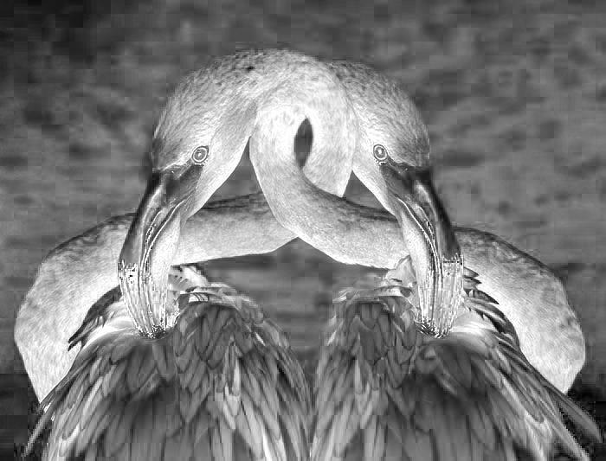
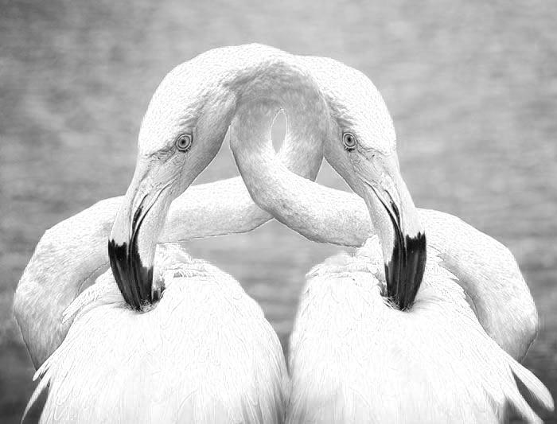
Implementation - HSV (cont.)
Figure 3 – Test Image (TL), Hue (TR), Saturation (BL), and Value (BR)

Slide 13
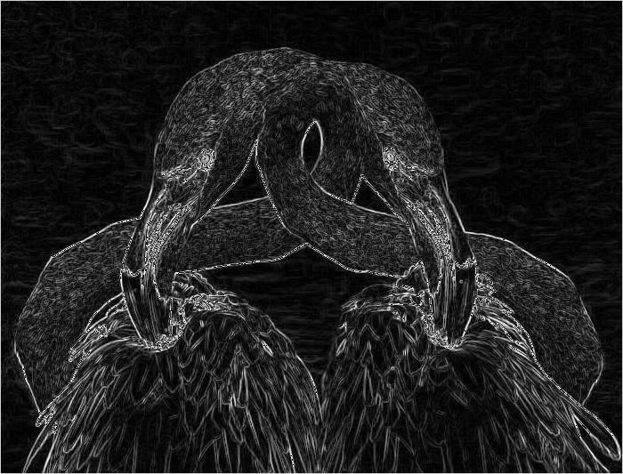
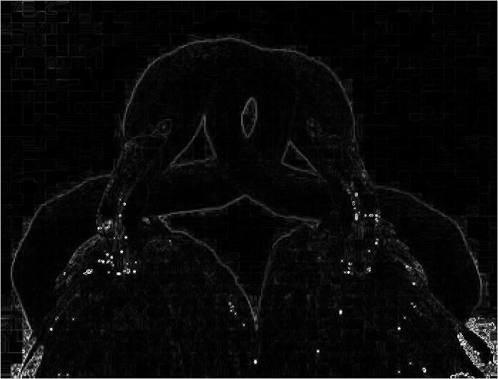
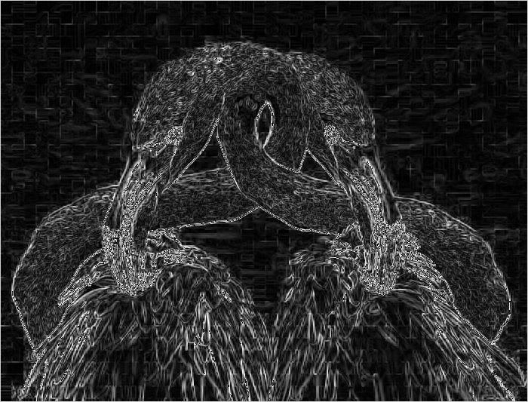
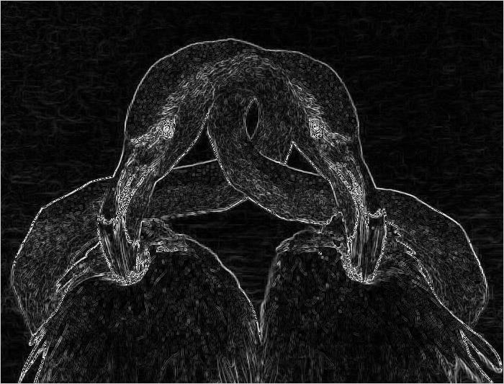
Analysis - Grayscale vs HSV (Prewitt)
Grayscale and Value output highlight less distinct edges
Ex. Feathers
Hue output seems to focus on just the birds
Could be useful for object recognition algorithms
Saturation output has concentrated intensity around the eyes and beaks
Could be useful for facial recognition algorithms
Figure 4 – Grayscale (TL), Hue (TR), Saturation (BL), and Value (BR)

Slide 14
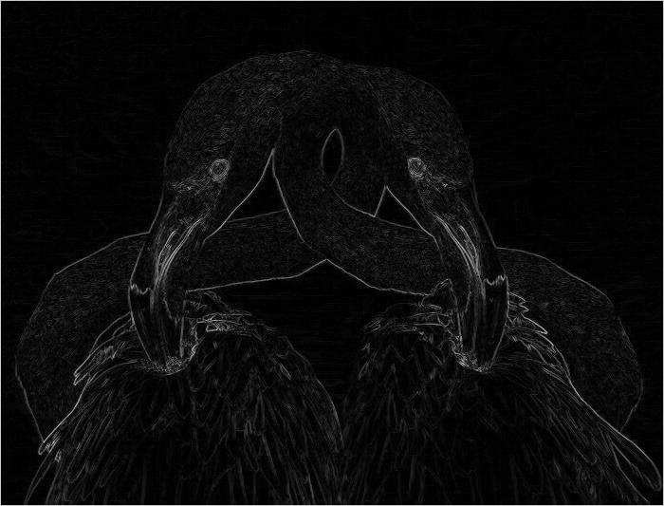
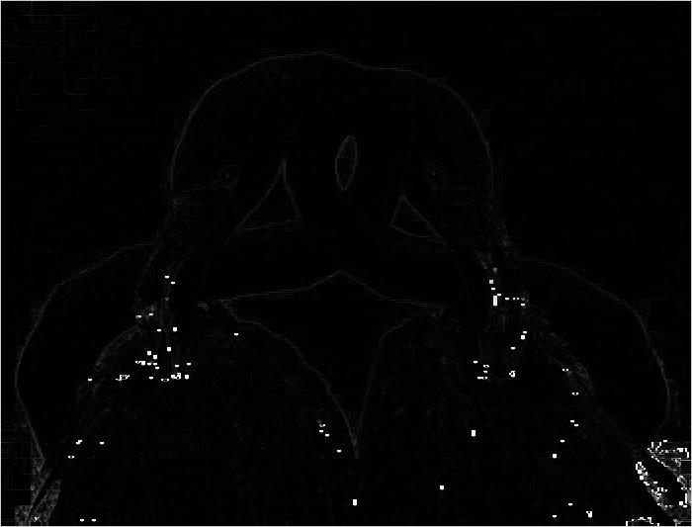
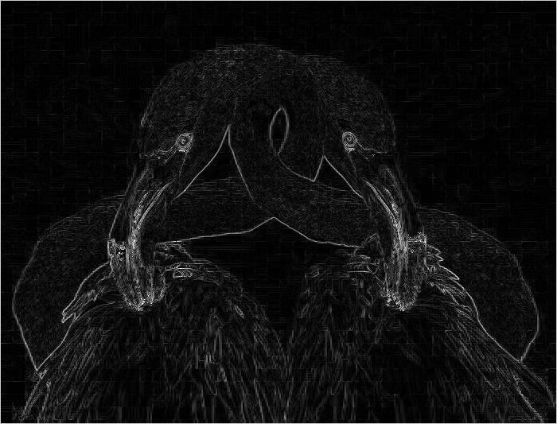
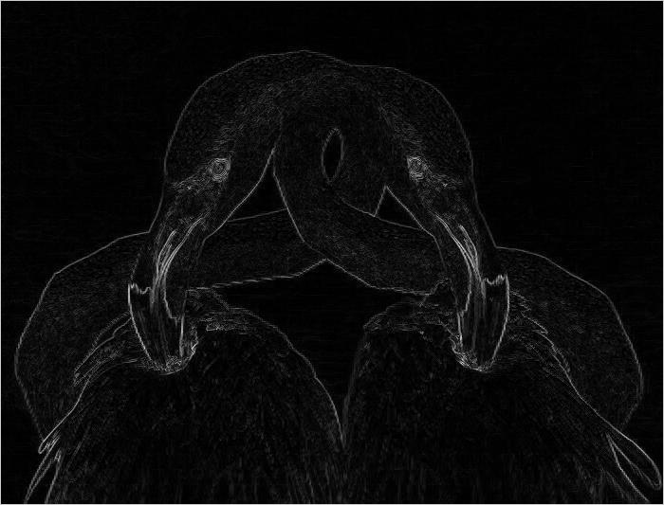
Analysis - Grayscale vs HSV (Roberts)
Grayscale and HSV comparisons match those made in the Prewitt section
Comparison to Prewitt output
Seems to do a better job at highlighting just the birds in the image
Appears to be less noisy
Figure 5 – Grayscale (TL), Hue (TR), Saturation (BL), and Value (BR)

Slide 15
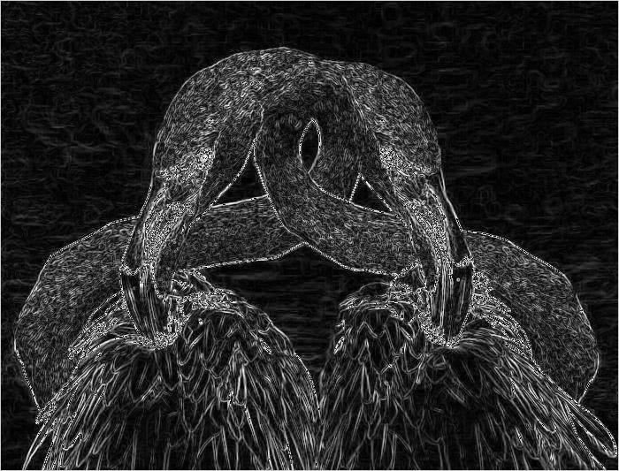
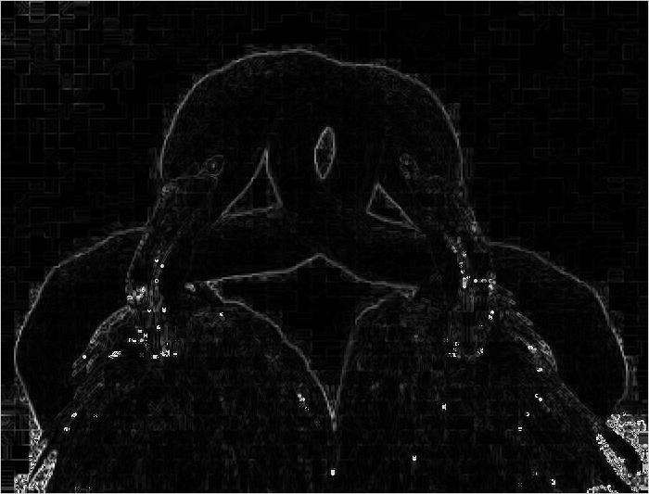
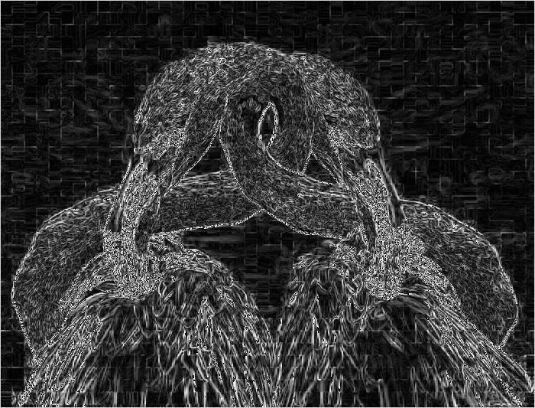
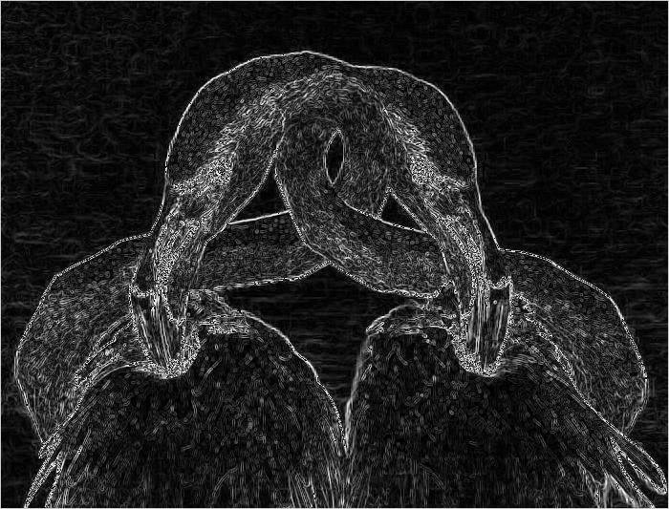
Analysis - Grayscale vs HSV (Sobel)
Grayscale and HSV comparisons match those made in the Prewitt section
Comparison to Prewitt and Roberts output
Output quite similar to Prewitt output
A bit noisier than other two gradient operators
Seems to do a better job at finding the diagonal edges in the image
Figure 6 – Grayscale (TL), Hue (TR), Saturation (BL), and Value (BR)

Slide 16
Analysis - Timing Results
Image | Image Dimensions (total pixels) | CPU Execution Times (ms) | GPU Execution Times (ms)
 |  |  | Global Memory | Shared Memory
mountains.jpg | 500 x 348 (174,000) | 6.3000 | 0.4530 | 0.4285
lena.png | 512 x 512 (262,144) | 9.6186 | 0.5202 | 0.4687
birds.jpg | 700 x 533 (373,100) | 15.9758 | 0.6813 | 0.5651
church.jpg | 1024 x 768 (786,432) | 28.9552 | 1.0745 | 0.8162
pisa.jpg | 1600 x 900 (1,440,000) | 52.4860 | 1.5420 | 1.2809
valley.jpg | 2560 x 1440 (3,686,400) | 135.4677 | 3.0519 | 2.0822
town.jpg | 3840 x 2160 (8,294,400) | 306.9337 | 7.9471 | 5.11236
Figure 7 – Timing Results

Slide 17
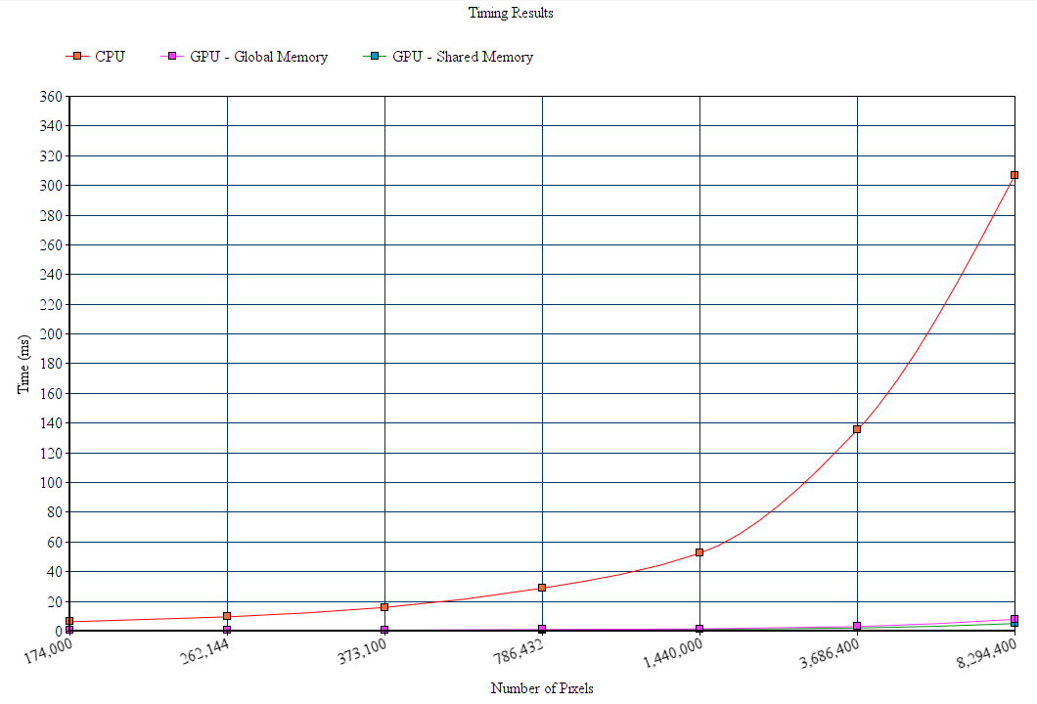
Analysis - Timing Results (cont.)
Figure 8 – Timing Results

Slide 18
Conclusion
GPU considerably better than CPU processing image data in SIMD fashion
Discrepancy grows substantially as image data size increases
CPU would have better results with multithreading support
Shared memory kernel outperformed global memory kernel
Pros and cons of each gradient operator made evident by RGB/grayscale and HSV color model output
Possible project extensions and improvements
Implement additional edge detection algorithms, gradient operators, and color models
Utilize pixel thresholds to reduce noise in output
Analyze filtered image data further using object/pattern recognition algorithms
Utilize texture memory, NPP library, and/or different block sizes for potential GPU improvements

Slide 19
Works Cited
Crane, Randy. A Simplified Approach to Image Processing: Classical and Modern Techniques in C. Prentice Hall PTR, 1997.
Kazemi, Hadi. “Image Filtering.” Machine Learning Guru, 6 Feb. 2017, 15:52:07, machinelearninguru.com/computer_vision/basics/convolution/image_convolution_1.html.

