Slide 1
AIDS Denialism on the Internet
Miles C. Coleman and Joy M. Cypher
Communication Studies

Slide 2
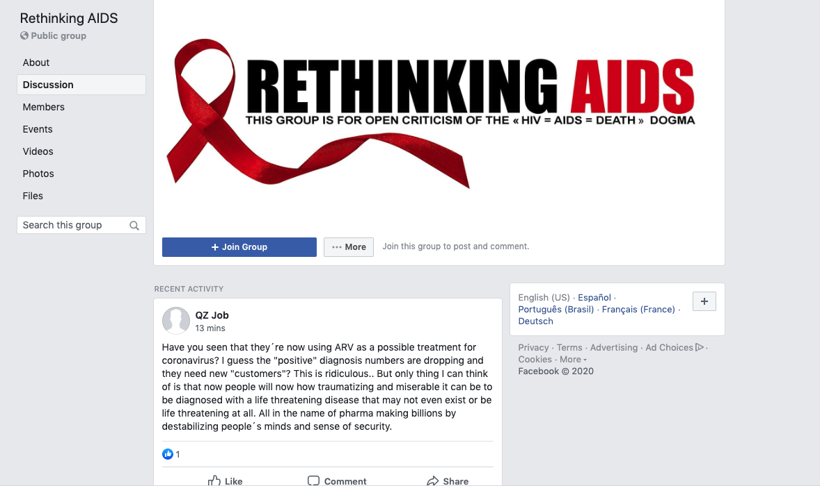
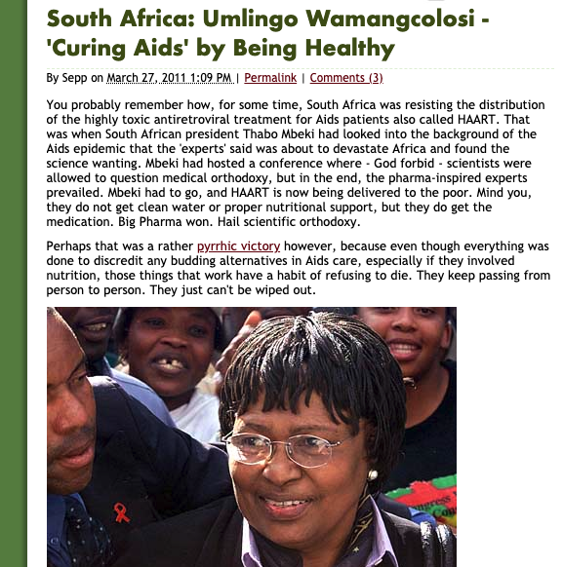


Slide 3
We need to learn more about AIDS denialist publics.
What is appealing about AIDS denialism?
We need methods for dealing with the “mess” of internet publics.
How can we “sift” through online texts and define the relevant intertextual relationships between those texts?

Slide 4
Background: HIV/AIDS Denialism, Science, and Conspiracy
Early 1980s: AIDS is identified.
Mid-1980s: HIV is discovered to be the cause of AIDS.
1987: Azidothymidine (AZT) introduced.
Peter Duesberg argues that HIV does not cause aids in Cancer Research.
1990s-present: Scientific consensus is that HIV causes AIDS, and therefore, HIV tests indicate disease, and antiretroviral therapies can treat infection.
AIDS activism—advocacy for the AIDS community—runs throughout this timeline.

Slide 5
Assumptions: Existential Suffering in HIV/AIDS Discourses
HIV+ diagnosis can entail:
Fear of stigma
Worry over mortality/chronic illness
Shame
Depression
As such, HIV+ diagnosis can carry threats of existential suffering: loss of control and stability.
To recognize the existential suffering of AIDS denialist publics is a responsible way to approach fellow persons with genuine stakes in the world.

Slide 6
Method: Networked Public Analysis
Composed of arrays of videos, websites, blog entries, et cetera, networks of texts—networked publics—afford the appearance of choice to the postmodern medical consumer.
Networked public analysis is a mode of intertextual analysis, which emphasizes the composition and shape of a network so as to inform rhetorical ”close readings” of texts important to a given networked public.

Slide 7
Method: Networked Public Analysis
To visualize a network of AIDS conspiracy texts is to afford visual/spatial representation to the constellation of texts, interacting with one another to create an environment hospitable to some discourses, and inhospitable to others.
Discovery of the network.
Analysis of the composition of the network/relationships between texts.
Close reading of the nodes/texts in the network.
Operationalization of themes regarding forms, narratives, and modalities discovered in the network/clusters of texts.
Synthesis of discovered themes with the composition of the network/relationship between texts.

Slide 8
Discovery of the AIDS Denialist Networked Public
Seed links harvested from:
“AIDS is a hoax”
“Is AIDS real?”
“HIV lies and deception”
“AIDS conspiracy”
“HIV conspiracy”
91 seed texts (e.g., rethinkingaids.facebook.com, isaidsreal.com)
1802 individual pages

Slide 9
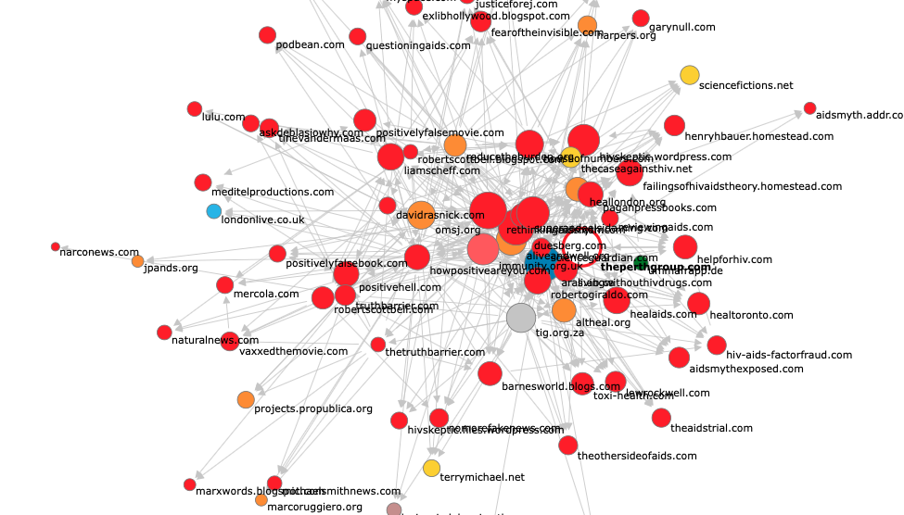
rethinkingaids.com
theperthgroup.com
duesberg.com
immunity.org.uk
aras.ab.ca

Slide 10
https://firstmonday.github.io/networkmap/
https://rethinkingaids.com
http://www.theperthgroup.com
http://www.immunity.org.uk
http://aras.ab.ca
http://www.duesberg.com/

Slide 11
Conclusions
What makes AIDS denialist arguments appealing?
By means of various digital rhetorics, the discourses of the AIDS denialist network, represent, ostensibly, persuasive arrays of choice to the user in order to make appeals to the existential states of persons, characterized generally by:
1) The perception of powerlessness in one’s health--loss of control.
2) The uncertainty of one’s future--the loss of stability.
How can we “sift” through online texts and define the relevant intertextual relationships between those texts?
By applying ideas of “networks” and “publics” we can map network of texts so as to discover the texts most important a given public.

Slide 12
Article will be out in May!
”The Digital Rhetorics of AIDS Denailist Networked Publics.” First Monday (May 2020).

