Slide 1
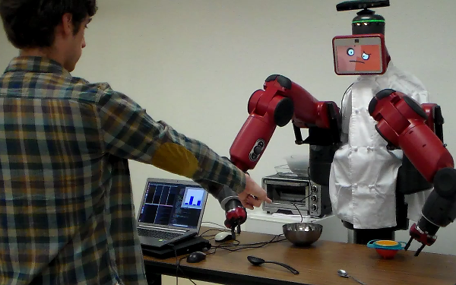
1
0
Black
spoon
Orange
bowl
Silver
spoon
Silver
bowl

Slide 2
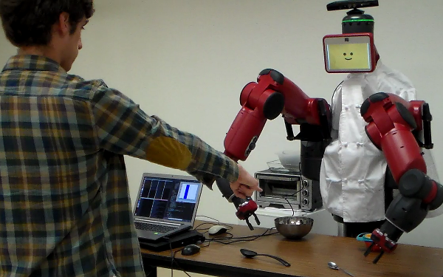
the spoon
1
0
Black
spoon
Orange
bowl
Silver
spoon
Silver
bowl

