Slide 1
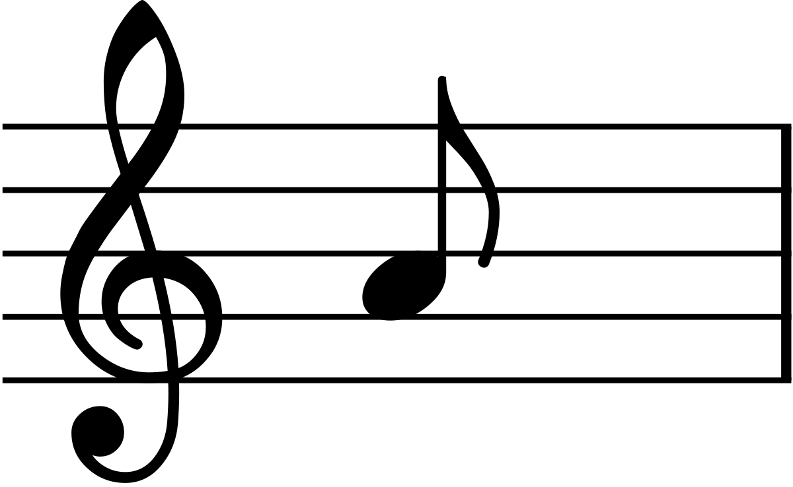
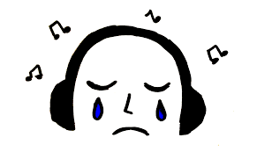
Music Sentiment Transfer
Michael Zhou, Miles Sigel, Jiebo Luo

Slide 2
What is Music Sentiment Transfer?
A machine learning task that modifies a music piece from a source sentiment to a target sentiment by transferring the underlying structure of different sentiment classes while preserving the original musical content
Sad melody
Happy melody

Slide 3
Goals of Project
Learn underlying patterns between different musical sentiments in an unsupervised setting
Transfer musical piece from one sentiment to another while preserving enough melodic content
Produce realistic-sounding music outputs
Consider two extreme sentiments - positive and negative
Focus on single-track (single-instrument)

Slide 4
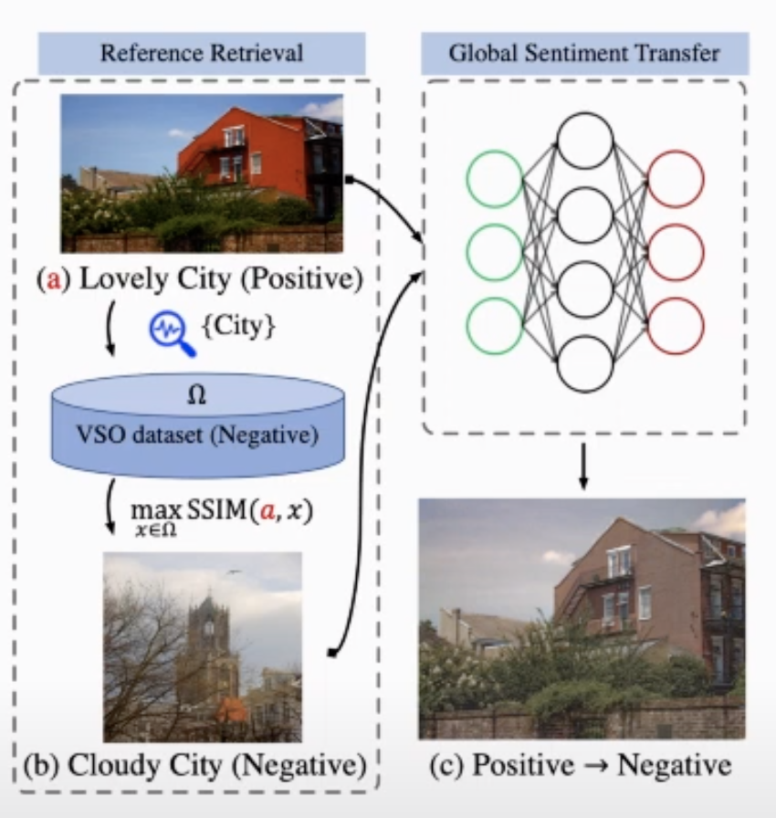
Context of Sentiment Transfer
First studied in images
Content and Sentiment Codes
Transferring the sentiment code (e.g. color, brightness, texture) while preserving content code (e.g. contour shapes)
Audio Sentiments - not as clearly defined as images
Time domain
Raw audio - higher tendency for noise and lack of structure due to high sampling rates
Need to learn important features of sentiment without noise interference (Data is Important!!)
Notes:
Reference:
Global Sentiment Transfer

Slide 5
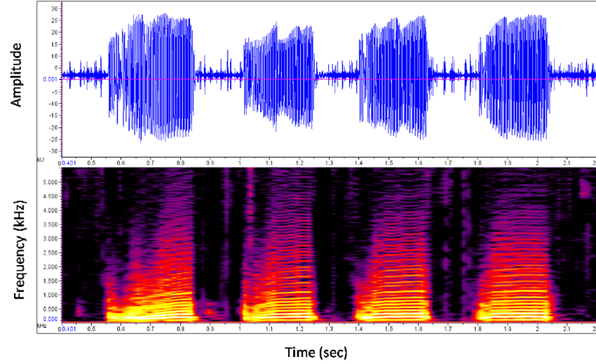
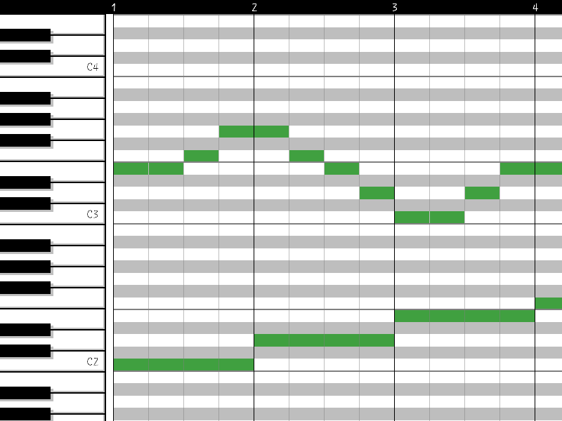
Music Data Representation
Raw Audio (WAV, MP3, etc.)
Voice Conversion GAN networks to learn male and female voices
Does NOT learn sentiments (deeper structures needed!)
Symbolic Music (MIDI)
Similar to sheet music
Encodes music structure properties useful for sentiment - note length, loudness, key, time signature, etc.
Notes:
Reference:
MelGAN-VC: Voice Conversion and Audio Style Transfer on arbitrarily long samples using Spectrograms

Slide 6
Data or Knowledge?
Data-Driven
Machine learning to learn the underlying patterns of music sentiments from data.
Only effective when you have good datasets
Knowledge-Driven
Music theory to change musical structure (e.g. minor to major keys)
No requirement for dataset
Plan to combine both approaches due to lack of extant dataset

Slide 7
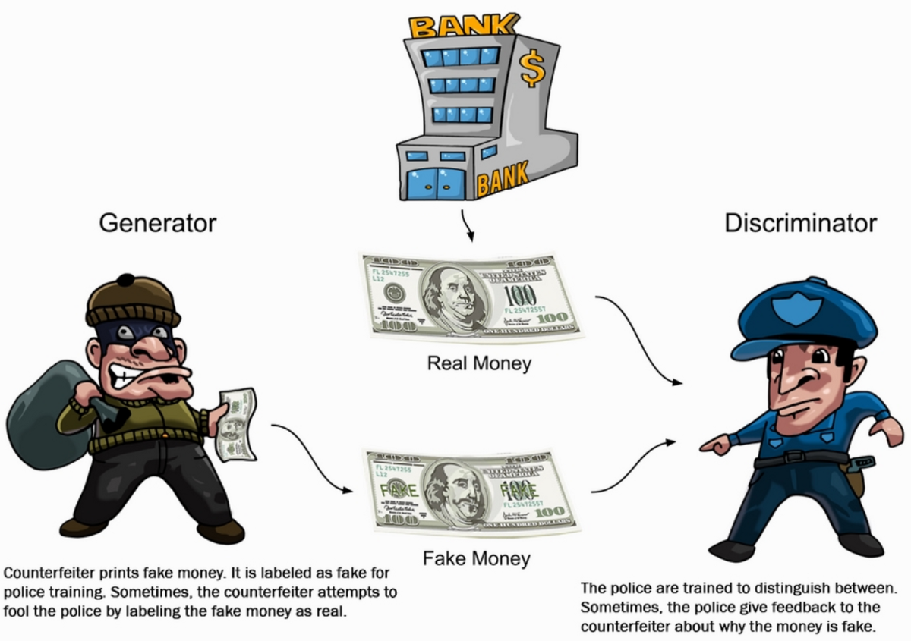
Generative Adversarial Network (GAN)
Commonly used in transfer tasks
Notes:
Generator - domain transfer mechanism
Discriminator - how well is the transfer of sentiment?

Slide 8
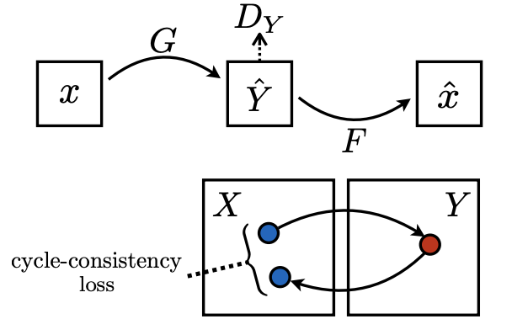
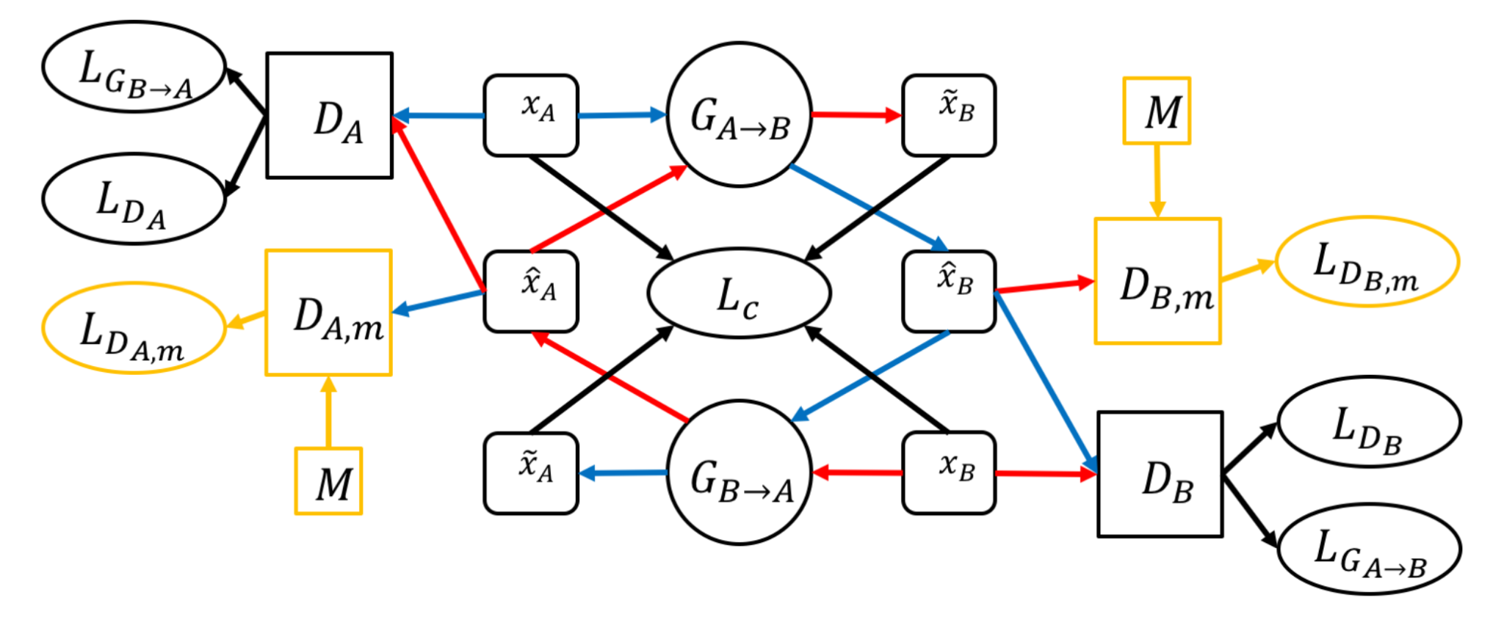
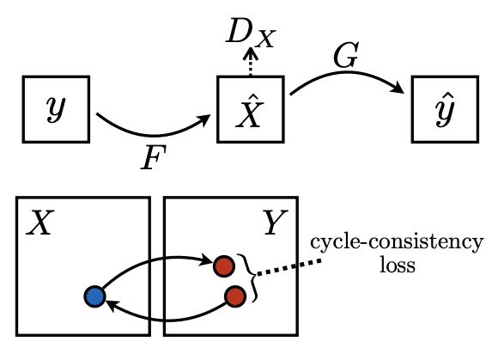
Proposed Network: CycleGAN
Learns a 1-to-1 mapping between the two sentiment domains using unpaired data
Cycles back and forth between sentiments while preserving melodic content
Generates realistic-sounding outputs
Notes:
M - full music dataset in 2+ domains
Transform x_A and x_B through a generator (transfer domains) -> obtain x_hat_B and x_hat_A
Transform back -> obtain obtain x_tilde_A and x_tilde_B
Cycle consistency loss: How close is x_tilde_A to x_A (and x_tilde_B to x_B)
Generator loss: 0 when discriminator outputs real, 1 if fake
Standard Discriminator loss: distinguish from within target domain only
Extra Discriminator loss: distinguish from multiple domains
Reference: Symbolic Music Genre Transfer with CycleGAN

Slide 9
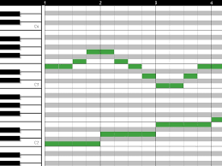
Discussion
Created our own dataset by transforming into piano roll arrays (display of note event data) from VGMIDI
Sentiment transfer in music is different from images - music cannot be separated into content and style codes once transformed into piano rolls.
Other models considered:
Autoregressive networks - can work with unpaired data, but cannot preserve source content
MelGAN-VC - similar to CycleGAN, but cannot learn deeper structures of music sentiment
Many image-based GANs cannot be used for music transfer (due to noise in spectrograms)
Symbolic music datasets allows less noise than in raw audio data, encodes deep underlying features for sentiment directly, but is less applicable in real-world situations that use raw audio
Initial Results still on the way (Stay tuned!)
Piano roll
Notes:
Create our own dataset - piano roll arrays (note events) - due to lack of extant dataset for sentiment labeled, single track MIDI
Divided dataset into different sentiment labels
Flattened pieces into different tracks
Transformed into piano roll
Spliced pieces into 4-bar measures
64 (16th note x 4 bars) x 84 (MIDI channels - piano) sections
Sentiment transfer - different from images (cannot just use style and content code)
Other models considered
Symbolic music datasets
less noise than in raw audio data
deep underlying structures
Less applicable in real-world situations
Initial results still in progress - stay tuned
References:
VGMIDI Dataset
MelGAN-VC

Slide 10
Conclusion
Audio sentiment transfer is a novel task which is an extension of the better studied style transfer task.
Audio sentiment transfer goes beyond changing note tones, as sentiment is embedded in deeper structures of music.
There are a lack of existing datasets that are labelled by sentiment for both raw audio and symbolic audio.
Further research should combine an expert knowledge of musical composition to tune parameters and provide insight into the relationship between musical structure and sentiment.

