Slide 1

BarKyanLal
AI food expiry assistant for smarter home kitchens
TEAM - BLIND MICE
• STI Myanmar College, Youth AI Innovation Competition

Slide 2
01.
Food Waste Pressure
→
BarKyanLal
02.
Smart Kitchen Solution
→
03.
Prototype Journey
→
04.
Viable Business Model
→
AI food expiry assistant for smarter home kitchens
TEAM - BLIND MICE
• STI Myanmar College, Youth AI Innovation Competition
Presentation
Map
BarKyanLal App
Blind Mice

Slide 3
Presentation
Map
01.
Food Waste Pressure
→
BarKyanLal
02.
Smart Kitchen Solution
→
03.
Prototype Journey
→
04.
Viable Business Model
→
BarKyanLal App
Blind Mice
AI food expiry assistant for smarter home kitchens
TEAM - BLIND MICE
• STI Myanmar College, Youth AI Innovation Competition

Slide 4
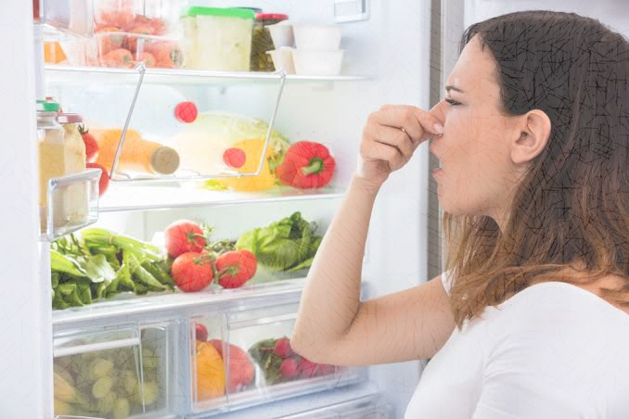
Presentation
Map
BarKyanLal App
Blind Mice
The Situation (Expired Food at Home)
01
01
Forgotten Expiry Dates
→
CHAPTER
01.
02.
Smart Kitchen Solution
→
Food Waste Pressure
02
Redundant Shopping
03.
Prototype Journey
→
04.
Viable Business Model
→
03
Invisible Resource Drain

Slide 5
01
CHAPTER
01.
Food Waste Pressure
The Situation (Expired Food at Home)
01
Forgotten Expiry Dates
02
Redundant Shopping
03
Invisible Resource Drain

Slide 6
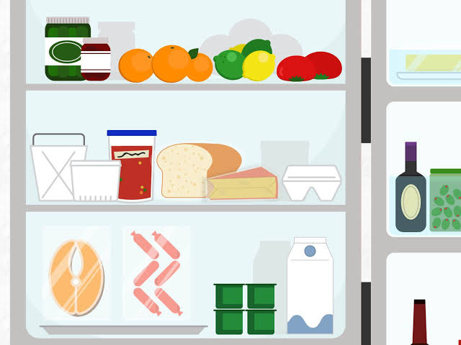
Time Loss
2
Financial Waste
The Problems
The Broken Household Memory System
Responsible Consumption
SDG 12 goal.
1
The Situation (Expired Food at Home)
01
Forgotten Expiry Dates
02
Redundant Shopping
⚠ The Daily Friction
03
Invisible Resource Drain
A massive scale of household food waste quietly draining money, time, and mental energy.
Meal Stress
BarKyanLal:
Sustainable Development Goal 12
3
Housewife Burden
4

Slide 7
The Situation (Expired Food at Home)
The Problems
The Broken Household Memory System
02
Financial Waste
Forgotten Expiry Dates
01
Responsible Consumption
Ingredients are forgotten in fridges and cabinets, leading to missed expiry dates and food spoilage.
CHAPTER
SDG 12 goal.
02.
Time Loss
1
2
Redundant Shopping
Smart Kitchen Solution
02
Without a reliable tracking system, grocery shopping is repeated, resulting in unnecessary duplicate purchases.
Housewife Burden
Invisible Resource Drain
⚠ The Daily Friction
Meal Stress
03
A massive scale of household food waste quietly draining money, time, and mental energy.
This daily friction quietly wastes money and time, adding significant mental load to home managers.
4
BarKyanLal:
Sustainable Development Goal 12
3

Slide 8
The Problems
The Solution (AI Guided Meal Planning)
The Broken Household Memory System
Seamless App Workflow
Financial Waste
Food waste stems from a broken household memory system, not just carelessness.
Ingredients disappear into the fridge until they expire, disrupting sustainable consumption and SDG 12 goals.
02
Time Loss
CHAPTER
1
02.
Storage Tracking
Shared Inventory
2
Expiry Alerts
AI Recipes
>
>
>
Smart Kitchen Solution
Housewife Burden
Meal Stress
4
SDG 12: Responsible Consumption
3
Save Food
Save Money
Simplify Management

Slide 9
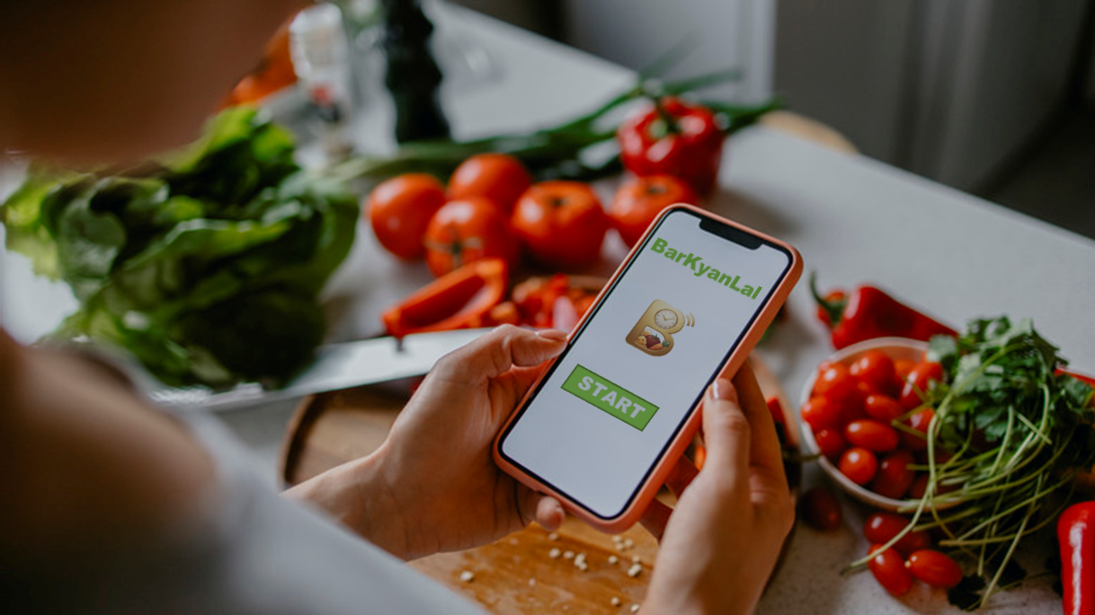
The Problems
Financial Waste
The Broken Household Memory System
Users pay twice for the same item when forgotten ingredients expire and require repurchasing.
Time Loss
Food waste stems from a broken household memory system, not just carelessness.
Ingredients disappear into the fridge until they expire, disrupting sustainable consumption and SDG 12 goals.
Extra time is wasted checking the fridge to verify which ingredients remain safe for cooking.
1
2
Housewife Burden
Meal Stress
Housewives bear the intense mental load of managing meal planning, storage, and budget pressures.
Last-minute panic occurs when planned ingredients are discovered to be unsafe right before mealtime.
4
3
SDG 12: Responsible Consumption
The Solution (AI Guided Meal Planning)
Seamless App Workflow
02
CHAPTER
02.
Storage Tracking
Shared Inventory
Expiry Alerts
>
AI Recipes
>
>
Smart Kitchen Solution
Save Food
Save Money
Simplify Management
Effects on users (Impact)
Four Direct Benefits
1
2
Prevents Forgotten Food
Reduces Spending
The app fits seamlessly into your existing daily kitchen routine.
3
4
Add an item once, receive a reminder, and choose your next action.
Faster Meal Decisions
Easier Cooking Steps
Scan → Alert → Act

Slide 10
The Solution (AI Guided Meal Planning)
Seamless App Workflow
Storage Tracking
Shared Inventory
Expiry Alerts
>
AI Recipes
>
>
Save Food
Save Money
Simplify Management
Effects on users (Impact)
Four Direct Benefits
1
2
Prevents Forgotten Food
Reduces Spending
The app fits seamlessly into your existing daily kitchen routine.
Add an item once, receive a reminder, and choose your next action.
3
4
Scan → Alert → Act
Faster Meal Decisions
Easier Cooking Steps

Slide 11
Effects on users (Impact)
Four Direct Benefits
03
1
2
CHAPTER
Prevents Forgotten Food
Reduces Spending
03.
The app fits seamlessly into your existing daily kitchen routine.
Prototype Journey
Add an item once, receive a reminder, and choose your next action.
3
4
Scan → Alert → Act
Faster Meal Decisions
Easier Cooking Steps

Slide 12
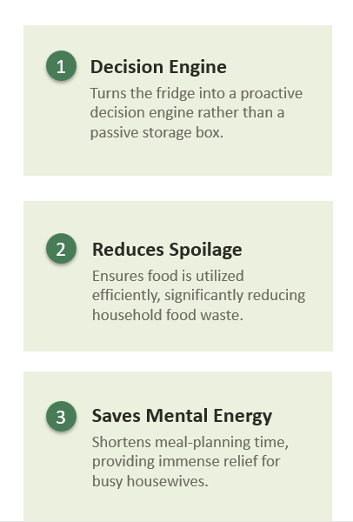
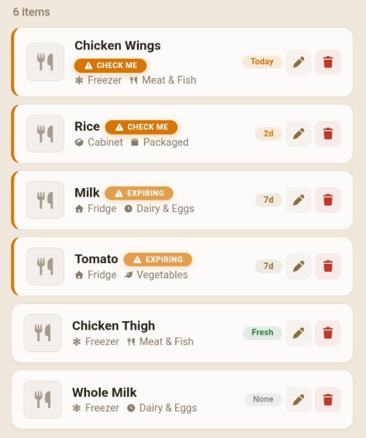
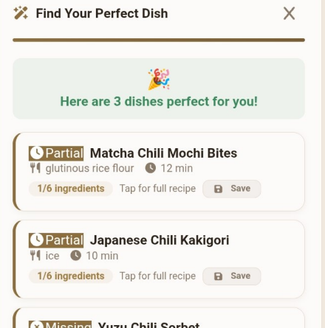

BarKyanLal
Smart Expiry Tracking
AI-Guided Meal Planning
Value Proposition
Target Audience: Busy Home Cooks
Differentiation:
An algorithm trained to suggest smart ingredient substitutions based on household cooking habits
BarKyanLal scans stored ingredients and ranks them by expiration date.
It surfaces the right ingredient at the exact right time automatically.
The app recommends recipes using the most urgent items first.
It converts expiring ingredients into practical cooking suggestions instantly.

Slide 13
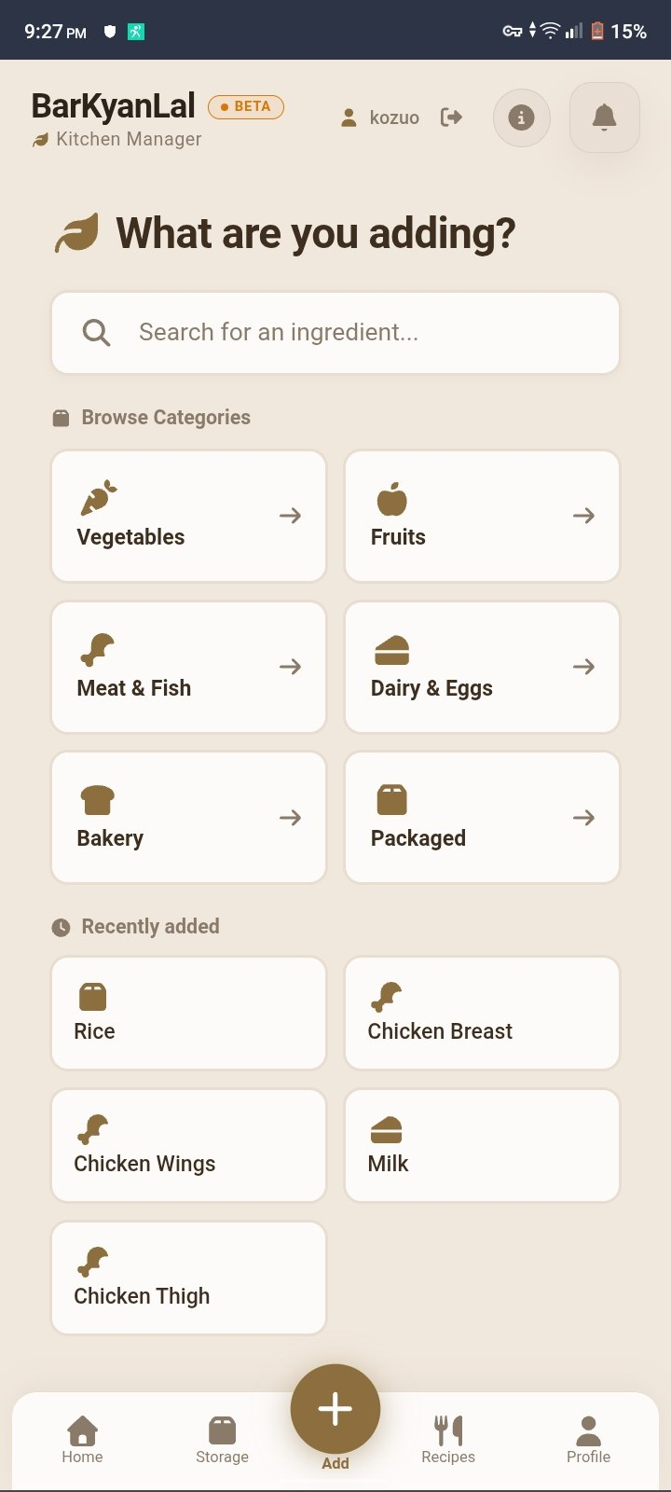
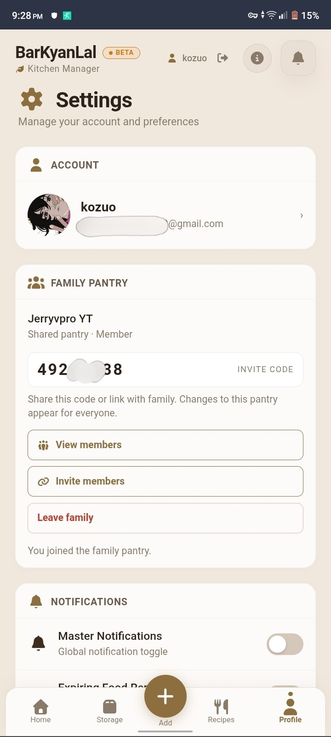
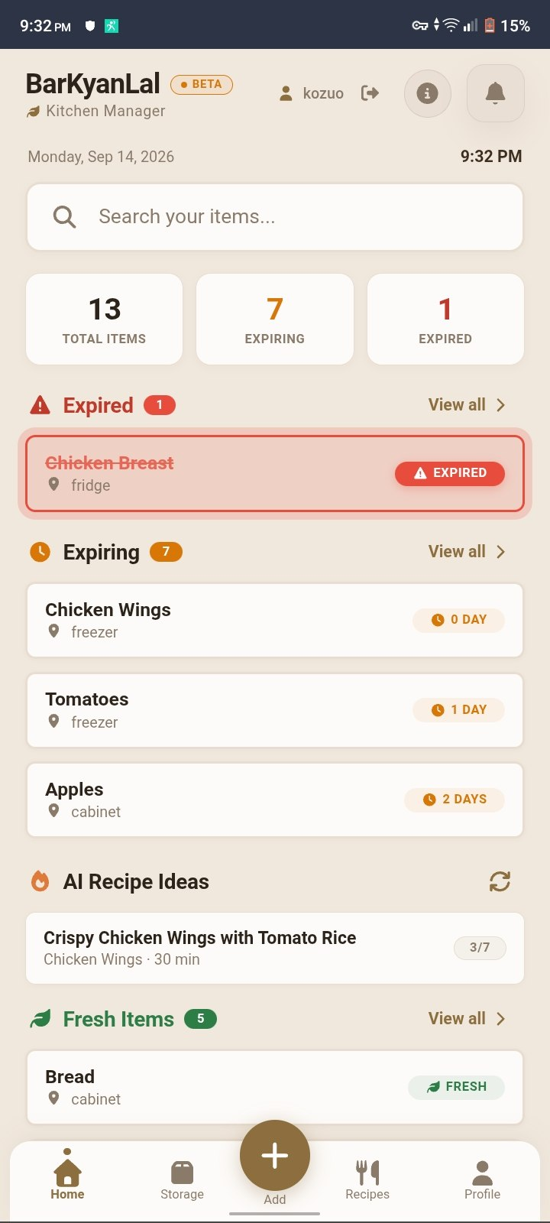
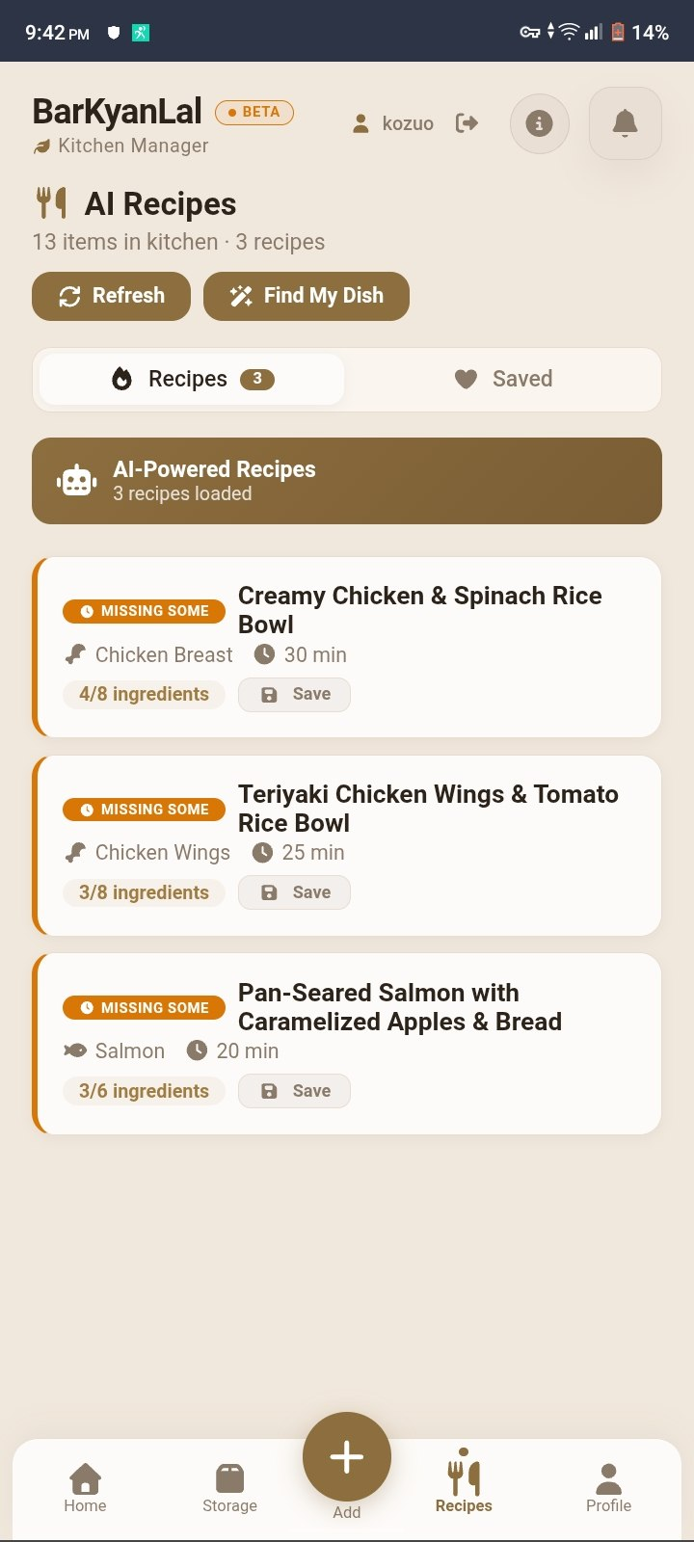


Prototype Screens
BarKyanLal
Smart Expiry Tracking
AI-Guided Meal Planning
Value Proposition
Target Audience: Busy Home Cooks
Differentiation:
An algorithm trained to suggest smart ingredient substitutions based on household cooking habits
Inventory Scan
Recipe Generation
BarKyanLal scans stored ingredients and ranks them by expiration date.
It surfaces the right ingredient at the exact right time automatically.
The app recommends recipes using the most urgent items first.
It converts expiring ingredients into practical cooking suggestions instantly.
STEP 01
STEP 02
STEP 03
STEP 04
Add Item
Family Pantry
Expiry Alert
Take Action
What you can do more
Log in, Sign up Accs.
Change themes & languages.
Import/Export inventory, auto-delete system.

Slide 14
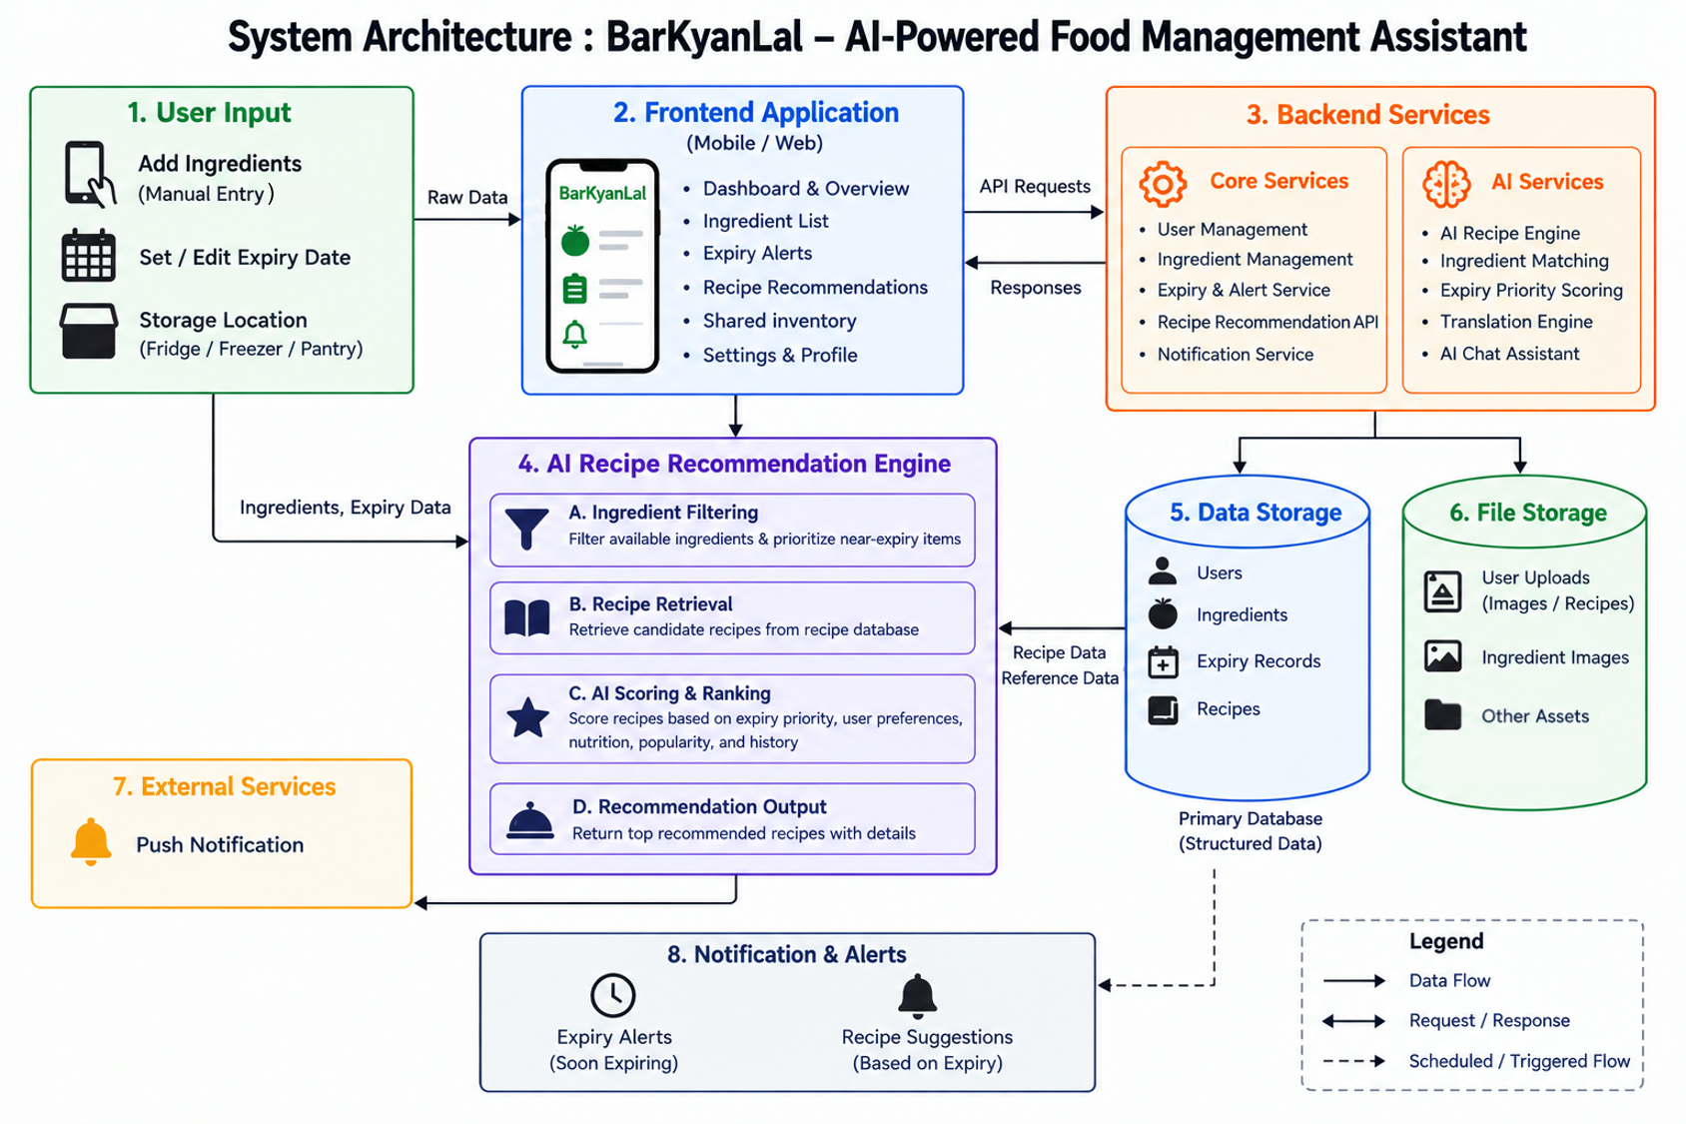


Prototype Screens
BarKyanLal
Smart Expiry Tracking
AI-Guided Meal Planning
Value Proposition
Target Audience: Busy Home Cooks
Differentiation:
An algorithm trained to suggest smart ingredient substitutions based on household cooking habits
Inventory Scan
Recipe Generation
BarKyanLal scans stored ingredients and ranks them by expiration date.
It surfaces the right ingredient at the exact right time automatically.
The app recommends recipes using the most urgent items first.
It converts expiring ingredients into practical cooking suggestions instantly.
STEP 01
STEP 02
STEP 03
STEP 04
Add Item
Family Pantry
Expiry Alert
Take Action
What you can do more
Log in, Sign up Accs.
Change themes & languages.
Import/Export inventory, auto-delete system.

Slide 15


Prototype Screens
STEP 01
STEP 02
STEP 03
STEP 04
Add Item
Family Pantry
Expiry Alert
Take Action
What you can do more
Log in, Sign up Accs.
Change themes & languages.
Import/Export inventory, auto-delete system.
04
CHAPTER
04.
Viable Business Model

Slide 16


Freemium Growth Model
BarKyanLal by Team Blind Mice: Transforming household routines with
sustainable, AI-driven food management.
Premium Tier
Free Core
•
Shopping list recommendations
•
Expiry alerts for food items
•
Advanced AI recommendations
•
Basic storage tracking system
•
Food recognition scan & recipe image
•
Simple AI recipe suggestions
•
Personalized meal planning
•
Share/Import/Export inventory
04
Feasibility and Sustainability
CHAPTER
04.
Feasibility
Sustainability
Freemium Model
Viable Business Model
Launch with a freemium structure to attract users while offering premium features.
Digital Channels
Utilize social media and app stores to reach the target audience of housewives effectively.
Scalable Growth
1
Designed to scale seamlessly as the user base expands beyond the prototype stage.
Lightweight Partnerships
Cost Management
Collaborate with local grocery stores and food bloggers to expand without heavy costs.
2
Keep operational costs manageable through efficient infrastructure and smart AI integration.
Future Impact
3
Ensure long-term viability by continuously reducing food waste and promoting eco-friendly habits.

Slide 17

Freemium Growth Model
Feasibility and Sustainability
Feasibility
Sustainability
BarKyanLal by Team Blind Mice: Transforming household routines with
sustainable, AI-driven food management.
Freemium Model
Launch with a freemium structure to attract users while offering premium features.
Free Core
Premium Tier
•
Expiry alerts for food items
•
Shopping list recommendations
Digital Channels
Utilize social media and app stores to reach the target audience of housewives effectively.
Scalable Growth
•
Basic storage tracking system
1
•
Advanced AI recommendations
Designed to scale seamlessly as the user base expands beyond the prototype stage.
•
Simple AI recipe suggestions
•
Food recognition scan & recipe image
•
Share/Import/Export inventory
•
Cost Management
Lightweight Partnerships
Personalized meal planning
Collaborate with local grocery stores and food bloggers to expand without heavy costs.
2
Keep operational costs manageable through efficient infrastructure and smart AI integration.
Future Impact
3
Ensure long-term viability by continuously reducing food waste and promoting eco-friendly habits.
04
CHAPTER
04.
Viable Business Model

Slide 18

Freemium Growth Model
BarKyanLal by Team Blind Mice: Transforming household routines with
sustainable, AI-driven food management.
Premium Tier
Free Core
•
Shopping list recommendations
•
Expiry alerts for food items
•
Advanced AI recommendations
•
Basic storage tracking system
•
Food recognition scan & recipe image
•
Simple AI recipe suggestions
•
Personalized meal planning
•
Share/Import/Export inventory
Feasibility and Sustainability
Feasibility
Sustainability
Freemium Model
Launch with a freemium structure to attract users while offering premium features.
Digital Channels
Utilize social media and app stores to reach the target audience of housewives effectively.
Scalable Growth
1
Designed to scale seamlessly as the user base expands beyond the prototype stage.
Lightweight Partnerships
Cost Management
Collaborate with local grocery stores and food bloggers to expand without heavy costs.
2
Keep operational costs manageable through efficient infrastructure and smart AI integration.
Future Impact
3
Ensure long-term viability by continuously reducing food waste and promoting eco-friendly habits.

Slide 19


Feasibility and Sustainability
Team – Blind Mice
Feasibility
Sustainability
Lu Maw (Leader)
Hein Zay Lyan
Khant Min Paing
Problems
we had faced
Freemium Model
Launch with a freemium structure to attract users while offering premium features.
BarKyanLal
Authentication Issues
Need VPN to get better experiences
couldn't find free AI
API failing very often
Digital Channels
https://barkyanlal.netlify.app/
Utilize social media and app stores to reach the target audience of housewives effectively.
Scalable Growth
estimated development support cost:
USD 150~250 per month
AI API usage
GitHub Copilot (3 members)
Hosting and deployment
Push notification services
Other necessary third-party services
Ongoing improvements, testing, and maintenance
1
Designed to scale seamlessly as the user base expands beyond the prototype stage.
Lightweight Partnerships
Cost Management
Collaborate with local grocery stores and food bloggers to expand without heavy costs.
2
Keep operational costs manageable through efficient infrastructure and smart AI integration.
STI Myanmar College, Youth AI Innovation Competition
Future Impact
3
Ensure long-term viability by continuously reducing food waste and promoting eco-friendly habits.

