Slide 1
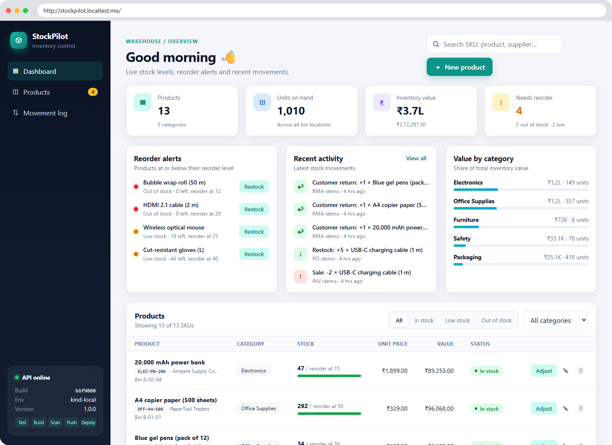
StockPilot
DEVOPS CAPSTONE PROJECT
Inventory management, from laptop to monitored Kubernetes
Varun Mundada · 24BCS10326
github.com/milesmoralis2411/devops_project_24bcs10326
FastAPI
React
PostgreSQL
Docker
GitHub Actions
Trivy
Terraform
AWS EKS
Helm
Prometheus
Grafana

Slide 2

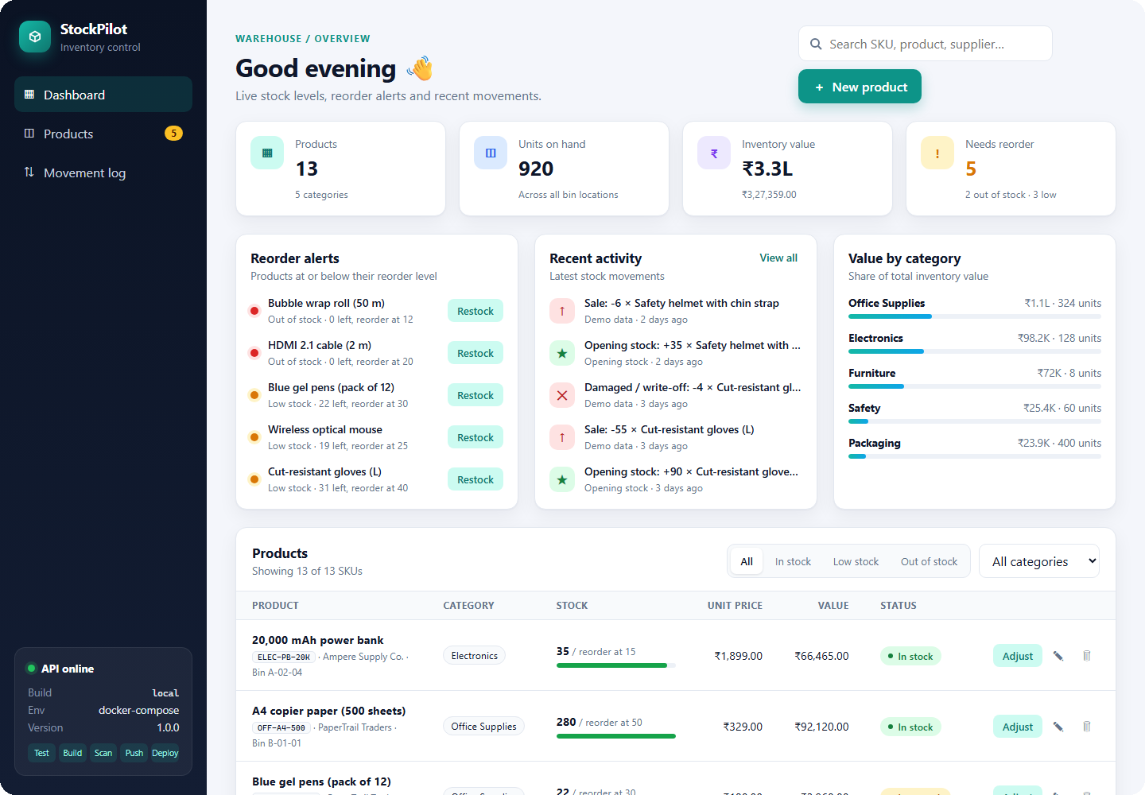



An inventory system with an audit trail
THE APPLICATION
Product catalogue
SKU, supplier, bin location, unit price and reorder level for every item
Stock movements
Receipts, sales, customer returns, damage write-offs and stock counts
Reorder alerts
Items at or below their reorder level, with one-click restock
Immutable movement log
Quantity changes only through logged adjustments, so every level can be explained
Dashboard: KPIs, reorder alerts, activity feed and inventory value by category

Slide 3



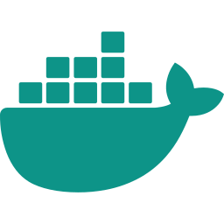








One repository, the whole delivery path
ARCHITECTURE
Developer
git push to main
GitHub
public repo, conventional commits
GitHub Actions
pytest · build · Trivy gate
GHCR
image:<git SHA>, never latest
helm upgrade --install, image tag = git SHA
Kubernetes: Amazon EKS 1.36 in a Terraform-built VPC (kind cluster for local runs)
Frontend ×2
React + Nginx, uid 101
Prometheus
scrapes /metrics
Grafana
16-panel dashboard
Ingress
Traefik: / and /api
Browser
/api proxy
Backend ×2–6
FastAPI, HPA at 60% CPU
PostgreSQL
StatefulSet + PVC
Alerts
4 alert rules

Slide 4
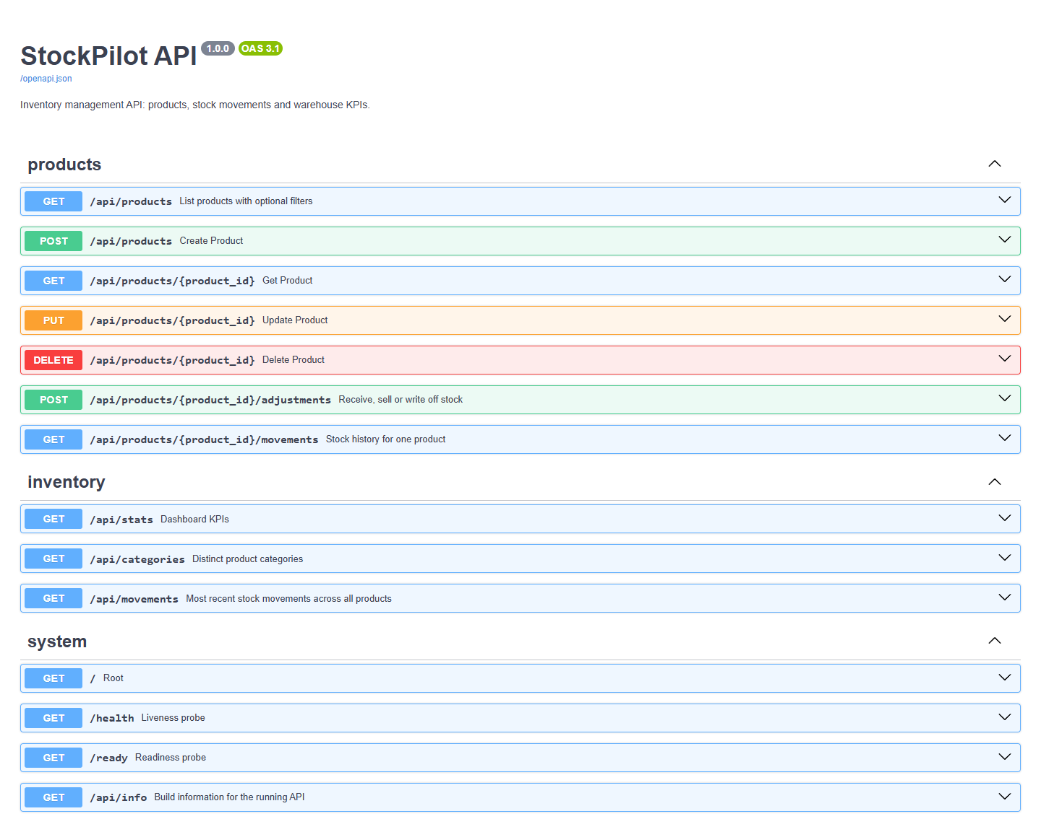
FastAPI backend with real domain rules
M1 · APPLICATION
11
2
409
REST endpoints under /api
Alembic migrations
returned on oversell
Rules enforced by the API
Stock changes only through adjustments, each one logged
Overselling returns 409, with a row lock against races
Unique, normalised SKUs; bad input returns 422
/health checks the process, /ready checks the database
Migrations run once at start-up under an advisory lock
Status is derived: IN_STOCK, LOW_STOCK, OUT_OF_STOCK

Slide 5
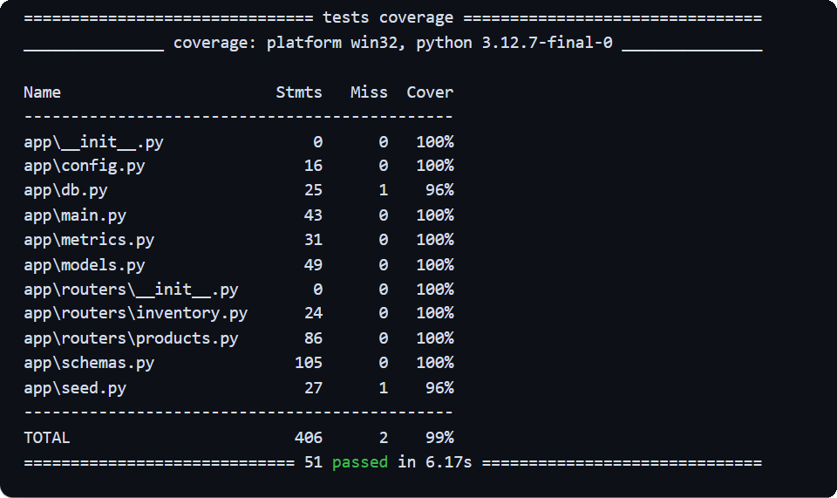
51 tests, isolated from real data
M2 · TESTING
51
99%
pytest tests
line coverage
2
5
databases in CI: SQLite and PostgreSQL
frontend unit tests
How the tests stay isolated
conftest.py sets DATABASE_URL before the app is imported and rebuilds the schema for every test. CI repeats the suite on a throw-away PostgreSQL container.
Test modules
test_products
test_stock
test_stats
test_system
test_migrations
test_seed

Slide 6
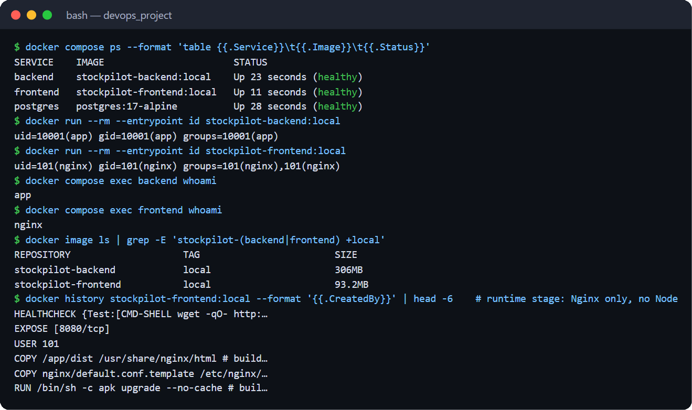

Multi-stage, non-root images
M4 · DOCKER
stockpilot-backend
python:3.12-slim builder installs pinned dependencies into a venv; the runtime copies only the venv and code
uid 10001
306 MB
HEALTHCHECK
stockpilot-frontend
node:24-alpine runs npm ci and the Vite build; nginx-unprivileged serves dist/ with no Node in the image
uid 101
93.2 MB
port 8080
Start order enforced by healthchecks: docker compose up --build
PostgreSQL 17
healthy when pg_isready answers
Backend
healthy after migrations (/health)
Frontend
Nginx at localhost:3000

Slide 7
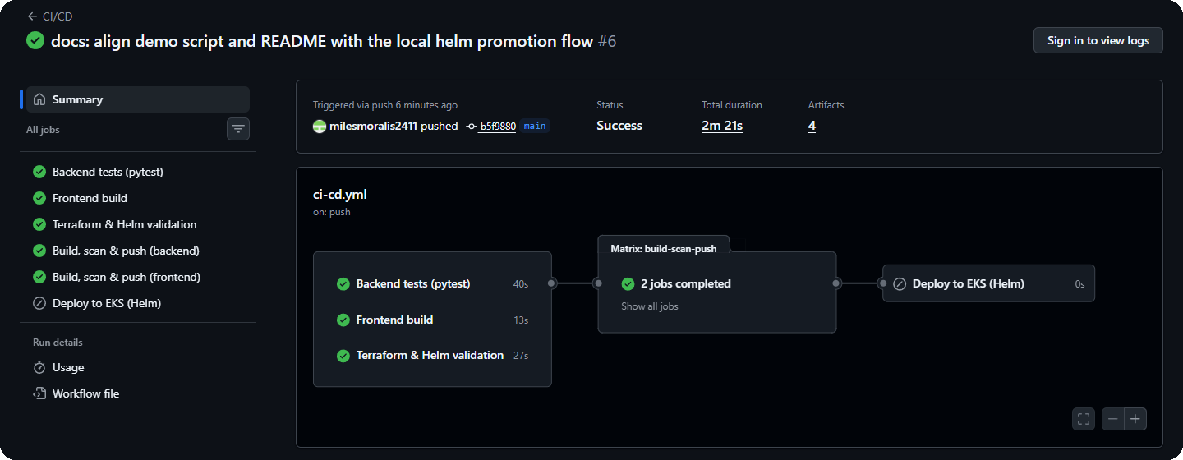
Every push is tested, scanned and published
M5 · CI/CD
backend-test
ruff · pytest ×2 DBs · alembic check
build-scan-push matrix: backend, frontend
deploy main only
helm upgrade --install with tag = SHA, --wait, helm test. AWS access via GitHub OIDC, no stored keys.
Skipped: this AWS account blocks IAM OIDC providers, so CI-built images are promoted with Helm.
docker build
Trivy report
Trivy gate
push :<sha>
frontend-build
npm ci · npm test · vite build
iac-validate
terraform test · helm lint
Stops on any fixable HIGH or CRITICAL CVE, before the push
Runs on push and pull request to main, or manually
A failing test stops the run before any image is built
Images tagged with the full commit SHA, never latest
Actions pinned to commit SHAs; least-privilege token
Public repo with conventional commits (feat, fix, test, ci)

Slide 8
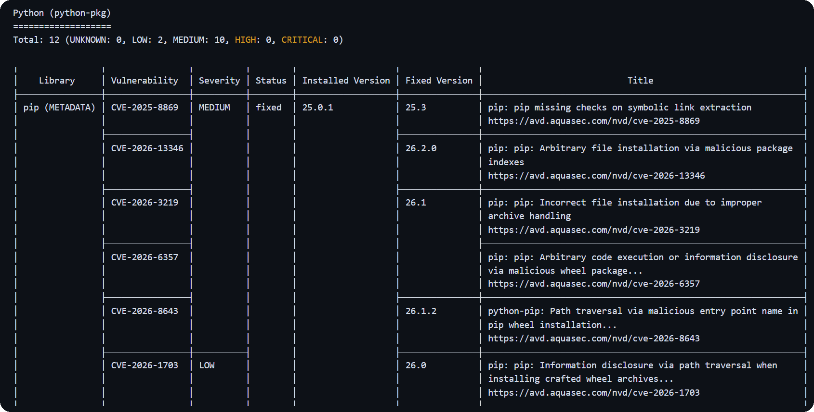
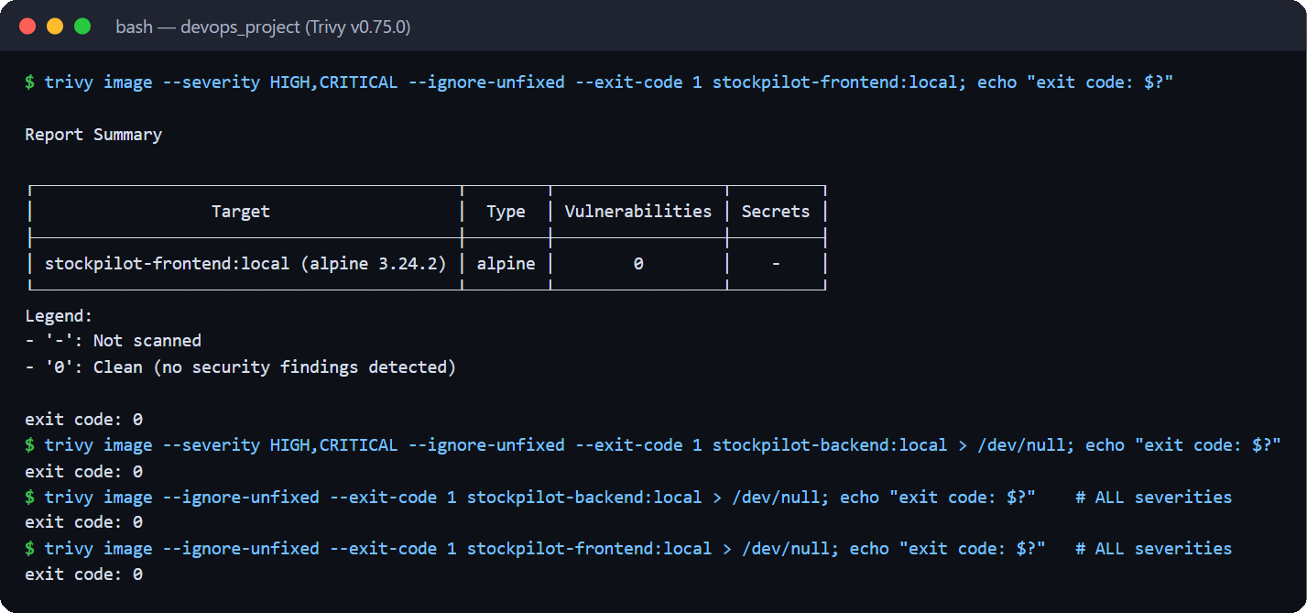


Trivy gate: found, explained, fixed
M6 · SECURITY
FIRST RUN
13 MEDIUM/LOW findings: gate passed, fixed anyway
AFTER
0 fixable vulnerabilities at any severity
CVE-2025-8869 (pip)
pip removed from the backend runtime image
CVE-2026-85091 (zlib)
apk upgrade in the frontend runtime stage
Gate on both images
HIGH,CRITICAL · fixable only · exit code 1

Slide 9
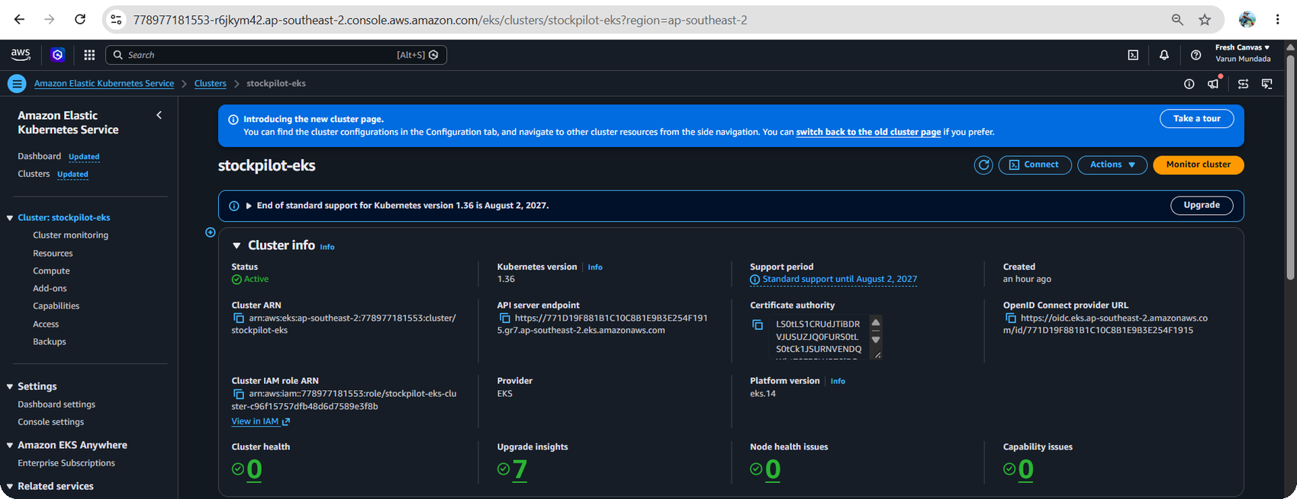
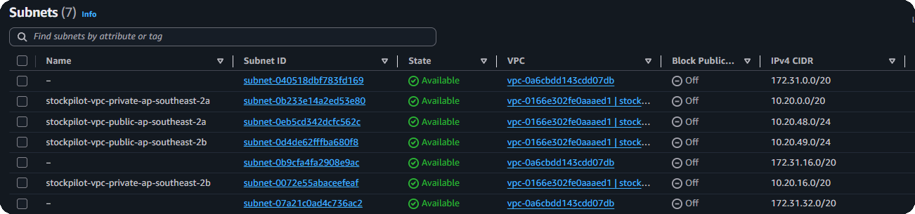
AWS VPC and EKS, built from code
M7 · TERRAFORM
VPC stockpilot-vpc · 10.20.0.0/16 · ap-southeast-2
Internet gateway
ap-southeast-2a
ap-southeast-2b
Public subnet
10.20.48.0/24 → IGW
Public subnet
10.20.49.0/24 → IGW
NAT gateway
NLB (Traefik)
EKS console: stockpilot-eks Active, Kubernetes 1.36
Private subnet
10.20.0.0/20 → NAT
Private subnet
10.20.16.0/20 → NAT
EKS worker node
EKS worker node
m7i-flex.large · AL2023
m7i-flex.large · AL2023
VPC console: 2 public + 2 private subnets across two AZs
Managed node group 2 × m7i-flex.large · add-ons: VPC CNI, CoreDNS, kube-proxy, Pod Identity agent, EBS CSI driver

Slide 10
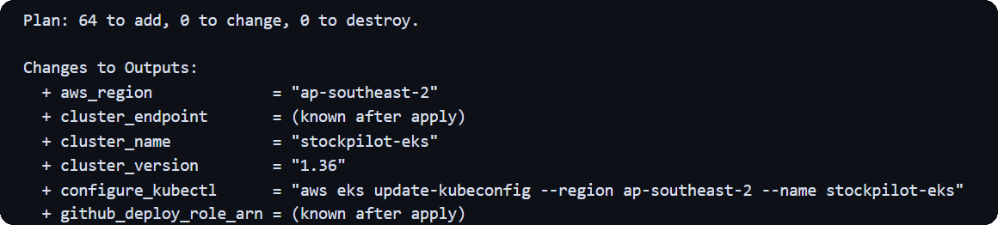

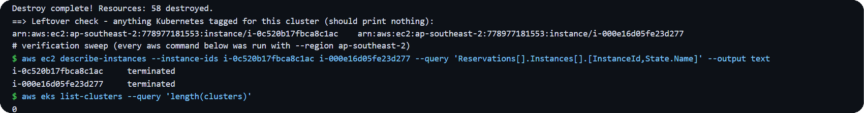
Validate, plan, apply, destroy on real AWS
M7 · TERRAFORM
1
Validate
2
Plan
3
Apply
4
Destroy
fmt, init, validate; terraform test with mocked AWS
64 to add, 0 to change, 0 to destroy
58 resources; EKS Active, 2 nodes Ready
58 destroyed; the sweep finds nothing left
terraform plan -out tfplan
Free-plan account limits, handled in code
Only ap-southeast-2 allowed
aws_region in terraform.tfvars
Free-tier instance types only
node group on m7i-flex.large (8 GiB)
scripts/eks-teardown.sh → terraform destroy
IAM OIDC providers denied
EBS CSI via EKS Pod Identity; GitHub OIDC role off
The 64-resource plan included the optional GitHub OIDC role; the final environment had 58.

Slide 11
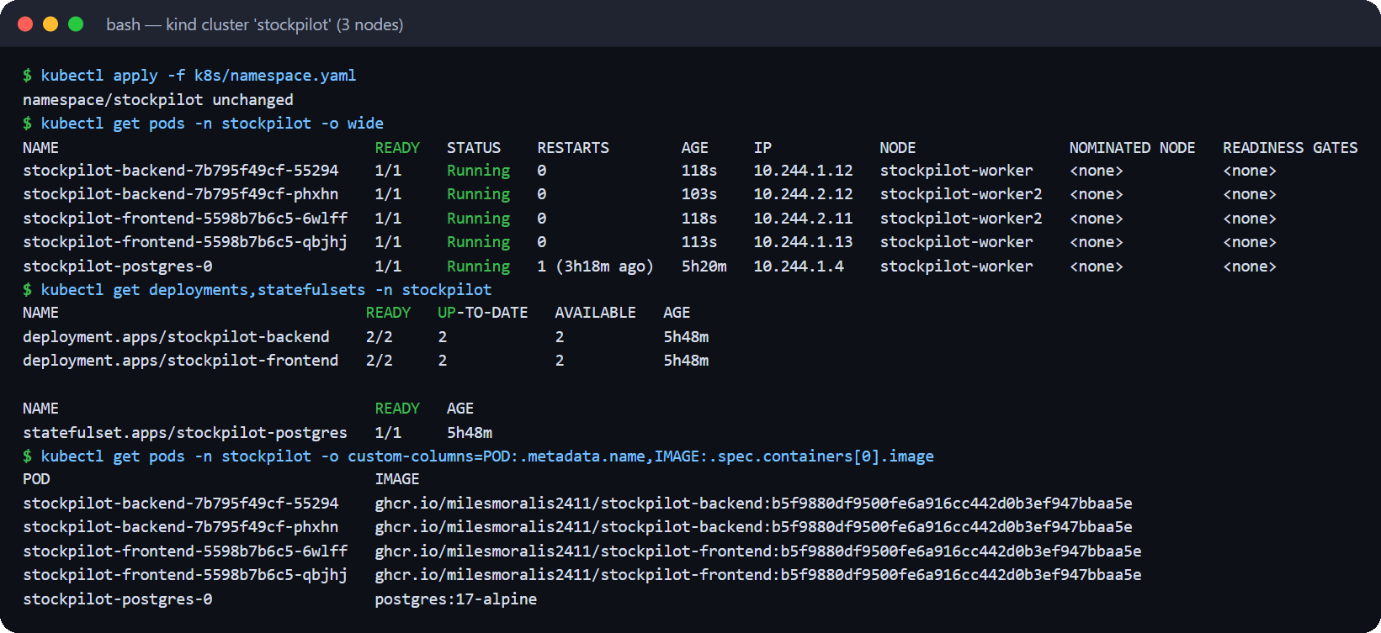
One Helm chart, a self-healing release
M8 · KUBERNETES + HELM
Deployments
backend + frontend, 2 replicas, maxUnavailable 0
Services
3 × ClusterIP: backend, frontend, postgres
HPA
backend 2 → 6 pods at 60% CPU
PodDisruptionBudgets
at least 1 pod per tier during drains
StatefulSet
PostgreSQL 17 with a PVC (gp3 on EKS)
Probes
startup, liveness /health, readiness /ready
/api /docs /openapi.json
→ stockpilot-backend:8000
Ingress (Traefik)
stockpilot.localtest.me
Secret + ConfigMap
generated DB password, app settings
helm test
checks /ready, /api/stats and the UI proxy
/
→ stockpilot-frontend:80

Slide 12
The HPA scales 2 → 6 pods under load
M8 · AUTOSCALING
2 → 6
backend pods, up to maxReplicas
411%
peak CPU against the 60% target
90 s
from the first load to 6 replicas

Slide 13


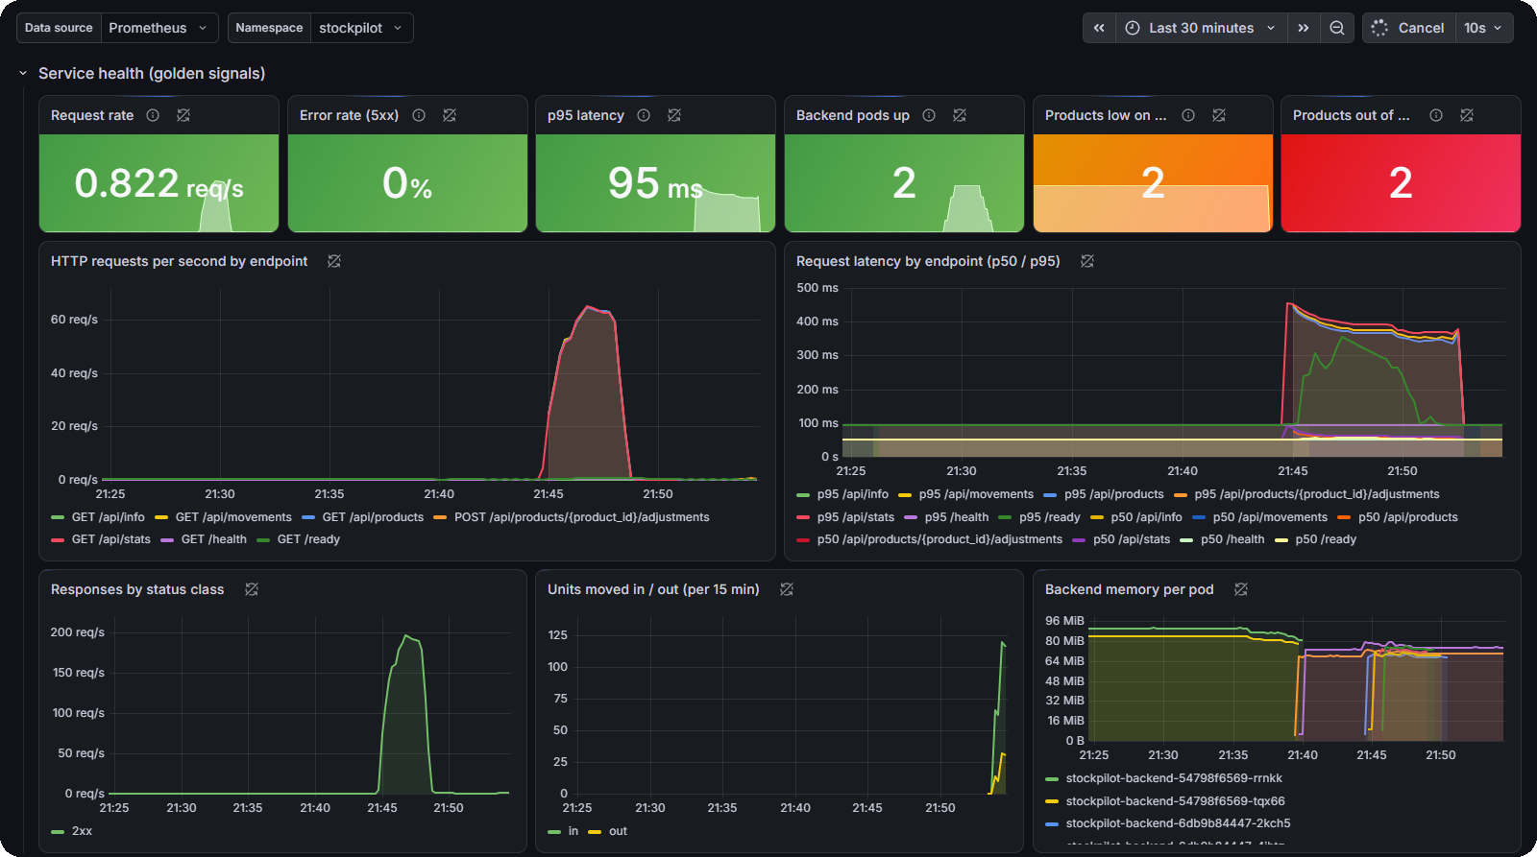
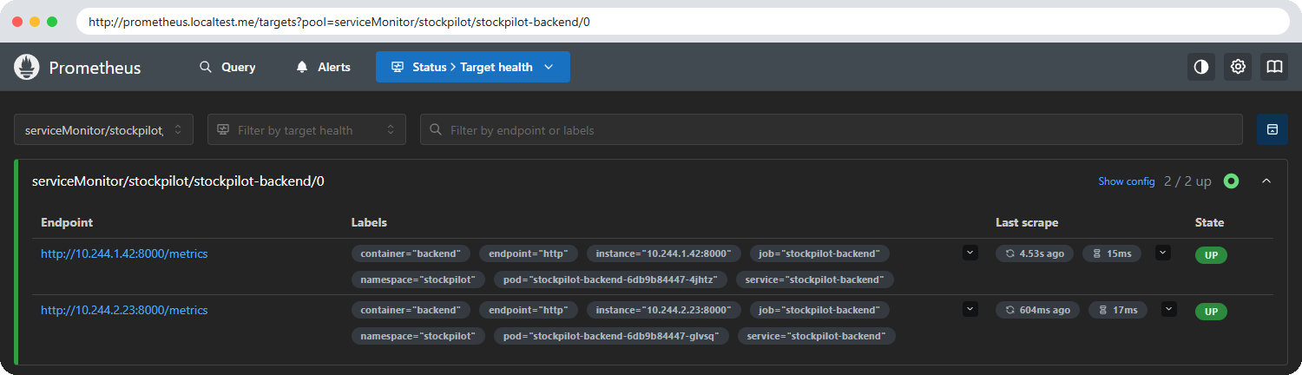
Metrics from the code to the dashboard
M9 · OBSERVABILITY
/metrics
HTTP + business metrics
ServiceMonitor
every backend pod
Prometheus
scrapes, evaluates alerts
Grafana
16-panel dashboard
Prometheus targets: 2 / 2 backend pods UP
Alert rules (PrometheusRule)
StockPilotBackendDown no backend target up
StockPilotHighErrorRate 5xx above 5%
StockPilotSlowRequests p95 above 500 ms
StockPilotProductsOutOfStock business alert

Slide 14




Four broken workloads, diagnosed and fixed
TROUBLESHOOTING LAB
01-broken-image.yaml
02-broken-service.yaml
03-crashloop-…yaml
04-failing-readiness-…yaml
ImagePullBackOff
No endpoints
CrashLoopBackOff
Running, 0/1 Ready
CAUSE
CAUSE
CAUSE
CAUSE
The image tag does not exist
The Service selector matches no pod labels
DATABASE_URL points at a host that does not exist
The readiness probe checks the wrong port
FIX
FIX
FIX
FIX
Point at a pushed SHA tag
Patch the selector to the pod labels
Load DATABASE_URL from the chart's Secret
Probe the container port
kubectl get
describe
logs
events
fix
verify

Slide 15
Commit → pipeline → deployment update
M10 · LIVE DEMO
1
Commit
2
Pipeline
3
Deploy
4
Verify
Change the dashboard subtitle in frontend/src/App.jsx, commit and push to main
Tests, frontend build and IaC checks, then build → Trivy gate → push :<sha>
helm upgrade with both image tags set to the new SHA; rolling update, zero downtime
New pods Running, a new Helm revision, and the new SHA in the UI and /api/info
$ git commit -am "feat(ui): update dashboard subtitle" && git push
# CI: backend-test, frontend-build, iac-validate → build-scan-push → ghcr.io/…:<sha>
$ SHA=$(git rev-parse HEAD); REG=ghcr.io/milesmoralis2411
$ helm upgrade stockpilot ./helm/stockpilot -n stockpilot -f helm/stockpilot/values-dev.yaml --wait \
--set backend.image.repository=$REG/stockpilot-backend --set backend.image.tag=$SHA \
--set frontend.image.repository=$REG/stockpilot-frontend --set frontend.image.tag=$SHA
$ kubectl get pods -n stockpilot && helm history stockpilot -n stockpilot
$ curl -s http://stockpilot.localtest.me/api/info # git_sha = the new commit

Slide 16
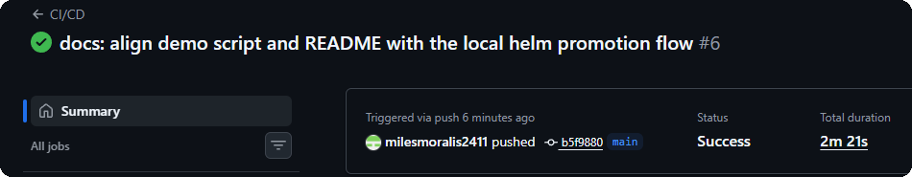
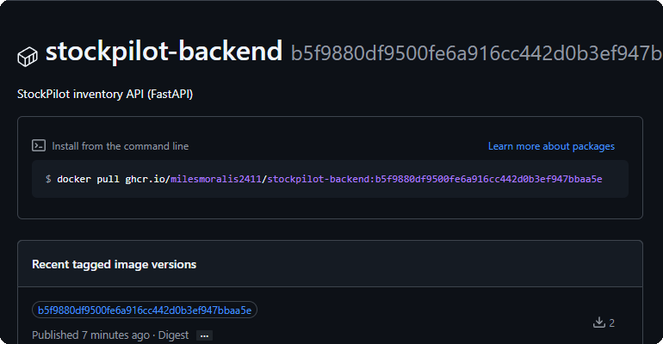
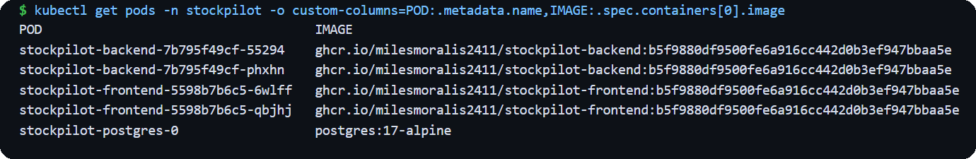
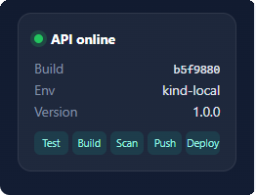
Commit b5f9880, traced end to end
M10 · RELEASE EVIDENCE
1
CI run #6 on b5f9880: every job green in 2 m 21 s
2
GHCR: image pushed with the full SHA as its tag
3
Every app pod runs the image tagged b5f9880…
5
The UI sidebar shows the running build
b5f9880
the same SHA at every stage: commit, pipeline, registry, pods, API and UI
4
/api/info through the Ingress returns the same git_sha

Slide 17




Decisions behind the build
ENGINEERING DECISIONS
Image tag = commit SHA
Liveness ≠ readiness
Audit-first data model
Immutable, traceable releases; latest is never deployed, and rollback is helm rollback
/health skips the database, so an outage stops traffic without restart loops
Quantity changes only through logged adjustments, locked against overselling
Safe migrations
Traefik for Ingress
Pinned everything
Alembic runs at start-up under an advisory lock, so N replicas migrate once
ingress-nginx was retired in March 2026; the Ingress stays standard networking.k8s.io/v1
Lockfiles, chart versions, the Terraform lock file and SHA-pinned GitHub Actions

Slide 18
Every module, with evidence in the repo
GRADING RUBRIC
# | Module | Pts | Delivered | Evidence
M1 | Application | 10 | FastAPI with 11 endpoints, Alembic tables, responsive React UI | m1-*.png, Swagger
M2 | Testing | 10 | 51 pytest tests, 99% coverage, isolated test database | m2-pytest-v.png
M3 | Git + GitHub | 5 | Public repo, conventional commits, .gitignore | m3-*.png
M4 | Docker | 10 | Multi-stage, non-root images; Compose with healthchecks | m4-*.png
M5 | CI/CD | 15 | Test → build → scan → push to GHCR with SHA tags | Actions run 37837734675
M6 | Trivy | 5 | HIGH/CRITICAL gate; CVEs explained and fixed | SECURITY.md, m6-*.png
M7 | Terraform | 15 | VPC + EKS on real AWS: plan, apply, destroy | m7-aws-*.png
M8 | Kubernetes + Helm | 15 | Chart, Ingress, HPA; 5/5 pods Running | m8-*.png
M9 | Observability | 10 | /metrics, Prometheus UP, 16-panel Grafana | m9-*.png
M10 | Docs + demo | 5 | README, this deck, live commit → deployment | README.md, slides 15–16
 | Total | 100 | Index: docs/SCREENSHOTS.md · map: docs/SUBMISSION-CHECKLIST.md

Slide 19




Questions?
THANK YOU
One git push tests, scans and publishes a traceable version. Helm ships it, Kubernetes keeps it healthy, Prometheus and Grafana show what it is doing.
Repository github.com/milesmoralis2411/devops_project_24bcs10326
Evidence docs/SCREENSHOTS.md · docs/SUBMISSION-CHECKLIST.md
Scan for the repository
Pipeline GitHub Actions run 37837734675

