Slide 1
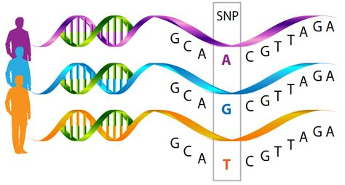
Miles’s guide to k-mer-based GWAS
AATTGC, TCCCAT, CGCGTT,…
AATTGC, TGGCAT, CGCGTT,…
AATTGC, TTTCAT, CGCGTT,…
Miles Roberts
2021-10-22
https://github.com/milesroberts-123/slurm-k-mer-gwas

Slide 2
What is a k-mer-based GWAS?
SNP-based GWAS
k-mer-based GWAS
AATTGC, TCCCAT, CGCGTT,…
AATTGC, TGGCAT, CGCGTT,…
AATTGC, TTTCAT, CGCGTT,…
 | Individual 1 | Individual 2 | Individual 3 | …
Chr1, BP: 50 | 1/1 | 1/1 | 1/1 | …
Chr1, BP: 60 | 0/0 | 1/1 | 0/0 | …
Chr1, BP: 70 | 0/0 | 0/0 | 0/0 | …
… | … | … | … | …
 | Individual 1 | Individual 2 | Individual 3 | …
AATTGC | 1 | 1 | 1 | …
TCCCAT | 1 | 0 | 1 | …
TGGCAT | 0 | 1 | 0 | …
… | … | … | … | …
K-mer = subsequence of a read

Slide 3
But Miles, why should I do a k-mer-based GWAS?
K-mers capture genetic variants beyond just SNPs
Presence/absence variants (PAVs)
Structural variants (SVs)
Copy number variants (CNVs)
Insertions/deletions (INDELs)
Multi-SNP variants
K-mer-based GWAS can be more powerful than SNP-based GWAS
Querying more sources of genetic variation gives more positive results
K-mer-based GWAS doesn’t (theoretically) require a reference genome
However, a reference genome can help immensely with interpreting results
K-mer-based GWAS uses the same starting data as a SNP-based GWAS
However, K-mer-based GWAS also:
requires higher multiple testing burden (you’ll test >100 million k-mers)
involves sometimes challenging, manual interpretations of alignments

Slide 4
Miles’s guide to k-mer-based GWAS
Part 1: Prepare sequence data for k-mer counting
Part 2: Create k-mer presence/absence matrix
Part 3: Filter out useless k-mers
Part 4: Actually, uhh do the GWAS…
Part 5: Interpret the results
https://github.com/milesroberts-123/slurm-k-mer-gwas

Slide 5
But Miles, how do I process lots of FASTQ data quickly?
Answer: split operations over multiple cores
SRR1946536
SRR1946537
SRR1946538
SRR1946540
SRR1946542
SRR1946543
…
Original list of SRA runs
Split list into smaller sub lists
SRR1946536
SRR1946537
SRR1946538
SRR1946540
SRR1946542
SRR1946543
…
Loop over each list on a different core
download
fastqc
cutadapt
download
fastqc
cutadapt
download
fastqc
cutadapt
download
fastqc
cutadapt
I use this trick frequently to parallelize simple tasks…
Scripts: S01 – S06

Slide 6
Miles’s guide to k-mer-based GWAS
Part 1: Prepare sequence data for k-mer counting
Scripts: s01 – s06
Parallelize every step when possible
Part 2: Create k-mer presence/absence matrix
Part 3: Filter out useless k-mers
Part 4: Actually, uhh do the GWAS…
Part 5: Interpret the results
https://github.com/milesroberts-123/slurm-k-mer-gwas

Slide 7
First count k-mers in trimmed fastq data
Both KMC v3 and Jellyfish are great for this
But Miles, how long should my k-mers be?
My answer: as long as your shortest read length
If your minimum read length is 31, then the length of k-mers you count should be 31
30-mers – 40-mers are commonly used
But Miles, how many times should a k-mer be counted to be considered “present”?
Most papers consider k-mers that occurs 10 times in a WGS dataset as present
ATGCATGCATGCATGCATGCATGCATGCATGCATGCATGC…
Scripts: S07 – S08

Slide 8
But Miles, how do I create a presence/absence matrix?
What we have now looks like this:
Want to merge hundreds of files with list of k-mer presence/absence patterns into a single matrix
Doing this in R will be extremely slow and require tons of memory
Bash join function only merges two files at once
Solution: use recursive join function in bash
Merge a few files at a time on separate cores
Merge in multiple stages
SRR1946536_kmers.txt
AAAAAAA 1
AAAAAAG 1
AAAAAAT 1
…
SRR1946537_kmers.txt
AAAAAAA 1
AAAAAAC 1
AAAAAAG 1
…
Etc.
Scripts: S09_0 – S09_1

Slide 9
Miles’s guide to k-mer-based GWAS
Part 1: Prepare sequence data for k-mer counting
Scripts: s01 – s06
Parallelize every step when possible
Part 2: Create k-mer presence/absence matrix
Scripts: s07-s09
Use bash as much as possible, R is too slow
Part 3: Filter out useless k-mers
Part 4: Actually, uhh do the GWAS…
Part 5: Interpret the results
https://github.com/milesroberts-123/slurm-k-mer-gwas

Slide 10
But Miles, will all the k-mers I count be useful?
First, remove k-mers with identical presence/absence patterns
Keep just one representative k-mer
Second, remove exceedingly rare and common k-mers
Similar to a MAF threshold in SNP-based GWAS
Usually remove k-mers that are present in fewer than 5 % of accessions or more than 95 % of accessions
Third, convert k-mers that pass into BIMBAM format for GEMMA
In the end, you’ll hopefully have just a couple hundred million k-mers left instead of billions
 | Individual 1 | Individual 2 | Individual 3 | …
AAAAAAAA | 1 | 1 | 1 | …
AAAAAAAT | 1 | 1 | 1 | …
… | … | … | … | …
TATACTATAT | 1 | 0 | 0 | …
TATACTATAG | 1 | 0 | 0 | …
Most k-mers are either:
present in all individuals
only present in one individual
Scripts: S10 – S13

Slide 11
Miles’s guide to k-mer-based GWAS
Part 1: Prepare sequence data for k-mer counting
Scripts: s01 – s06
Parallelize every step when possible
Part 2: Create k-mer presence/absence matrix
Scripts: s07-s09
Use bash as much as possible, R is too slow
Part 3: Filter out useless k-mers
Scripts: s10 – s13
Most of the k-mers you count won’t be useful
Part 4: Actually, uhh do the GWAS…
Part 5: Interpret the results
https://github.com/milesroberts-123/slurm-k-mer-gwas

Slide 12
But Miles, when do I actually do the GWAS?
Almost there!!!
First, estimate kinship matrix from k-mers
Using all of the k-mers for this requires a lot of memory
Use a random subset of several million k-mers instead
I use 10,000,000 k-mers because many SNP-based GWAS usually use this many SNPs or fewer
Finally, fit a GWAS model!
Cannot treat k-mers as bi-alleleic SNPs because genomes cannot be heterozygous for a given k-mer
All data should be in BIMBAM format, use –notsnp option
You’ll likely get thousands of significant k-mers
And visualize the results
Manhattan plot
qqplot
Only plot the most-significant k-mers, unless you want to create a massive image that’s impossible to load
Scripts: S14 – S15

Slide 13
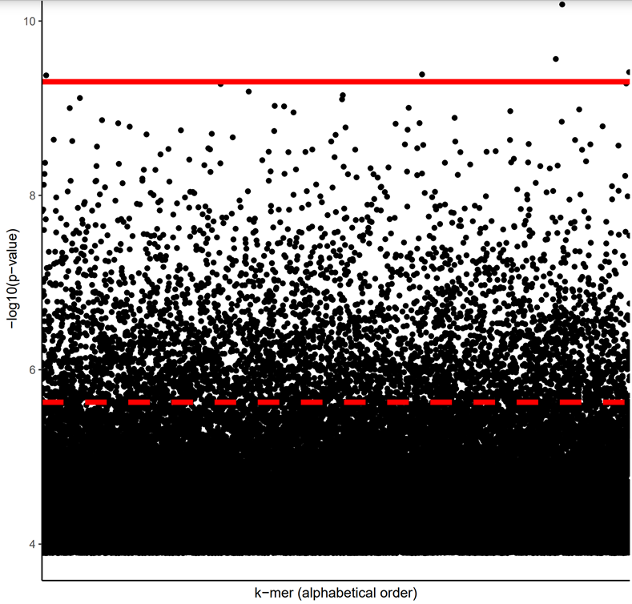
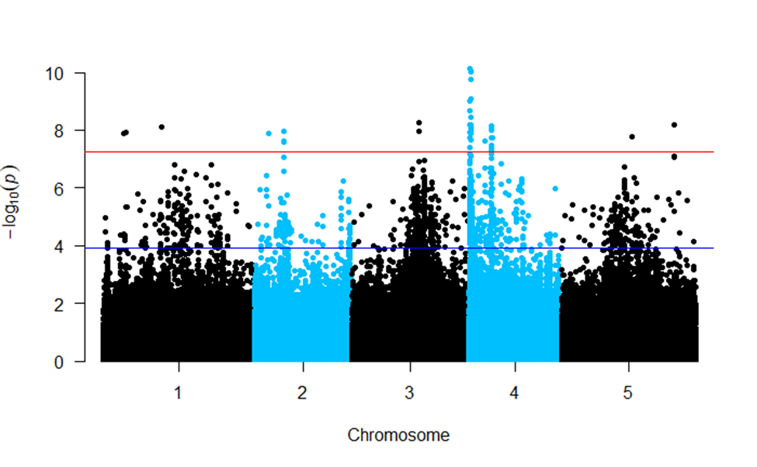
Not sure if there’s a better way to visualize this…

Slide 14
Miles’s guide to k-mer-based GWAS
Part 1: Prepare sequence data for k-mer counting
Scripts: s01 – s06
Parallelize every step when possible
Part 2: Create k-mer presence/absence matrix
Scripts: s07-s09
Use bash as much as possible, R is too slow
Part 3: Filter out useless k-mers
Scripts: s10 – s13
Most of the k-mers you count won’t be useful
Part 4: Actually, uhh do the GWAS…
Scripts: s14 – s15
Use just a subset of k-mers for plotting and estimating kinship
Part 5: Interpret the results
https://github.com/milesroberts-123/slurm-k-mer-gwas

Slide 15
Ahhhh so nice to be done! But wait…
We have two massive problems:
How the heck do I interpret my results?
I have thousands of significant k-mers… HELP!!!
Let’s solve the second problem first:
Apply very strict multiple testing thresholds
but you'll probably have a high false negative rate
Apply multiple different GWAS models
multivariate, univariate, principal component-based models to same phenotypes
Look at only k-mers in the intersection of significant k-mer sets from these different approaches
Apply multiple rounds of GWAS
one round to identify best k-mers, another round to distinguish further between best and worst
Include covariate in GWAS model
A good covariate to include is sequencing coverage!!!
Script: s16

Slide 16
How do I interpret the results of a k-mer-based GWAS?
If you have a reference genome, you have three different options:
Map significant k-mers back to reference genome(s) with bowtie v1
k-mers might be too short to align uniquely
Map k-mer-containing WGS reads back to reference genome(s) with bowtie v2
reads might be too short to align well
Assemble k-mer-containing WGS reads into scaffolds using SPAdes then align to reference genome with BLAST
Need to filter out scaffolds generated via assembly errors
If you don’t have a reference genome:
Assemble k-mer-containing WGS reads into scaffolds using SPAdes then align to general BLAST database
I don’t know of other options…
In both cases, you’ll look at alignments to determine what genetic variants are captured by your significant k-mers
Script: s17 – s20

Slide 17
Miles’s guide to k-mer-based GWAS
Part 1: Prepare sequence data for k-mer counting
Scripts: s01 – s06
Parallelize every step when possible
Part 2: Create k-mer presence/absence matrix
Scripts: s07-s09
Use bash as much as possible, R is too slow
Part 3: Filter out useless k-mers
Scripts: s10 – s13
Most of the k-mers you count won’t be useful
Part 4: Actually, uhh do the GWAS…
Scripts: s14 – s15
Use just a subset of k-mers for plotting and estimating kinship
Part 5: Interpret the results
Scripts: s16 – s20
Always combine multiple GWAS approaches
https://github.com/milesroberts-123/slurm-k-mer-gwas

Slide 18
In summary, what do I need for k-mer-based GWAS?
Whole genome sequencing (WGS) data in fastq format
Download from short read sequence archive or sequence yourself
A text file of normalized phenotypes for the individuals included in the GWAS
Probably a few terabytes of disk space (use scratch space on HPC)
Compress data as much as possible and delete intermediate files
Software to quality check WGS reads
fastqc and multiqc
Software to trim adapters
cutadapt or trimmomatic
Software to count k-mers
KMC or Jellyfish
Software to build genome-wide association models
GEMMA
Software to assemble WGS reads into scaffolds
SPAdes
Software for aligning k-mers and/or WGS reads to reference genome (if you have one)
Bowtie or BLAST
General purpose sequence manipulation software
Seqkit and SeqTK
Plus, R and Python for data visualization and some simple calculations

Slide 19
Useful references
Plant-based k-mer-based GWAS papers
Voichek Y, Weigel D (2020) Identifying genetic variants underlying phenotypic variation in plants without complete genomes. Nature Genetics 52: 534–540
Kim J-H, Park J-S, Lee C-Y, Jeong M-G, Xu JL, Choi Y, Jung H-W, Choi H-K (2020) Dissecting seed pigmentation-associated genomic loci and genes by employing dual approaches of reference-based and k-mer-based GWAS with 438 Glycine accessions. PLOS ONE 15: e0243085
Akagi T, Henry IM, Tao R, Comai L (2014) A Y-chromosome–encoded small RNA acts as a sex determinant in persimmons. Science 346: 646–650
Arora S, Steuernagel B, Gaurav K, Chandramohan S, Long Y, Matny O, Johnson R, Enk J, Periyannan S, Singh N, et al (2019) Resistance gene cloning from a wild crop relative by sequence capture and association genetics. Nature Biotechnology 37: 139–143
Microbe k-mer-based GWAS papers
Lees JA, Vehkala M, Välimäki N, Harris SR, Chewapreecha C, Croucher NJ, Marttinen P, Davies MR, Steer AC, Tong SYC, et al (2016) Sequence element enrichment analysis to determine the genetic basis of bacterial phenotypes. Nat Commun 7: 12797
Lees JA, Croucher NJ, Goldblatt D, Nosten F, Parkhill J, Turner C, Turner P, Bentley SD (2017) Genome-wide identification of lineage and locus specific variation associated with pneumococcal carriage duration. eLife 6: e26255
Lees JA, Galardini M, Bentley SD, Weiser JN, Corander J (2018) pyseer: a comprehensive tool for microbial pangenome-wide association studies. Bioinformatics 34: 4310–4312
Aun E, Brauer A, Kisand V, Tenson T, Remm M (2018) A k-mer-based method for the identification of phenotype-associated genomic biomarkers and predicting phenotypes of sequenced bacteria. PLOS Computational Biology 14: e1006434

Slide 20
Additional considerations
Can you use k-mers of variable length in GWAS instead of one-fixed length? Some microbe papers do this
Can you correlate the frequency of k-mers (normalized for sequencing coverage) instead of presence/absence patterns with your phenotype of interest?
Could be better for picking up on copy number variants
Can you use a variant-caller (like GATK) to call SNPs and INDELs from the alignments of scaffolds from k-mer based GWAS to a reference sequence?

