Slide 1
Music
SPOTIFY APP
MENU
ANALYSIS
CONTACT
SOFTWARE ENGINEERING
FLUID
2/c Jake Carpenter & 2/c Miles Tran

Slide 2
PROPOSAL
MENU
ANALYSIS
CONTACT
SOFTWARE ENGINEERING
App that allows users to retrieve playlists from Spotify, input the songs the user likes, and have the app recommend other songs in the playlist the user would like.

Slide 3
SCOPE AND STAKEHOLDERS
Scope
Stakeholders
MENU
ANALYSIS
CONTACT
SOFTWARE ENGINEERING
Avid music listeners who are looking for a fresh playlist to discover
LT. Quarry, Dr. Elwakil, Mr. Gold

Slide 4
DEFINE TOOLS
MENU
ANALYSIS
CONTACT
SOFTWARE ENGINEERING
SPYDER
TKINTER
IPython IDE used for programming
Python library used for coding GUI
SPOTIFY API
SPOTIPY
API provided by Spotify allowing us to retrieve songs
Python library used for compiling metadata about songs

Slide 5
USER REQUIREMENTS
FUNCTIONAL
NON-FUNCTIONAL
MENU
ANALYSIS
CONTACT
SOFTWARE ENGINEERING
Provide the user with a GUI
Contain a help screen
Allow the user to access any screen at any given time
Be visually appealing
User be pleased with the new playlist

Slide 6

SYSTEM REQUIREMENTS
MENU
ANALYSIS
CONTACT
SOFTWARE ENGINEERING
4 screens with specific functions
User will select 10 songs, algorithm will recommend 12 new
Algorithm will utilize song metadata
Using Spotify API, user has access to whole song database
Notes:
Add pic of opening gui

Slide 7
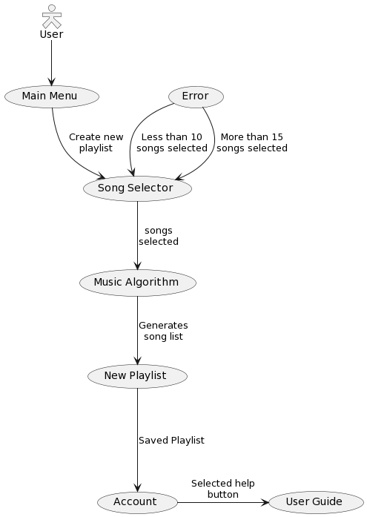
case
diagram
MENU
ANALYSIS
CONTACT
SOFTWARE ENGINEERING
use

Slide 8
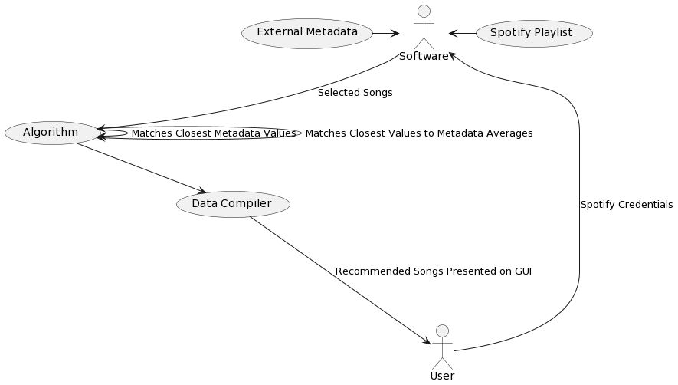
ALGORITHM
diagram
MENU
ANALYSIS
CONTACT
SOFTWARE ENGINEERING

Slide 9
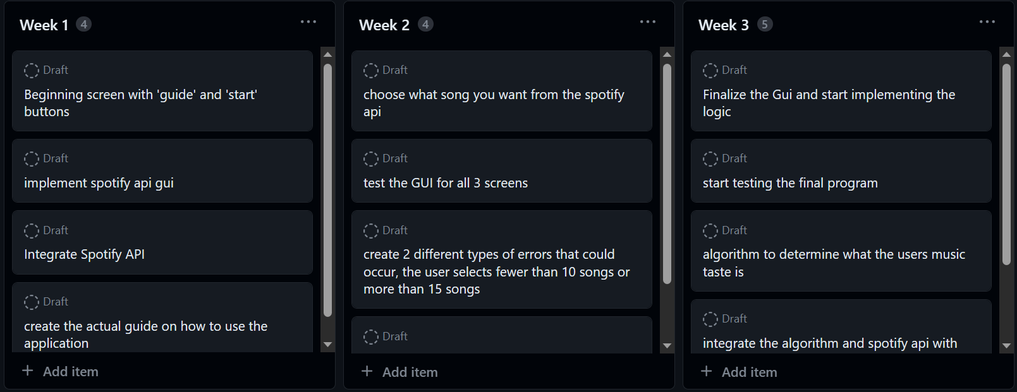
COMPLEXITY VELOCITY
MENU
ANALYSIS
CONTACT
SOFTWARE ENGINEERING
Complexity
On average, each week had an average of 4 tasks to be done
Github
Improved our thought, code, and progress organization
Sprints
Gave us autonomy, while still cooperating effectively

Slide 10
CHALLENGES VS SUCCESSES
CHALLENGES
SUCCESSES
MENU
ANALYSIS
CONTACT
SOFTWARE ENGINEERING
GUI needed to be hand-coded. Proving to be difficult
Algorithm was very complicated and frustrating to write
Spotify API was crucial in song compilation
Made an aesthetic logo easily
Able to quickly integrate GUI with algorithm
VS

Slide 11
Results and Reflection
MENU
ANALYSIS
CONTACT
SOFTWARE ENGINEERING
Overall the project proved difficult for two members
Difficulty compounded as program became more advanced
A useful software others could use if uploaded online
Scrums did not need to be as rigid due to small team size
Goals and sprint structure evolved significantly as project matured
Notes:
Add pic of opening gui

Slide 12
TIME FOR A DEMONSTRATION!
MENU
ANALYSIS
CONTACT
SOFTWARE ENGINEERING

