Slide 1
US-01
Go Backend Scaffold
EPIC-01 — Project Foundation & Infrastructure
Priority: Must Have | Story Points: 2
Sprint 1 — Todo App

Slide 2
Overview
US-01 — Go Backend Scaffold
Story Summary
Establish the Go + Gin + GORM backend with health check endpoint, auto-migrated SQLite database, and structured request logging.
Tech Stack
Points: 2
Go 1.21+
Gin HTTP framework
GORM ORM
SQLite (todos.db)

Slide 3
Acceptance Criteria
US-01 — Go Backend Scaffold
✓
Server starts on port 8080 with go run ./...
✓
GET /health returns 200 OK with {"status":"ok"}
✓
todos.db auto-created via GORM on first run
✓
Method, path, status, and latency logged to stdout

Slide 4
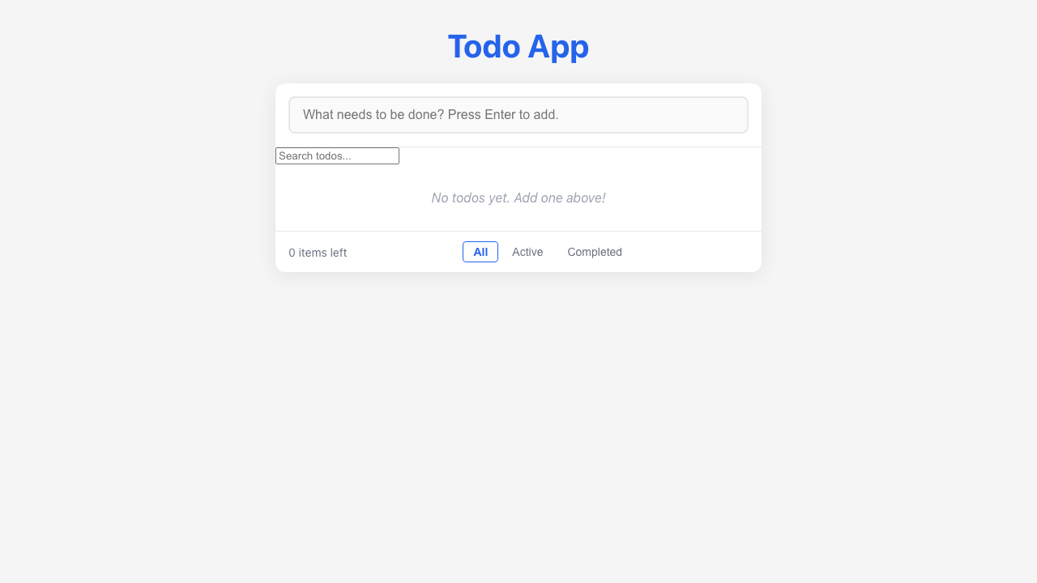
Feature Demo
US-01 — Go Backend Scaffold

Slide 5
Definition of Done
US-01 — Go Backend Scaffold
✓
Unit tests written with >80% coverage
✓
Integration tests for API endpoints
✓
Code review completed
✓
E2E tests passed (all journeys green)
✓
User documentation written (help article, FAQ, troubleshooting)
✓
Architecture diagram updated
✓
PowerPoint deliverable generated
○
Git commit and push completed

