Slide 1
US-02
React + TypeScript Frontend Scaffold
EPIC-01 — Project Foundation & Infrastructure
Priority: Must Have | Story Points: 1
Sprint 1 — Todo App

Slide 2
Overview
US-02 — React + TypeScript Frontend Scaffold
Story Summary
Scaffold the React + TypeScript + Vite frontend with a dev server on port 3000, Todo App title, and clean TypeScript build.
Tech Stack
Points: 1
React 18
TypeScript
Vite
ESLint

Slide 3
Acceptance Criteria
US-02 — React + TypeScript Frontend Scaffold
✓
Dev server starts on http://localhost:3000
✓
Browser shows "Todo App" title on load
✓
npm run build completes without TypeScript errors
✓
VITE_API_URL configures backend connection

Slide 4
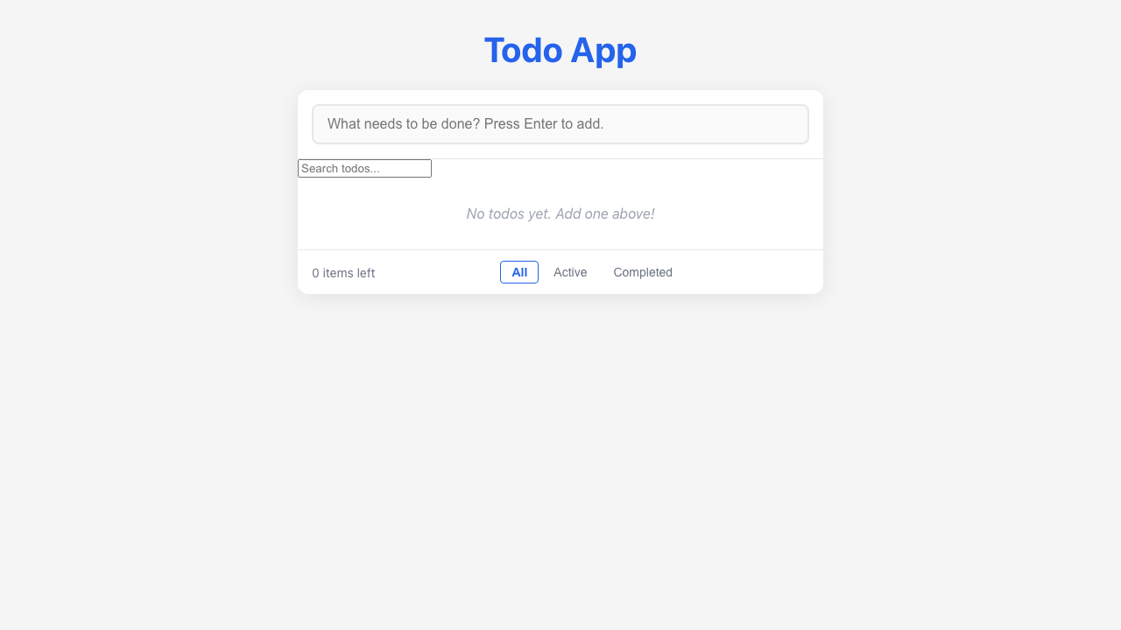
Feature Demo
US-02 — React + TypeScript Frontend Scaffold

Slide 5
Definition of Done
US-02 — React + TypeScript Frontend Scaffold
✓
Unit tests written with >80% coverage
✓
Integration tests for API endpoints
✓
Code review completed
✓
E2E tests passed (all journeys green)
✓
User documentation written (help article, FAQ, troubleshooting)
✓
Architecture diagram updated
✓
PowerPoint deliverable generated
○
Git commit and push completed

