Slide 1
US-03
Create a Todo
EPIC-02 — Todo CRUD (Core Feature)
Priority: Must Have | Story Points: 3
Sprint 1 — Todo App

Slide 2
Overview
US-03 — Create a Todo
Story Summary
Allow users to add new todos by typing in the input field and pressing Enter. Empty submissions are ignored. Todos persist in the database.
Tech Stack
Points: 3
React state
POST /todos API
SQLite persistence

Slide 3
Acceptance Criteria
US-03 — Create a Todo
✓
Typing + Enter creates todo if input is non-empty
✓
Empty input is ignored — no blank todos created
✓
New todo persists across page reloads (stored in DB)
✓
POST /todos returns 201 Created with new todo
✓
Input field clears after successful creation

Slide 4
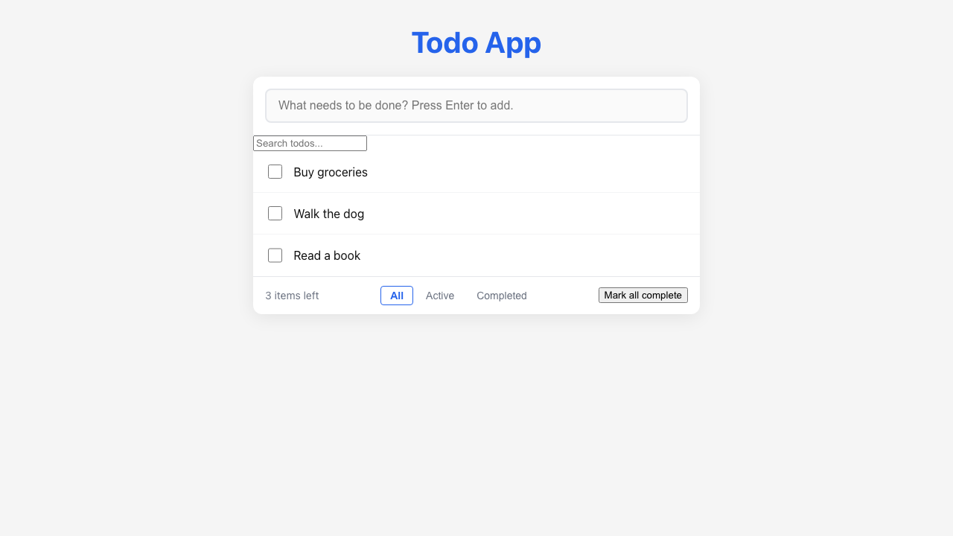
Feature Demo
US-03 — Create a Todo

Slide 5
Definition of Done
US-03 — Create a Todo
✓
Unit tests written with >80% coverage
✓
Integration tests for API endpoints
✓
Code review completed
✓
E2E tests passed (all journeys green)
✓
User documentation written (help article, FAQ, troubleshooting)
✓
Architecture diagram updated
✓
PowerPoint deliverable generated
○
Git commit and push completed

