Slide 1
US-04
List All Todos
EPIC-02 — Todo CRUD (Core Feature)
Priority: Must Have | Story Points: 2
Sprint 1 — Todo App

Slide 2
Overview
US-04 — List All Todos
Story Summary
Fetch and display all todos from the backend on app load, with a skeleton loader during fetch and an empty state message when the list is empty.
Tech Stack
Points: 2
GET /todos API
Skeleton loading
React useEffect

Slide 3
Acceptance Criteria
US-04 — List All Todos
✓
GET /todos returns all stored todos as an array
✓
Empty list shows "empty state" message
✓
Each todo displays title and completion status
✓
Skeleton loader shown while fetch is in progress

Slide 4
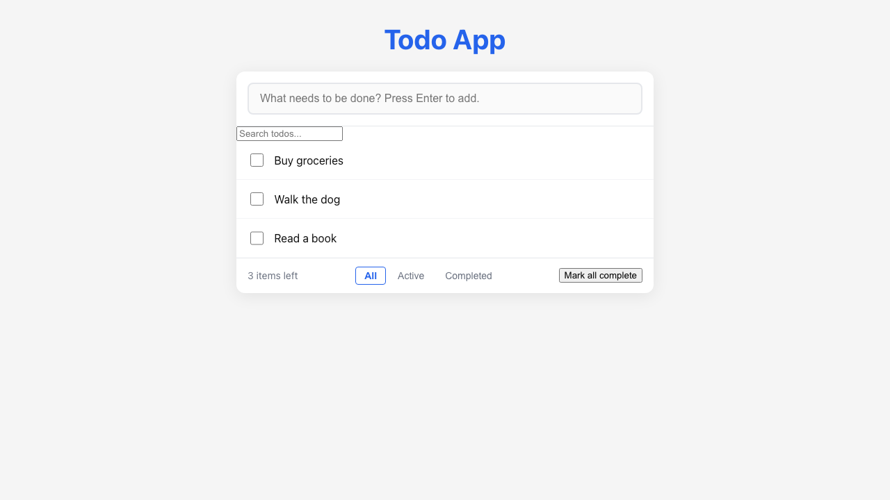
Feature Demo
US-04 — List All Todos

Slide 5
Definition of Done
US-04 — List All Todos
✓
Unit tests written with >80% coverage
✓
Integration tests for API endpoints
✓
Code review completed
✓
E2E tests passed (all journeys green)
✓
User documentation written (help article, FAQ, troubleshooting)
✓
Architecture diagram updated
✓
PowerPoint deliverable generated
○
Git commit and push completed

