Slide 1
US-05
Complete / Uncomplete a Todo
EPIC-02 — Todo CRUD (Core Feature)
Priority: Must Have | Story Points: 2
Sprint 1 — Todo App

Slide 2
Overview
US-05 — Complete / Uncomplete a Todo
Story Summary
Toggle todo completion status via checkbox. Completed todos show strikethrough text. State persists across reloads via the backend.
Tech Stack
Points: 2
PUT /todos/:id API
Checkbox toggle
SQLite update

Slide 3
Acceptance Criteria
US-05 — Complete / Uncomplete a Todo
✓
Clicking checkbox marks todo as completed (strikethrough)
✓
Clicking completed checkbox toggles back to active
✓
Toggle state persists across page reloads
✓
PUT /todos/:id returns 404 for unknown IDs

Slide 4
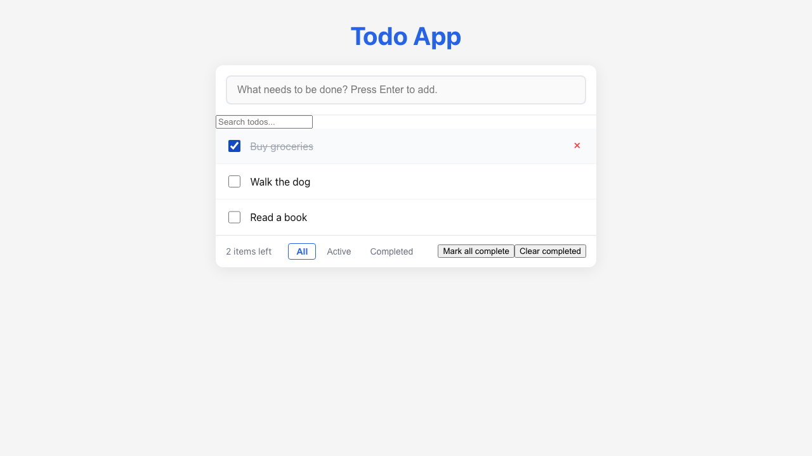
Feature Demo
US-05 — Complete / Uncomplete a Todo

Slide 5
Definition of Done
US-05 — Complete / Uncomplete a Todo
✓
Unit tests written with >80% coverage
✓
Integration tests for API endpoints
✓
Code review completed
✓
E2E tests passed (all journeys green)
✓
User documentation written (help article, FAQ, troubleshooting)
✓
Architecture diagram updated
✓
PowerPoint deliverable generated
○
Git commit and push completed

