Slide 1
US-06
Edit a Todo Title
EPIC-02 — Todo CRUD (Core Feature)
Priority: Must Have | Story Points: 3
Sprint 1 — Todo App

Slide 2
Overview
US-06 — Edit a Todo Title
Story Summary
Double-click a todo title to enter inline edit mode. Save with Enter or blur; cancel with Escape. Empty edits are discarded.
Tech Stack
Points: 3
PUT /todos/:id API
onDoubleClick handler
cancelledRef guard

Slide 3
Acceptance Criteria
US-06 — Edit a Todo Title
✓
Double-click title activates inline edit input
✓
Enter or click-away saves the new title
✓
Escape cancels edit and restores original title
✓
Empty title edit is cancelled (no empty todos)
✓
New title persists after page reload

Slide 4
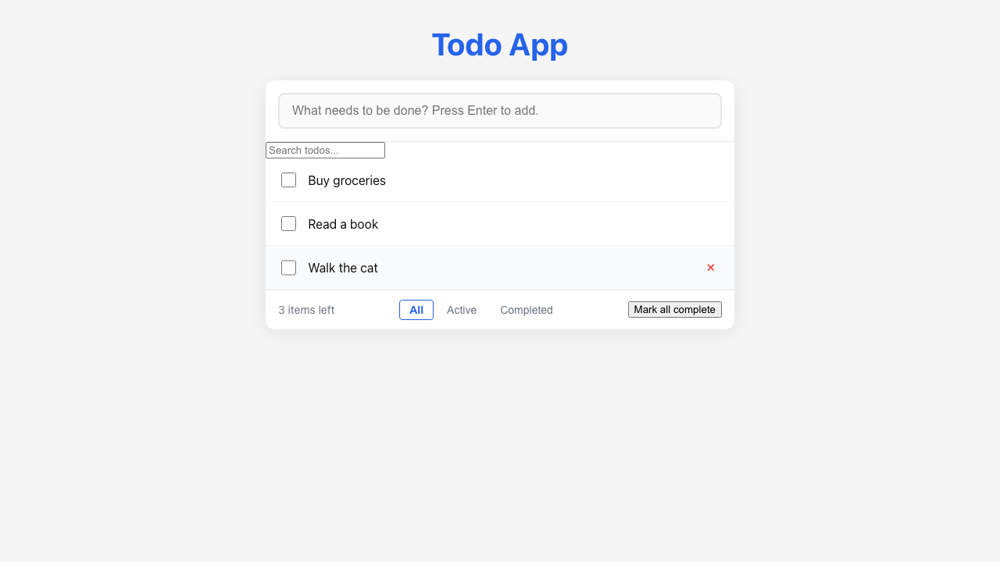
Feature Demo
US-06 — Edit a Todo Title

Slide 5
Definition of Done
US-06 — Edit a Todo Title
✓
Unit tests written with >80% coverage
✓
Integration tests for API endpoints
✓
Code review completed
✓
E2E tests passed (all journeys green)
✓
User documentation written (help article, FAQ, troubleshooting)
✓
Architecture diagram updated
✓
PowerPoint deliverable generated
○
Git commit and push completed

