Slide 1
US-07
Delete a Todo
EPIC-02 — Todo CRUD (Core Feature)
Priority: Must Have | Story Points: 2
Sprint 1 — Todo App

Slide 2
Overview
US-07 — Delete a Todo
Story Summary
Delete a todo by hovering to reveal a delete button. The todo is removed immediately from the list and permanently from the database.
Tech Stack
Points: 2
DELETE /todos/:id API
CSS hover reveal
SQLite delete

Slide 3
Acceptance Criteria
US-07 — Delete a Todo
✓
Clicking delete removes todo from the list immediately
✓
Backend confirms deletion — todo removed from DB
✓
DELETE /todos/:id returns 404 for unknown IDs
✓
Delete button only visible on hover (clean UI)

Slide 4
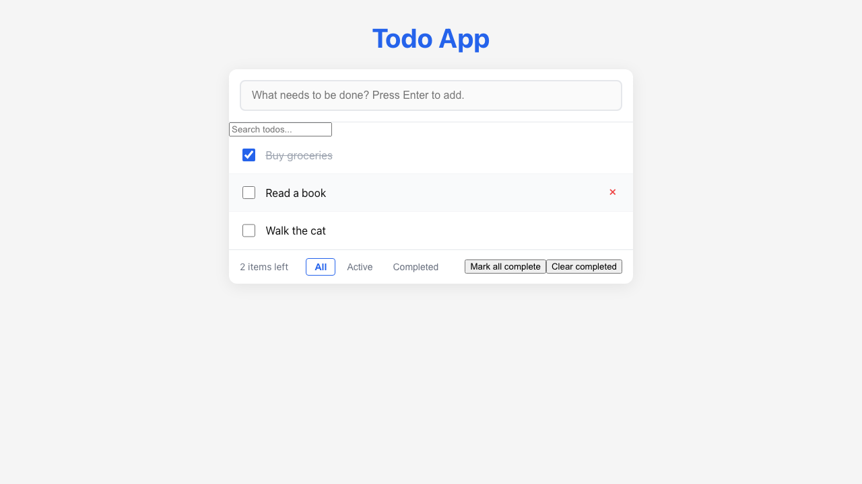
Feature Demo
US-07 — Delete a Todo

Slide 5
Definition of Done
US-07 — Delete a Todo
✓
Unit tests written with >80% coverage
✓
Integration tests for API endpoints
✓
Code review completed
✓
E2E tests passed (all journeys green)
✓
User documentation written (help article, FAQ, troubleshooting)
✓
Architecture diagram updated
✓
PowerPoint deliverable generated
○
Git commit and push completed

