Slide 1
US-08
Filter Todos by Status
EPIC-03 — Todo Organization & Filtering
Priority: Should Have | Story Points: 2
Sprint 1 — Todo App

Slide 2
Overview
US-08 — Filter Todos by Status
Story Summary
Filter the todo list by All, Active, or Completed status using the footer filter bar. The active filter is visually highlighted.
Tech Stack
Points: 2
React state filtering
Footer filter bar
CSS highlight

Slide 3
Acceptance Criteria
US-08 — Filter Todos by Status
✓
"Active" filter shows only incomplete todos
✓
"Completed" filter shows only done todos
✓
"All" filter shows every todo
✓
Active filter is visually highlighted in the UI

Slide 4
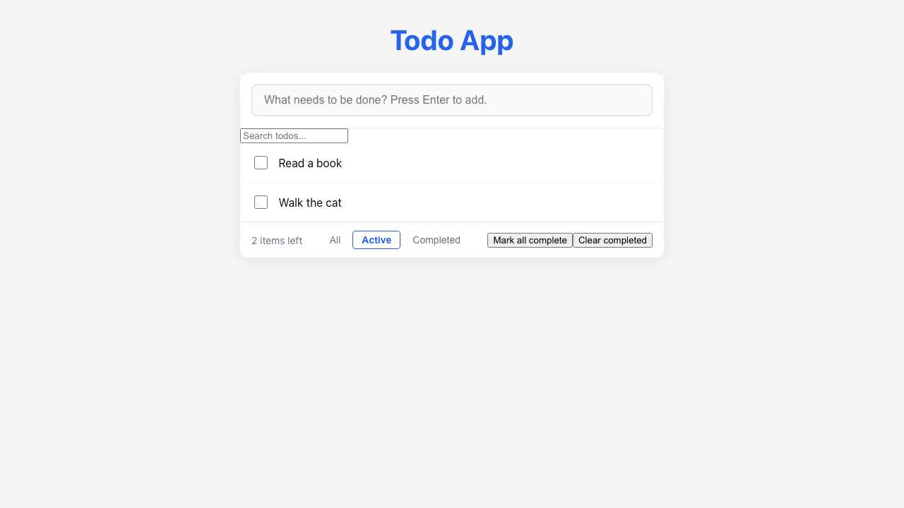
Feature Demo
US-08 — Filter Todos by Status

Slide 5
Definition of Done
US-08 — Filter Todos by Status
✓
Unit tests written with >80% coverage
✓
Integration tests for API endpoints
✓
Code review completed
✓
E2E tests passed (all journeys green)
✓
User documentation written (help article, FAQ, troubleshooting)
✓
Architecture diagram updated
✓
PowerPoint deliverable generated
○
Git commit and push completed

