Slide 1
US-11
Loading & Error States
EPIC-04 — User Experience Polish
Priority: Should Have | Story Points: 3
Sprint 1 — Todo App

Slide 2
Overview
US-11 — Loading & Error States
Story Summary
Show skeleton loaders during data fetch, toast notifications for API errors, auto-dismiss after 4 seconds, and disable action buttons during in-flight requests.
Tech Stack
Points: 3
Skeleton CSS animation
Toast component
React loading state

Slide 3
Acceptance Criteria
US-11 — Loading & Error States
✓
Skeleton loader shown while fetching todos
✓
Toast notification appears on any API failure
✓
Toast auto-dismisses after 4 seconds
✓
Action buttons disabled during pending mutations

Slide 4
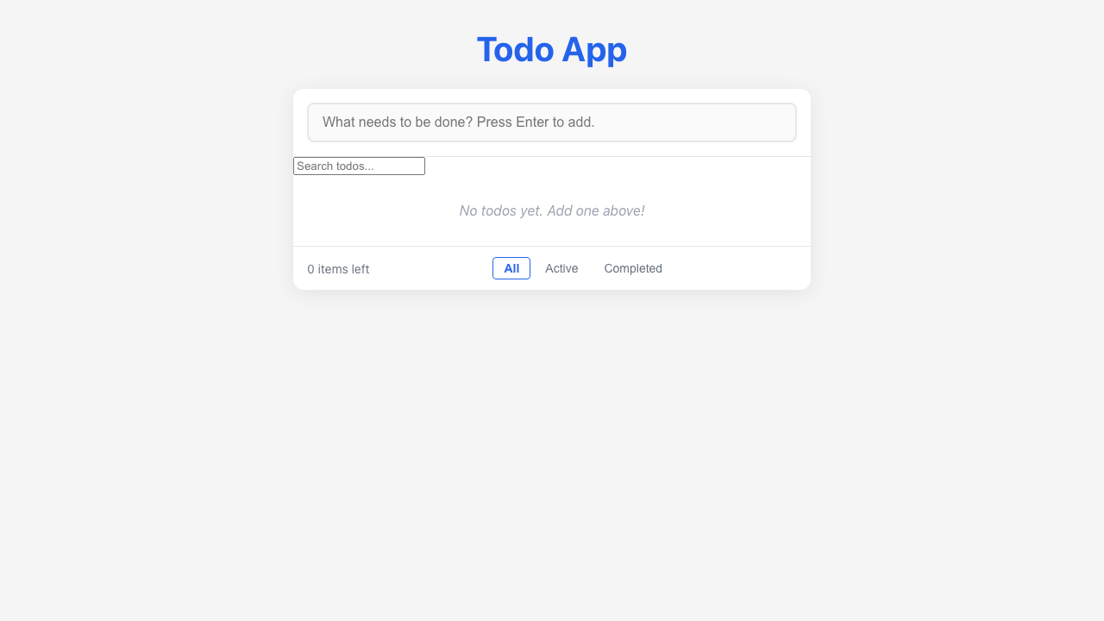
Feature Demo
US-11 — Loading & Error States

Slide 5
Definition of Done
US-11 — Loading & Error States
✓
Unit tests written with >80% coverage
✓
Integration tests for API endpoints
✓
Code review completed
✓
E2E tests passed (all journeys green)
✓
User documentation written (help article, FAQ, troubleshooting)
✓
Architecture diagram updated
✓
PowerPoint deliverable generated
○
Git commit and push completed

