Slide 1
化工廠建廠籌備執行實務
陳森路
中鼎工程股份有限公司
2014/6/20

Slide 2
Project Life
PDP
FEED
Mechanical Guarantee
Engineering, Procurement, Construction
Mechanical Completion
Hand-over
Performance Guarantee
Commissioning
Ready for
Start-up
(RFSU)
Performance Test
Warranty
Provisional Acceptance
Final
Acceptance

Slide 3
專案管理知識體
專案整合管理
專案範疇管理
專案時間管理
專案成本管理
專案品質管理
專案人力資源管理
專案溝通管理
專案風險管理
專案採購管理
專案整合管理
專案利害關係人管理

Slide 4
Agenda
Invitation to Bid (ITB)
Budget
Planning
Engineering
Procurement
Construction
Pre-commissioning
Commissioning
Performance Test
Project Management

Slide 5
Agenda
Invitation to Bid (ITB)
Budget
Planning
Engineering
Procurement
Construction
Pre-commissioning
Commissioning
Performance Test
Project Management

Slide 6
Invitation to Bid
Instruction to Bidder
Scope of Work
Contract
Project Document
Specifications
Procedures
Reporting
Site and Environmental Data

Slide 7
Agenda
Invitation to Bid (ITB)
Budget
Planning
Engineering
Procurement
Construction
Pre-commissioning
Commissioning
Performance
Project Management

Slide 8
Budget
Licensor fee
Engineering, Equipment & Material, Construction cost
Chemical and Catalyst cost
Importing Tax
Insurance Fee
Others

Slide 9
Agenda
Invitation to Bid (ITB)
Budget
Planning
Engineering
Procurement
Construction
Pre-commissioning
Commissioning
Performance Test
Project Management

Slide 10
Planning
Contract Type
Process Unit (ISBL)
Supporting Facilities (OSBL)
Permit Application
Project Schedule
Engineering / Procurement / Construction / Commissioning
Temporary Facilities
Shutdown & Tie-in to Existing Systems
Transportation of Heavy/Large Equipment
Insurance Policy

Slide 11
Contract Type
Lump Sum Turn Key (LSTK) for Engineering, Equipment & Material Supply, Erection, and Installation; or,
Reimbursable,
Cost Plus

Slide 12
Process Unit (ISBL)
Licensing unit, or
Open Art unit
Process Design Package (PDP) by Licensor
Front End Engineering Design (FEED)

Slide 13
Supporting Facilities
Power Supply System
City Power, Emergency Power, UPS, etc.,
Air System
Plant Air, Instrument Air, Nitrogen, etc.,
Fire Fighting System
Fire Station / Fire Engine, Fire Water Pond, Fire Water Pump, Clean Agent System, etc.
Plant Water System
Raw Water, De-mineral Water, Cooling Water System, Potable Water, etc.
Steam System
HP, MP, LP Steam
Environment Protection System
WWT, Incinerator, Solid Waste Storage, etc.

Slide 14
Permit Application
建築物執照
雜項執照
固定污染源設置 / 操作許可
危險性機械檢查合格證
天車、升降機
危險性設備檢查
鍋爐、 壓力容器
進口設備重新檢查
危險性工作場所 (甲&丙類)審查暨檢查
廠區消防系統
防爆電氣設備型式認證
台電用電申請與許可

Slide 15
Project Schedule
Process Design Package
Front End Engineering Design
Detailed Engineering Design
Procurement of Equipment & Material
- Delivery of Long Lead Equipment/Material
Construction & Pre-Commissioning
Commissioning & Performance Test
Total Schedule --> Target Completion Date

Slide 16
Engineering / Procure. / Constr. / Comm.
Potential EPC Contractors
Approved Vendor List
Pre-Qualification (PQ) / Shop Visit
Detailed Engineering Design
Procurement Service + E/M Supply
Construction Management + Construction
Commissioning Assistance

Slide 17
Temporary Facilities
Construction Fence
Construction Office
Construction office, Warehouse, Work Shop, Dormitory, Canteen, etc.
Laydown Area & Dumping Area
Temporary Water & Power
Telephone & Internet
Utilities for Commissioning

Slide 18
Tie-in to Existing Systems
Modification of Existing Systems to fit new requirements
Tie-in Points and Locations
Shut-down Schedule for tie-in work

Slide 19
Transportation Route
Transportation Route for People and Vehicles
Transportation Route for Large/Heavy Equipment
Bearing Capacity of Unloading Berth, Roll-in/Roll-out, Clearance, etc.
Modification of Existing Access Way

Slide 20
Insurance Policy
Construction All Risk
Employer Liability Insurance
Vehicle Insurance
3rd Party Liability Insurance
Marine Insurance
Insurance Policy

Slide 21
Agenda
Invitation to Bid (ITB)
Budget
Planning
Engineering
Procurement
Construction
Pre-commissioning
Commissioning
Performance Test
Project Management

Slide 22
Engineering Design
Process
Civil / Structure / Building
Pressure Vessel / Machinery
Instrument / Control System
Piping
Electrical
Safety Engineering
Tools Application
Codes and Standards

Slide 23
Engineering Design - Process
P&ID for Process, Utilities, and Waste Water Treatment
Equipment Data Sheets
Instrument Data Sheets
Line List
Safety Interlock System
Catalyst & Chemical

Slide 24
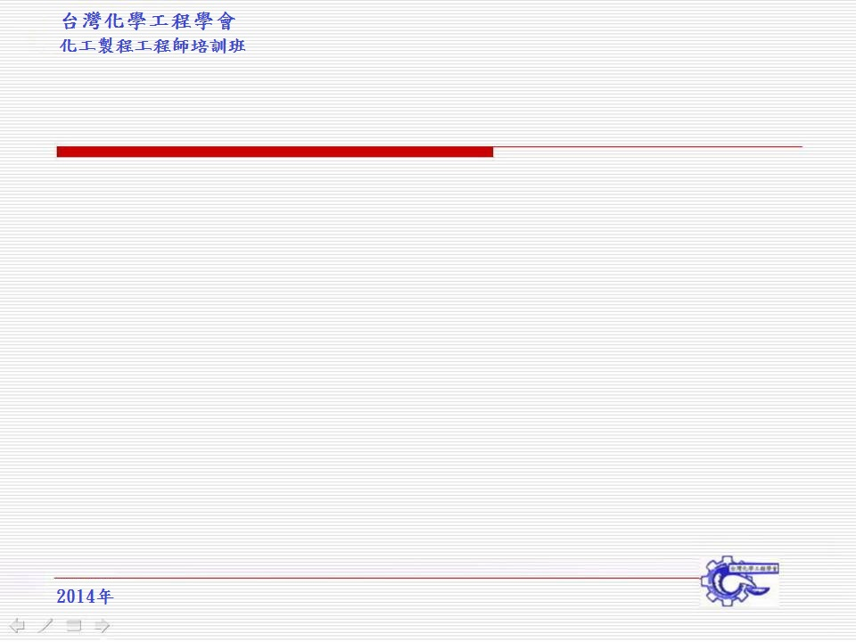
Engineering Design – CVL/STR/ARCH
Specification
Soil Investigation Report
Site Preparation and Improvement
Paving, Road, Drainage
RC Structure vs. Steel Structure
Architecture & Building
Landscape

Slide 25
Engineering Design - Equipment
Specifications
Requisition / Technical Bid Evaluation
Engineering Drawings for Pressure Vessels and Tanks
Vendor drawing review
Shop inspection

Slide 26
Engineering Design – Instrument
Specifications
Plant Automation System
Requisitions / Technical Bid Evaluation
Layout of Control Room / Rack Room
Instrument Cable Layout
Hook-up Drawings
Vendor drawing review
DCS FAT / SAT
Shop inspection

Slide 27
Engineering Design - Piping
Specifications
Plot Plan / Equipment Layout
Piping Layout
3D Model / Model Review (30%, 60%, 90%)
Stress Analysis / Pipe Support
Requisition / Technical Bid Evaluation
Vendor drawing review

Slide 28
Engineering Design - Electrical
Specifications
One-line Diagram
Main Substation
Motor Control Center
Requisition / Technical Bid Evaluation
Vendor drawing review
Shop inspection

Slide 29
Engineering Design - HSE
Safety Engineering
- Fire Protection, Hazardous Area Classification, etc.
Environment and Health Engineering
- Waste Management and Human Factor
Noise Engineering
HSE Review
EIA (Environmental Impact Assessment),
ENVID (Environment Impact Identification),
QRA (Quantitative Risk Assessment),
HAZID (Hazard Identification Risk Analysis),
HRA (Health Risk Assessment)
HAZOP (Hazard and Operability Study)
IPF (Instrumented Protective Function)

Slide 30
Engineering Design – Tools
3D Model
PDMS,
PDS,
Smartplant 3D
Smartplant P&ID
In Tools
AutoCAD

Slide 31
Engineering Design – Code & STD
Local Regulations & Standards
CNS,
各類場所消防安全設備設置標準
建築技術規則
鍋爐及壓力容器安全規則
壓力容器安全檢查構造標準
International Codes & Standards
- API, TEMA, ASME, NFPA, NEC, IN, etc.

Slide 32
Agenda
Invitation to Bid (ITB)
Budget
Planning
Engineering
Procurement
Construction
Pre-commissioning
Commissioning
Performance Test
Project Management

Slide 33
Procurement
Approved Vendor List
Requisition / Inquiry / Place Order
Payment Terms and Conditions
Vendor Document
Expediting
Inspection and Test
Delivery
Customs Clearance

Slide 34
Procurement – Approved Vendor List
Licensor Nominated Vendor
Approved Vendor List
Potential Subcontractor List

Slide 35
Procurement – Requisition / PO
Proprietary Equipment
Equipment
Pressure Vessel
Heat Exchangers
Rotary Machine
Package
Tanks
Spare Parts
Construction / Commissioning Spare, Operating Spare, etc.,
Bulk Material
Net Quantity + Allowance
Catalyst
Chemicals
Subcontracting Construction Work

Slide 36
Procurement – Terms and Condition
Performance Bond
Down Payment
Progress Payment
Warranty
Delay Penalty

Slide 37
Procurement – Vendor Document
Specifications
Manufacturing Schedule
General Assembly Drawings
Material Certificate
Operation Manual
WPS & PQR
Inspection and Test Plan
Performance Test Report
Maintenance Manual
Tools and Spare Parts

Slide 38
Procurement – Expediting
Equipment Criticality
Residential Expediting
Desk Expediting

Slide 39
Procurement – Inspection and Test
Inspection Level
Inspection and Test Plan (ITP)
Pre-Inspection Meeting (PIM)
Performance Test (FAT / SAT)
Positive Material Identification (PMI)
Welding Procedure Specification (WPS)
Procedure Qualification Record (PQR)

Slide 40
Procurement – Customs Clearance
Consignee vs. Consignor
Importing Duty
Tax Exemption
- How to maximize Tax Exemption?

Slide 41
Procurement – Delivery
EXW (Ex Work,工廠交貨)
FOB (Free on Board, 裝運港船上交貨)
CIF (Cost, Insurance, and Freight,成本加保險費、運費)
DES (Delivered Ex Ship, 目的港船上交貨)
Logistics

Slide 42
Agenda
Invitation to Bid (ITB)
Budget
Planning
Engineering
Procurement
Construction
Pre-commissioning
Commissioning
Performance Test
Project Management

Slide 43
Construction
Constructability Review
Temporary Facilities
Subcontracting Plan
Construction
Rigging Plan
Health, Safety, Security, Environment (HSSE)
QC Report

Slide 44
Construction - Constructability
Review engineering design from construction point of view

Slide 45
Construction - Construction
Civil (Site preparation + Civil Work)
Steel Structure Prefabrication + Installation
Equipment Installation
Piping Prefabrication + Installation
Electrical / Instrument installation
Painting / Insulation

Slide 46
Construction – Rigging Plan
Rigging Plan

Slide 47
Construction – HSSE
HSSE:
Health,
Safety,
Security,
Environment

Slide 48
Construction – QC
Test Report
Piling Test - Pile
Strength Test - RC
Pressure Test – Piping work, Pressure Vessel
NDE – Welding point
Loop Test - Instrument
Running Test - Motor

Slide 49
Agenda
Invitation to Bid (ITB)
Budget
Planning
Engineering
Procurement
Construction
Hand-over / Start-up
Pre-commissioning
Commissioning
Performance Test
Project Management

Slide 50
Pre-commissioning
Conformity Check
Static, de-energized test
Machinery cold alignment
Instrument calibration
Conventional line cleaning (air blowing, water flushing, steam blowing) and reinstatement
Special line cleaning, such as chemical cleaning, lube oil flushing, hydro blasting, sand blasting
Air leak test and utility service test
Cable continuity and insulation integrity test
Equipment cleaning, final box up and preservation
Low energy test such as energized loop test and LV motor solo run

Slide 51
Agenda
Invitation to Bid (ITB)
Budget
Planning
Engineering
Procurement
Construction
Pre-commissioning
Commissioning
Performance Test
Project Management

Slide 52
Commissioning
Preliminary checks in preparation for commissioning execution (PSSR)
Substation and electrical network energization
Instrument/electrical functional tests
Rotating equipment run in (w/inert fluid)
High pressure leak test
Inerting
Catalyst and chemical (first fill) loading
Refractory drying out of furnaces
Dry out/boil out and steam blowing of boilers
Commissioning and service testing of utilities
Passivation of cooling water network
Catalyst and reactor loop drying

Slide 53
Agenda
Invitation to Bid (ITB)
Budget
Planning
Engineering
Procurement
Construction
Pre-commissioning
Commissioning
Performance Test
Project Management

Slide 54
Performance Test
Feedstock
Utilities
Stable Running
Performance Test

Slide 55
Agenda
Invitation to Bid (ITB)
Budget
Planning
Engineering
Procurement
Construction
Pre-commissioning
Commissioning
Performance Test
Project Management

Slide 56
Project Management
Tools Application
Primavera P6 : Schedule Control
WINPCS : Turn over control
SPF-TDC : Document Management
Progress Measurement
Earned value
Appraisal guide
Reporting
Weekly Progress Report
Monthly Progress Report
Data Book

Slide 57
Thank you!

