Slide 1
AI
Image support

Slide 2


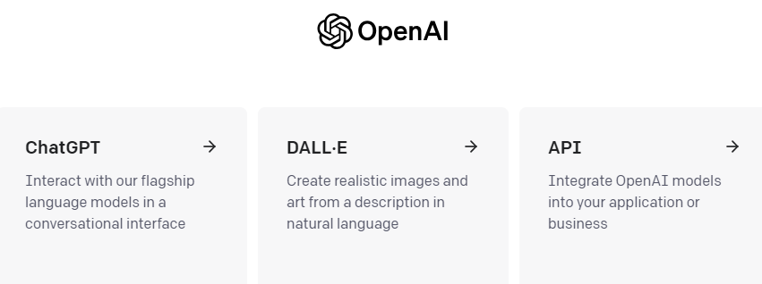
A journey of a thousand
miles starts wit the first step

Slide 3


Classification
Completion
Text-davinci-003
Conversation
OpenAI Organization
Generation
Transformation
GPT-3
Natural language task via prompt
Create an ad for an ice cream company
GPT-3 Capabilities
Codex
Natural language to code
Create a function that returns the square
root of a number
Prompts
Tokens
Temperature
Key Concepts
DALL-E
Create and edit images
Create the image of a dog chasing a cat
OpenAI Models

Slide 4
