Slide 1
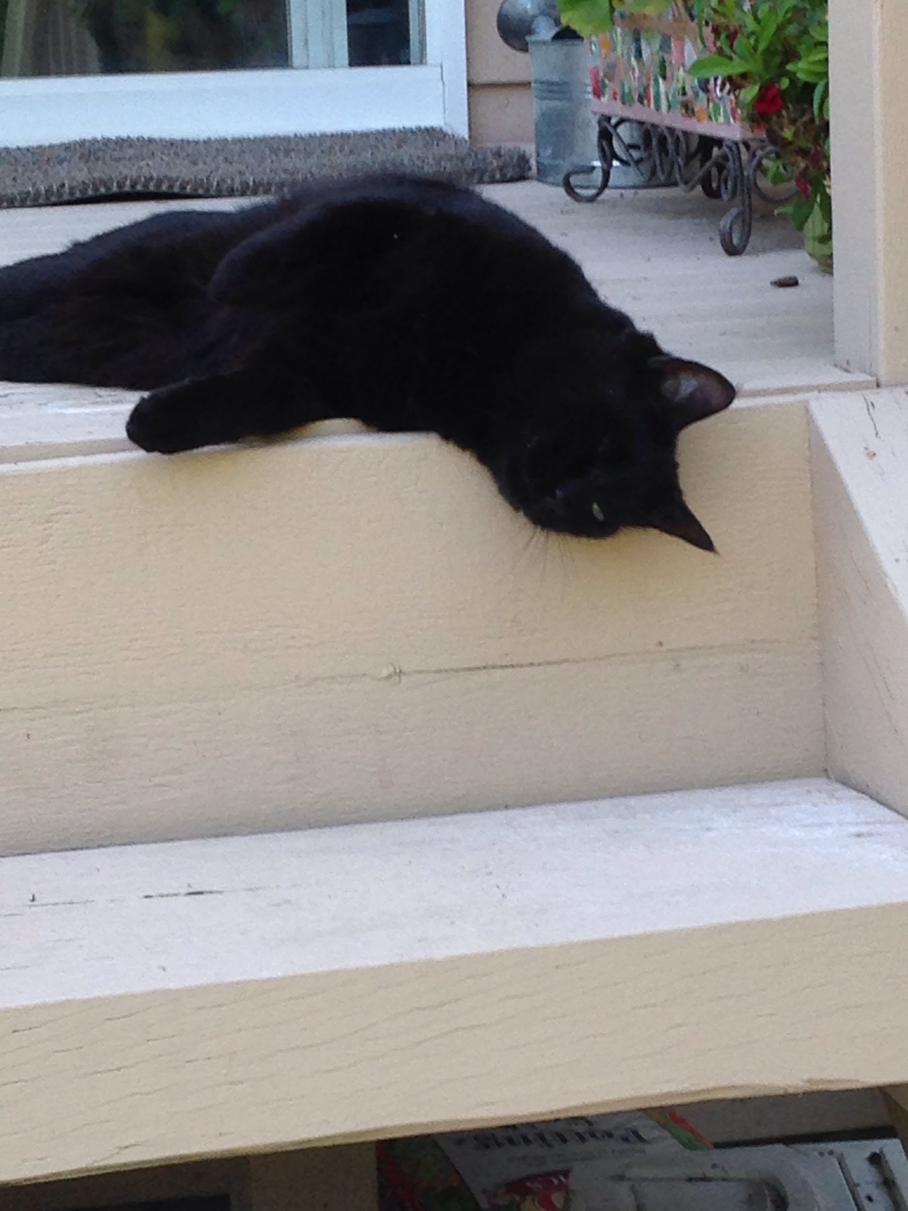
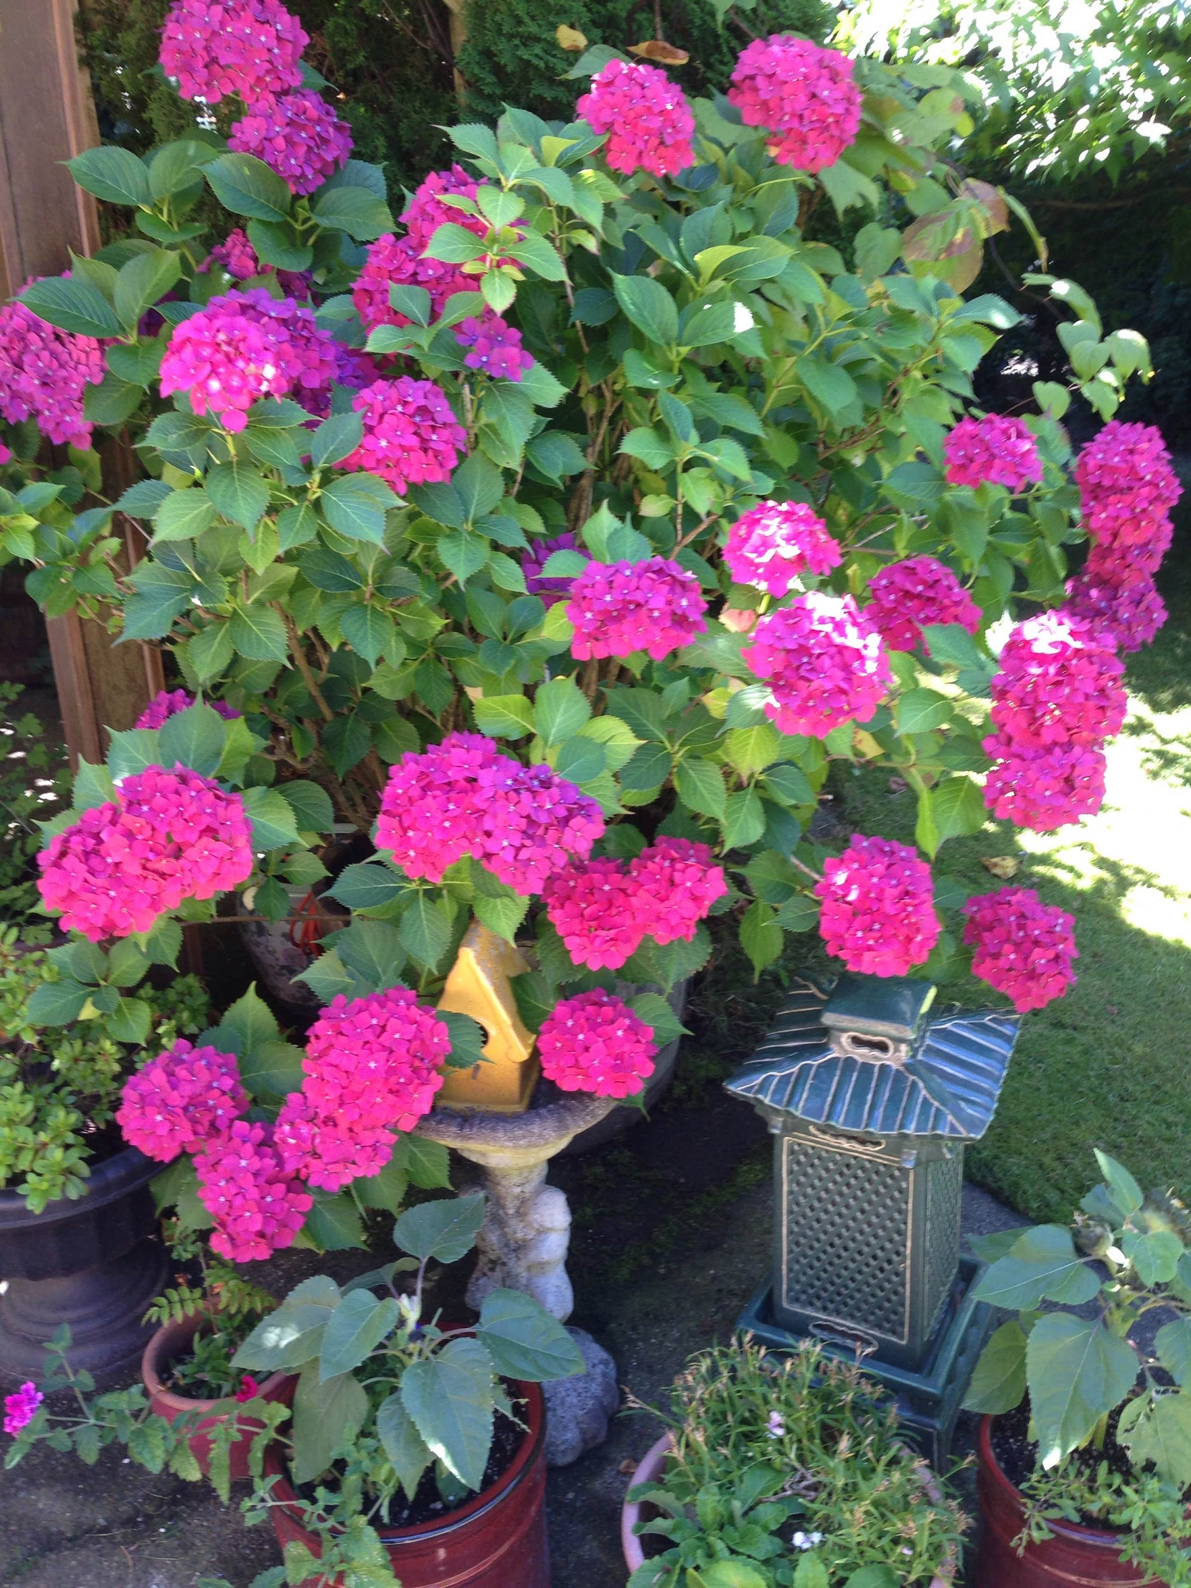
Midsummereve
Using Drive API

Slide 2
Stanza 1
Where are you going, summer breeze?
Off beyond the fields and trees.
What do you see when you blow that way?
Children jumping from bales of hay.

Slide 3
Stanza 2
What do you hear as you travel the land?
People dancing to an outdoor band.
What do you smell as you rush about?
The perfume of blossoms bursting out.

Slide 4
Stanza 3
What do you taste as you soar up high?
Fresh corn on the cob and apple pie.
What do you feel as you climb the great heights?
The heat of the day and the warmth of the nights.

