Slide 1
Personal Health Wallet
JiaqI zhang (63144551)

Slide 2
agenda
List of participants
Introduction of Big Project
UBC Research part
My responsible part – NGS Report

Slide 3
Participants
Academic Supervisor | Department | Academic Institution | City and Country location of academic institution
Victoria Lemieux | University of Engineering | University of British Columbia | Vancouver, Canada
Partner organization(s) | Contact name at partner organization | City and Country location of organization | Partner Legal Status
Molecular You | Rob Fraser | Vancouver, BC | Legal

Slide 4
BIG Project overview Goal
Using blockchain technology to securely share private health information
Patients can get all their medical history from the platform
Long term Goal
Every interested Canadian can upload and share their health information via platform
A reward system to encourages more people participate in

Slide 5
BIG Project overview Problems
Unconnected Health data
Technical challenge to integrate all the data
Individuals have privacy concerns
Healthcare researchers have little access real-world data

Slide 6
BIG Project overview Solutions
Utilize open source blockchain technology
Individuals control their own health data completely
Users will be able to choose to share information with different parties
The platform will also help overcome growing trust barriers and collect real-world data to researchers
Putting individuals in control of sharing their own data can help break down these barriers.

Slide 7
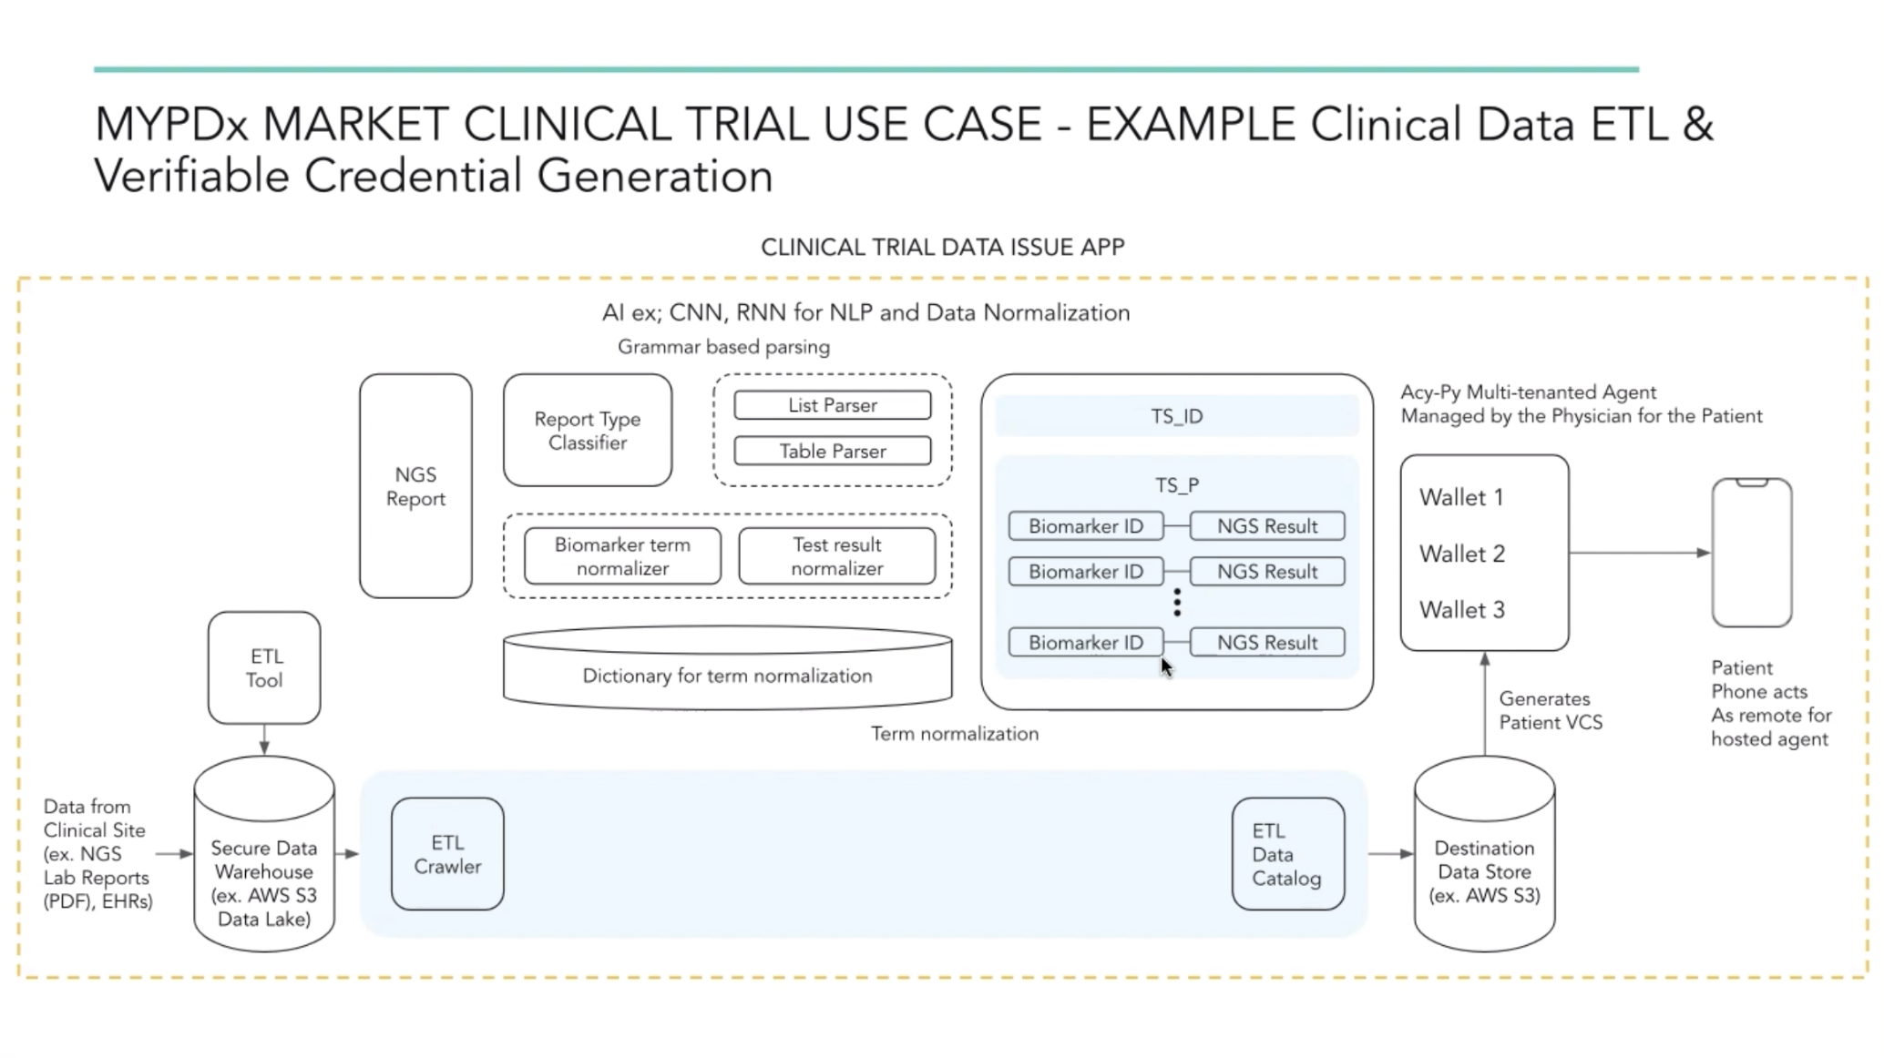
UBC Research Team

Slide 8
MY Schedule
Nov, 2020 – Dec, 2020
Understand the project
Finish proposal
Jan, 2021 – Apr, 2021
Do more research on the Biomarker Extraction
Build BN and TR Dictionary
May, 2021 – Sep, 2021
Start to work with real data

Slide 9
NGS REport
NGS: Next Generation Sequencing
An important reference of tumor diagnosis
Contains many biomarker names
Biomarker: A biological molecule found in blood, other body fluids, or tissues that is a sign of a normal or abnormal process, or of a condition or disease.
An indicator of how well the body responds to a treatment for a disease or condition
Extract Biomarker information from the NGS Reports

Slide 10
NGS Report problems and Challenges
Pathology reports are written in free-text form, which precludes efficient data gathering
Pathology reports generally do not follow formal grammar rules
Inappropriate format style by using many line breaks, white spaces, and hyphens
Difficult to automatically detect the sentence boundary
Difficult to apply normalization of term variation
Clinical reports sometimes contain specific jargons and spelling errors
Too much irrelevant information
Aims to build a system to compute and display statistics of clinical data extracted from pathology reports

Slide 11
Methods – NGS report preprocessing
Utilize cTAKES approach to identify and correct some spelling errors
May adopt a semi-structured style to describe NGS findings
classified as list- or table-based style
ensure simplicity and accuracy of parsing
Define a context-free grammar
Identify which tokens stands for Biomarker names
Identify which tokens corresponding to Test results

Slide 12
Methods – NGS report BN Dictionary
Aim: Build our own Biomarker Name Dictionary to facilitate term normalization
Handle terminology variation
Example: ‘Wilms’ tumor 1 protein,’ ‘WT-1′, ‘Wilms tumor 1-protein,’ and ‘WT1 (4)’ converted to one single term ‘Genes, Wilms Tumor’
Based on a list of official product names of biomarkers from SNUH
Preferred Terms (P_BN) linked with Medical Subject Headings (MeSH) codes
Expand the BN dictionary by following the rules

Slide 13
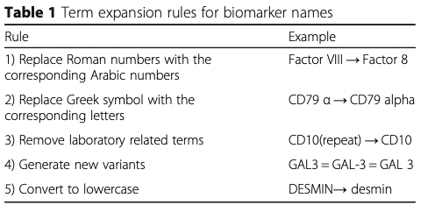
Methods – NGS report BN Dictionary – Expansion Rules

Slide 14
Methods – NGS report TR Dictionary
Term variations in Test results need to be considered
Example: ‘positive in mesothelial cells’ and ‘positive in tumor cells’ are normalized to ‘Positive’
Require Background knowledge
May not follow the same rule as BN
Manually created a TR dictionary based on all TRs from training set
Four normalized TR terms: “Positive”, “Focal Positive”, “Negative”, or “Error”

Slide 15
Methods – NGS report TR Dictionary
Term variations in Test results need to be considered
Example: ‘positive in mesothelial cells’ and ‘positive in tumor cells’ are normalized to ‘Positive’
Require Background knowledge
May not follow the same rule as BN
Manually created a TR dictionary based on all TRs from training set
Four normalized TR terms: “Positive”, “Focal Positive”, “Negative”, or “Error”

Slide 16
Conclusion
Personal Health Wallet will provide a way to help individuals store and share their medical history securely by taking advantages of blockchain technologies
Biomarker information could be extracted from the NGS report by looking up BN dictionary
BN dictionary could be expanded by follow particular rules
TR dictionary may be helpful to extract test results information

Slide 17
Thank you

