Slide 1
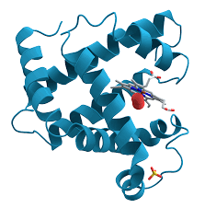
CASP
Miles Keppler, Sam Carpenter, Dedeepya Gudipati

Slide 2


Introduction
Critical Assessment of protein Structure Prediction
Identifying protein from a sequence
Amino acid sequences provided
Goal: Scoring system
CASP12 predictions had the highest average prediction than previous predictions

Slide 3
Motivation
Protein structures vs. Sequences
1/1000th
Narrow information gap
Model accuracy
Casp models help structural biologists

Slide 4
Methods
Search for similar proteins
Comparative modeling
Pairwise and multiple sequence alignment
What is similarity?

Slide 5
Expected Obstacles
Evaluating our prediction
Hard to understand if the direction is valid
Low homology proteins that don’t have much data
Project timeline

