Slide 1
ERA5→CONUS404 Latent CorrDiff
Frequency-domain detail · CorrDiff comparison · Anderson Creek Fire case study
Notes:
Deck assembled from the corrdiff-r2d2 benchmark branch. Three threads: (1) a T2 frequency-domain follow-up to the main event-based spectra figure, (2) the official CorrDiff (physicsnemo) accuracy/training-time comparison against our latent model, plus date-matched side-by-side output panels, (3) the Anderson Creek Fire (2016) case study -- kept separate from the headline 10-event, test-year (2018-2020) scorecard since 2016 is a validation year, not a held-out test year. Throughout, 'pipeline' means a single draw from the FULL pipeline (DRN + diffusion), not the smoothed ensemble mean -- that's what a user of the generative model actually gets.

Slide 2
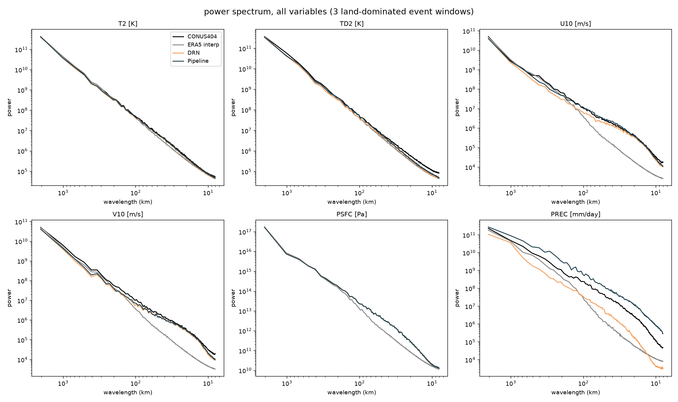
power spectrum, all variables
Notes:
Power spectrum for all 6 base variables: T2, TD2, U10, V10, PSFC, PREC_ACC_NC. No derived fields here (RH, VPD, FFWI, HDW are elsewhere in the deck). CONUS404 truth, ERA5 interp, DRN, pipeline, mean over 3 land dominated event windows.

Slide 3
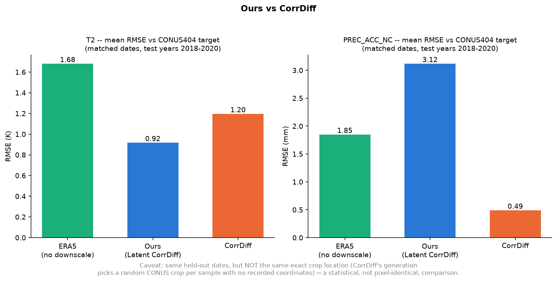
ours vs corrdiff, T2 and precip only, mean RMSE
Notes:
Accuracy on T2 and precip only, from the earlier two variable comparison: our latent model vs the official CorrDiff codebase (physicsnemo), both trained to completion (5,000,000+ steps) on our own ERA5 to CONUS404 data, not the authors' released weights (no CONUS checkpoint exists publicly). T2 RMSE: ERA5 interp about 1.7 to 2.0K, ours 0.92K, CorrDiff 1.20K, we win on T2. Precip RMSE: ERA5 about 0.7 to 3.0mm, ours 3.12mm, CorrDiff 0.49mm, CorrDiff wins clearly on precip (our known precip failure mode). See the next slide for all 6 variables, and the side by side pages later in this deck for actual output maps.

Slide 4
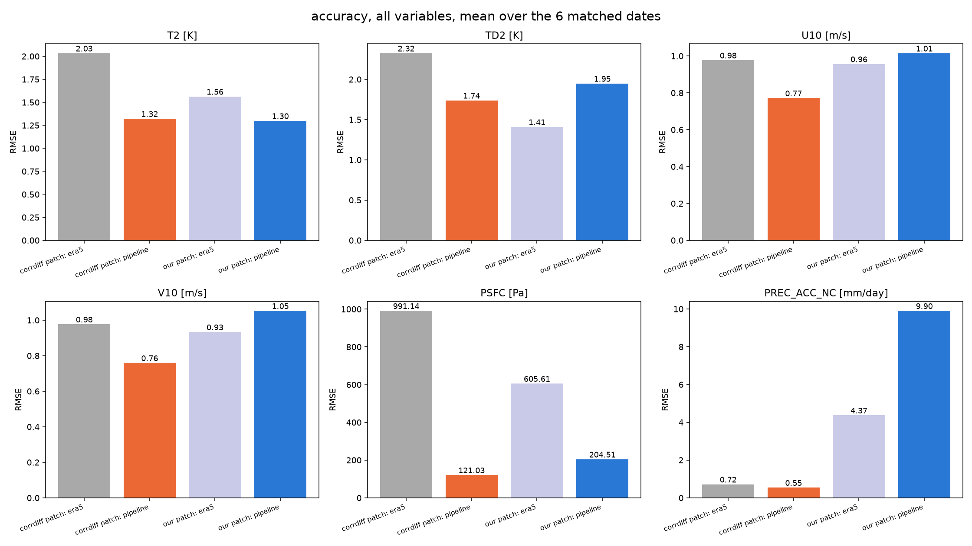
accuracy, all variables, corrdiff vs ours
Notes:
All 6 variables, same 6 matched held out dates. Those 6 dates are randomly sampled held out test year (2018-2020) dates from scripts/run_generic_baselines.py (seed 0, not cherry picked), originally chosen to check whether the diffusion stage sometimes hurts RMSE vs DRN alone on generic random days, then reused here so CorrDiff's generation config could test on the same dates. A 'patch' here just means a cutout tile of the map, a few hundred km across, that the model actually runs on (neither model processes the whole continent at once). 'CorrDiff patch' and 'our patch' are different map locations for each date. CorrDiff's generate.py does not save which location it ran on for each date (the output file's lat and lon fields are blank), so we know the date but not where on the map that sample came from. We picked one fixed location for our own runs and used it for all 6 dates. That means the two ERA5 bars per variable are not the same patch of ground and should not be compared to each other, only pipeline to its own ERA5 bar within the same patch. Is CorrDiff's truth a different data source: no. CorrDiff's generation config (external/corrdiff/conf/config_generate_era5conus404.yaml) points at the exact same CONUS404 cache directory we train and evaluate against, read through our own dataset adapter. Same ground truth source, different map location, not an independent dataset. With only 6 dates and 1 fixed patch on our side, this is noisy: our pipeline beats its own ERA5 bar on T2, U10, PSFC and is close on precip, but loses to its own ERA5 bar on TD2 and V10 at this particular patch, which is not what the larger 10 event benchmark elsewhere in this repo finds on average. Small sample, take the per variable numbers as illustrative, not as a replacement for the main benchmark.

Slide 5
CorrDiff training time, one clean pass
Regression (CorrDiffRegressionUNet, 5,000,000 steps): 7 SLURM jobs, 3 days 7 hours 39 minutes compute, about 318.6 GPU-hours on 4xA100
Diffusion (EDMPrecondSuperResolution, 5,000,000 steps): 10 SLURM jobs, 4 days 23 hours 2 minutes compute, about 476.1 GPU-hours
Total: 17 jobs, 8 days 6 hours 40 minutes compute, about 794.7 GPU-hours
Wall clock span: 8 days 18 hours 11 minutes (longer than compute time because of two multi hour SLURM queue waits between resubmissions)
Notes:
Both stages trained for 5,000,000+ steps to completion on this repo's hardware (1 node, 4xA100 40GB), each resubmitted repeatedly because the SLURM queue caps jobs at 12h wall time (train.py auto-resumes from the checkpoint dir). Source: corrdiff_regression_loop.log, corrdiff_diffusion_loop.log, sacct job accounting.

Slide 6
Our training time (DRN + VAE + diffusion), clean path only
DRN: 17 jobs, 3 days 9 hours 29 minutes compute, about 326 GPU-hours
VAE: 4 jobs, 1 day 13 hours 17 minutes compute, about 149 GPU-hours
Diffusion: 16 jobs, 6 days 1 hour 37 minutes compute, about 582 GPU-hours (only reached epoch 106 of a planned 300)
Total: 37 jobs, 11 days 0 hours 23 minutes compute, about 1,058 GPU-hours
This is more total GPU-hours than CorrDiff's 794.7, even on the clean path, because our pipeline has three stages (DRN, then VAE, then diffusion) against CorrDiff's two (regression, then diffusion)
Notes:
Same 4xA100 hardware, scripts/run_training.sh --stage {drn,vae,diffusion}. The real history also includes a superseded first diffusion attempt (around Mar 29-30, trained against an early VAE before a spectral loss was added) and some short crashed/retried jobs, this slide is the one clean path to the final checkpoints (drn_best.pt -> vae_best.pt -> diffusion_best.pt), excluding that abandoned attempt and the crashes, for a fair stage for stage comparison against the previous slide. The 'latent space is cheaper' argument elsewhere in this repo is about per sample inference cost in the compressed 64x64 latent space, not total training GPU-hours, see event_benchmark_output/README.md section 10 'Cost', where it is also not found faster than the small CorrDiff style pixel baseline at inference time either. Do not read 'ours trains faster' from this slide.

Slide 7
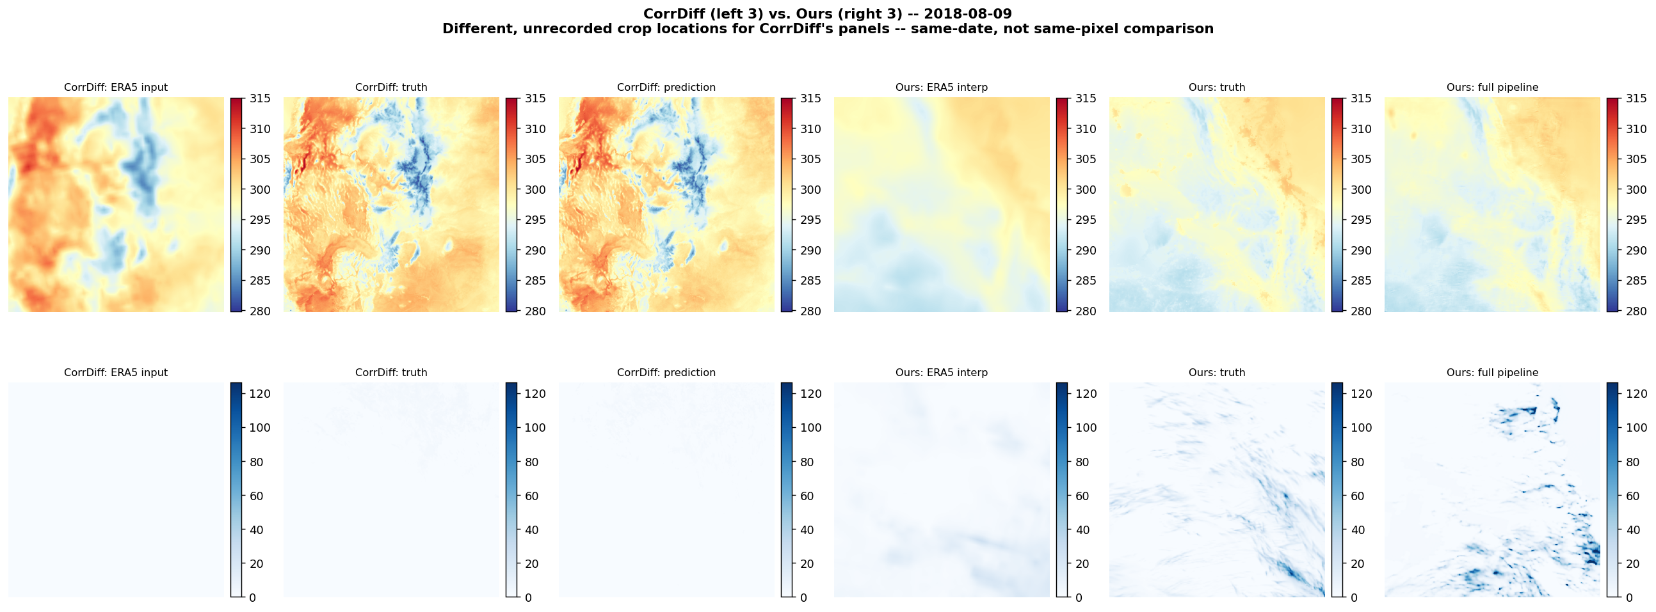
CorrDiff vs ours, 2018-08-09, same date, different map locations
Notes:
Date-matched run of both pipelines on 2018-08-09 (one of the 6 dates CorrDiff's own generate.py used). Left 3 columns = CorrDiff's own output (ERA5 input / truth / its prediction, pipeline). Right 3 columns = ours, same date, pipeline (ERA5 interp / truth / our prediction). Rows: T2 (top), PREC_ACC_NC (bottom). Same caveat as the RMSE slide earlier: CorrDiff's generate.py does not save which map location it ran on for this date, so these are each pipeline's real output on the same calendar date, at two different and unknown-vs-known map locations, not a pixel-identical side by side. Still useful to see each pipeline's actual visual behavior (smoothness, sharpness, artifacts) rather than just a summary RMSE number.

Slide 8
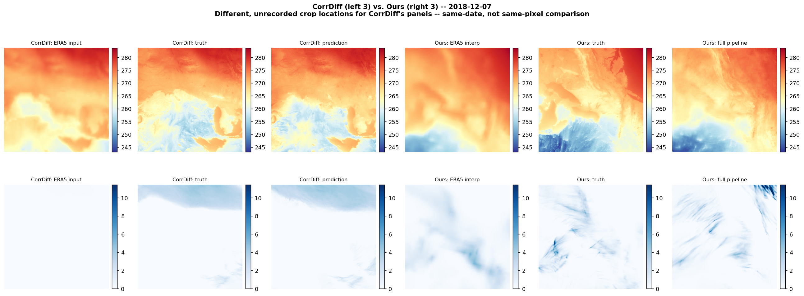
CorrDiff vs ours, 2018-12-07, same date, different map locations
Notes:
Date-matched run of both pipelines on 2018-12-07 (one of the 6 dates CorrDiff's own generate.py used). Left 3 columns = CorrDiff's own output (ERA5 input / truth / its prediction, pipeline). Right 3 columns = ours, same date, pipeline (ERA5 interp / truth / our prediction). Rows: T2 (top), PREC_ACC_NC (bottom). Same caveat as the RMSE slide earlier: CorrDiff's generate.py does not save which map location it ran on for this date, so these are each pipeline's real output on the same calendar date, at two different and unknown-vs-known map locations, not a pixel-identical side by side. Still useful to see each pipeline's actual visual behavior (smoothness, sharpness, artifacts) rather than just a summary RMSE number.

Slide 9
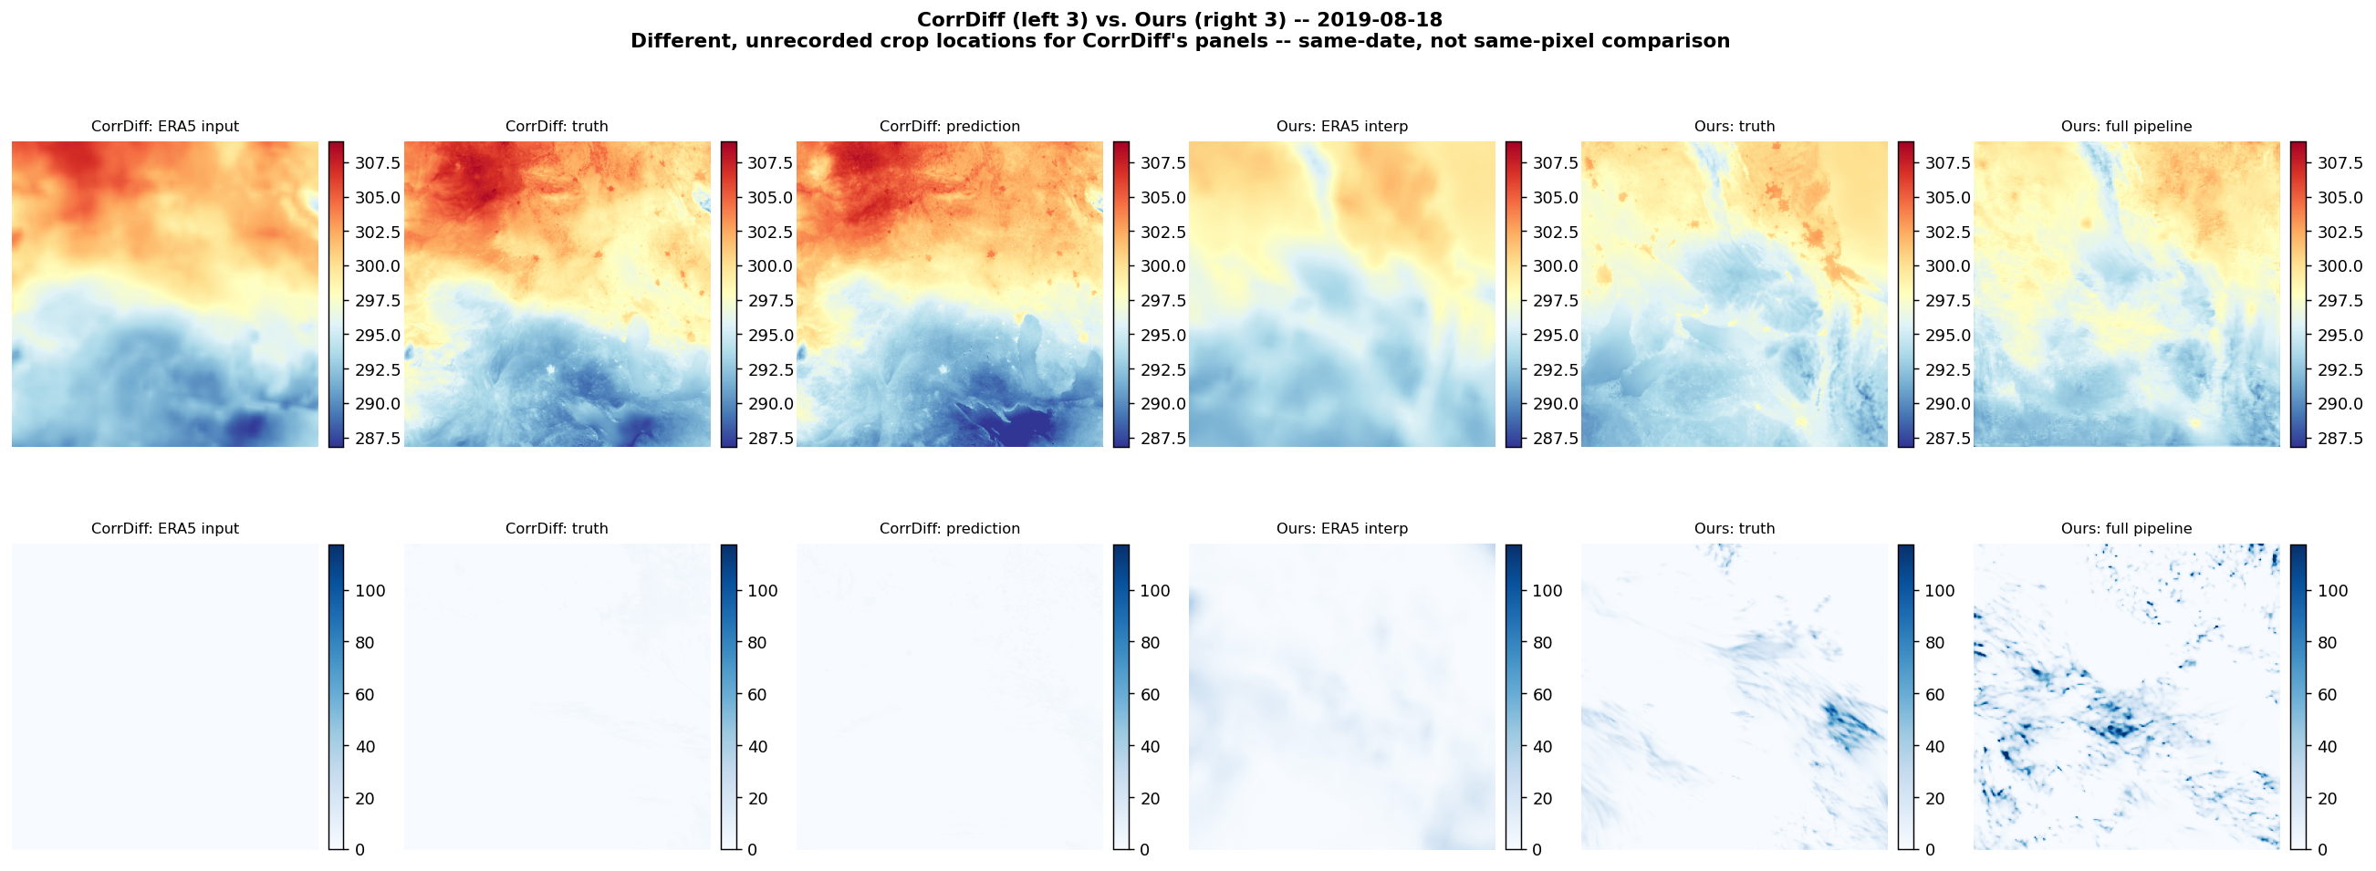
CorrDiff vs ours, 2019-08-18, same date, different map locations
Notes:
Date-matched run of both pipelines on 2019-08-18 (one of the 6 dates CorrDiff's own generate.py used). Left 3 columns = CorrDiff's own output (ERA5 input / truth / its prediction, pipeline). Right 3 columns = ours, same date, pipeline (ERA5 interp / truth / our prediction). Rows: T2 (top), PREC_ACC_NC (bottom). Same caveat as the RMSE slide earlier: CorrDiff's generate.py does not save which map location it ran on for this date, so these are each pipeline's real output on the same calendar date, at two different and unknown-vs-known map locations, not a pixel-identical side by side. Still useful to see each pipeline's actual visual behavior (smoothness, sharpness, artifacts) rather than just a summary RMSE number.

Slide 10
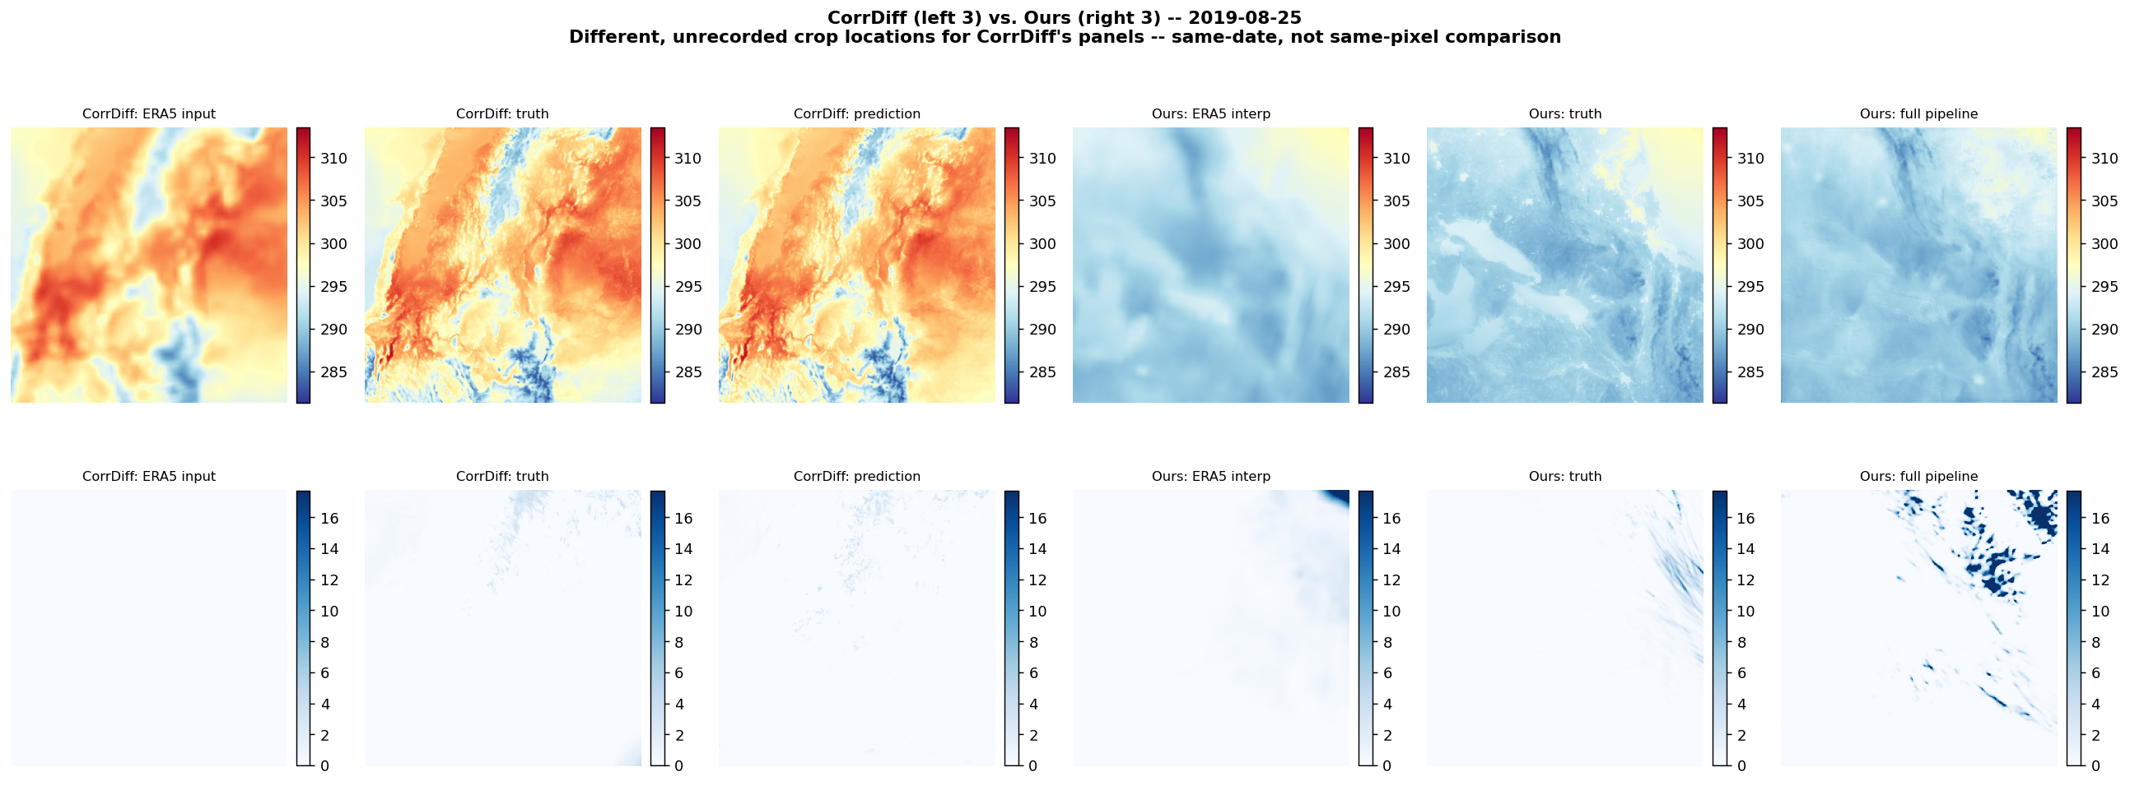
CorrDiff vs ours, 2019-08-25, same date, different map locations
Notes:
Date-matched run of both pipelines on 2019-08-25 (one of the 6 dates CorrDiff's own generate.py used). Left 3 columns = CorrDiff's own output (ERA5 input / truth / its prediction, pipeline). Right 3 columns = ours, same date, pipeline (ERA5 interp / truth / our prediction). Rows: T2 (top), PREC_ACC_NC (bottom). Same caveat as the RMSE slide earlier: CorrDiff's generate.py does not save which map location it ran on for this date, so these are each pipeline's real output on the same calendar date, at two different and unknown-vs-known map locations, not a pixel-identical side by side. Still useful to see each pipeline's actual visual behavior (smoothness, sharpness, artifacts) rather than just a summary RMSE number.

Slide 11
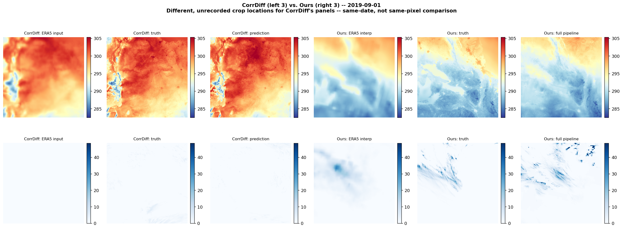
CorrDiff vs ours, 2019-09-01, same date, different map locations
Notes:
Date-matched run of both pipelines on 2019-09-01 (one of the 6 dates CorrDiff's own generate.py used). Left 3 columns = CorrDiff's own output (ERA5 input / truth / its prediction, pipeline). Right 3 columns = ours, same date, pipeline (ERA5 interp / truth / our prediction). Rows: T2 (top), PREC_ACC_NC (bottom). Same caveat as the RMSE slide earlier: CorrDiff's generate.py does not save which map location it ran on for this date, so these are each pipeline's real output on the same calendar date, at two different and unknown-vs-known map locations, not a pixel-identical side by side. Still useful to see each pipeline's actual visual behavior (smoothness, sharpness, artifacts) rather than just a summary RMSE number.

Slide 12
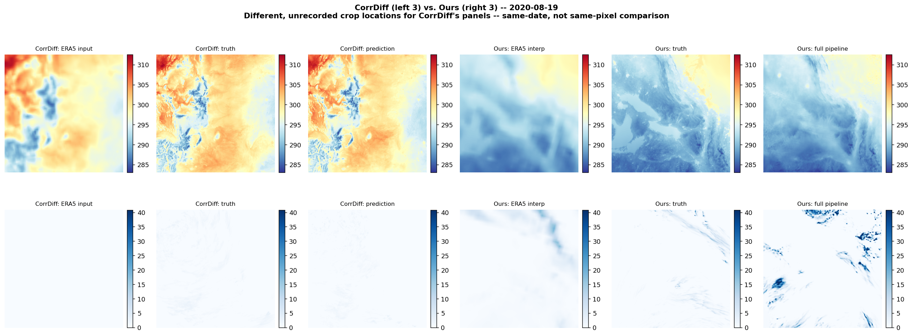
CorrDiff vs ours, 2020-08-19, same date, different map locations
Notes:
Date-matched run of both pipelines on 2020-08-19 (one of the 6 dates CorrDiff's own generate.py used). Left 3 columns = CorrDiff's own output (ERA5 input / truth / its prediction, pipeline). Right 3 columns = ours, same date, pipeline (ERA5 interp / truth / our prediction). Rows: T2 (top), PREC_ACC_NC (bottom). Same caveat as the RMSE slide earlier: CorrDiff's generate.py does not save which map location it ran on for this date, so these are each pipeline's real output on the same calendar date, at two different and unknown-vs-known map locations, not a pixel-identical side by side. Still useful to see each pipeline's actual visual behavior (smoothness, sharpness, artifacts) rather than just a summary RMSE number.

Slide 13
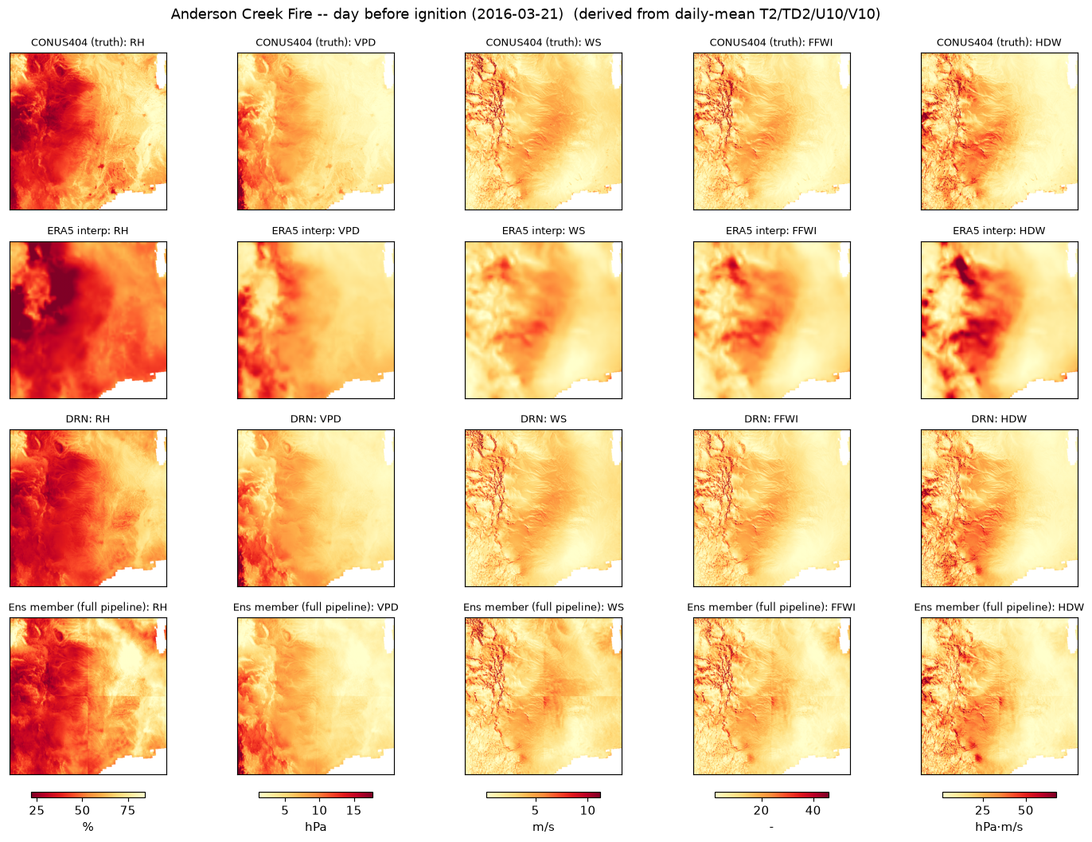
Anderson Creek Fire, day before ignition (2016-03-21)
Notes:
Day BEFORE ignition (2016-03-21) -- starting/background conditions, the day before the fire that would become the largest wildfire in Kansas history (~374,226 MTBS-mapped acres) started near Freedom, Woods County, Oklahoma. CONSISTENCY NOTE: this follows a 'use the day before/first date' convention for picking a fire's starting-conditions date. The existing CampFire_wind event elsewhere in this repo is already dated 2018-11-08, which IS the Camp Fire's actual ignition date, so no change was needed there. LaborDay_heat (2020-09-06) is intentionally dated to a regional wind/heat EVENT day, not one fire's ignition date (it covers several already-burning August 2020 fires plus some new Sept 2020 ignitions) -- that's a different kind of case study by design, not an inconsistency. Panels: CONUS404 truth / ERA5 interp / DRN / pipeline (a single DRN+diffusion draw, not the ensemble mean), columns RH / VPD / WS / FFWI / HDW, all derived from daily-mean T2/TD2/U10/V10 via the same fire_fields() formula used throughout the benchmark (Magnus RH/VPD, Fosberg FFWI, Hot-Dry-Windy = VPD x wind). IMPORTANT CAVEAT for this whole case study: 2016 is a VALIDATION year (2015-2017 per docs/DATA_SPECIFICATION.md), not a held-out TEST year (2018-2020) -- kept separate from the main 10-event scorecard on purpose, since mixing it in would silently change numbers already quoted elsewhere.

Slide 14
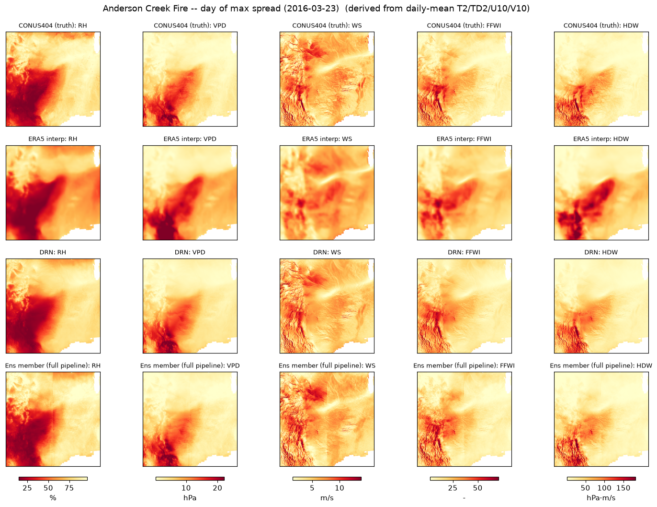
Anderson Creek Fire, day of maximum spread (2016-03-23)
Notes:
Day of MAXIMUM SPREAD (2016-03-23) -- the fire started ~17:45 local on 2016-03-22 (vehicle-sparked, dry fuels, gusty wind) and made a fast overnight run north into Barber/Comanche Counties, Kansas; it had burned ~72,000 of its eventual ~374,000-400,000 acres by the afternoon of the 23rd, so this captures most of the spread. Panels: CONUS404 truth / ERA5 interp / DRN / pipeline (a single DRN+diffusion draw, not the ensemble mean), columns RH / VPD / WS / FFWI / HDW, all derived from daily-mean T2/TD2/U10/V10 via the same fire_fields() formula used throughout the benchmark (Magnus RH/VPD, Fosberg FFWI, Hot-Dry-Windy = VPD x wind). IMPORTANT CAVEAT for this whole case study: 2016 is a VALIDATION year (2015-2017 per docs/DATA_SPECIFICATION.md), not a held-out TEST year (2018-2020) -- kept separate from the main 10-event scorecard on purpose, since mixing it in would silently change numbers already quoted elsewhere.

Slide 15
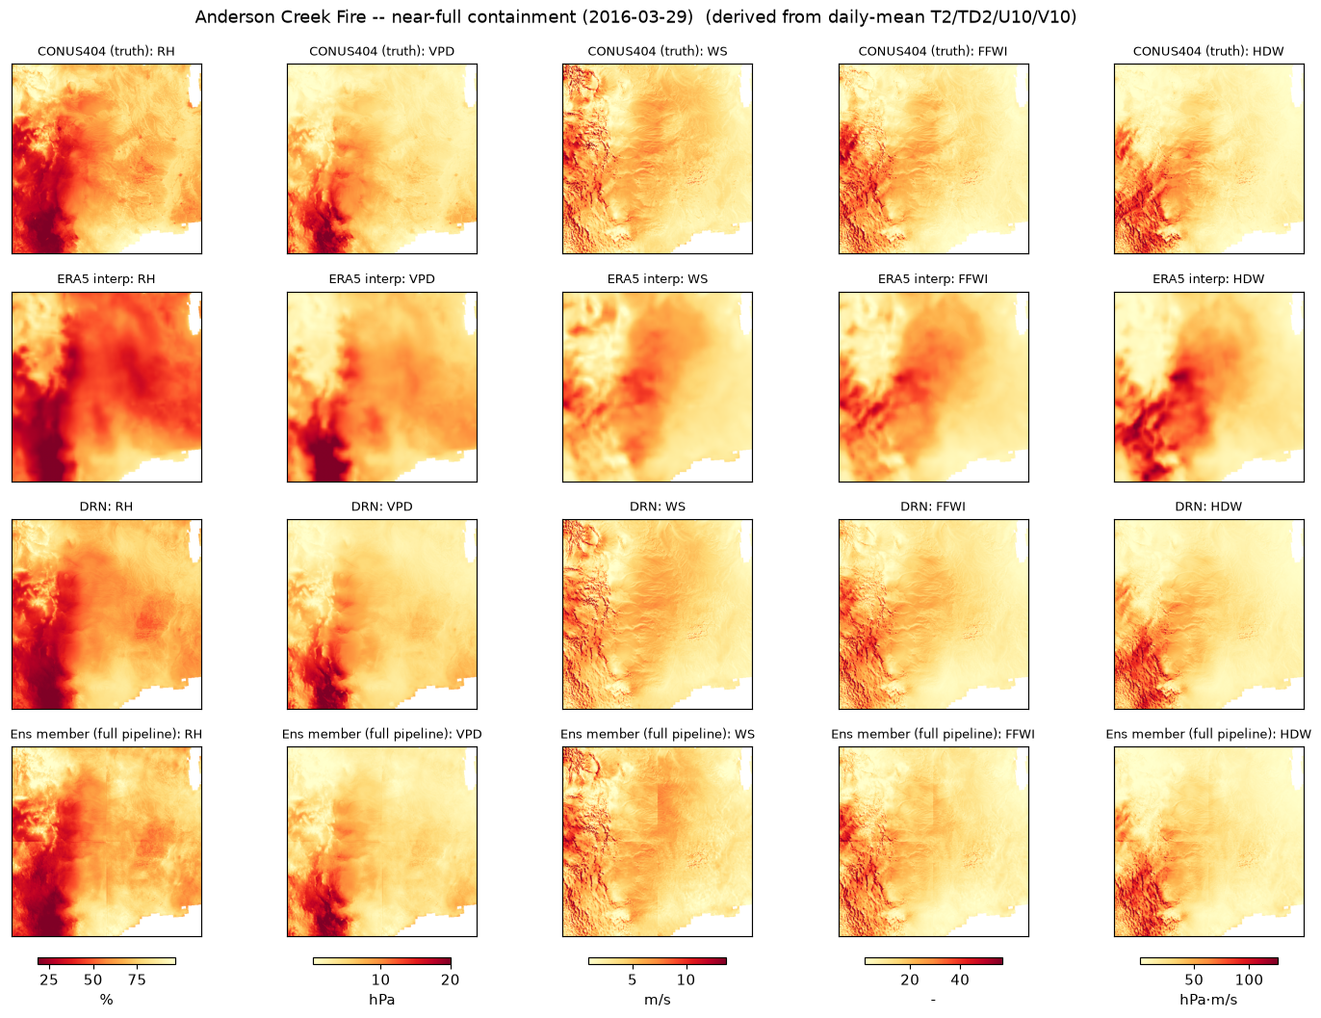
Anderson Creek Fire, near-full containment (2016-03-29)
Notes:
Near-full CONTAINMENT (2016-03-29) -- 95% contained this day, fully controlled 2016-03-31. Panels: CONUS404 truth / ERA5 interp / DRN / pipeline (a single DRN+diffusion draw, not the ensemble mean), columns RH / VPD / WS / FFWI / HDW, all derived from daily-mean T2/TD2/U10/V10 via the same fire_fields() formula used throughout the benchmark (Magnus RH/VPD, Fosberg FFWI, Hot-Dry-Windy = VPD x wind). IMPORTANT CAVEAT for this whole case study: 2016 is a VALIDATION year (2015-2017 per docs/DATA_SPECIFICATION.md), not a held-out TEST year (2018-2020) -- kept separate from the main 10-event scorecard on purpose, since mixing it in would silently change numbers already quoted elsewhere.

Slide 16
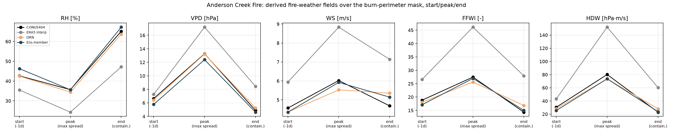
Fire-weather timeline: start → peak → containment
Notes:
Spatial means over the MTBS fire-perimeter mask, start -> peak -> end, for RH/VPD/WS/FFWI/HDW. 'pipeline' = full pipeline, single real draw, not an averaged ensemble mean. THE HEADLINE RESULT of this whole case study: ERA5 interp dramatically overstates how dangerous the peak-spread and containment days were, while DRN and the full-pipeline ensemble member track CONUS404 truth closely at all three dates. At peak spread: truth FFWI ~27 vs ERA5 ~46 (~1.7x over). At containment (post-frontal recovery -- truth RH jumps back to ~65%): ERA5's HDW is still ~60 vs truth ~24 (~2.5x over) -- ERA5 alone would have called the containment day nearly as dangerous as the peak-spread day, which is wrong. DRN/ensemble-member reproduce truth's sharp peak-then-recovery shape in all 5 fields. This is exactly the situation the correction pipeline exists for: a specific, consequential historical fire-weather emergency, not just aggregate stats.

Slide 17
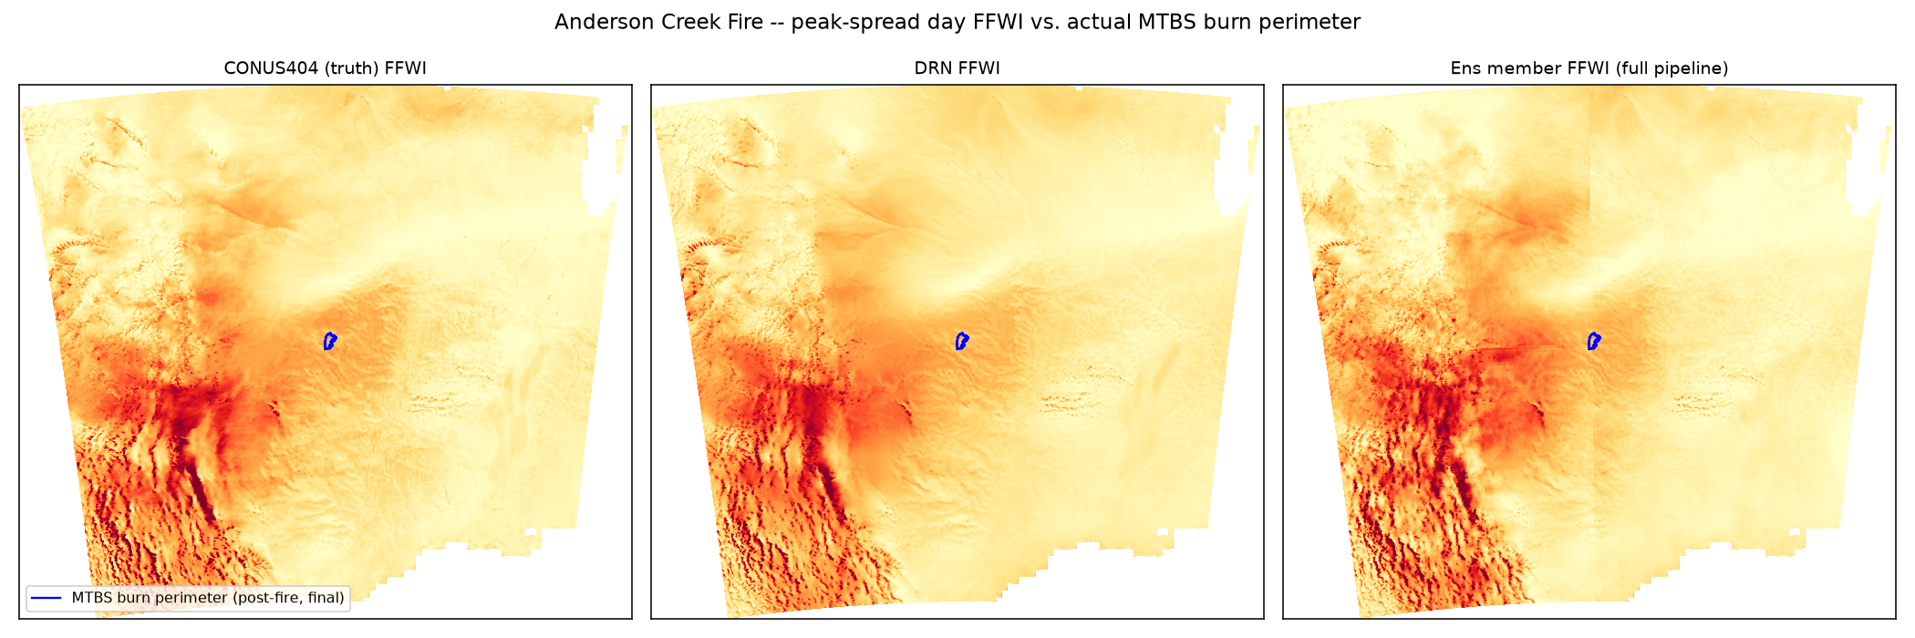
Peak-spread FFWI vs. the actual MTBS burn perimeter
Notes:
Peak-spread-day FFWI (truth / DRN / pipeline) with the actual MTBS burn perimeter overlaid (blue outline). Two perimeter-source checks: NIFC/WFIGS has NO RECORD for this fire -- likely because it was a state/private-rangeland fire (Oklahoma Forestry Services / Kansas Forest Service jurisdiction), and WFIGS's federal IRWIN-sourced history mainly covers BLM/USFS/NPS incidents. MTBS (Landsat-derived, jurisdiction-agnostic) DOES have it: fire_id OK3692409905720160323, 374,226 acres, one assessed perimeter from a post-fire Landsat scene (2016-04-07, after full containment) -- for a grassland fire with no reburn, that single MTBS perimeter is effectively BOTH the final AND the maximum extent (no separate daily-growth polygon series available without VIIRS/MODIS hotspot clustering, not attempted). Note the burn scar (~65x45km) is small relative to this 2048km model window -- the regional FFWI hot spot in this crop is actually southwest of the fire itself, so a correct REGIONAL pattern isn't by itself proof the model nails the fire's own micro-scale conditions (see next slide for the zoomed check).

Slide 18
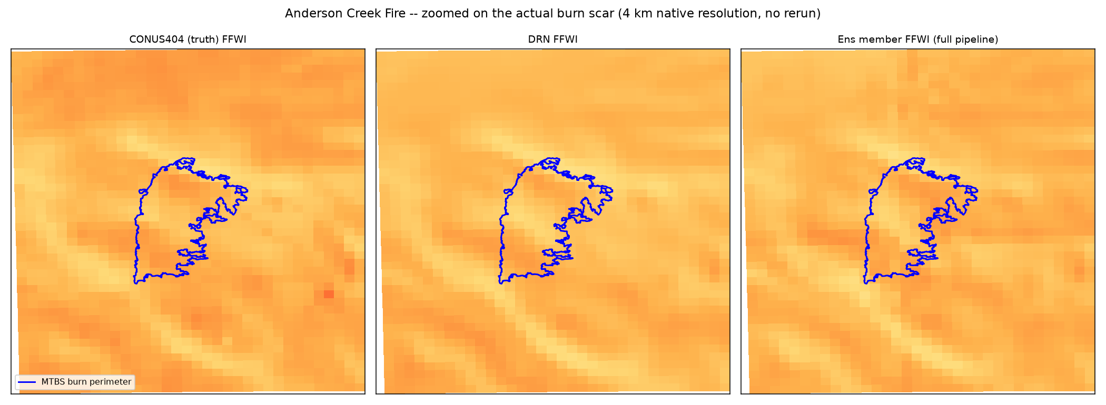
Zoomed on the actual burn scar (4 km native resolution)
Notes:
Same data, cropped to the perimeter's bounding box at native 4km resolution -- no GPU rerun needed, just a post-hoc crop of the already-saved prediction array. The actual burn scar shape is clearly resolved, and truth/DRN/full-pipeline-member FFWI all show mildly elevated fire-weather index roughly coincident with the perimeter interior.

Slide 19
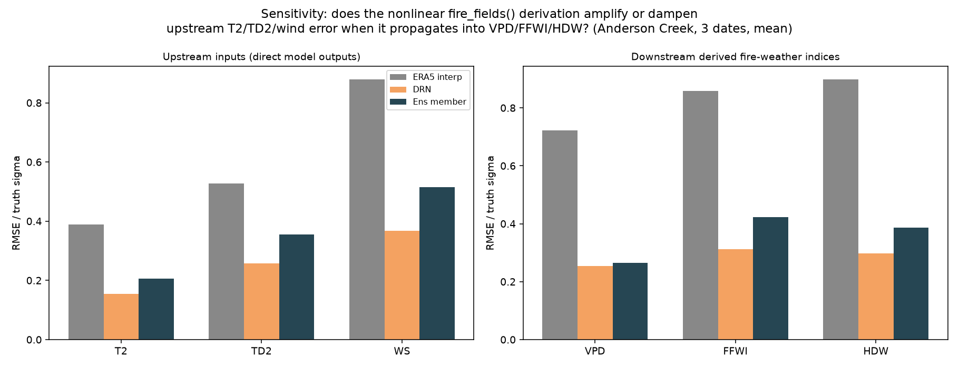
Sensitivity: does the fire-weather formula amplify upstream error?
Notes:
Sensitivity analysis -- 'plug different methods' outputs into the same downstream model': feed each method's own T2/TD2/wind-speed into the identical fire_fields() VPD/FFWI/HDW formula and compare normalized RMSE (RMSE / truth sigma) at the input stage vs. the derived-index stage, mean over the 3 dates. 'pipeline' here is the full pipeline single draw, which is noisier than an averaged mean would be -- that's intentional, it's what a real user of the model actually sees. Numbers (ERA5 interp / DRN / pipeline): T2 0.39/0.16/0.21, TD2 0.53/0.26/0.36, WS 0.88/0.37/0.52 -> VPD 0.72/0.25/0.27, FFWI 0.86/0.31/0.42, HDW 0.90/0.30/0.39. Key finding: VPD/FFWI/HDW's normalized error tracks WIND SPEED's error (the worst of the three inputs) far more closely than a simple average of T2/TD2/WS errors would predict -- consistent with HDW being a direct product (VPD x WS) and FFWI's strong wind-speed dependence. Practical takeaway: fixing wind-speed error would do more for downstream fire-weather-index accuracy here than fixing temperature error would, for both the baseline (ERA5) and the model (DRN/full pipeline).

Slide 20
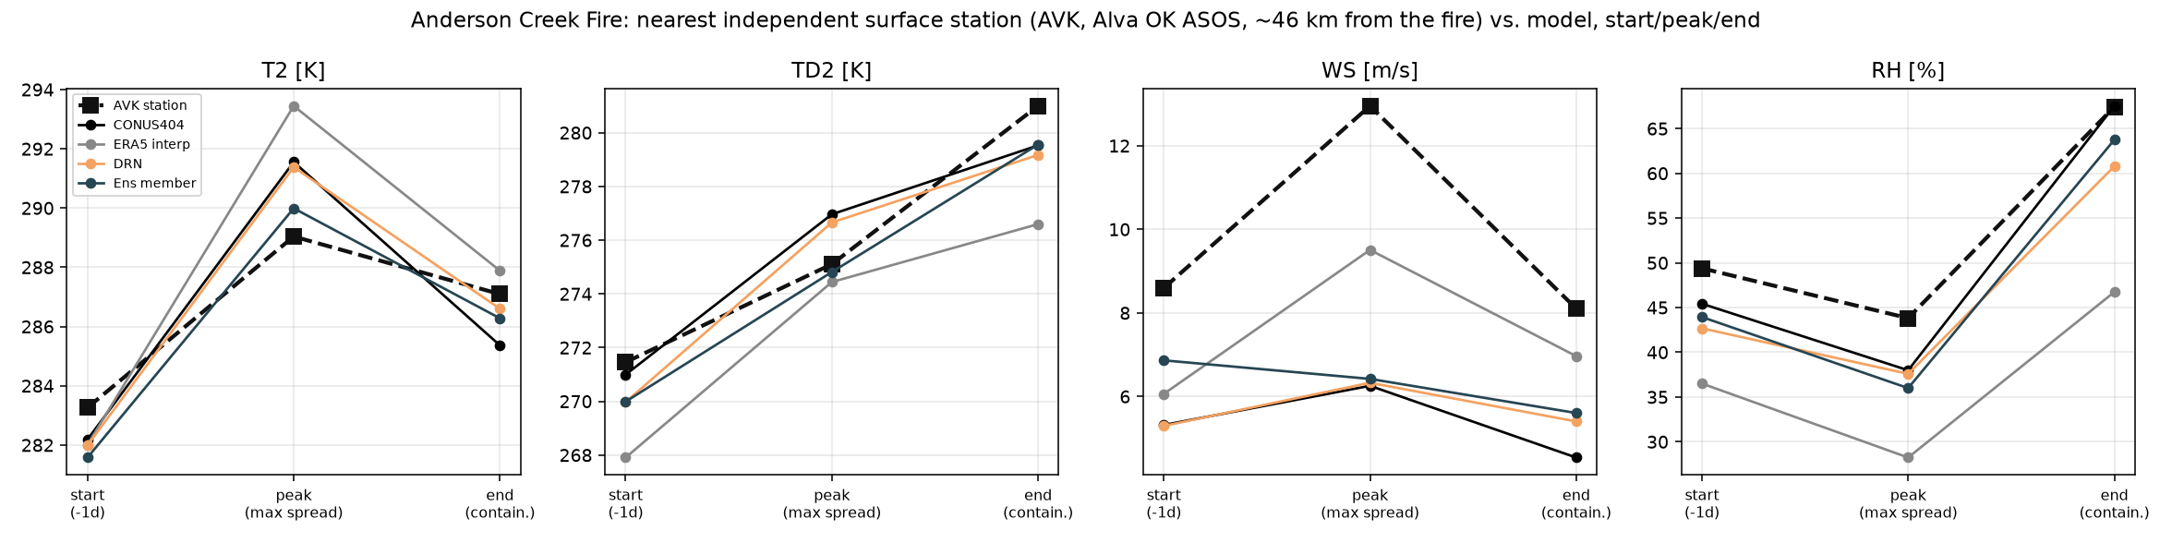
Independent station check (AVK ASOS, ~46 km from the fire) vs. model
Notes:
Independent ground-truth check against a real surface station -- not derived from CONUS404/ERA5 at all. No RAWS (Remote Automated Weather Station) sits close to this fire (nearest ones are >100 km away). The closest actual station with public, no-API-key historical data is AVK (Alva Regional Airport, Woods Co. OK, ASOS network), ~46 km from the fire-perimeter centroid -- pulled from the Iowa Environmental Mesonet's free ASOS archive (mesonet.agron.iastate.edu), no login required. Daily means computed from hourly obs for the 3 Anderson Creek dates, compared against CONUS404 truth / ERA5 interp / DRN / pipeline at the nearest model grid pixel to the station. T2/TD2/RH track CONUS404 reasonably well at all 3 dates (good independent corroboration that CONUS404 itself is believable near this fire). WIND SPEED is the interesting exception: the station reads NOTICEABLY HIGHER wind speed than even CONUS404 truth at all 3 dates (e.g. peak day: station ~13 m/s vs CONUS404 truth ~6.3 m/s) -- plausibly a representativeness mismatch (a point observation at an open airfield vs. a 4km grid-cell average), not necessarily a model error, but worth flagging since wind speed is the variable the fire-weather sensitivity analysis says matters most.

