Slide 1

RASD
Software Engineering 2 – A.Y. 2014/2015
Jovanovic Milica 835953
Vidanovic Pavle 854472
POLITECNICO DI MILANO

Slide 2

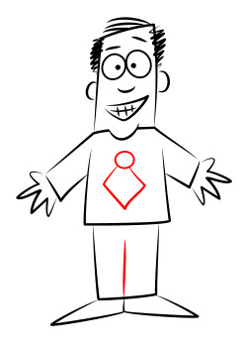
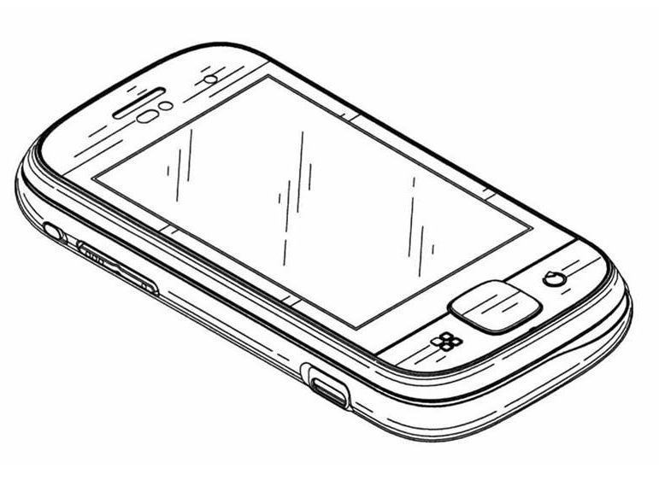

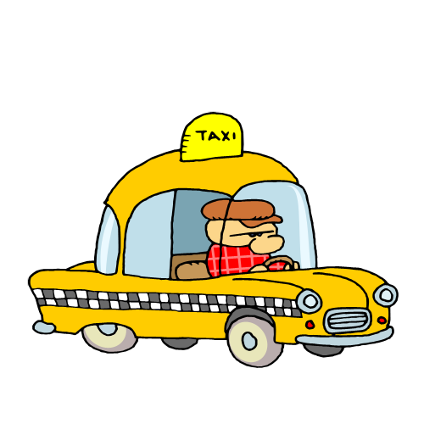

myTaxiService software application
an application similar to Uber, which makes the process of assigning an available taxi vehicle to possible passengers
POLITECNICO DI MILANO

Slide 3
Structure of RASD
Introduction
- Describe the structure of the document
- Give a basic overview about the system to be developed
- Glossary
Overall description
- Give a list of stakeholders
- Describe the user characteristics
- Lists the actors in the system
- List of goals, assumptions and constraints
- Describes the domain of the problem
Specific Requirements
- Mockups of the software to be
- Scenarios
- Use cases and sequence diagrams
- Class diagram and Activity flow diagram
- Non functional requirements
Alloy
- Worlds generated by Alloy Analyzer
- Prove the model's consistency
POLITECNICO DI MILANO

Slide 4
Overall description
Stakeholders:
Company
- provided project specification
- expect it to be delivered in a way that satisfies given specification
- respecting the set deadlines and budget
Developer group
Taxi driver
- person working for the company that ordered the software product
Passenger
- person who need a ride to specific location
Actors:
Guest - person accessing a system that has either never registered of hasn't logged in yet
User - person already registered and logged into the system
Taxi driver - same as User, but can access to all features offered by the driver application
Admin - person responsible for handling reports, can ban users or driver from system
POLITECNICO DI MILANO

Slide 5
Overall description
Goals:
[G1] registering new user
[G2] login to existing user’s account
[G3] managing user's profile
[G4] requesting a taxi
[G5] reserving a taxi
[G6] canceling a ride
[G7] checking taxi availability around user
[G8] reporting a problem caused by passenger or taxi driver
[G9] confirming/declining a ride(taxi driver)
POLITECNICO DI MILANO

Slide 6

Overall description
Domain properties - these conditions hold in the analyzed world:
the passenger needs a ride to specific location
the details of the ride provided by the passenger are accurate
money exchange between the passenger and the taxi driver is made independently from the myTaxiService system
distinction between the zones are clearly defined
POLITECNICO DI MILANO

Slide 7
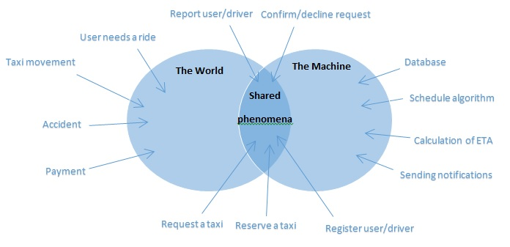
Specific Requirements
World and the machine
POLITECNICO DI MILANO

Slide 8
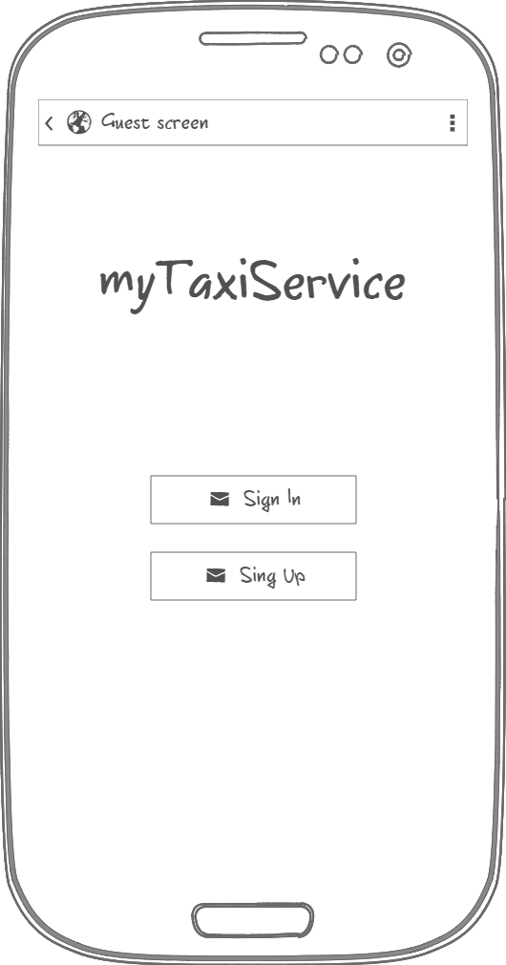
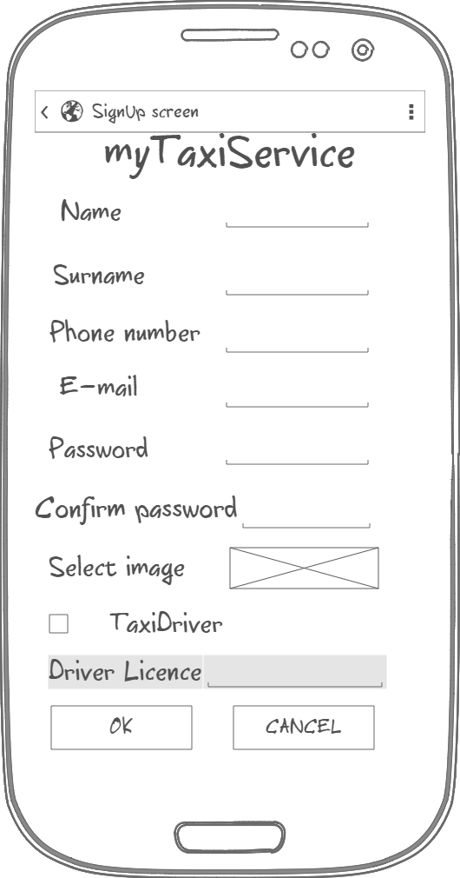
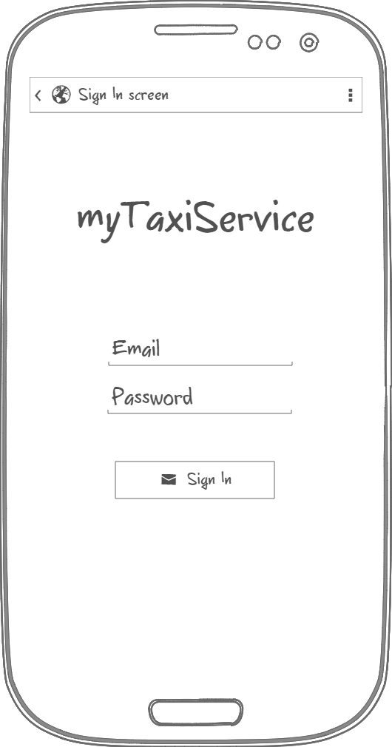
Specific requirements
Mockups
POLITECNICO DI MILANO

Slide 9
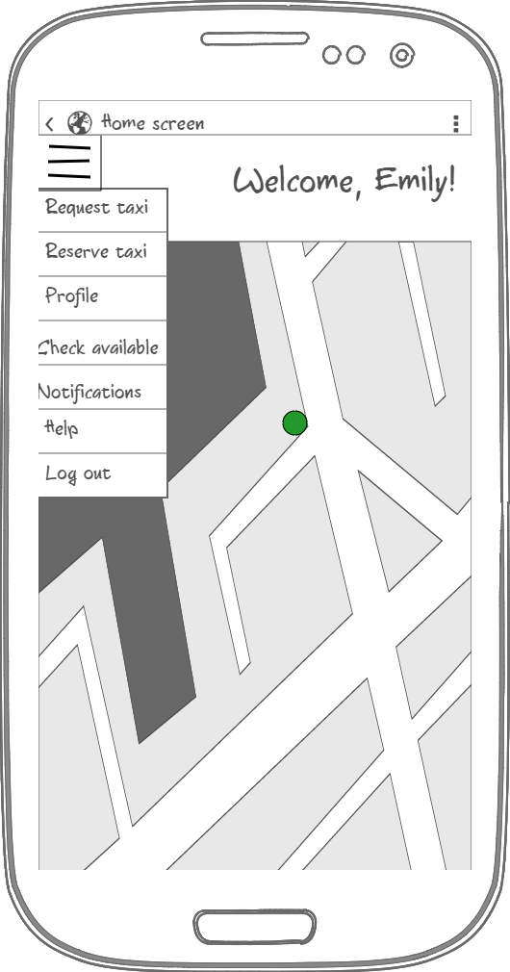
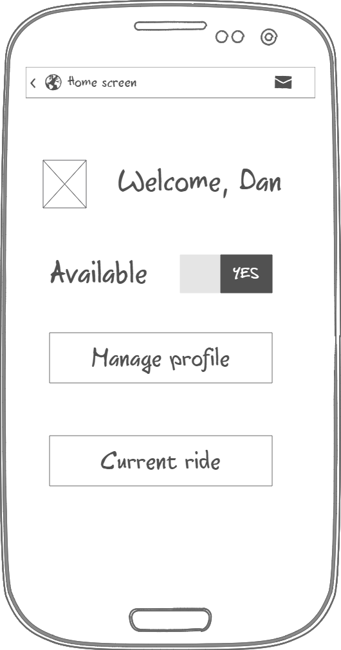
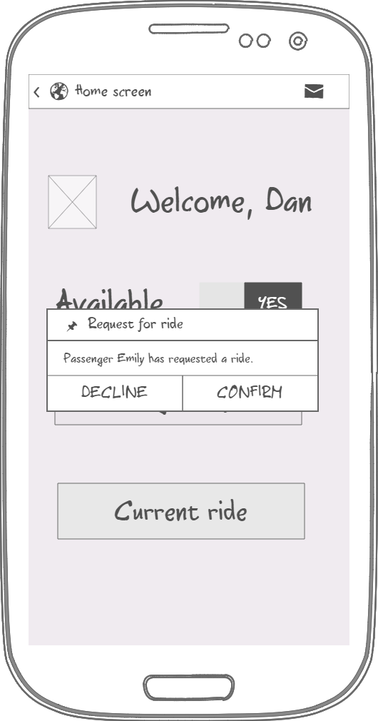
Specific requirements
Mockups
POLITECNICO DI MILANO

Slide 10
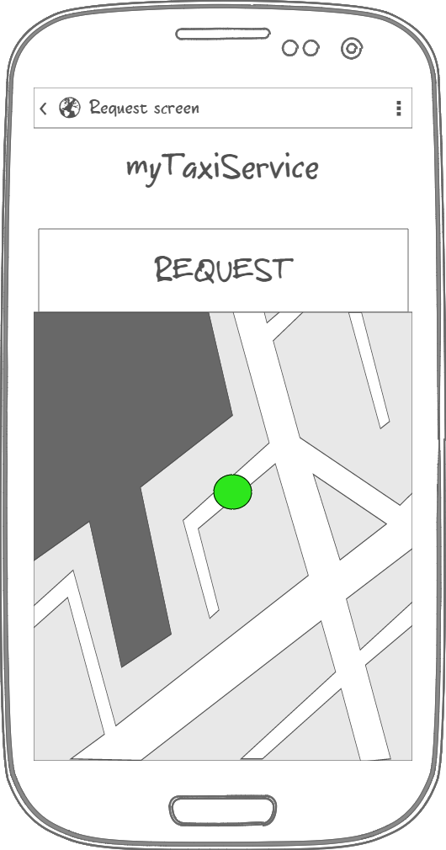
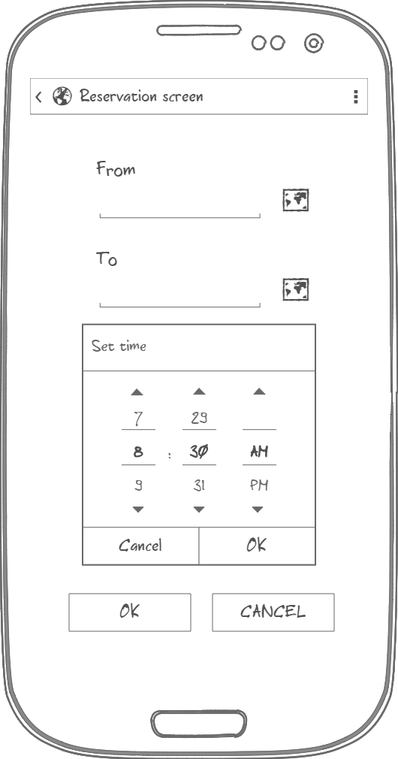
Specific requirements
Mockups
POLITECNICO DI MILANO

Slide 11
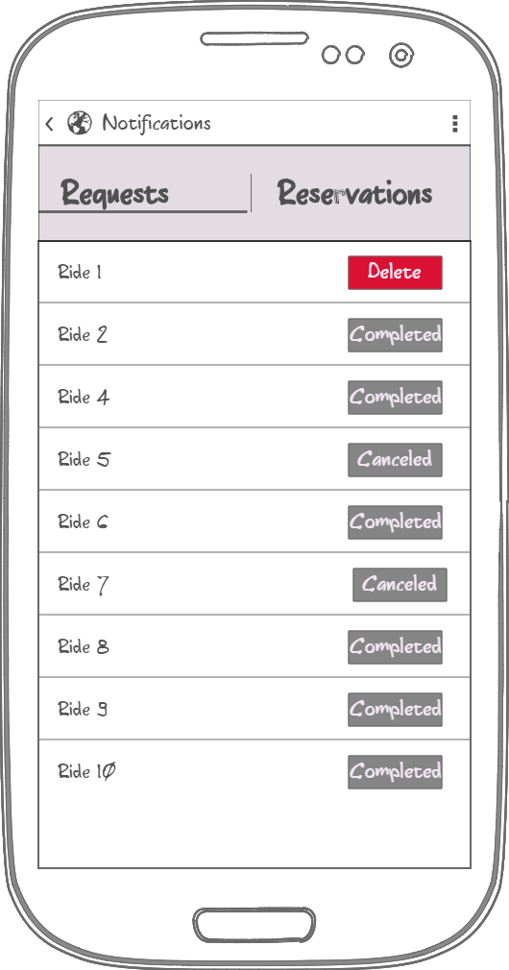
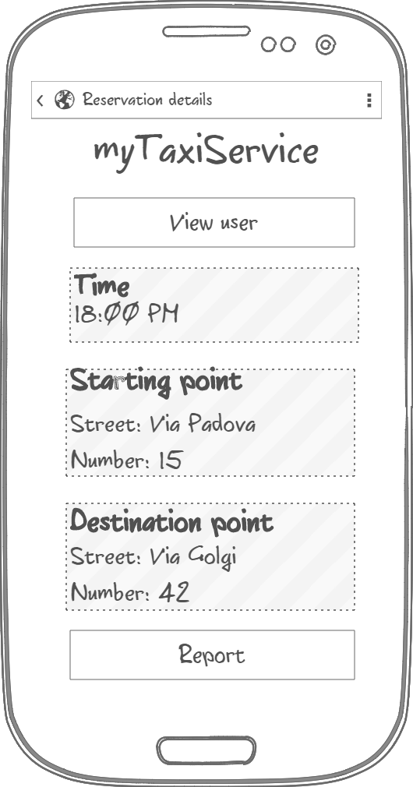
Specific requirements
Mockups
POLITECNICO DI MILANO

Slide 12
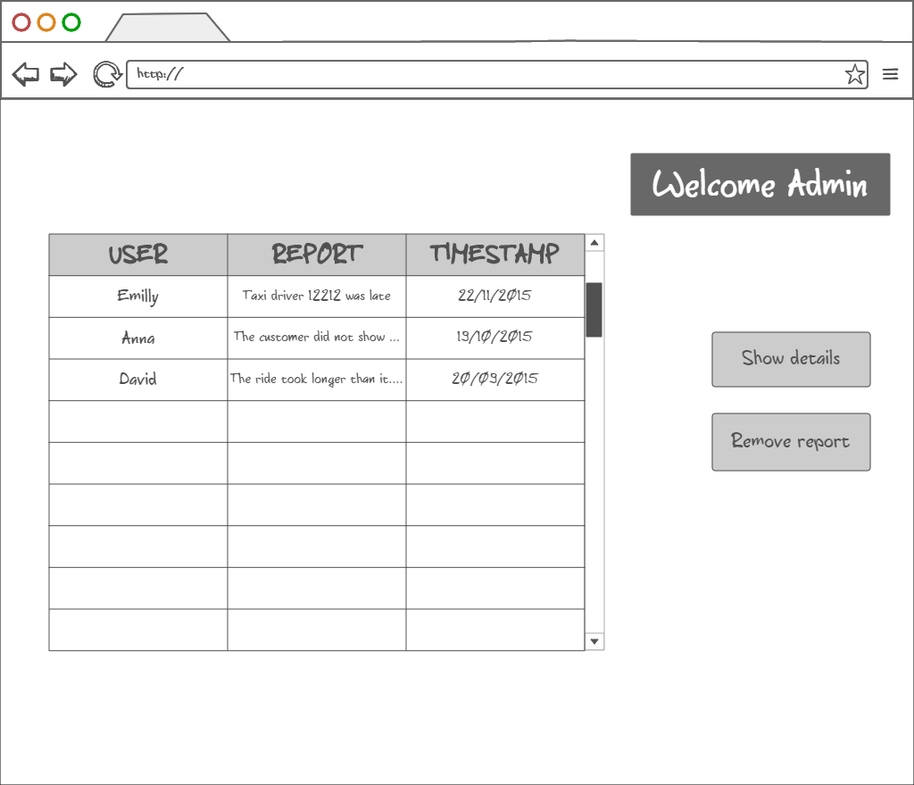
Specific requirements
Mockups
POLITECNICO DI MILANO

Slide 13
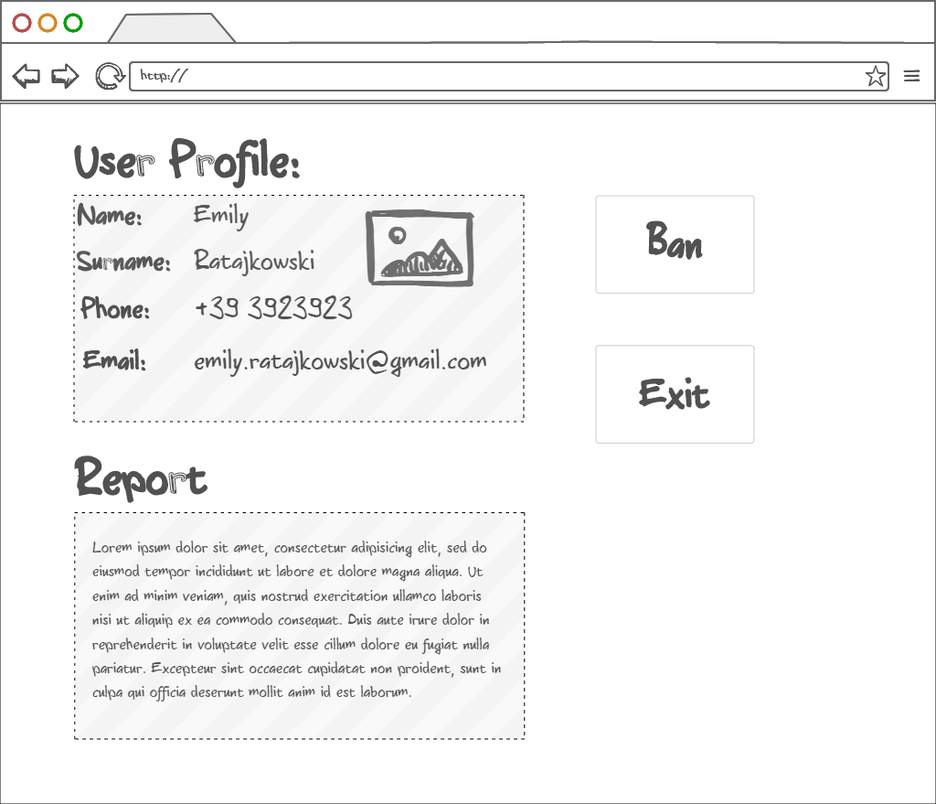
Specific requirements
Mockups
POLITECNICO DI MILANO

Slide 14
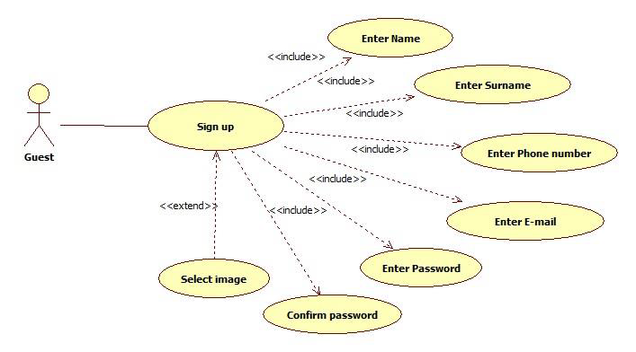
Specific requirements
Use cases
POLITECNICO DI MILANO

Slide 15
Specific requirements
Use cases
POLITECNICO DI MILANO

Slide 16
Specific requirements
Mockups
POLITECNICO DI MILANO

