Slide 1

RASD
Software Engineering 2 – A.Y. 2015/2016
Jovanovic Milica 835953
Vidanovic Pavle 854472
POLITECNICO DI MILANO

Slide 2

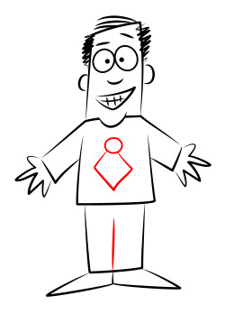
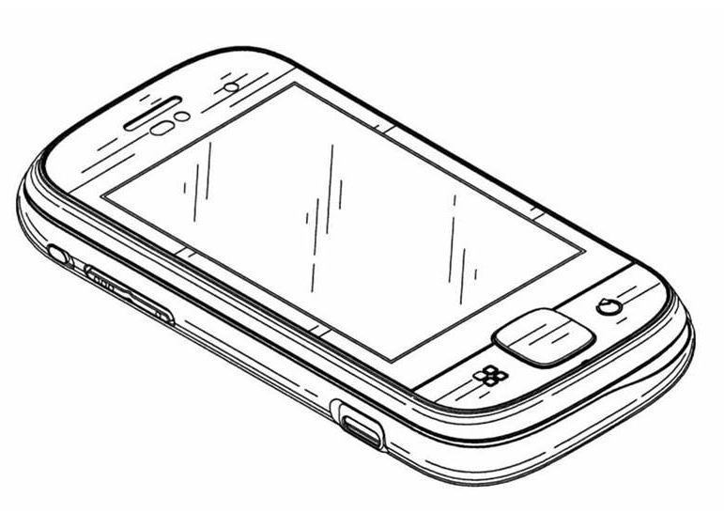
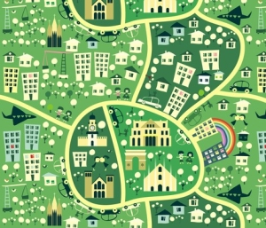
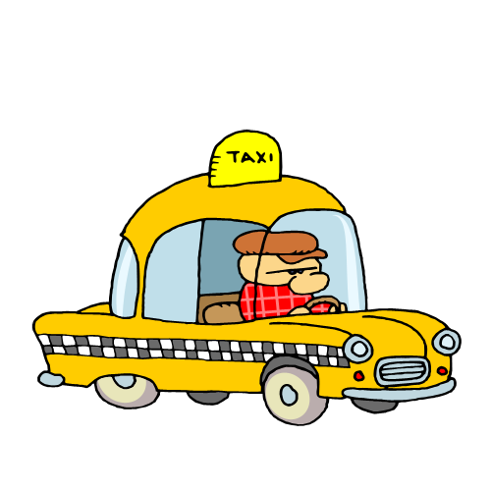
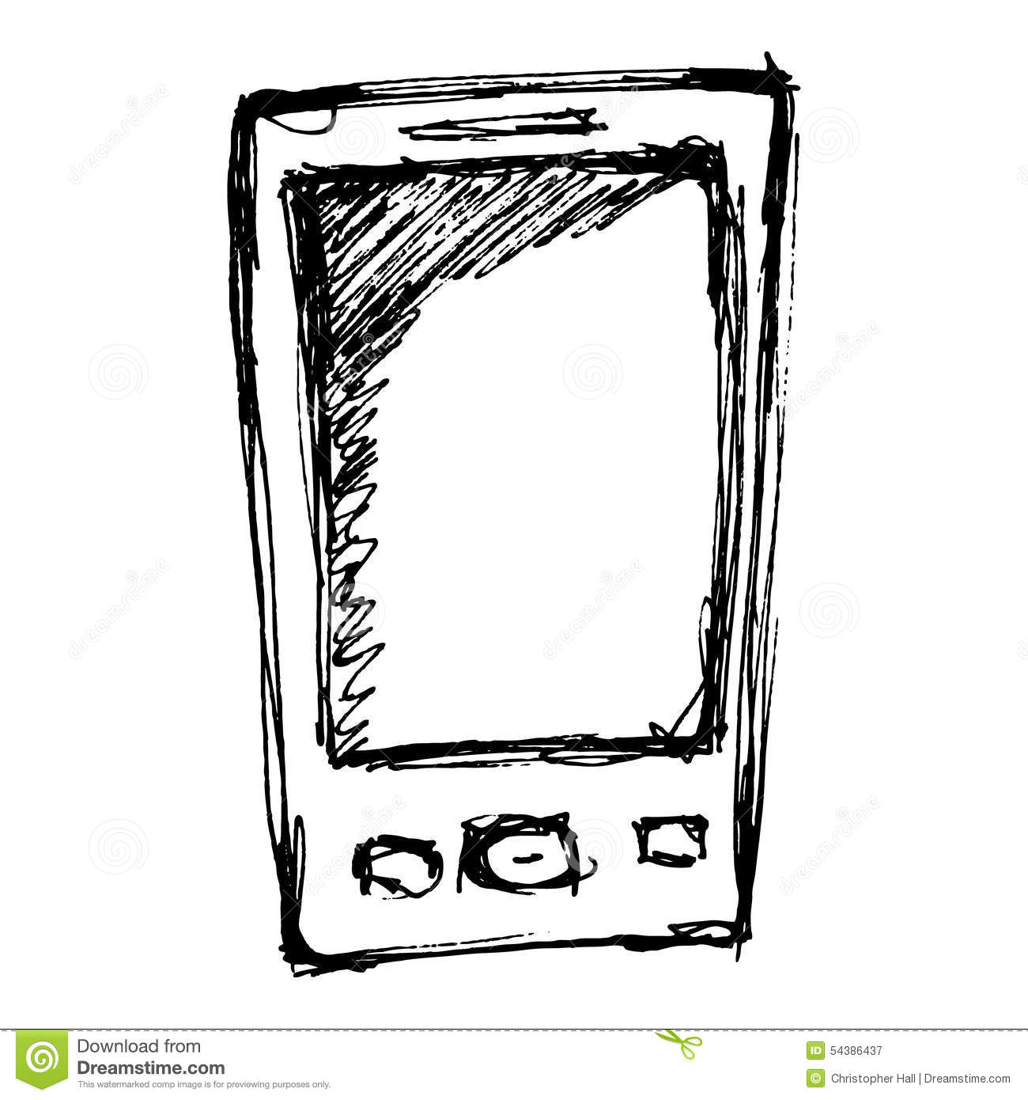
myTaxiService software application
Application similar to Uber, which makes the process of assigning an available taxi vehicle to possible passengers
POLITECNICO DI MILANO

Slide 3
Structure of RASD
Introduction
- Describe the structure of the document
- Give a basic overview about the system to be developed
- Glossary
Overall description
- Give a list of stakeholders
- Describe the user characteristics
- Lists the actors in the system
- List of goals, assumptions and constraints
- Describes the domain of the problem
Specific Requirements
- Mockups
- Scenarios
- Use cases and sequence diagrams
- Class diagram and State Chart diagrams
- Non functional requirements
Alloy
- Worlds generated by Alloy Analyzer
- Prove the model's consistency ili Code of alloy model?
POLITECNICO DI MILANO

Slide 4
Overall description
Stakeholders:
Company
- provided project specification
- expect it to be delivered in a way that satisfies given specification
- respecting the set deadlines and budget
Developer group
Taxi driver
- person working for the company that ordered the software product
Passenger
- person who need a ride to specific location
Actors:
Guest - person accessing a system that has either never registered of hasn't logged in yet
User - person already registered and logged into the system
Taxi driver - same as User, but can access to all features offered by the driver application
Admin - person responsible for handling reports, can ban users or driver from system
POLITECNICO DI MILANO

Slide 5
Overall description
Goals:
[G1] registering new user
[G2] login to existing user’s account
[G3] managing user's profile
[G4] requesting a taxi
[G5] reserving a taxi
[G6] canceling a ride
[G7] checking taxi availability around user
[G8] reporting a problem caused by passenger or taxi driver
[G9] confirming/declining a ride(taxi driver)
POLITECNICO DI MILANO

Slide 6

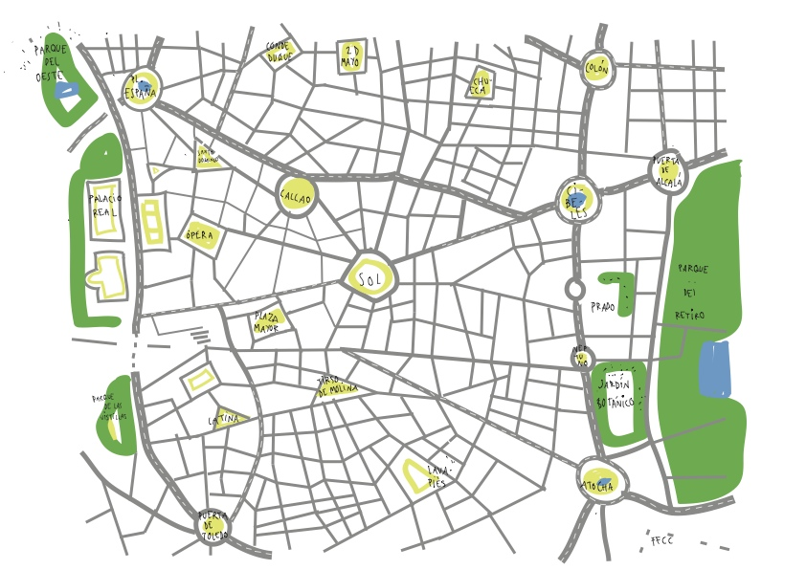
Overall description
Domain properties - these conditions hold in the analyzed world:
the passenger needs a ride to specific location
the details of the ride provided by the passenger are accurate
money exchange between the passenger and the taxi driver is made independently from the myTaxiService system
distinction between the zones are clearly defined
POLITECNICO DI MILANO

Slide 7
Overall description
Constraints
Regulatory policies - will not take advantage of users personal information and will respect the privacy policy
Hardware limitation - access to Internet and own a device with a web browser and GPS service
Interfaces to other applications - Google Maps API, Google Places API and email service in order to make authentication
Parallel operation - support parallel access to the applications database in a transparent way
Assumptions
user have only one account
- user provides accurate information
- if users location is not available, the application will show a screen with an option of typing your current address
- we assume that Google Maps service will calculate location accurately
- taxi driver will respect the ETA, otherwise they could be banned from the system
- if a taxi driver has an unexpected issue, the user will be automatically notified by the system and a new vehicle will be assigned to him with new ETA
POLITECNICO DI MILANO

Slide 8
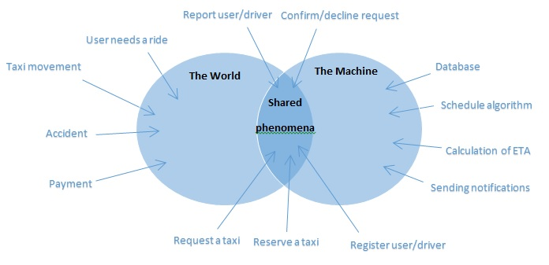
Specific Requirements
World and the machine
Ce Vidimo ! Moze a i ne mora bit! ☺
POLITECNICO DI MILANO

Slide 9
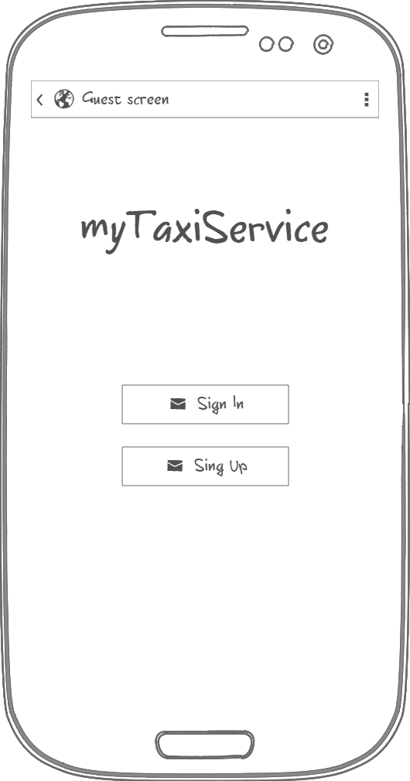
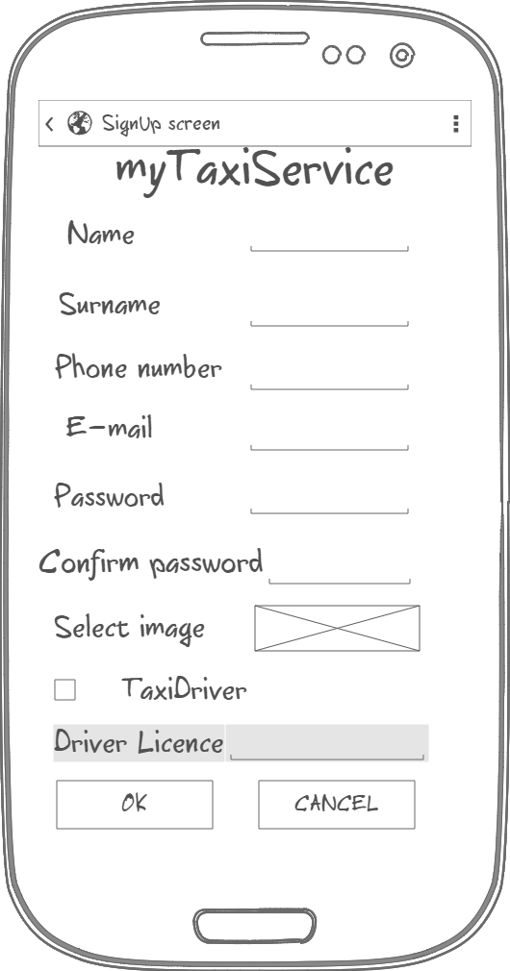
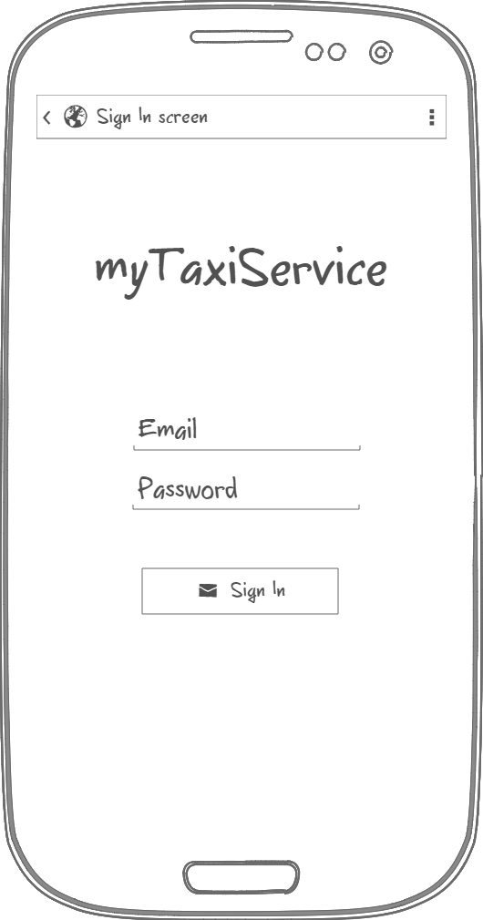
Specific requirements - Mockups
Initial page
Sign Up
Sign In
POLITECNICO DI MILANO

Slide 10
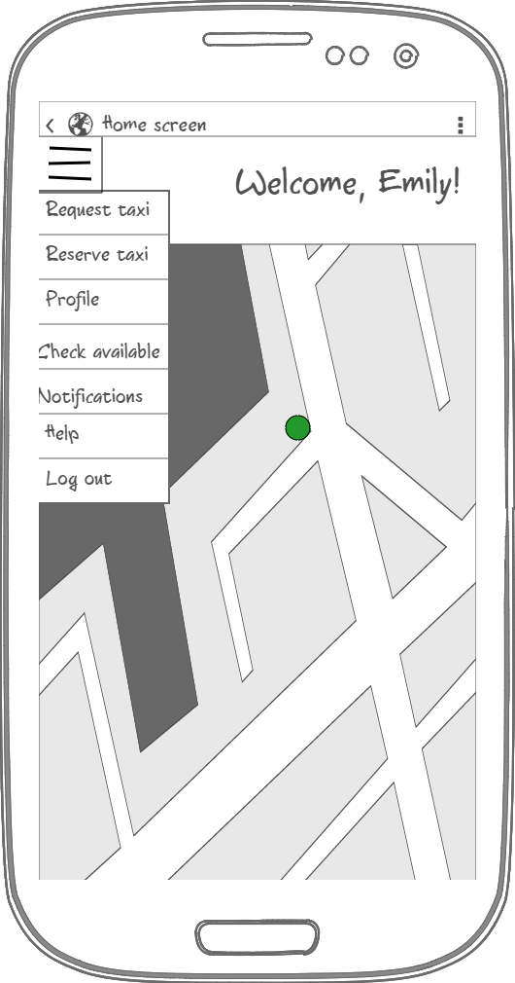
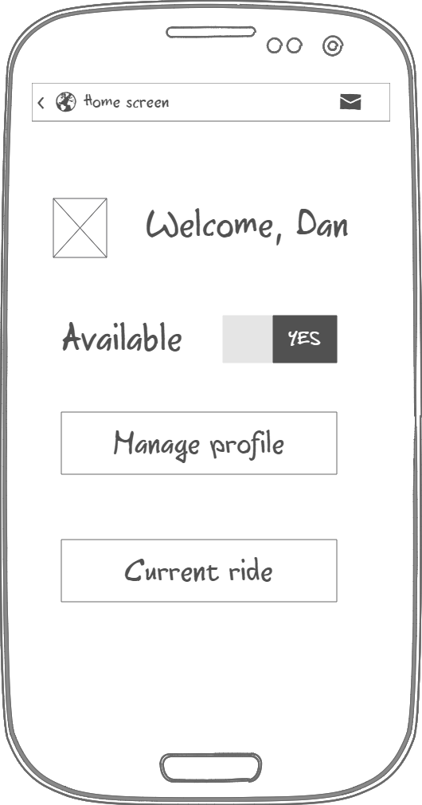
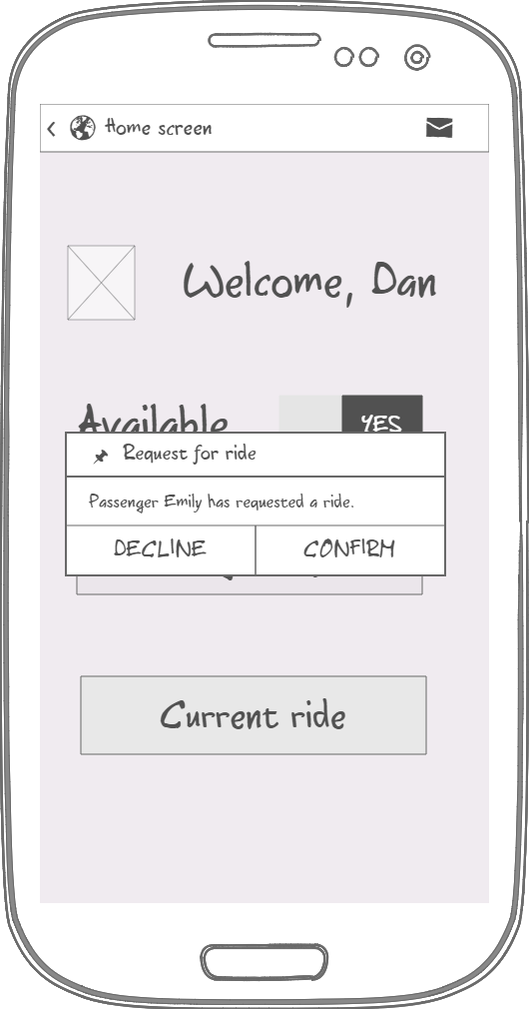
Specific requirements - Mockups
Driver application
Passenger Home page
Driver Home page
Pop up message
POLITECNICO DI MILANO

Slide 11
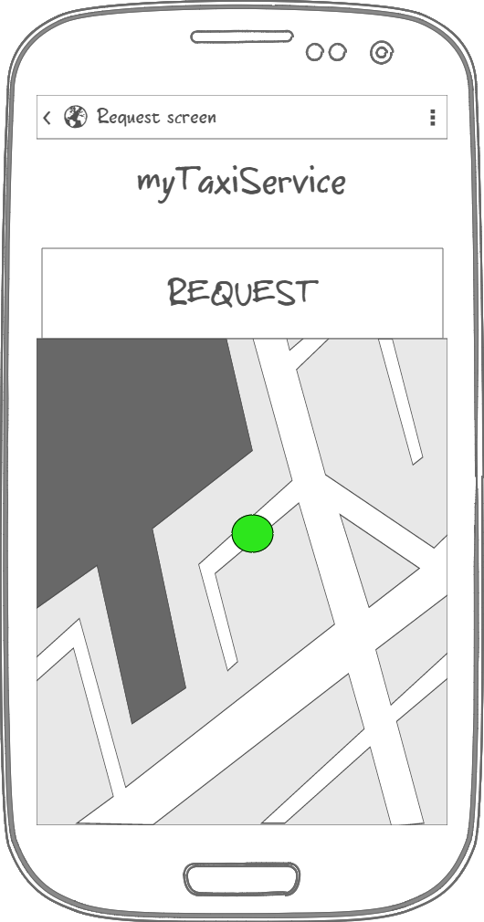
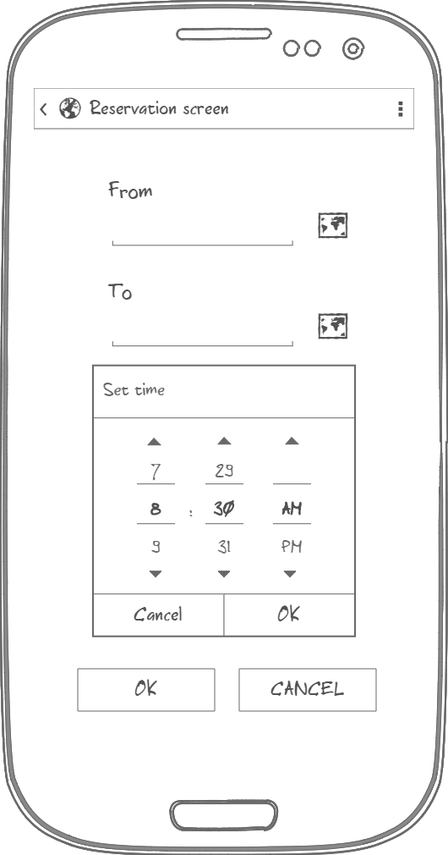
Specific requirements - Mockups
User specify location either by typing address or by specifying it on the map
User specifies address by clicking on the map
Passenger Request page
Passenger Reservation page
POLITECNICO DI MILANO

Slide 12
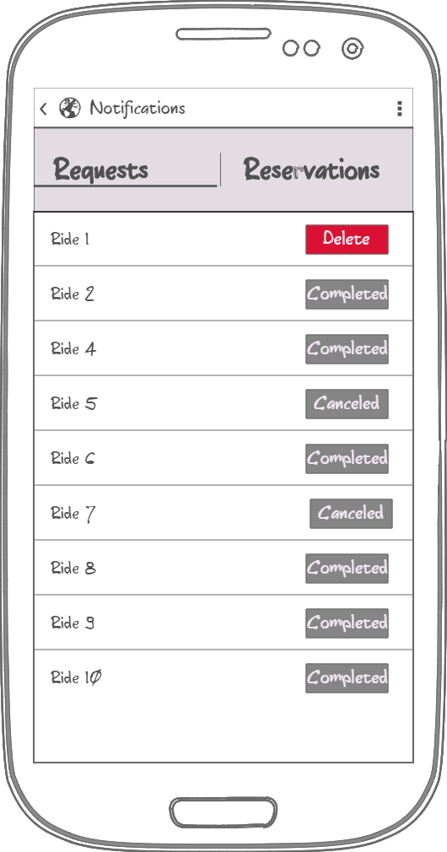
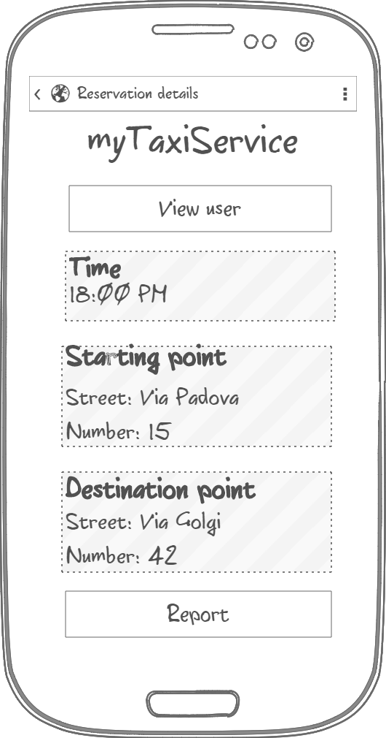
Specific requirements - Mockups
All user rides with an option of canceling active ones
Reservation Details page with data
Notification page
Reservation details
POLITECNICO DI MILANO

Slide 13
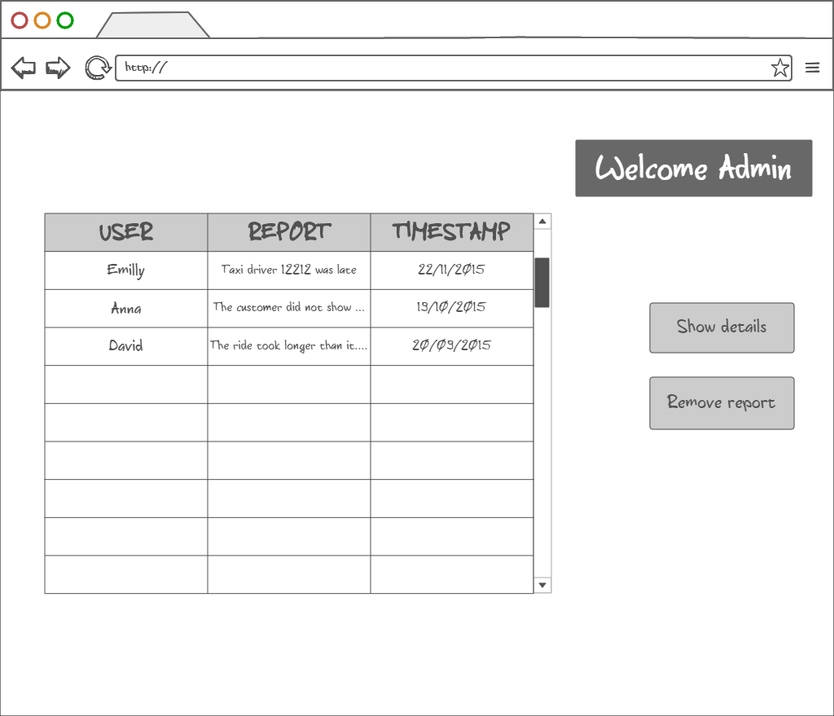
Specific requirements - Mockups
Admin home page
Show details action brings Admin to Report details page
POLITECNICO DI MILANO

Slide 14
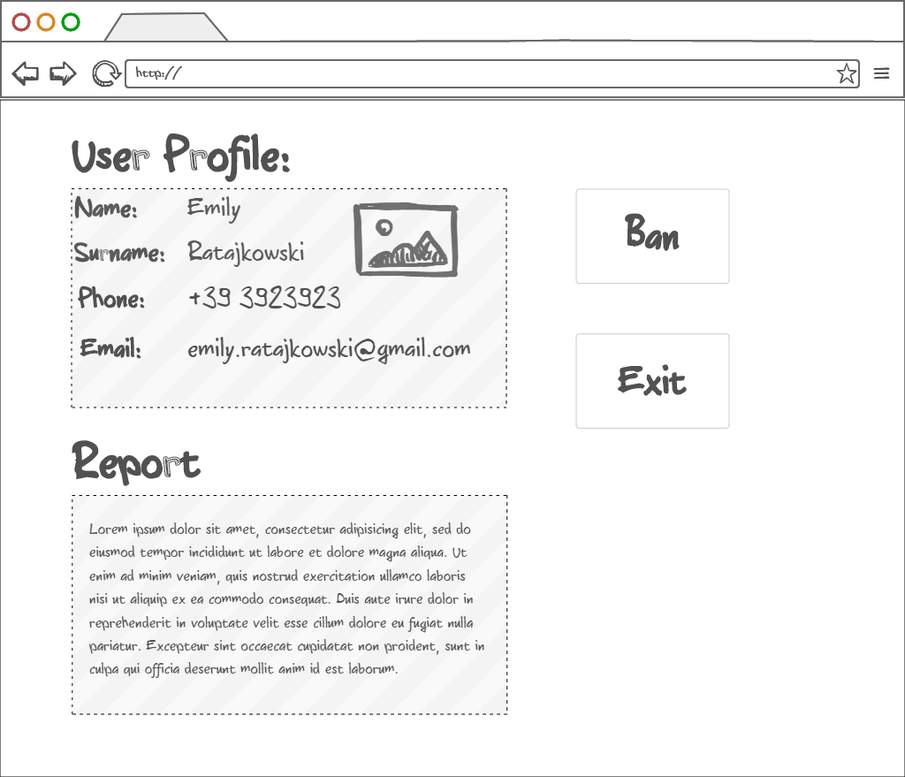
Specific requirements - Mockups
Admin report details page
Information about the user that made the repot
Bans reported user from the system
POLITECNICO DI MILANO

Slide 15
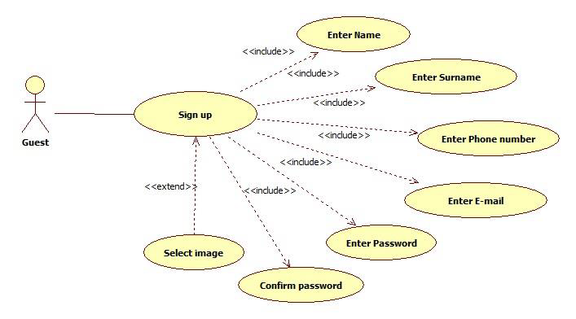
Specific requirements - Use cases
Sign Up use case
POLITECNICO DI MILANO

Slide 16
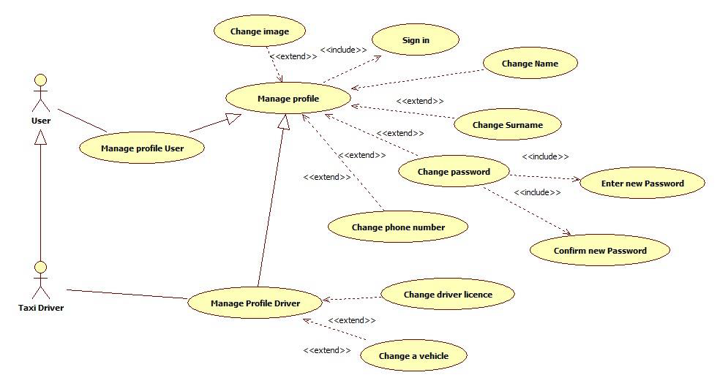
Specific requirements - Use cases
Manage profile use case
POLITECNICO DI MILANO

Slide 17
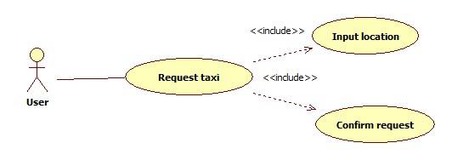
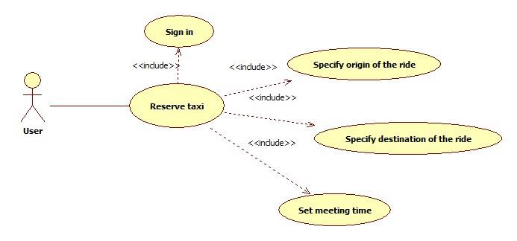
Specific requirements - Use cases
Request / Reserve a taxi use case
POLITECNICO DI MILANO

Slide 18
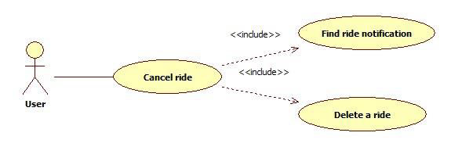
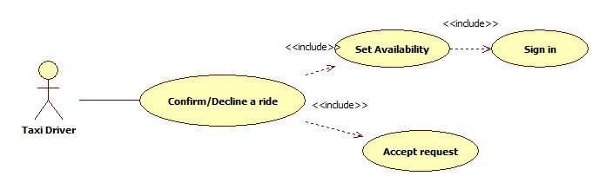
Specific requirements - Use cases
Use cases
Cancel ride use case
Confirm/Decline a ride use case
POLITECNICO DI MILANO

Slide 19
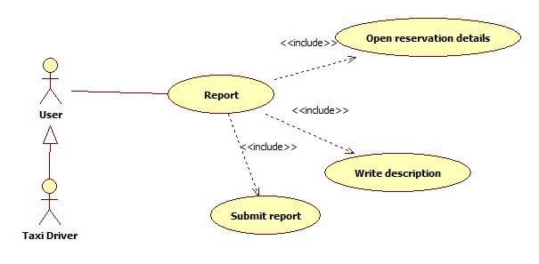
Specific requirements - Use cases
Report use case
POLITECNICO DI MILANO

Slide 20
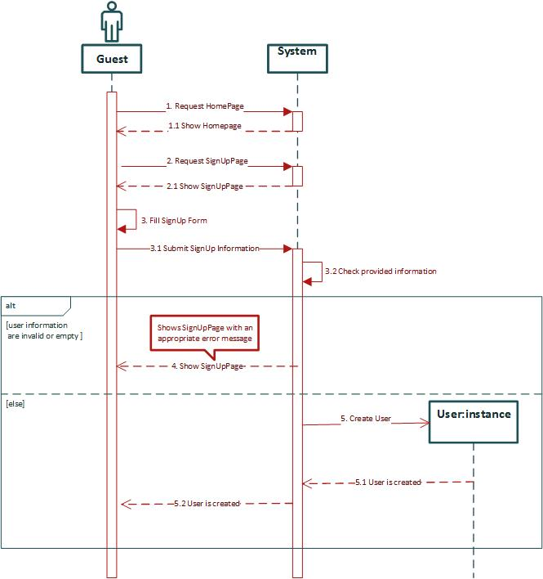
Specific requirements – Sequence diagrams
Sign Up sequence diagram
POLITECNICO DI MILANO

Slide 21
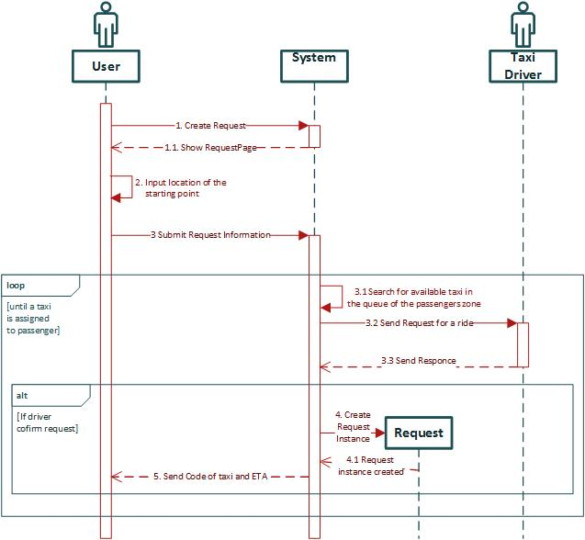
Specific requirements – Sequence diagrams
Request a taxi sequence diagram
POLITECNICO DI MILANO

Slide 22
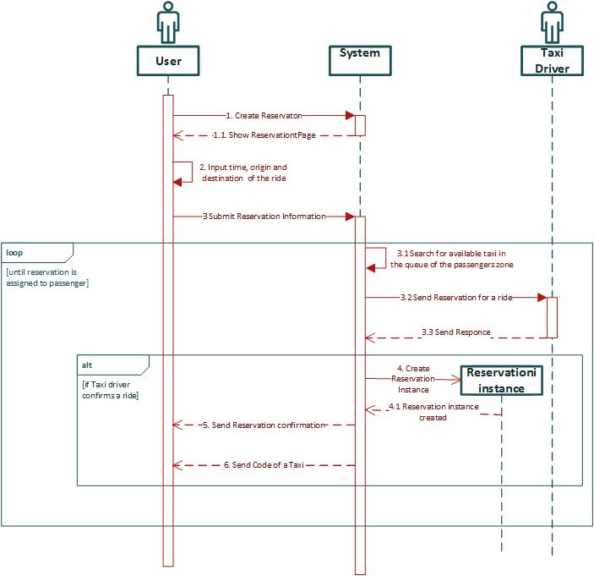
Specific requirements – Sequence diagrams
Reserve a taxi sequence diagram
POLITECNICO DI MILANO

Slide 23
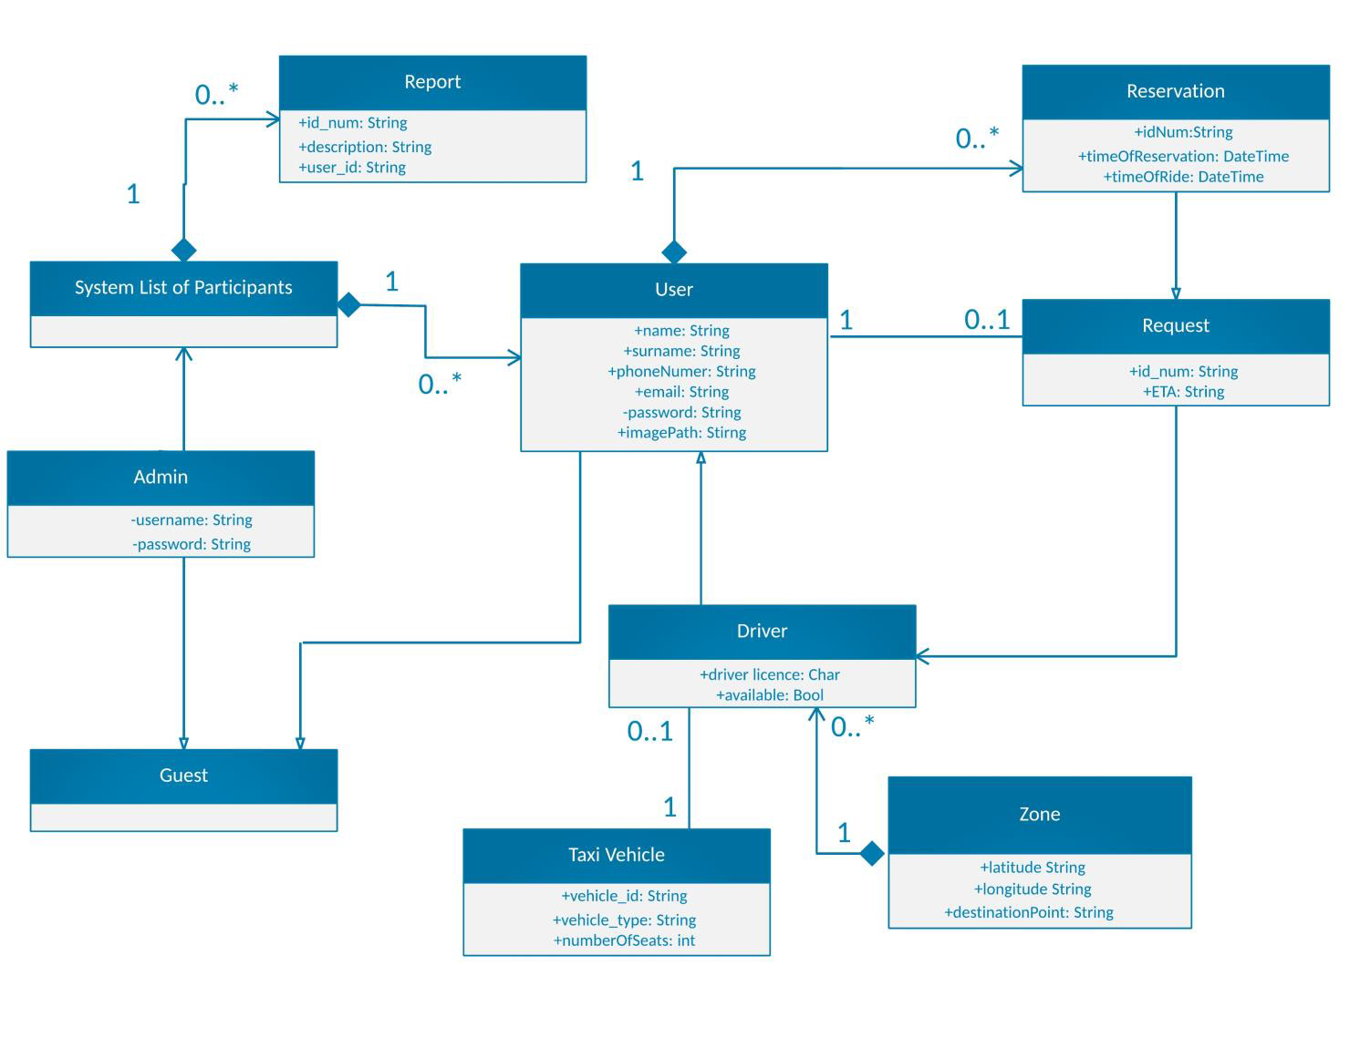
Specific requirements – Class diagram
POLITECNICO DI MILANO

Slide 24
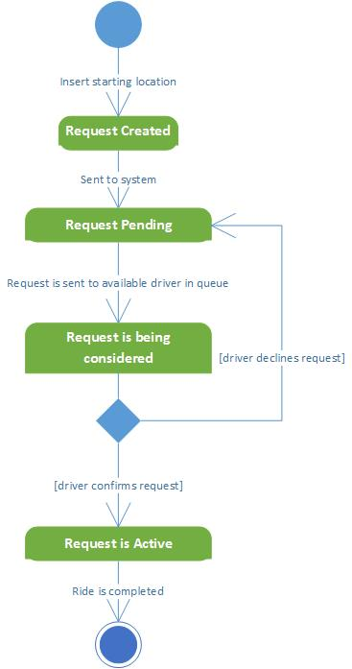
Specific requirements – State Chart diagrams
Request lifecycle
POLITECNICO DI MILANO

Slide 25
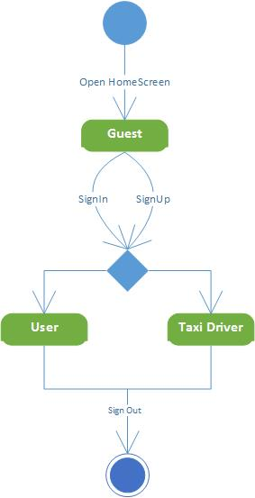
Specific requirements – State Chart diagrams
Guest lifecycle
Ovo nzm dal da ubacujemo
POLITECNICO DI MILANO

Slide 26
Specific requirements – Non functional requirements
Availability
Application should be available to handle user's request at all times using any device with an installed web browser
Maintainability
The software system provide specific API for enabling future developers with option to add more services or fix bugs in the system
Portability
Application could be run on device with any OS that has access to Internet and has a web browser
User Interface
Web application should be intuitive so even the nontechnical users can use the system as simply and efficiently as possible
POLITECNICO DI MILANO

Slide 27
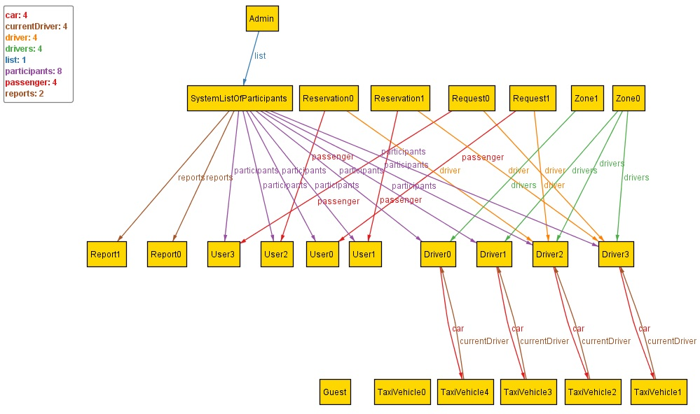
Alloy- World generated by Alloy analyzer
POLITECNICO DI MILANO

Slide 28
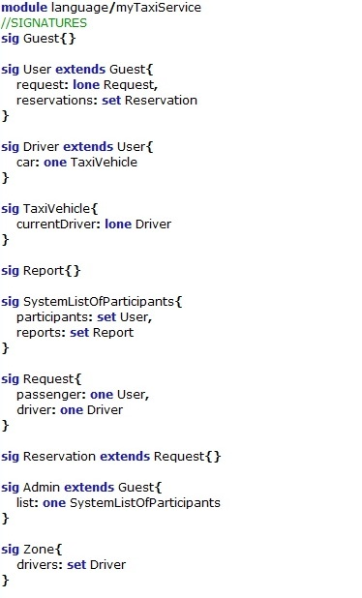
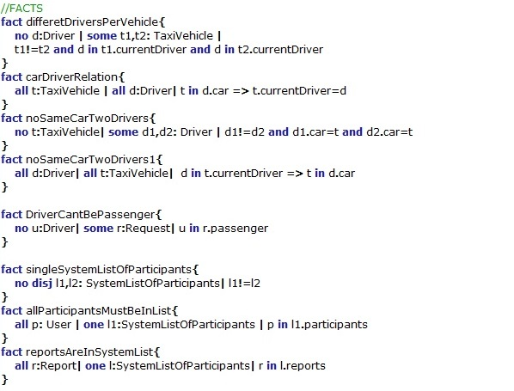
Alloy- Prove the model’s consistency
POLITECNICO DI MILANO

Slide 29
Future possible implementation
Online payment
Option of rating the drivers
Facebook authentication
Taxi sharing options
Isto I ovo mi palo na pamet al nzm dal da stavljamo il samo da stavimo
“Thank you for your attention”
POLITECNICO DI MILANO

