Slide 1
CT scan segmentation
Milica Nikolić
Aleksandar Stefanović

Slide 2
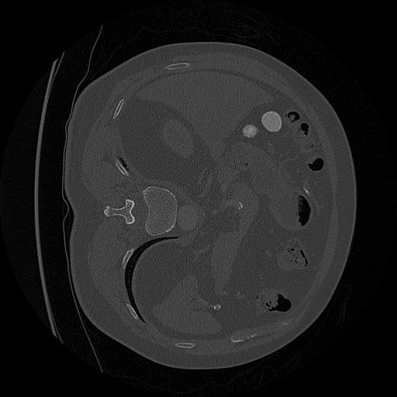

Problem
For a given 3D CT scan of an organ, mark the part where the tumor is located

Slide 3
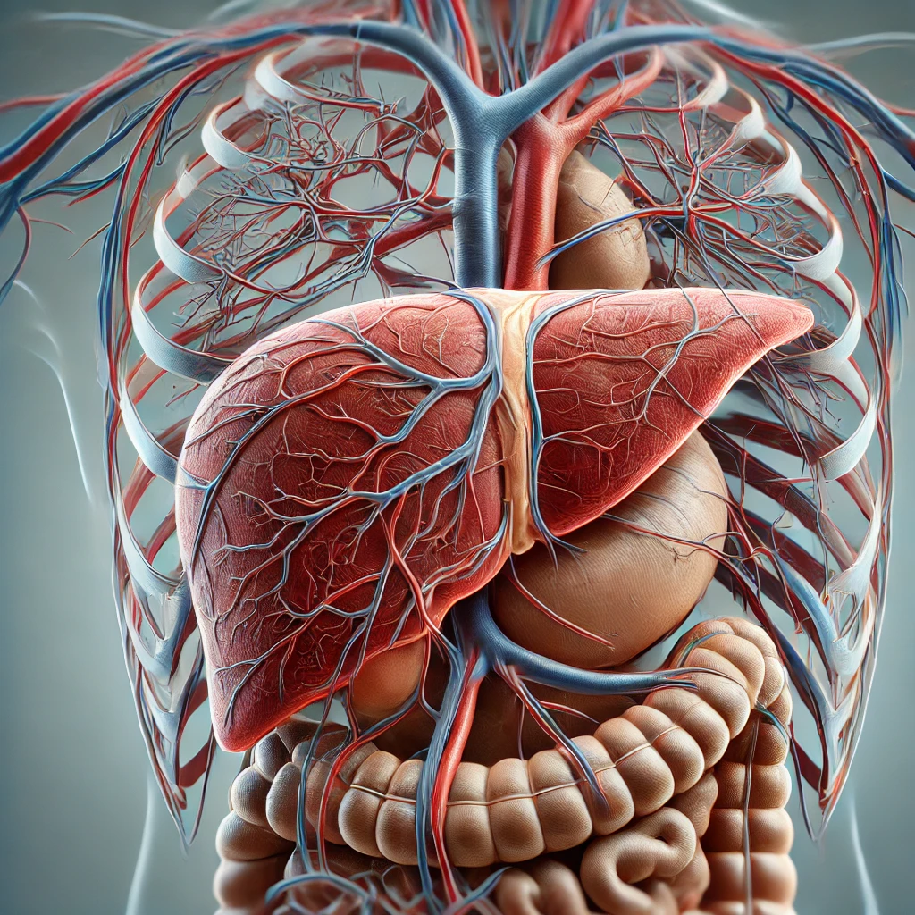
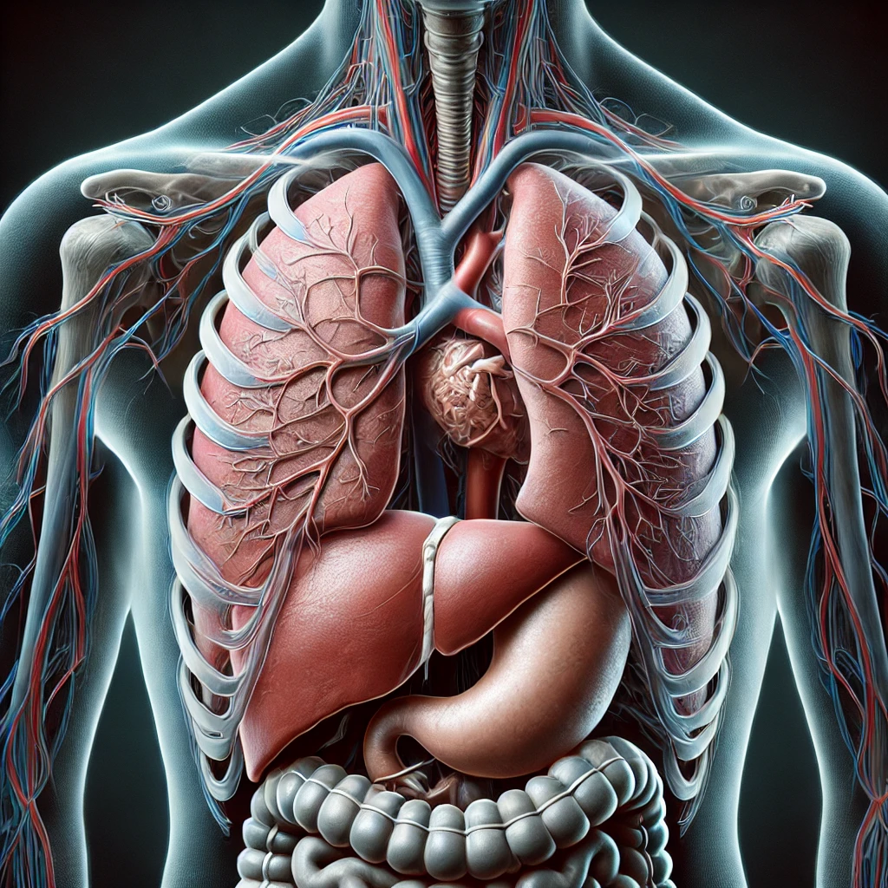
Datasets
Liver dataset – 130 instances
Lung dataset – 63 instances

Slide 4
Data preprocessing
CT scans for both datasets are sliced into 2D images with one channel (gray-scale images)
Healthy slices are downsampled
Slices are normalized
CT scan -> slices -> Dataset -> Loader
Data is split into train, test and validation sets

Slide 5
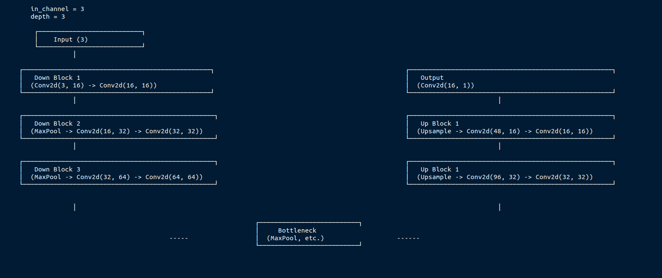
Model – U-net

Slide 6
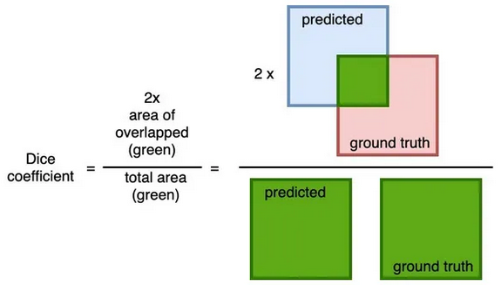
Model – loss function
Dice loss. Why?
Behaves better than BCE loss in the case of imbalanced classes
Possible alternative – weighted BCE loss
Image taken from https://cvinvolution.medium.com/dice-loss-in-medical-image-segmentation-d0e476eb486

Slide 7
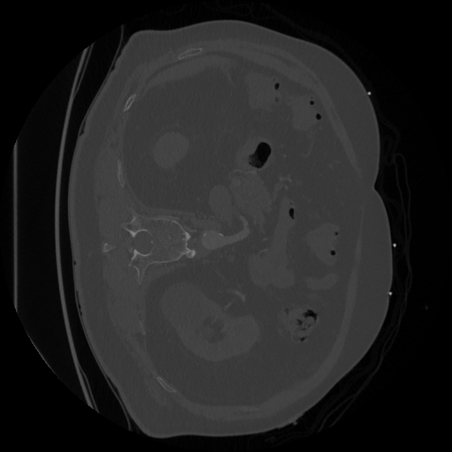

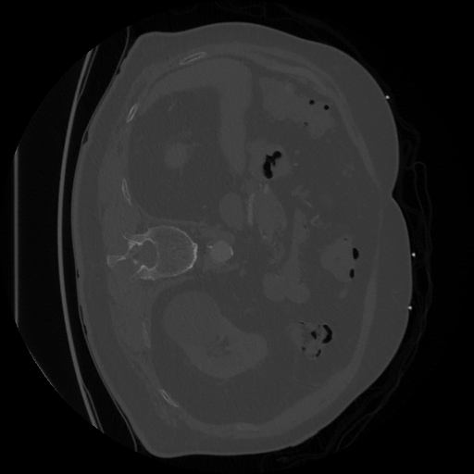
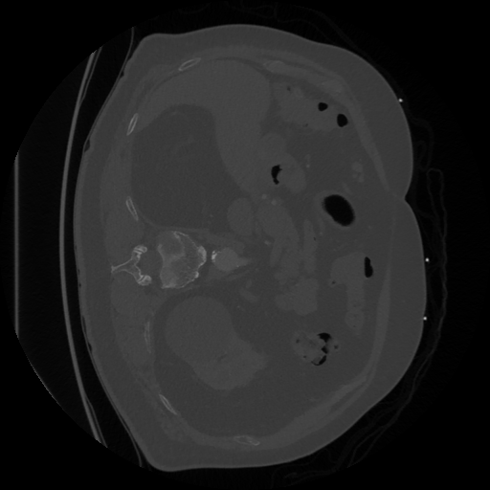
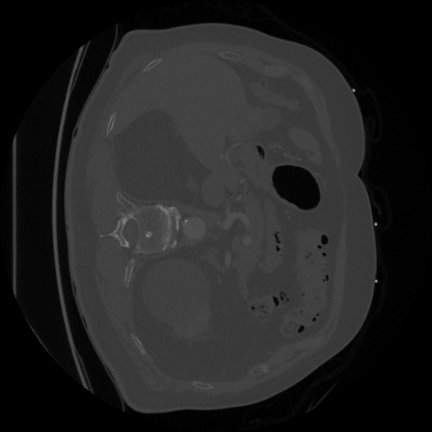
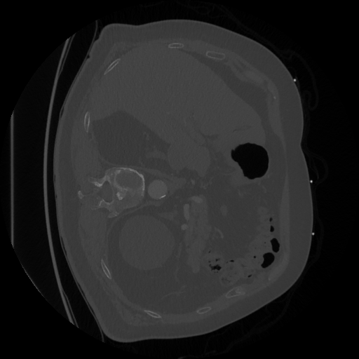
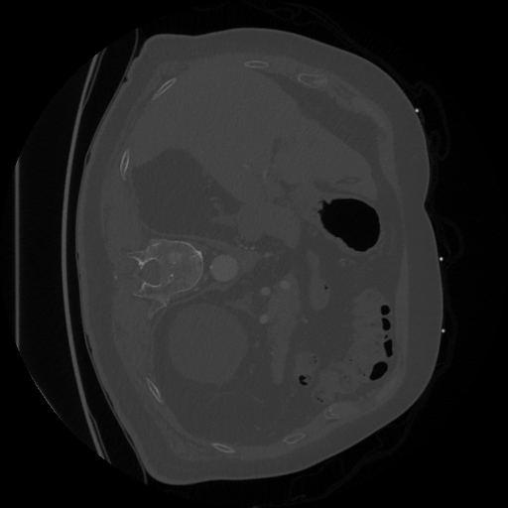
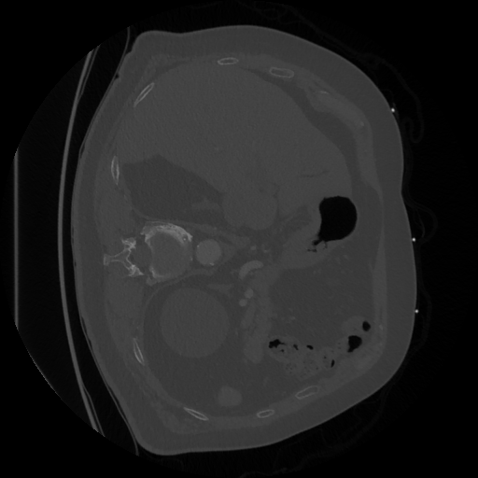
Model Training – First approach
[ 1 channel images as input for model training ]
[ Model training ]

Slide 8
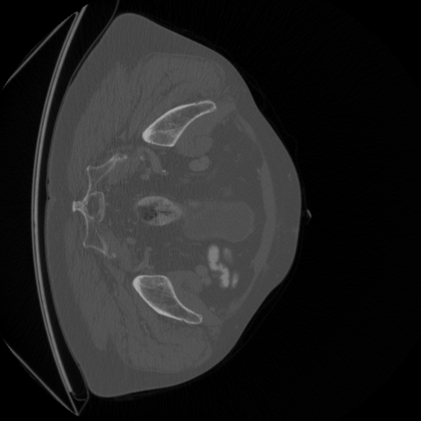
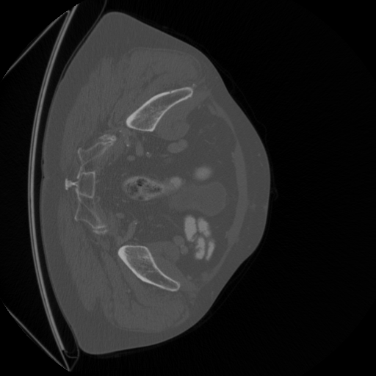

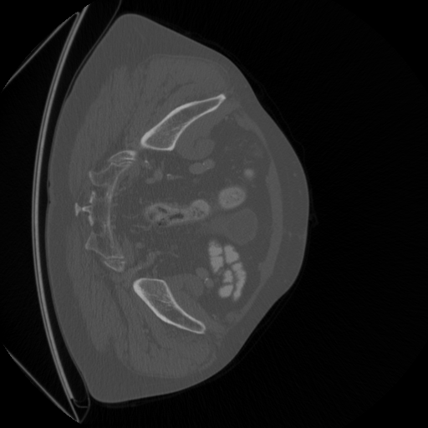
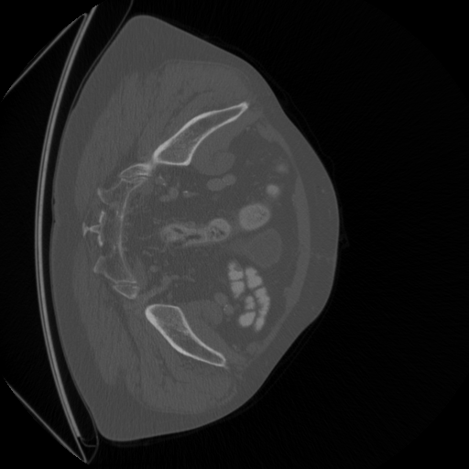
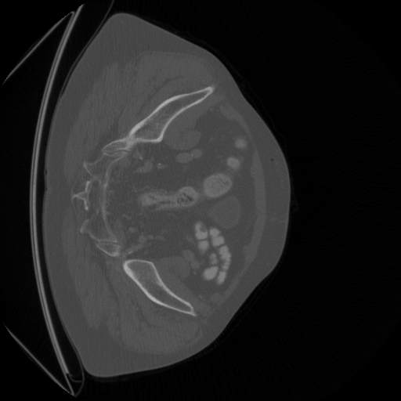
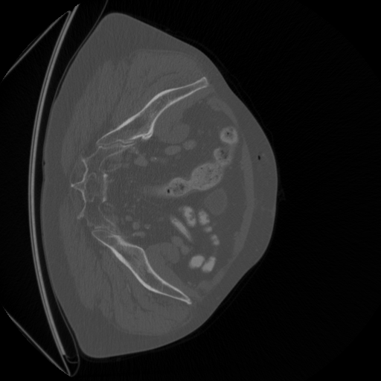
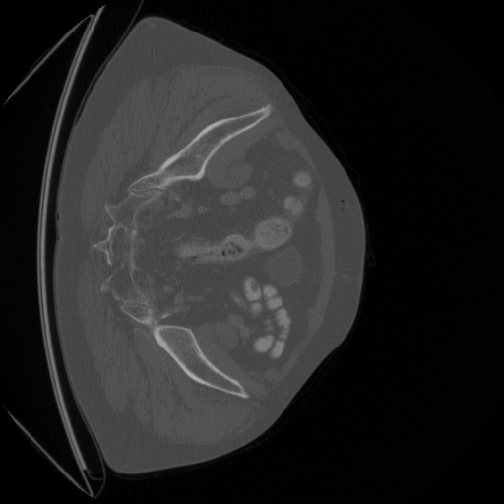
Model Training – First approach
[ 1 channel images as input for model training ]
[ Model training ]

Slide 9
Model Training – Multislices approach
[ 3 channel images as input for model training ]
[ Model training ]

Slide 10
Model Training – Multislices approach
[ 3 channel images as input for model training ]
[ Model training ]

Slide 11
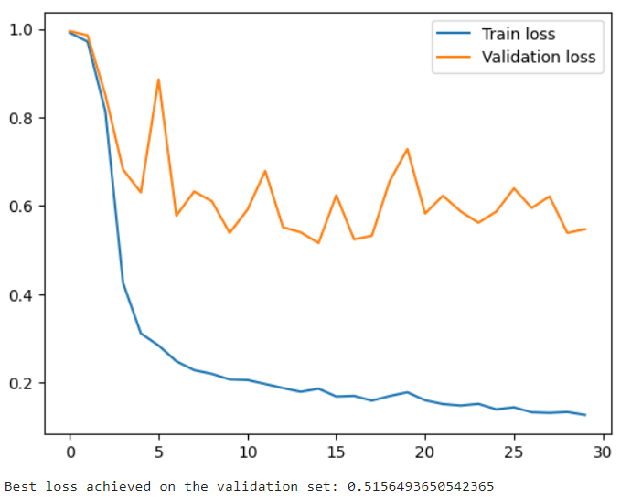
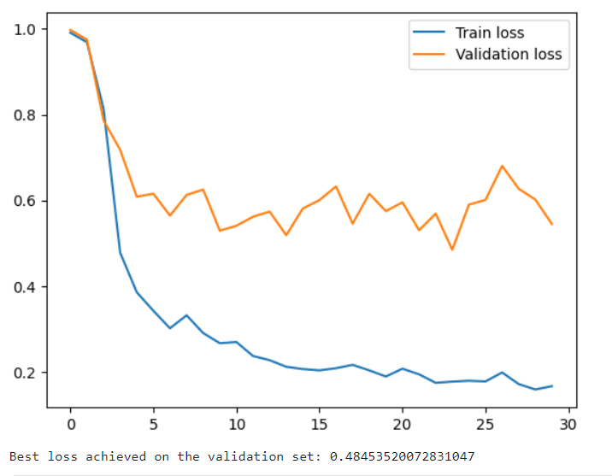
Results – Lung dataset
Test set loss at around 0.76

Slide 12
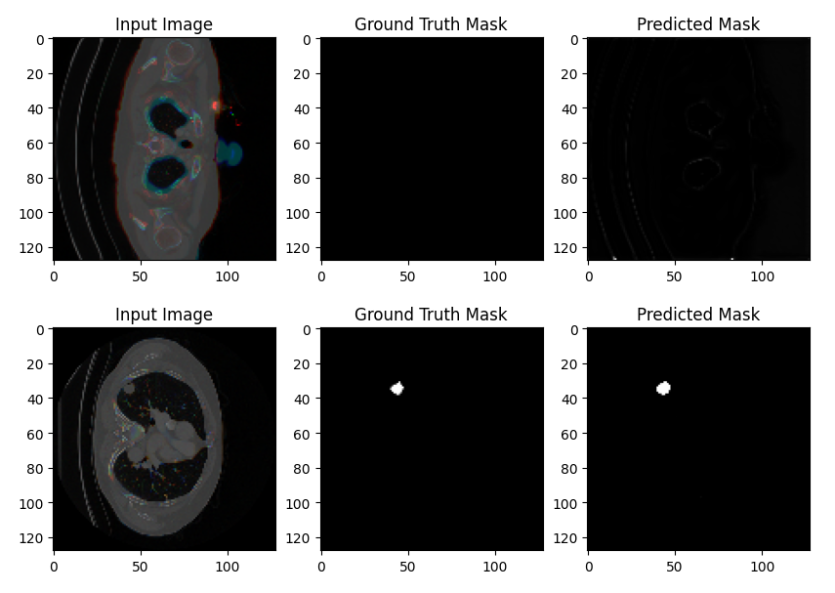
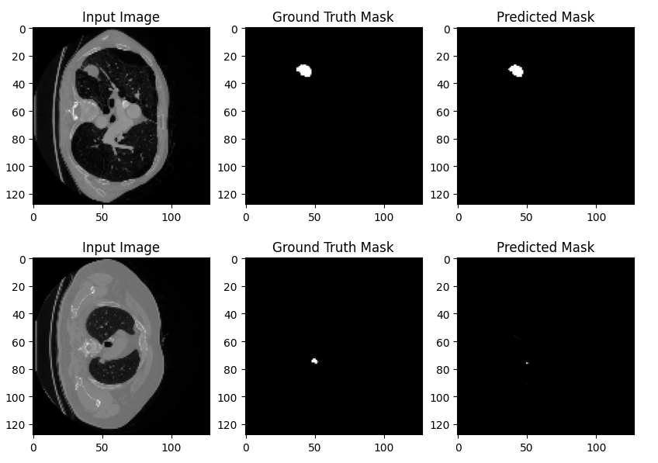
Results – Lung dataset

Slide 13
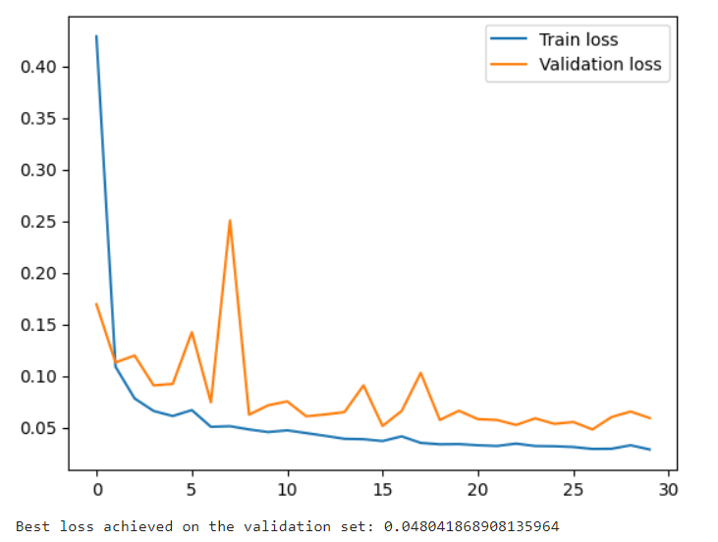
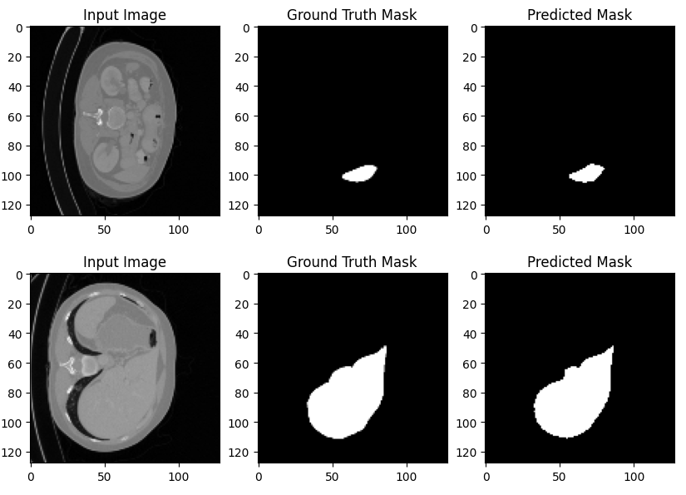
Results – Liver dataset
Test set loss less than 0.07

Slide 14
Conclusion
Poor results on the lung dataset for both the single and multislice approach, as well as different U-Net depths (3, 5 and 7)
Consistent with the Medical Decathlon results: http://medicaldecathlon.com/results/
Possible reasons – very small dataset and extreme class imbalance (small tumors on large images)
Very promising results on the liver dataset – close to pixel-perfect segmentation on previously unseen scans

Slide 15
References
U-Net: Convolutional Networks for Biomedical Image Segmentation: Olaf Ronneberger, Philipp Fischer, and Thomas Brox - Computer Science Department and BIOSS Centre for Biological Signalling Studies, University of Freiburg, Germany
Multislice input for 2D and 3D residual convolutional neural network noise reduction in CT - Zhongxing Zhou, Nathan R. Huber, Akitoshi Inoue, Cynthia H. McCollough, and Lifeng Yu
The Medical Segmentation Decathlon – Michela Antonelli, Annika Reinke, Spyridon Bakas, Keyvan Farahani, et al.

Slide 16
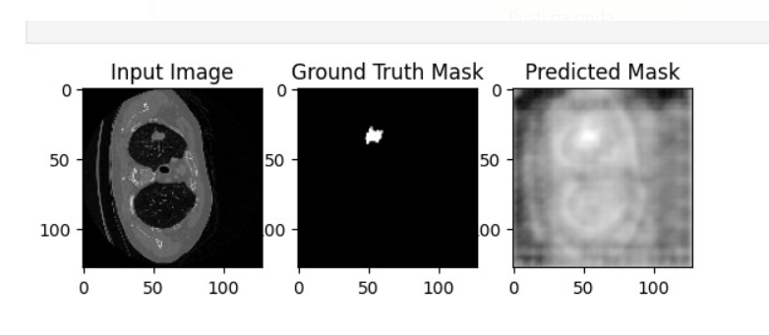
Results – Lung dataset
Behaves poorly on previously unseen scans (test set)

