Slide 1


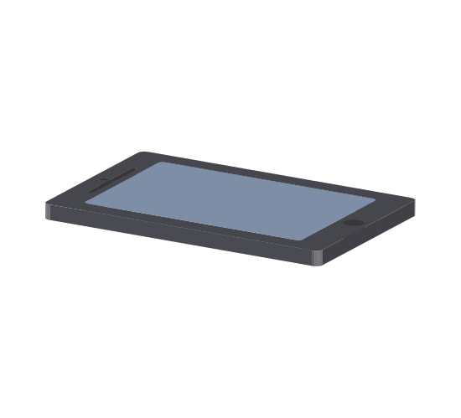
Up-Down Open-Close Eight-In-The-Air

