Slide 1
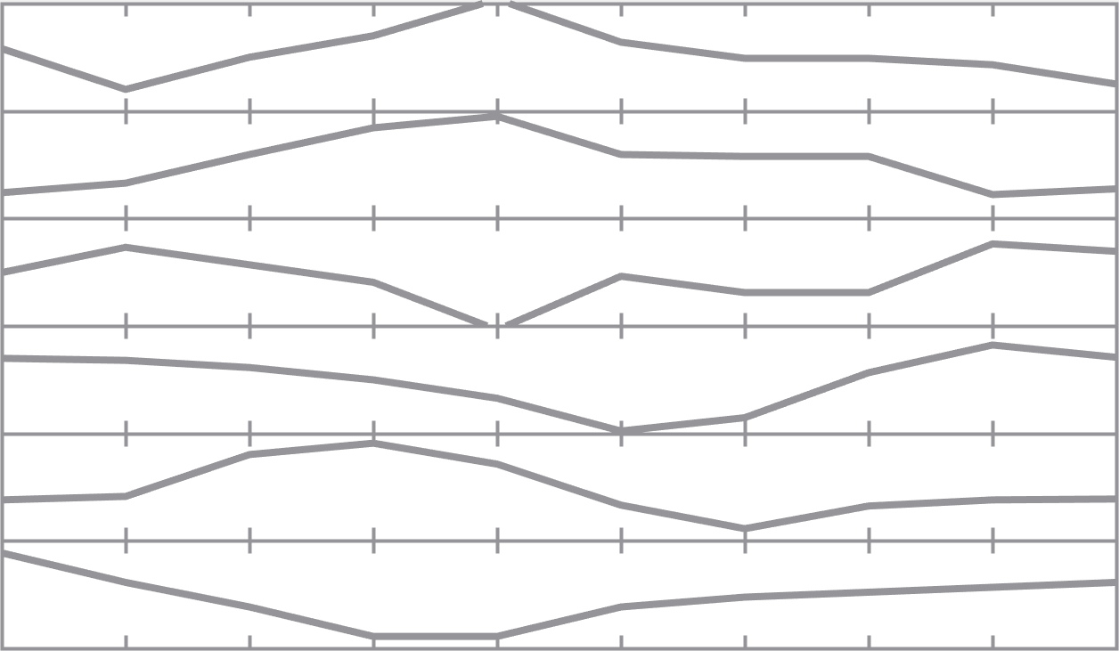
Classification Output Layer
···
Softmax Layer
Softmax
Fully Connected Layer
(Hidden Status Layer)
······
Bi-LSTM Layer
LSTM
Block
LSTM
Block
LSTM
Block
······
LSTM
Block
······
Acc-x
Acc-y
Acc-z
Gyro-x
Gyro-y
Gyro-z
Sequence
Input Layer
Feature Dimension
 | 1 | 2 | 3 | 4 | 5 | …
Sample Index

Slide 2
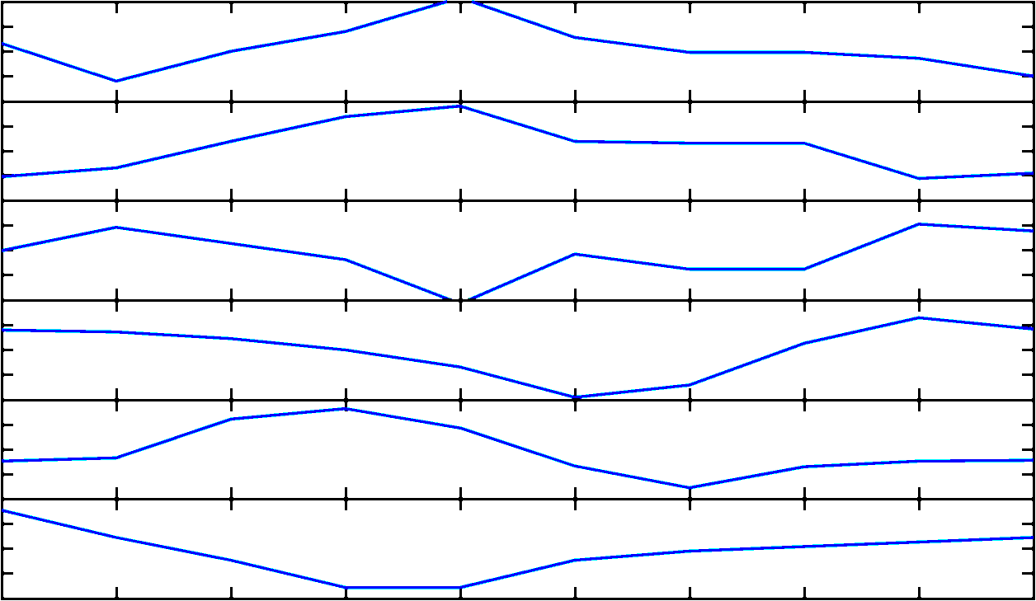
Classification Output Layer
···
Softmax Layer
Softmax
Fully Connected Layer
(Hidden Status Layer)
······
Bi-LSTM Layer
LSTM
Block
LSTM
Block
LSTM
Block
······
LSTM
Block
······
Acc-x
Acc-y
Acc-z
Gyro-x
Gyro-y
Gyro-z
Sequence
Input Layer
Feature Dimension
 | 1 | 2 | 3 | 4 | 5 | …
Sample Index

Slide 3
Classification Output Layer
···
Softmax Layer
Softmax
Fully Connected Layer
(Hidden Status Layer)
······
LSTM Layer
LSTM
Block
LSTM
Block
LSTM
Block
·····
LSTM
Block
······
Acc-x
Acc-y
Acc-z
Gyro-x
Gyro-y
Gyro-z
Sequence
Input Layer
Feature Dimension
 | 1 | 2 | 3 | 4 | 5 | …
Sample Index

Slide 4
 |  | Softmax
LSTM
Block
LSTM
Block
LSTM
Block
LSTM
Block
······

