Slide 1
Front “Surround” Suspension
Speaker Cone
Dust Cover
Terminals
Rear “Spider” Suspension
Metal Frame
Voice Coil
Magnet Structure
Magnet
Membrane
Plate
MEMS Tweeter
Piezoelectric Layer
Box with Acoustic Cavities
PCB Substrate

Slide 2
Front “Surround”
Suspension
Speaker Cone
Dust Cover
Terminals
Rear “Spider” Suspension
Metal Frame
Voice Coil
Magnet Structure
Magnet
Membrane
MEMS Tweeter
Plate
Piezoelectric Layer
Box with Acoustic Cavities
PCB Substrate

Slide 3
Front “Surround”
Suspension
Speaker Cone
Dust Cover
Terminals
Rear “Spider” Suspension
Metal Frame
Voice Coil
Magnet Structure
Magnet
Membrane
MEMS Tweeter
Plate
Piezoelectric
Layer
Box with
Acoustic Cavities
PCB Substrate

Slide 4
Front “Surround”
Suspension
Speaker Cone
Dust Cover
Terminals
Rear “Spider”Suspension
Metal Frame
Voice Coil
Magnet Structure
Magnet

Slide 5
Membrane
MEMS Tweeter
Plate
Piezoelectric
Layer
Box with
Acoustic Cavities
PCB Substrate

Slide 6
Plate
Membrane
MEMS
Piezoelectric Layer
PCB Substrate

Slide 7
Front
“Surround”
Suspension
Speaker Cone
Dust Cover
Terminals
Rear “Spider” Suspension
Metal Frame
Magnet
Magnet Structure
Voice Coil

Slide 8
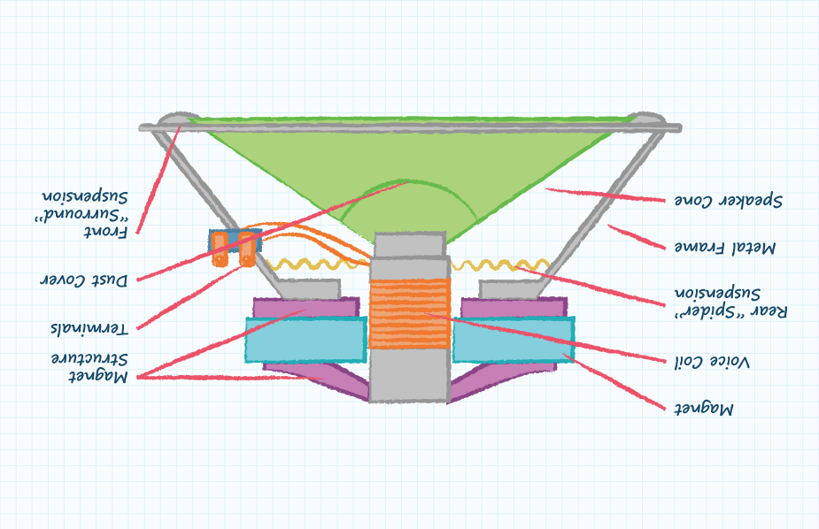

Slide 9
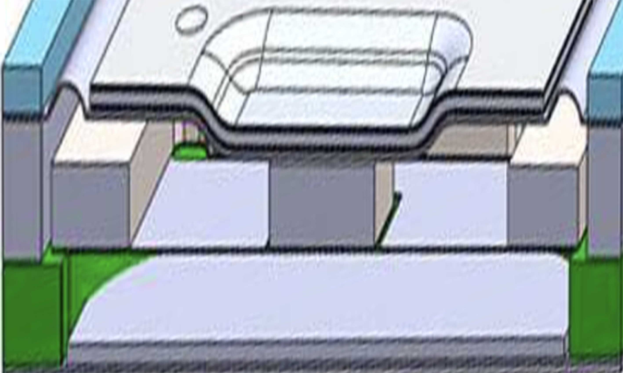

Slide 10
