Slide 1
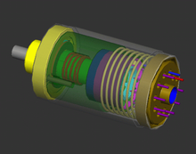
Accelerometer
- Milin Joshi

Slide 2
Introduction
Motion sensing
Relative acceleration
G-Force

Slide 3
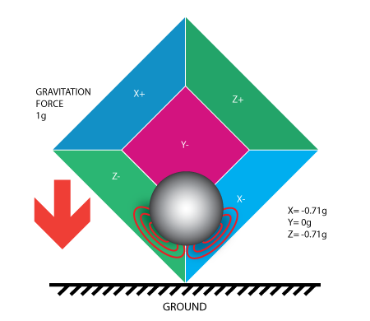
Physical Principles
Relative frame of reference
Einstein’s equivalence principle
Free fall

Slide 4
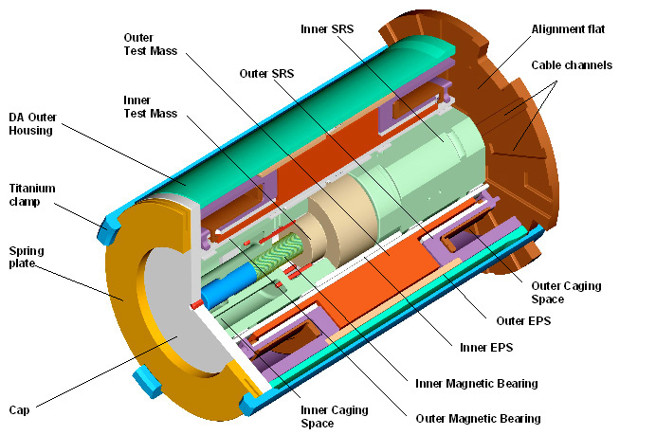
Structure
Test mass
Suspension of a damped mass on a spring
Converts mechanical motion into electrical signals
Electrical signals calibrated accordingly

Slide 5
Applications
Engineering
Biology
Industry
Architecture
Medicine
Navigation
Transport
Vulcanology
Consumer electronics
Device integrity
Gravimetry

Slide 6
Engineering
Measure vehicle acceleration
Braking systems
Measures Vibration in cars,machines,etc
Measures seismic activity

Slide 7
Biology
High frequency recordings of bi-axial or tri-axial acceleration
discrimination of behavioral patterns while animals are out of sight
quantify the rate at which an animal is expending energy in the wild, by either determination of limb-stroke frequency or measures such as overall dynamic body acceleration

Slide 8
Industry
monitoring of rotating equipment such as pumps, fans, rollers, compressors, and cooling towers
allows the user to monitor machines and detect these faults before the rotating equipment fails.
Vibration monitoring programs are utilized in industries such as automotive manufacturing, machine tool applications, pharmaceutical production, power generation and power plants, pulp and paper,food and beverage production, water and wastewater, hydropower, petrochemical and steel manufacturing.

Slide 9
Architecture
Accelerometers are used to measure the motion and vibration of a structure that is exposed to dynamic loads. Dynamic loads originate from a variety of sources including:
Human activities – walking, running, dancing or skipping
Working machines – inside a building or in the surrounding area
Construction work – driving piles, demolition, drilling and excavating
Moving loads on bridges
Vehicle collisions
wind loads and wind gusts
Air blast pressure
measuring and recording how a structure responds to these inputs is critical for assessing the safety and viability of a structure. This type of monitoring is called Dynamic Monitoring.

Slide 10
medicine
Zoll's AED Plus uses CPR-D•padz which contain an accelerometer to measure the depth of CPR chest compressions
Herman Digital Trainer uses accelerometers to measure strike force in physical training
Within the last several years, Nike, Polar and other companies have produced and marketed sports watches for runners that include footpods, containing accelerometers to help determine the speed and distance for the runner wearing the unit.

Slide 11
Navigation
An Inertial Navigation System (INS) is a navigation aid that uses a computer and motion sensors (accelerometers) to continuously calculate via dead reckoning the position, orientation, and velocity (direction and speed of movement) of a moving object without the need for external references
An accelerometer alone is unsuitable to determine changes in altitude over distances where the vertical decrease of gravity is significant, such as for aircraft and rockets

Slide 12
Transport
accelerometers is in airbag deployment systems for modern automobiles.
Another common automotive use is in electronic stability control systems, which use a lateral accelerometer to measure cornering forces
Another automotive application is the monitoring of noise, vibration and harshness (NVH), conditions that cause discomfort for drivers and passengers and may also be indicators of mechanical faults.
Tilting trains use accelerometers and gyroscopes to calculate the required tilt.

Slide 13

Consumer electronics
Motion input
Orientation sensing
Image stabilization

Slide 14
TYPES
Piezoelectric accelerometer
Shear mode accelerometer
MEMS
Capacitive spring mass base
Null-balance
Strain gauge
Resonance
Magnetic induction
Optical
Surface acoustic wave (SAW)
Laser accelerometer
DC response
High temperature
Low frequency
Modally tuned impact hammers
Seat pad accelerometers

Slide 15
Thank You

