Slide 1
PROJECT ID 15
Career guidance system
Organization name : Perfetto solutions
Guide : V.K.Jadeja
Milin Joshi
Vatsal shah

Slide 2
Introduction
Assistance of appropriate career option
Tests + results = suggestions
Consultancies for different institutes and courses offered
Information for courses in India as well as abroad
Regular updates through newsletter

Slide 3
Motivation
What if they select the wrong option and have to suffer throughout their life?
Students as well as their parents face a great dilemma for selecting the right career option
Providing information about all the areas of education

Slide 4
Objectives
Bringing out the interests and abilities
Providing suggestions for career option
Providing details about institutes and courses offered by them
Offering information for studying in India as well as abroad
Answering FAQs
Providing expert’s opinions

Slide 5
Application
Suggesting appropriate career option
Updating regularly about institutes and courses
Covering all areas of studies
Advertisements for institutes

Slide 6
Approach
Knowing user’s area of interest
Knowing students capabilities by taking tests
Test results suggesting them the right path
Answering FAQs

Slide 7
Modules
Admin
Institute
Student
Test
Courses
Newsletter
FAQ
Inquiry
Experts opinion
Polls
Feedback
Institute Photo Gallery

Slide 8
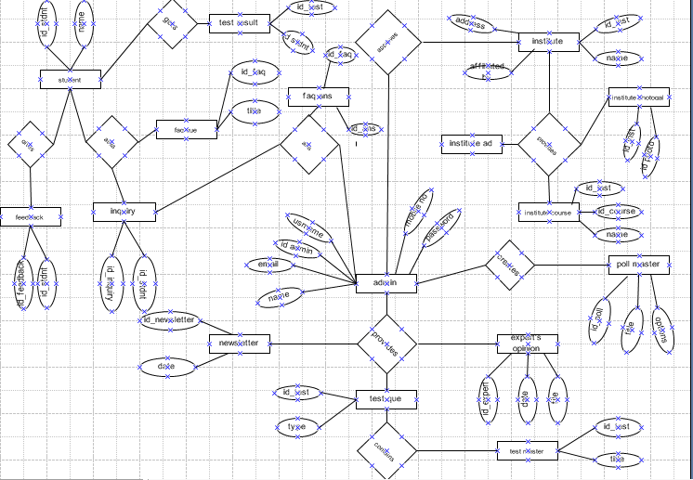
E-R diagram

Slide 9
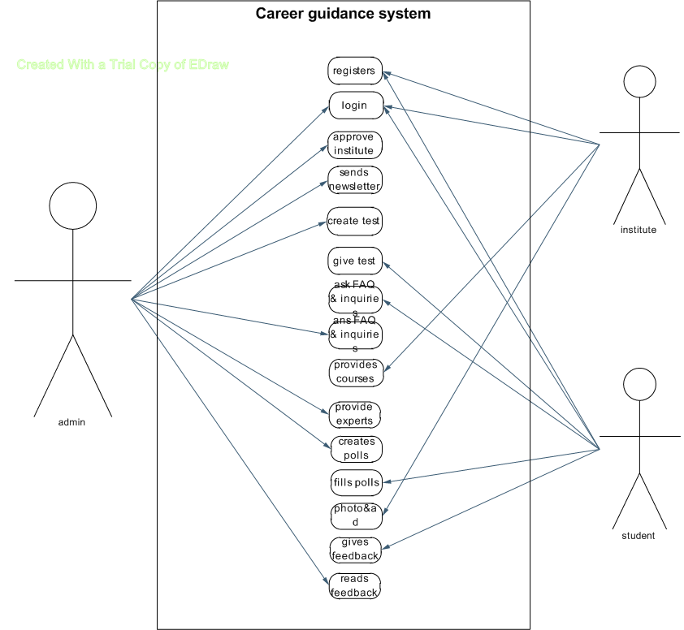
Use case diagram

Slide 10
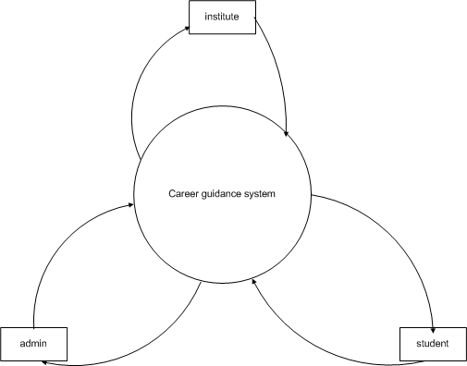
Context diagram

Slide 11
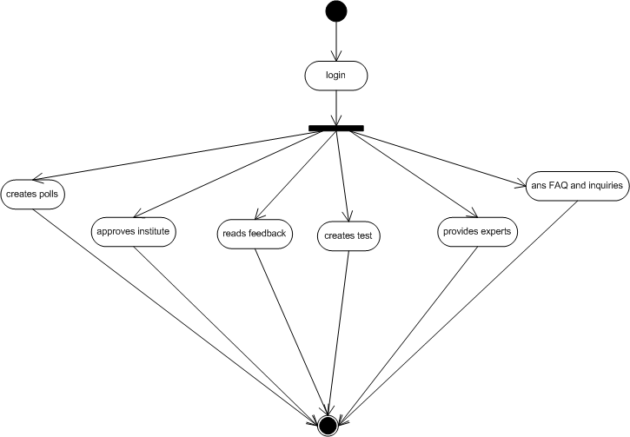
Admin activity diagram

Slide 12
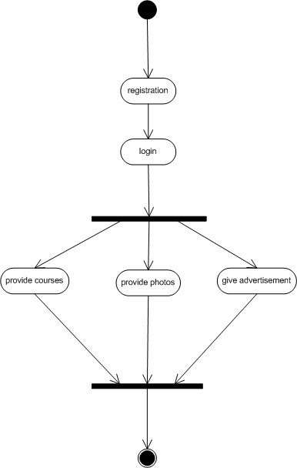
Institute activity diagram

Slide 13
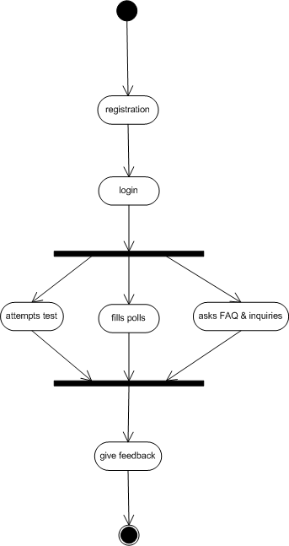
Student activity diagram

Slide 14
Thank You
Any queries?

