Slide 1


Amazon Sales Data Analysis Report
An overview of key sales metrics and trends
By Milind Thakur

Slide 2
Total Revenue, Units Sold, and Total Profit
Description:
This slide provides an overview of the key financial metrics for the Amazon sales data:
Total Revenue: Represents the total income generated from sales, amounting to over $137 million. This figure reflects the overall financial performance and market demand.
Units Sold: Indicates the total number of items sold, totaling 512,871 units. This metric demonstrates the scale of operations and customer purchasing behavior.
Total Profit: Shows the total profit earned, which is $44 million. This figure highlights the profitability of the sales activities, showing how well the company managed its costs relative to the revenue.
These metrics collectively offer insights into the business's sales performance and profitability, helping to assess financial health and operational success.

Slide 3
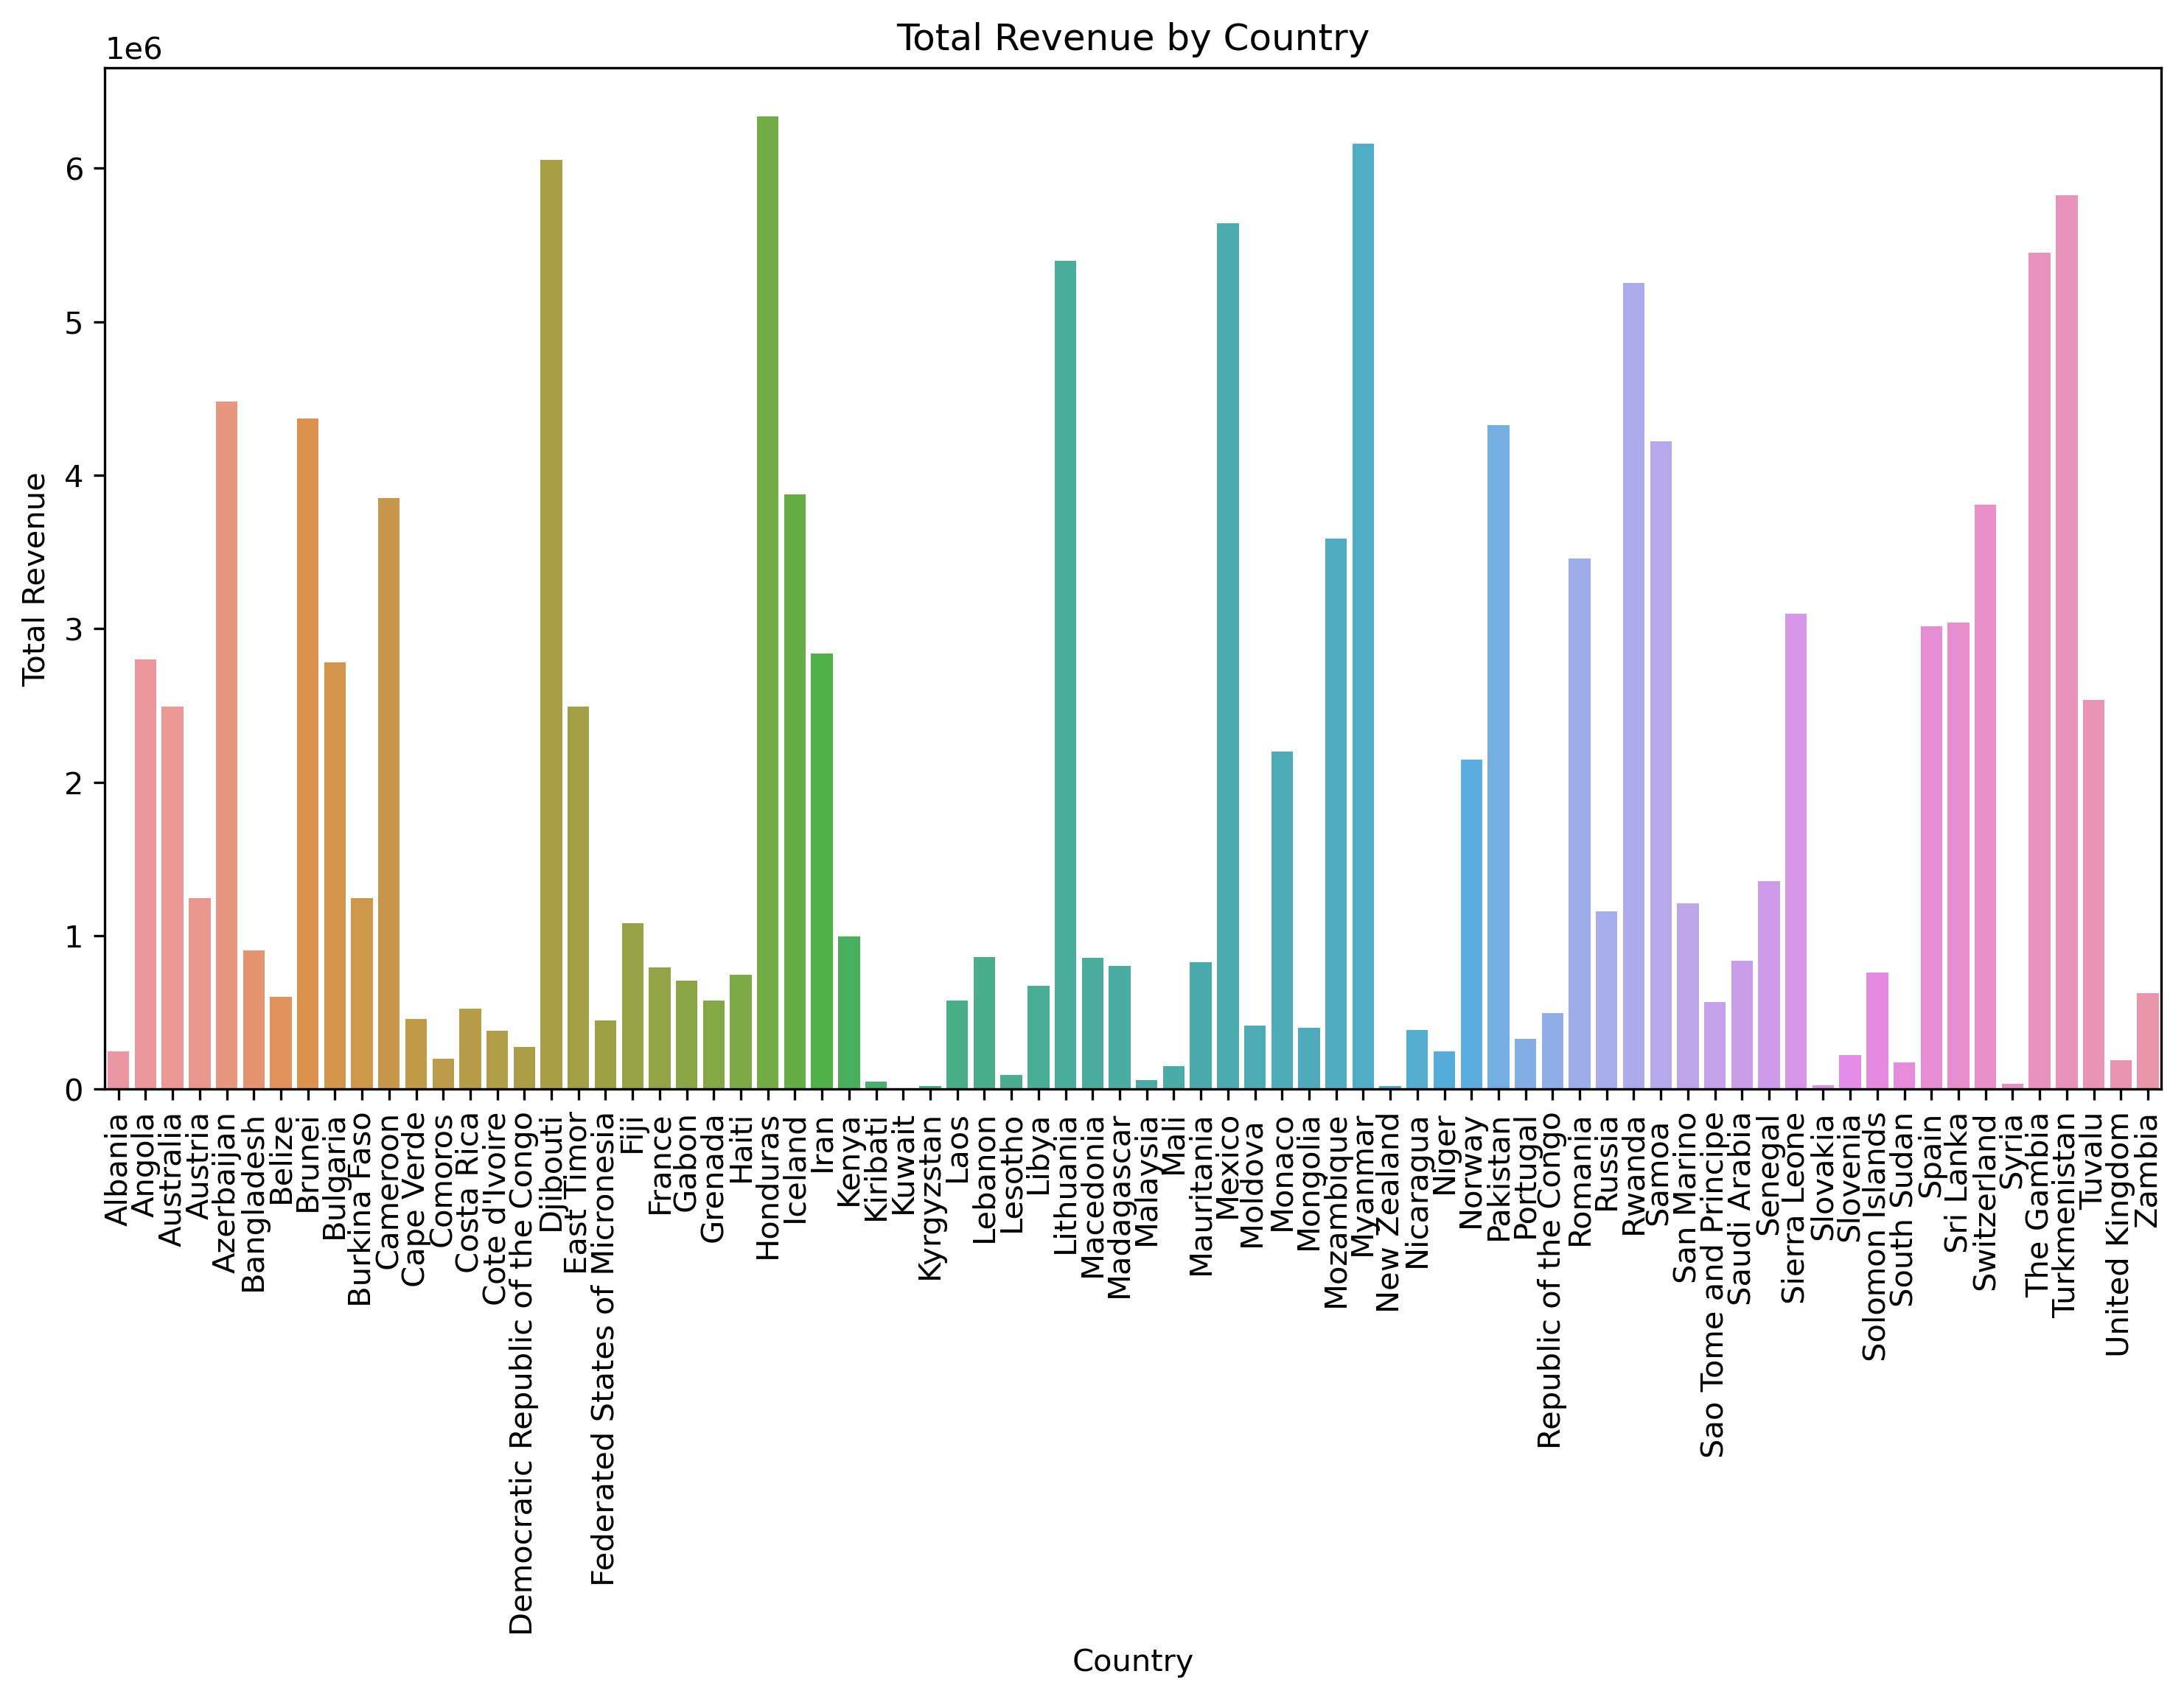
Total Revenue by Country
Honduras Tops : $6.3 B
This slide shows the total revenue generated by different countries. It highlights the key revenue-generating markets.

Slide 4
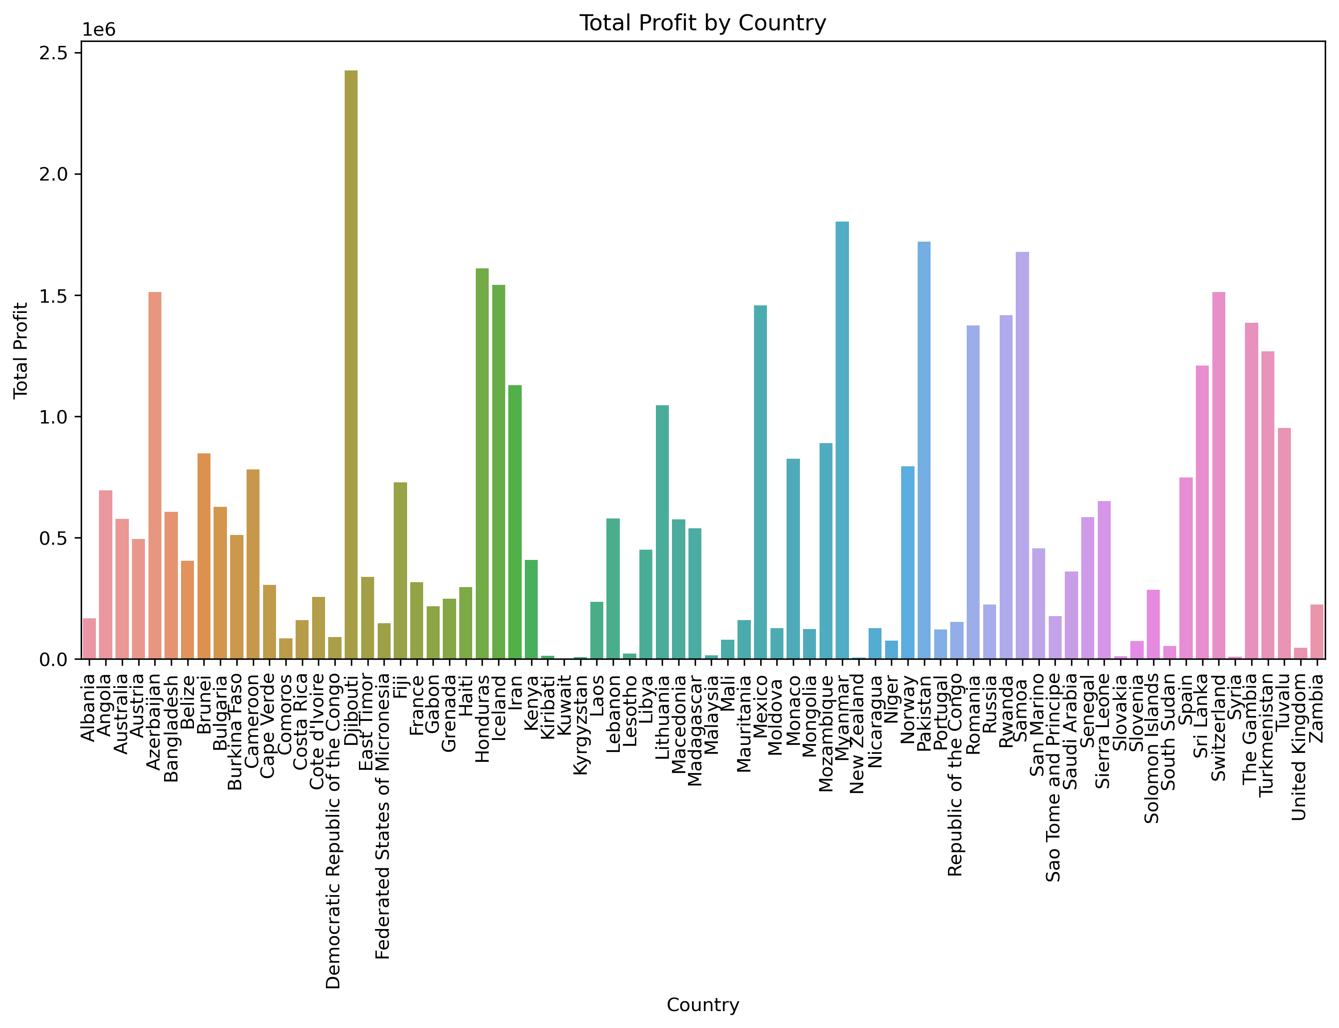
Total Profit by Country
Djibouti Tops : $2.4M
This slide illustrates the total profit by country, indicating which regions are the most profitable.

Slide 5
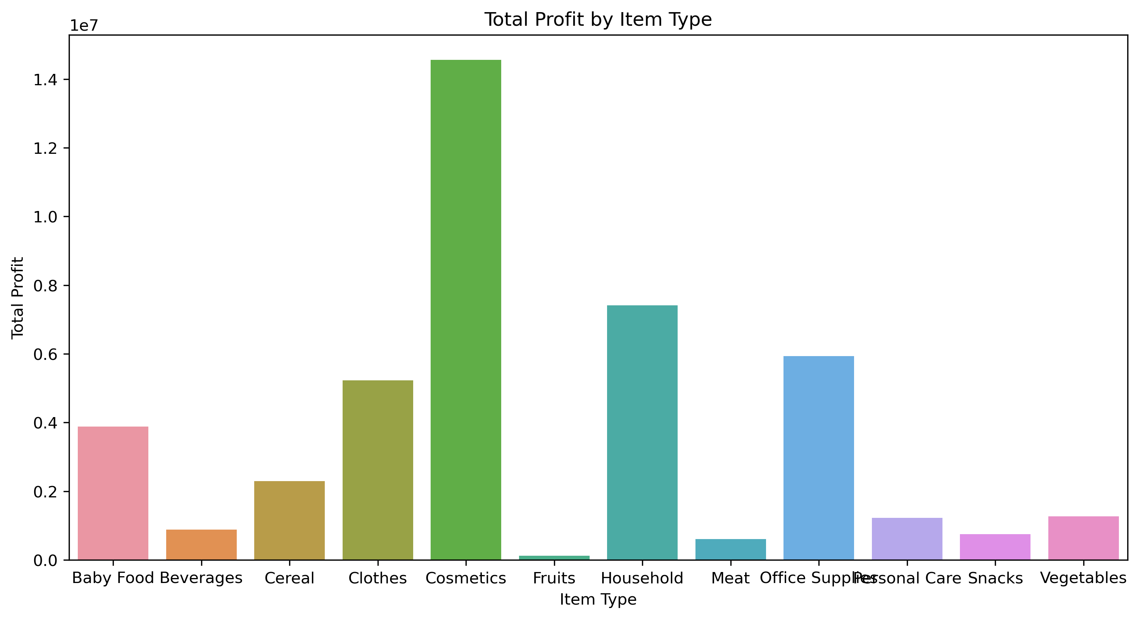
Total Profit by Item Type
$15M
$7M
$6M
This slide shows the total profit generated from different item types, helping to identify the most profitable products.

Slide 6
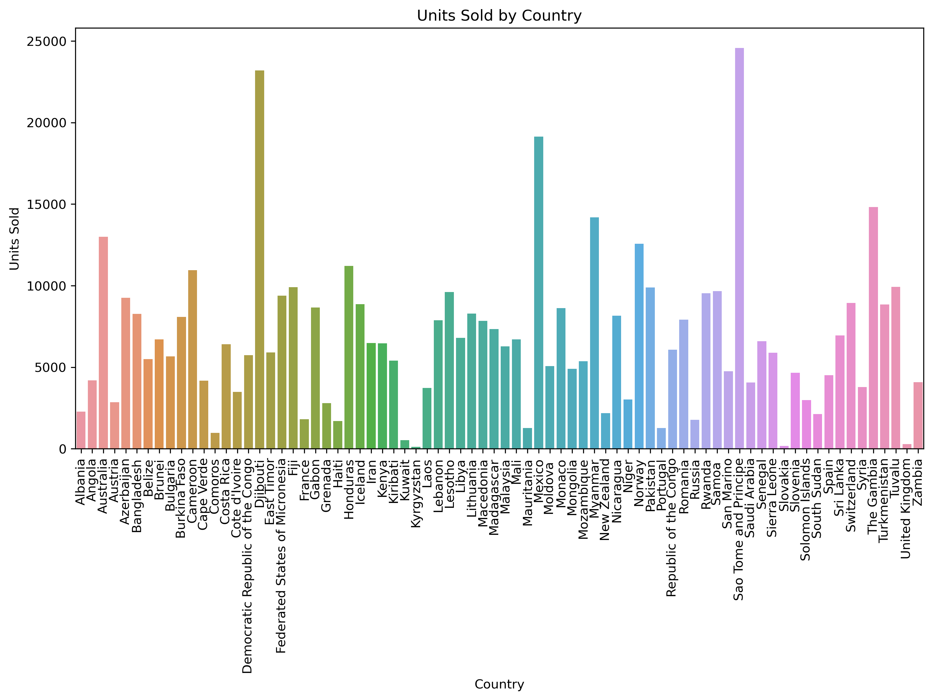
Units Sold by Country
23k : Djibouti
25k : Sao Tome and Principe
This slide displays the number of units sold across different countries, highlighting sales distribution globally.

Slide 7
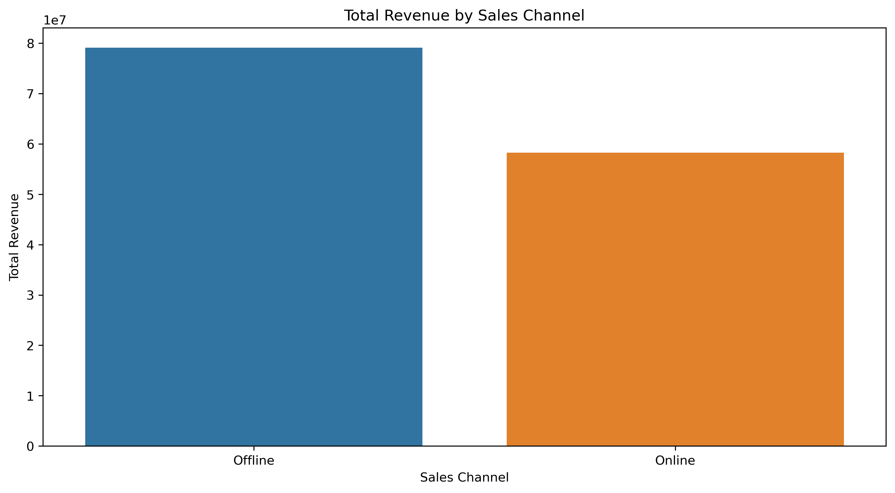
Total Revenue by Sales Channel
$79.09M
$58.25M
This slide provides an overview of total revenue generated through different sales channels, helping to assess channel performance.

