Slide 1



Sales_Data_BI
View in Power BI
Last data refresh:
13/07/2024 13:04:05 UTC
Downloaded at:
13/07/2024 15:38:54 UTC

Slide 2
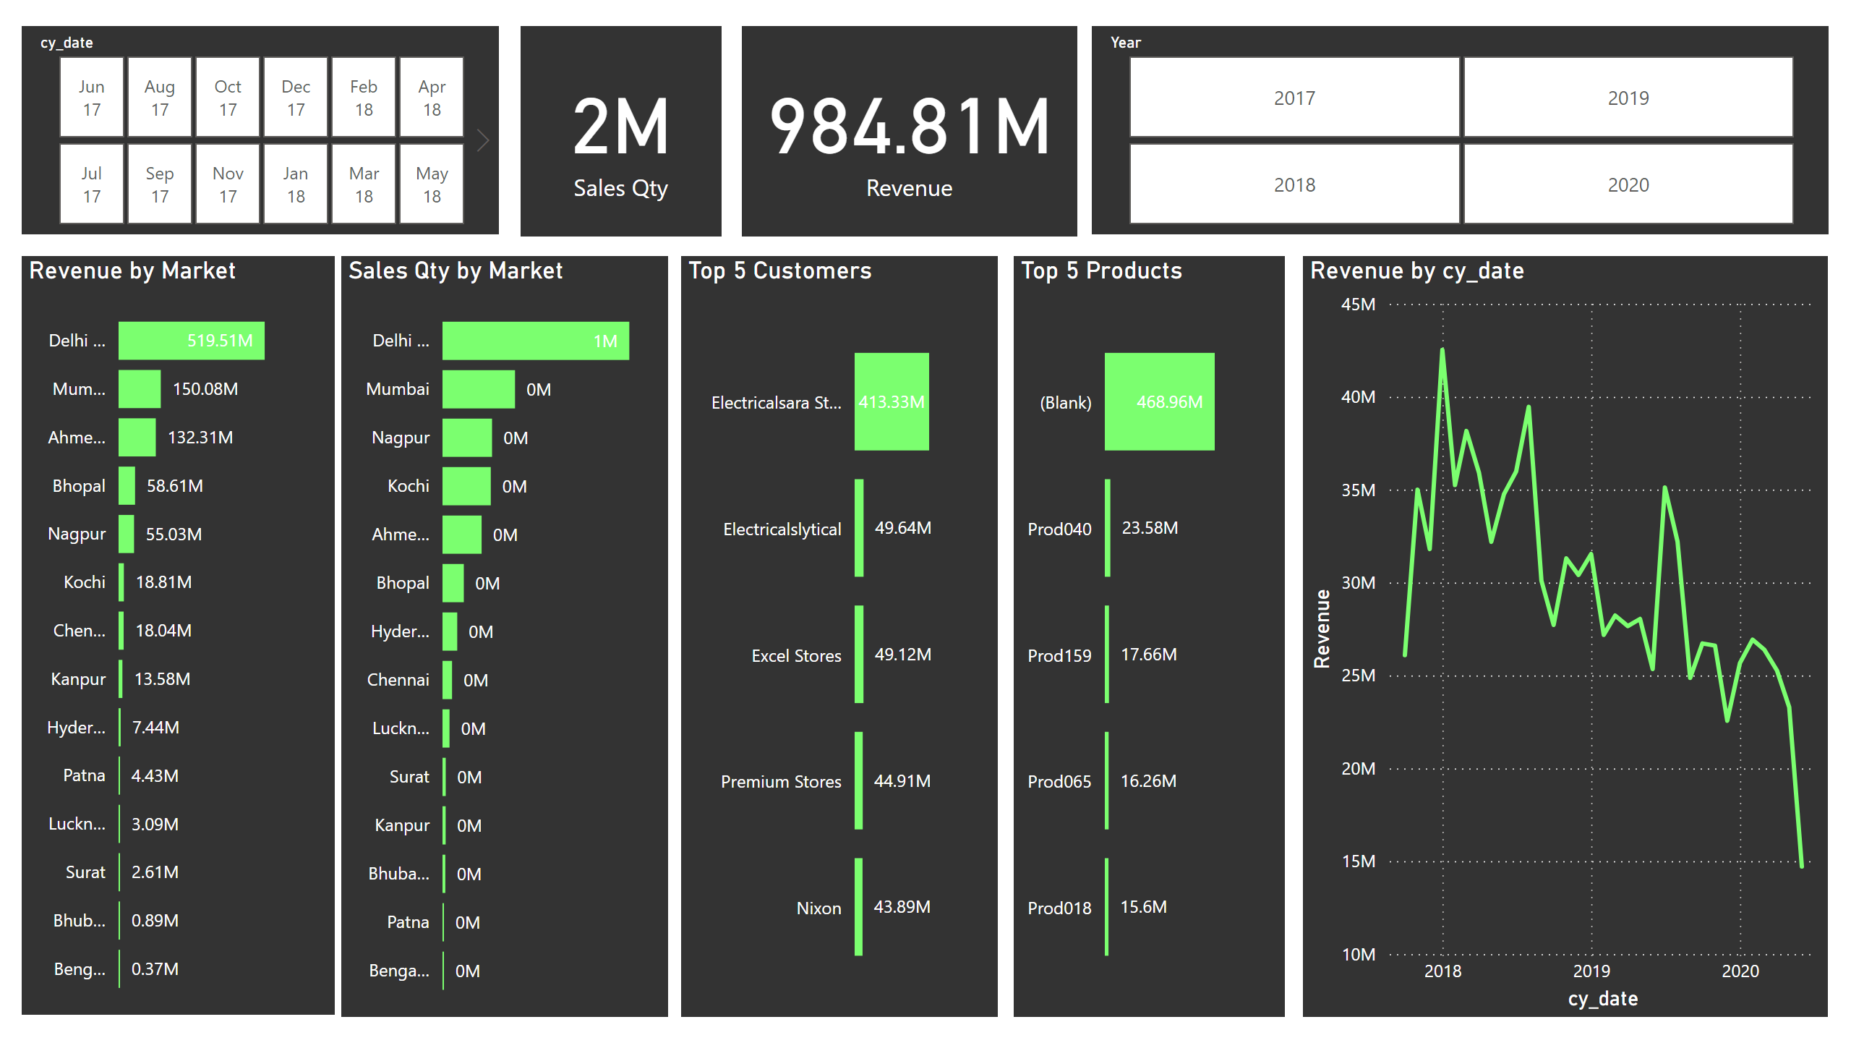
Page 1
Notes:
card
No alt text provided
card
No alt text provided
Revenue by Market
No alt text provided
Sales Qty by Market
No alt text provided
slicer
No alt text provided
slicer
No alt text provided
Top 5 Customers
No alt text provided
Top 5 Products
No alt text provided
lineChart
No alt text provided

