Slide 1



Zomato_PB
View in Power BI
Last data refresh:
08/08/2024 12:37:56 UTC
Downloaded at:
08/08/2024 12:46:53 UTC

Slide 2
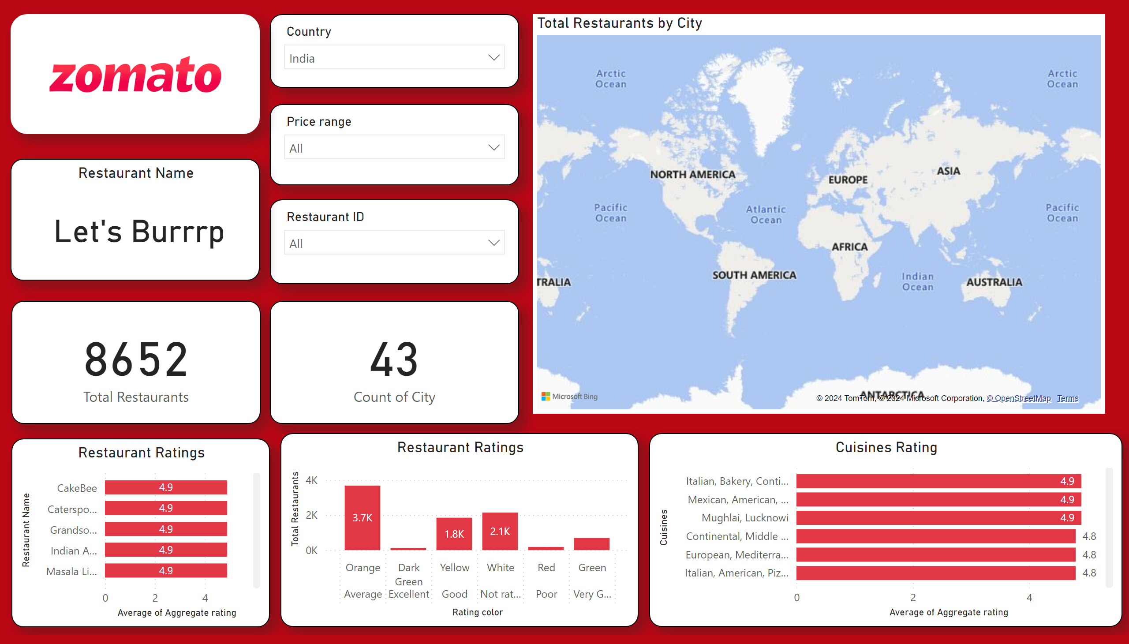
Page 1
Notes:
slicer
No alt text provided
slicer
No alt text provided
card
No alt text provided
card
No alt text provided
Restaurant Ratings
No alt text provided
Restaurant Ratings
No alt text provided
Cuisines Rating
No alt text provided
image
No alt text provided
slicer
No alt text provided
Restaurant Name
No alt text provided
map
No alt text provided

