Slide 1
5G Network Performance Report 2026
Quarterly KPI Review
Q3 2026 · Latency · Throughput · Coverage
Notes:
Overview of latency, throughput, and coverage metrics.

Slide 2
Executive Summary
Latency: average round-trip latency reduced 20% quarter over quarter, driven by edge (MEC) offload.
Throughput: peak downlink reached 12 Gbps on mmWave carriers after carrier-aggregation upgrades.
Coverage: 98% of urban population now covered, with suburban infill continuing.
Energy efficiency: energy per GB delivered fell 15% through AI-driven cell sleep modes.
−20%
12 Gbps
Avg latency
Peak downlink
98%
−15%
Urban coverage
Energy per GB

Slide 3
Latency by Region
Region | Avg Latency (ms) | Peak Latency (ms)
North America | 4.2 | 9.1
Europe | 3.8 | 8.5
Asia-Pacific | 5.1 | 11.2
Latin America | 6.4 | 13.7
Middle East & Africa | 7.0 | 15.3
3.8 ms
Europe leads on average latency
All regions now average under 7 ms; peak-to-average ratio holds near 2.2×.

Slide 4
Throughput Specifications
Band | Downlink (Gbps) | Uplink (Gbps)
n77 · 3.7 GHz C-band (mid-band) | 4.5 | 0.9
n78 · 3.5 GHz (mid-band) | 4.2 | 0.8
n258 · 26 GHz (mmWave) | 12.0 | 2.4
n261 · 28 GHz (mmWave) | 11.6 | 2.2
mmWave bands deliver ~2.7× the mid-band downlink; mid-band carries most traffic thanks to wider reach.

Slide 5
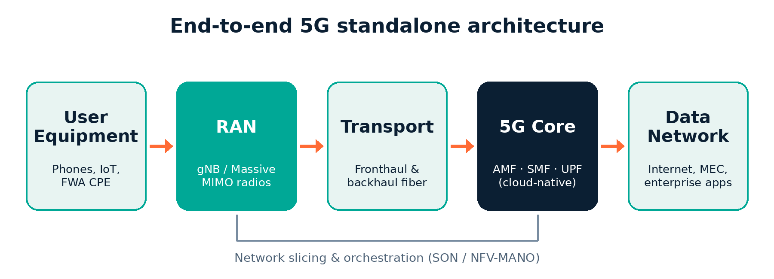
Network Architecture
Figure 1. Standalone 5G architecture: traffic flows from devices through the RAN and transport to the cloud-native core.

Slide 6
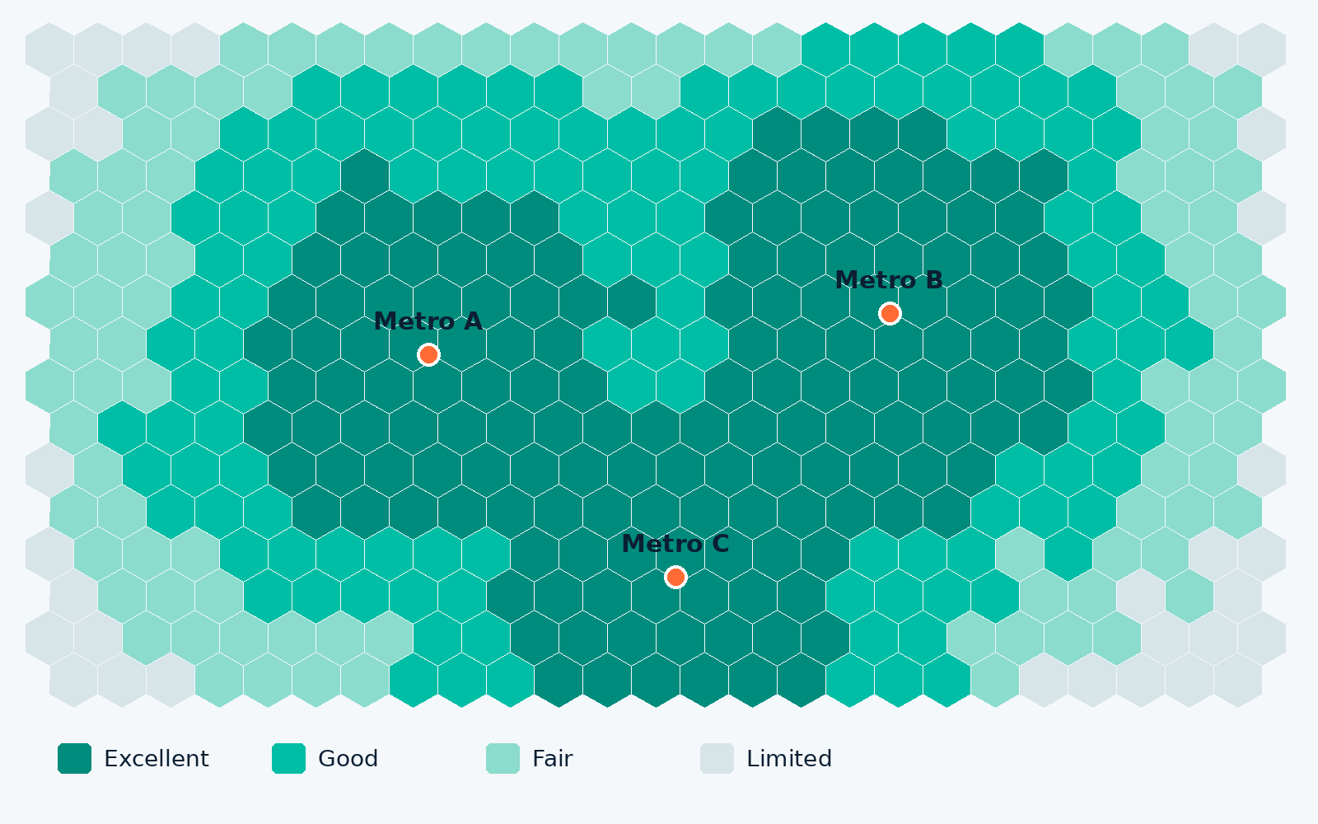
Coverage Map
Urban cores: 98% of the urban population sits in Good or Excellent coverage across all three metros.
Rural edge: Fair and Limited zones remain at the periphery; low-band infill is planned for Q4.

