Slide 1
Talking Points
Capturing the conversation

Slide 2

Capture the conversation
“ Dip into the comments, the American text genre of the moment, and you can sense the currents that move American life.”
- Michael Erard in his article ‘No comments’

Slide 3








Algorithm
URL String
Database
Web App
Comments
Pre-processing
Post-processing
Bag of words
Representative
comments
Pre-processing
Ranking
Tf-idf
Dimensionality
Reduction using
LSI
K-means
clustering

Slide 4
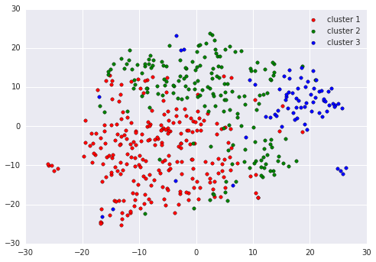
K-means clustering

Slide 5
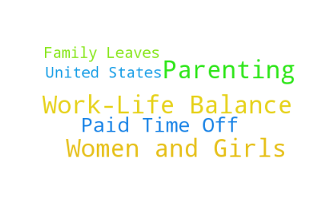
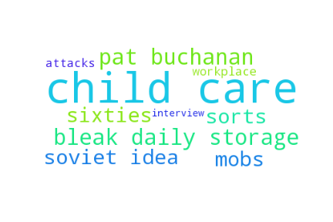

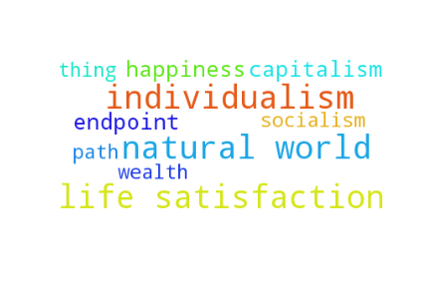
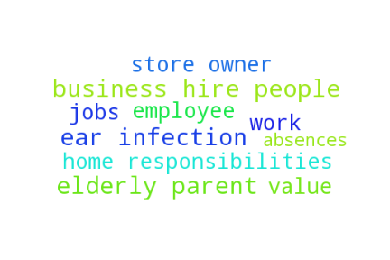
A Toxic Work World by ANNE-MARIE SLAUGHTER Sept. 18 2015

Slide 6





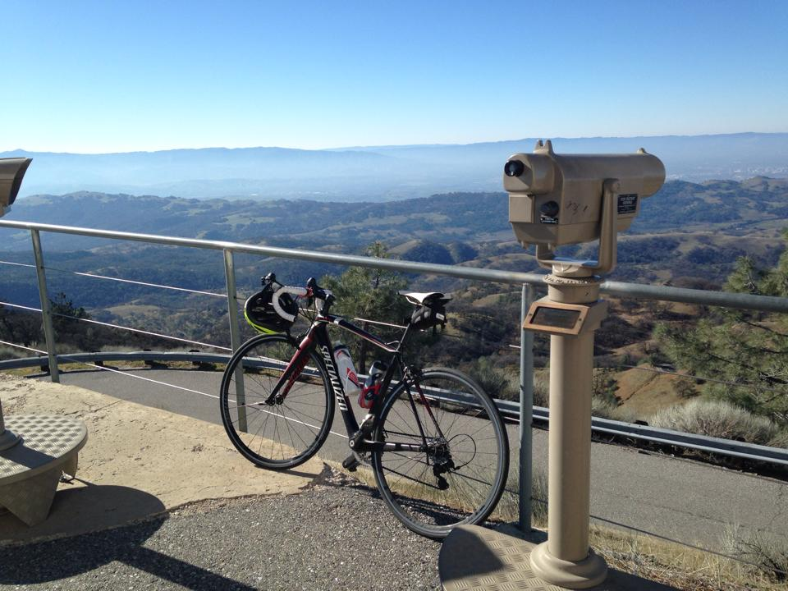
Milinda Lakkam

