Slide 1
Capture the conversation

Slide 2
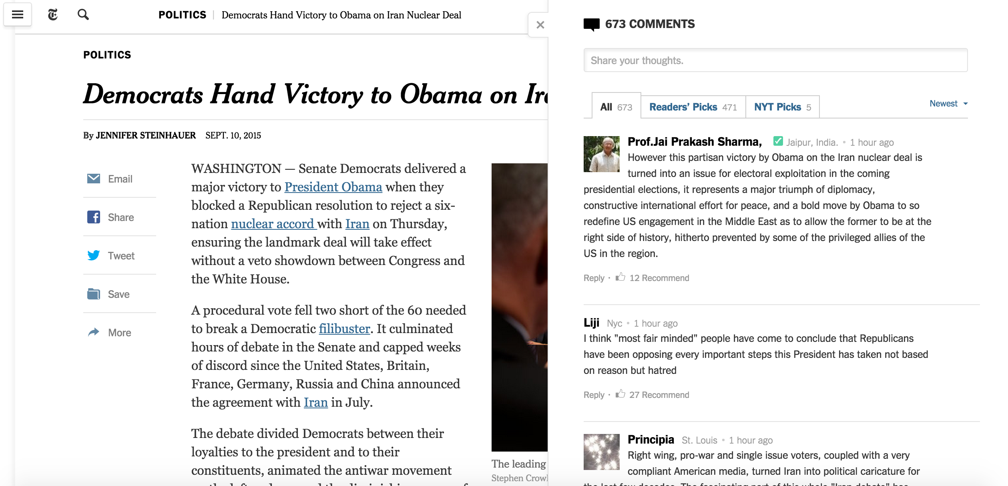
Capture the conversation
Comments on the NYT articles have diverse viewpoints.
Can I curate the comments to get the representative set that covers the entire spectrum?

Slide 3

Web Interface
Enter the NY Times URL
Article Content
Comment 1
Comment 2
Comment 3

Slide 4
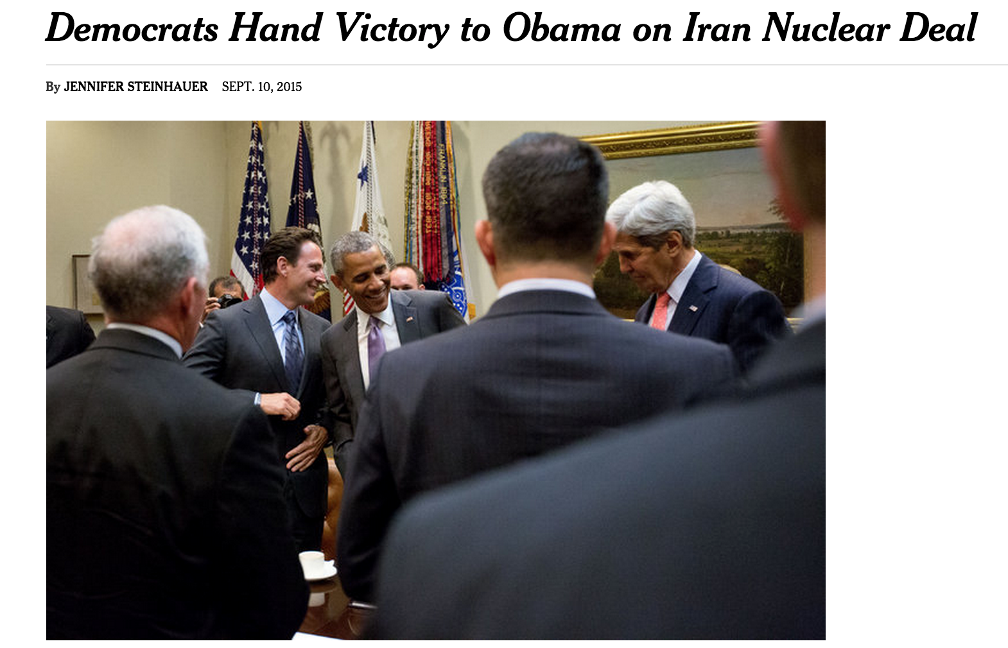
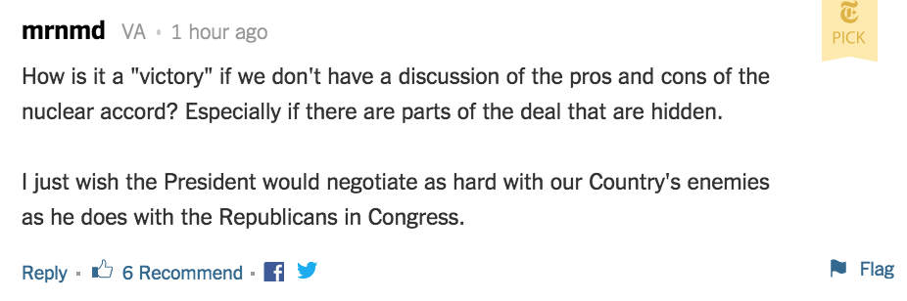
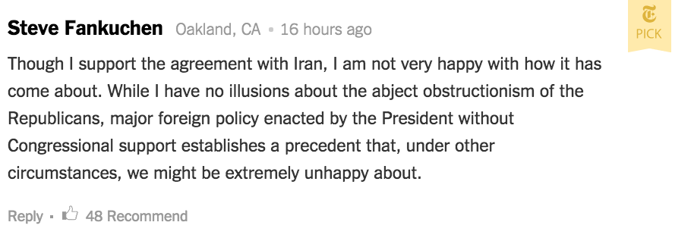
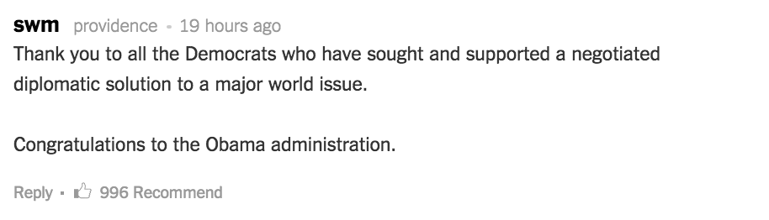
Web Interface
http://www.nytimes.com/2015/09/11/us/politics/iran-nuclear-deal-senate.html?_r=0

Slide 5
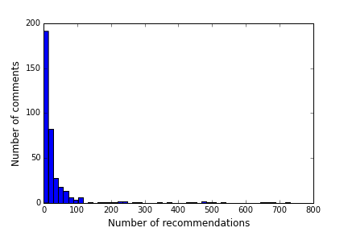
Data Sources
NY Times Community API, NYT Articles API
Distribution of the number of recommendations per comment of a sample article

Slide 6
Algorithms
Feature set of the comments:
- user ID, user location, user trust, recommendations, editor selection, trusted, reply count
- bag of words for comment body
Clustering algorithm for the bag of words models of the comment body
Select a representative comment for the cluster using other comment features
representative comment
representative comment
representative comment

