Slide 1
Capture the conversation

Slide 2
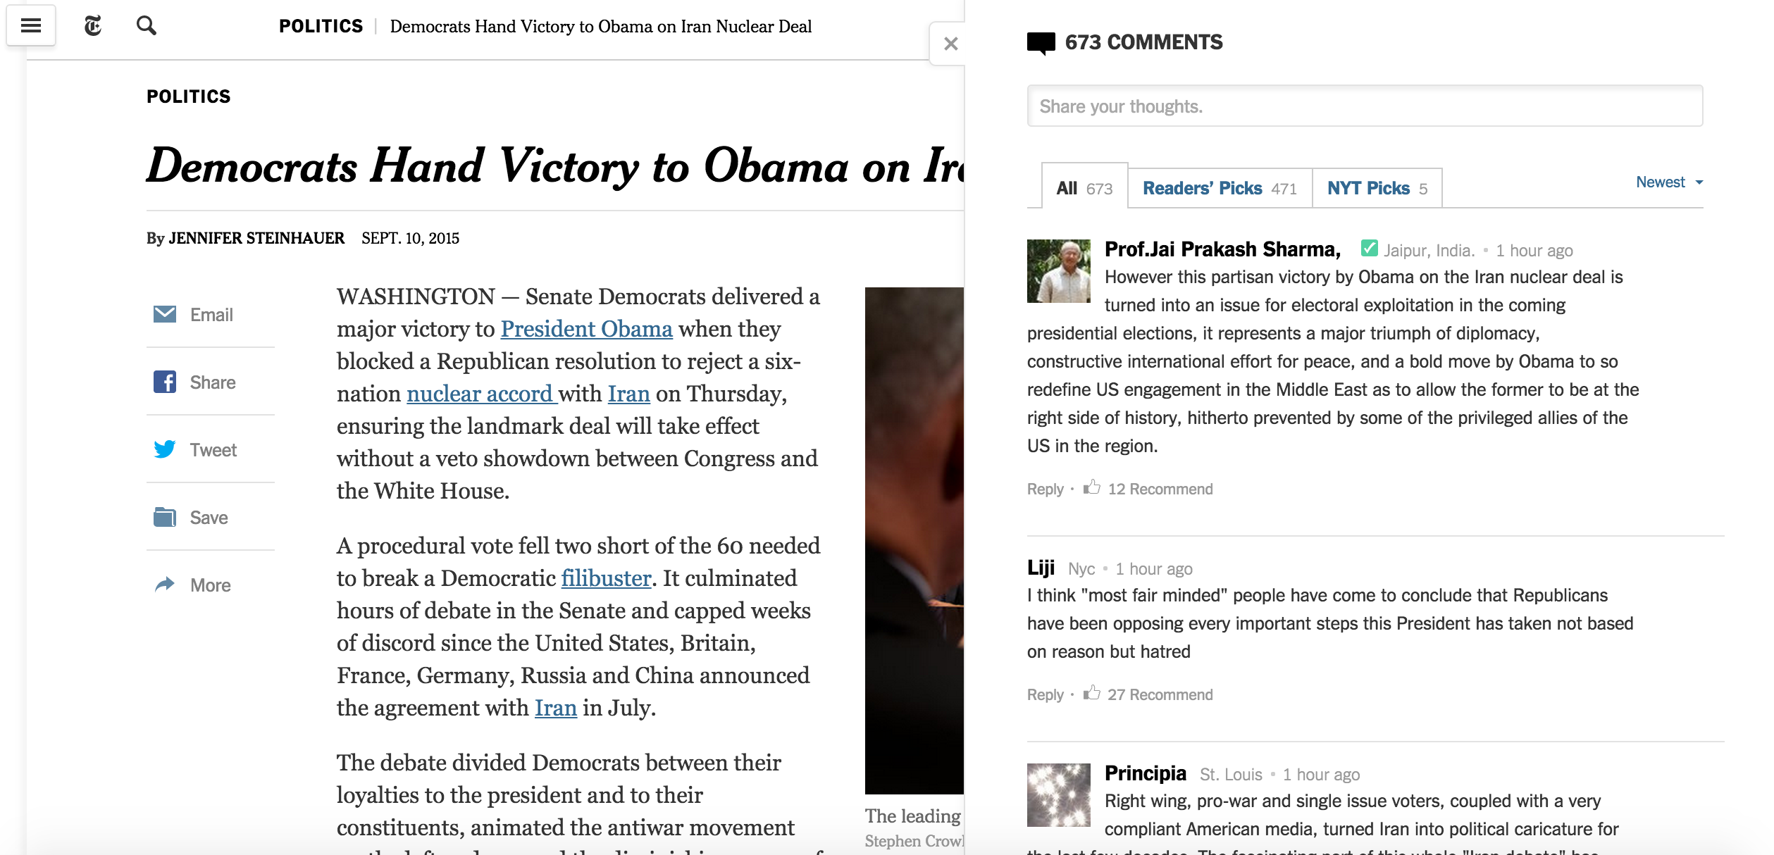
Capture the conversation
Comments on the NYT articles have diverse viewpoints.
Can I curate the comments to get the representative set that cover the entire spectrum?

Slide 3

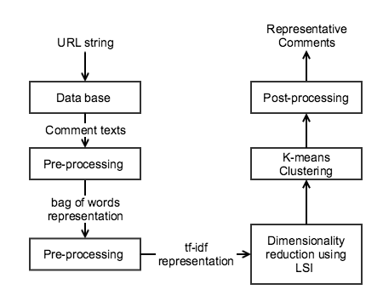
Algorithm

Slide 4
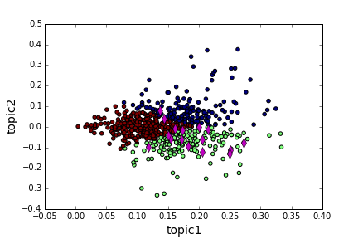
Algorithm Implementation

Slide 5
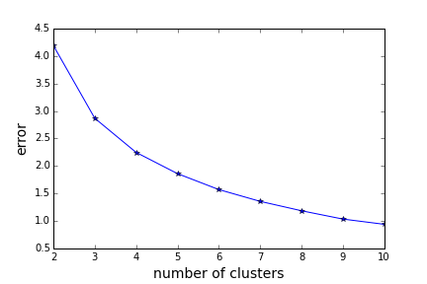
Algorithm Implementation

